Slide 1
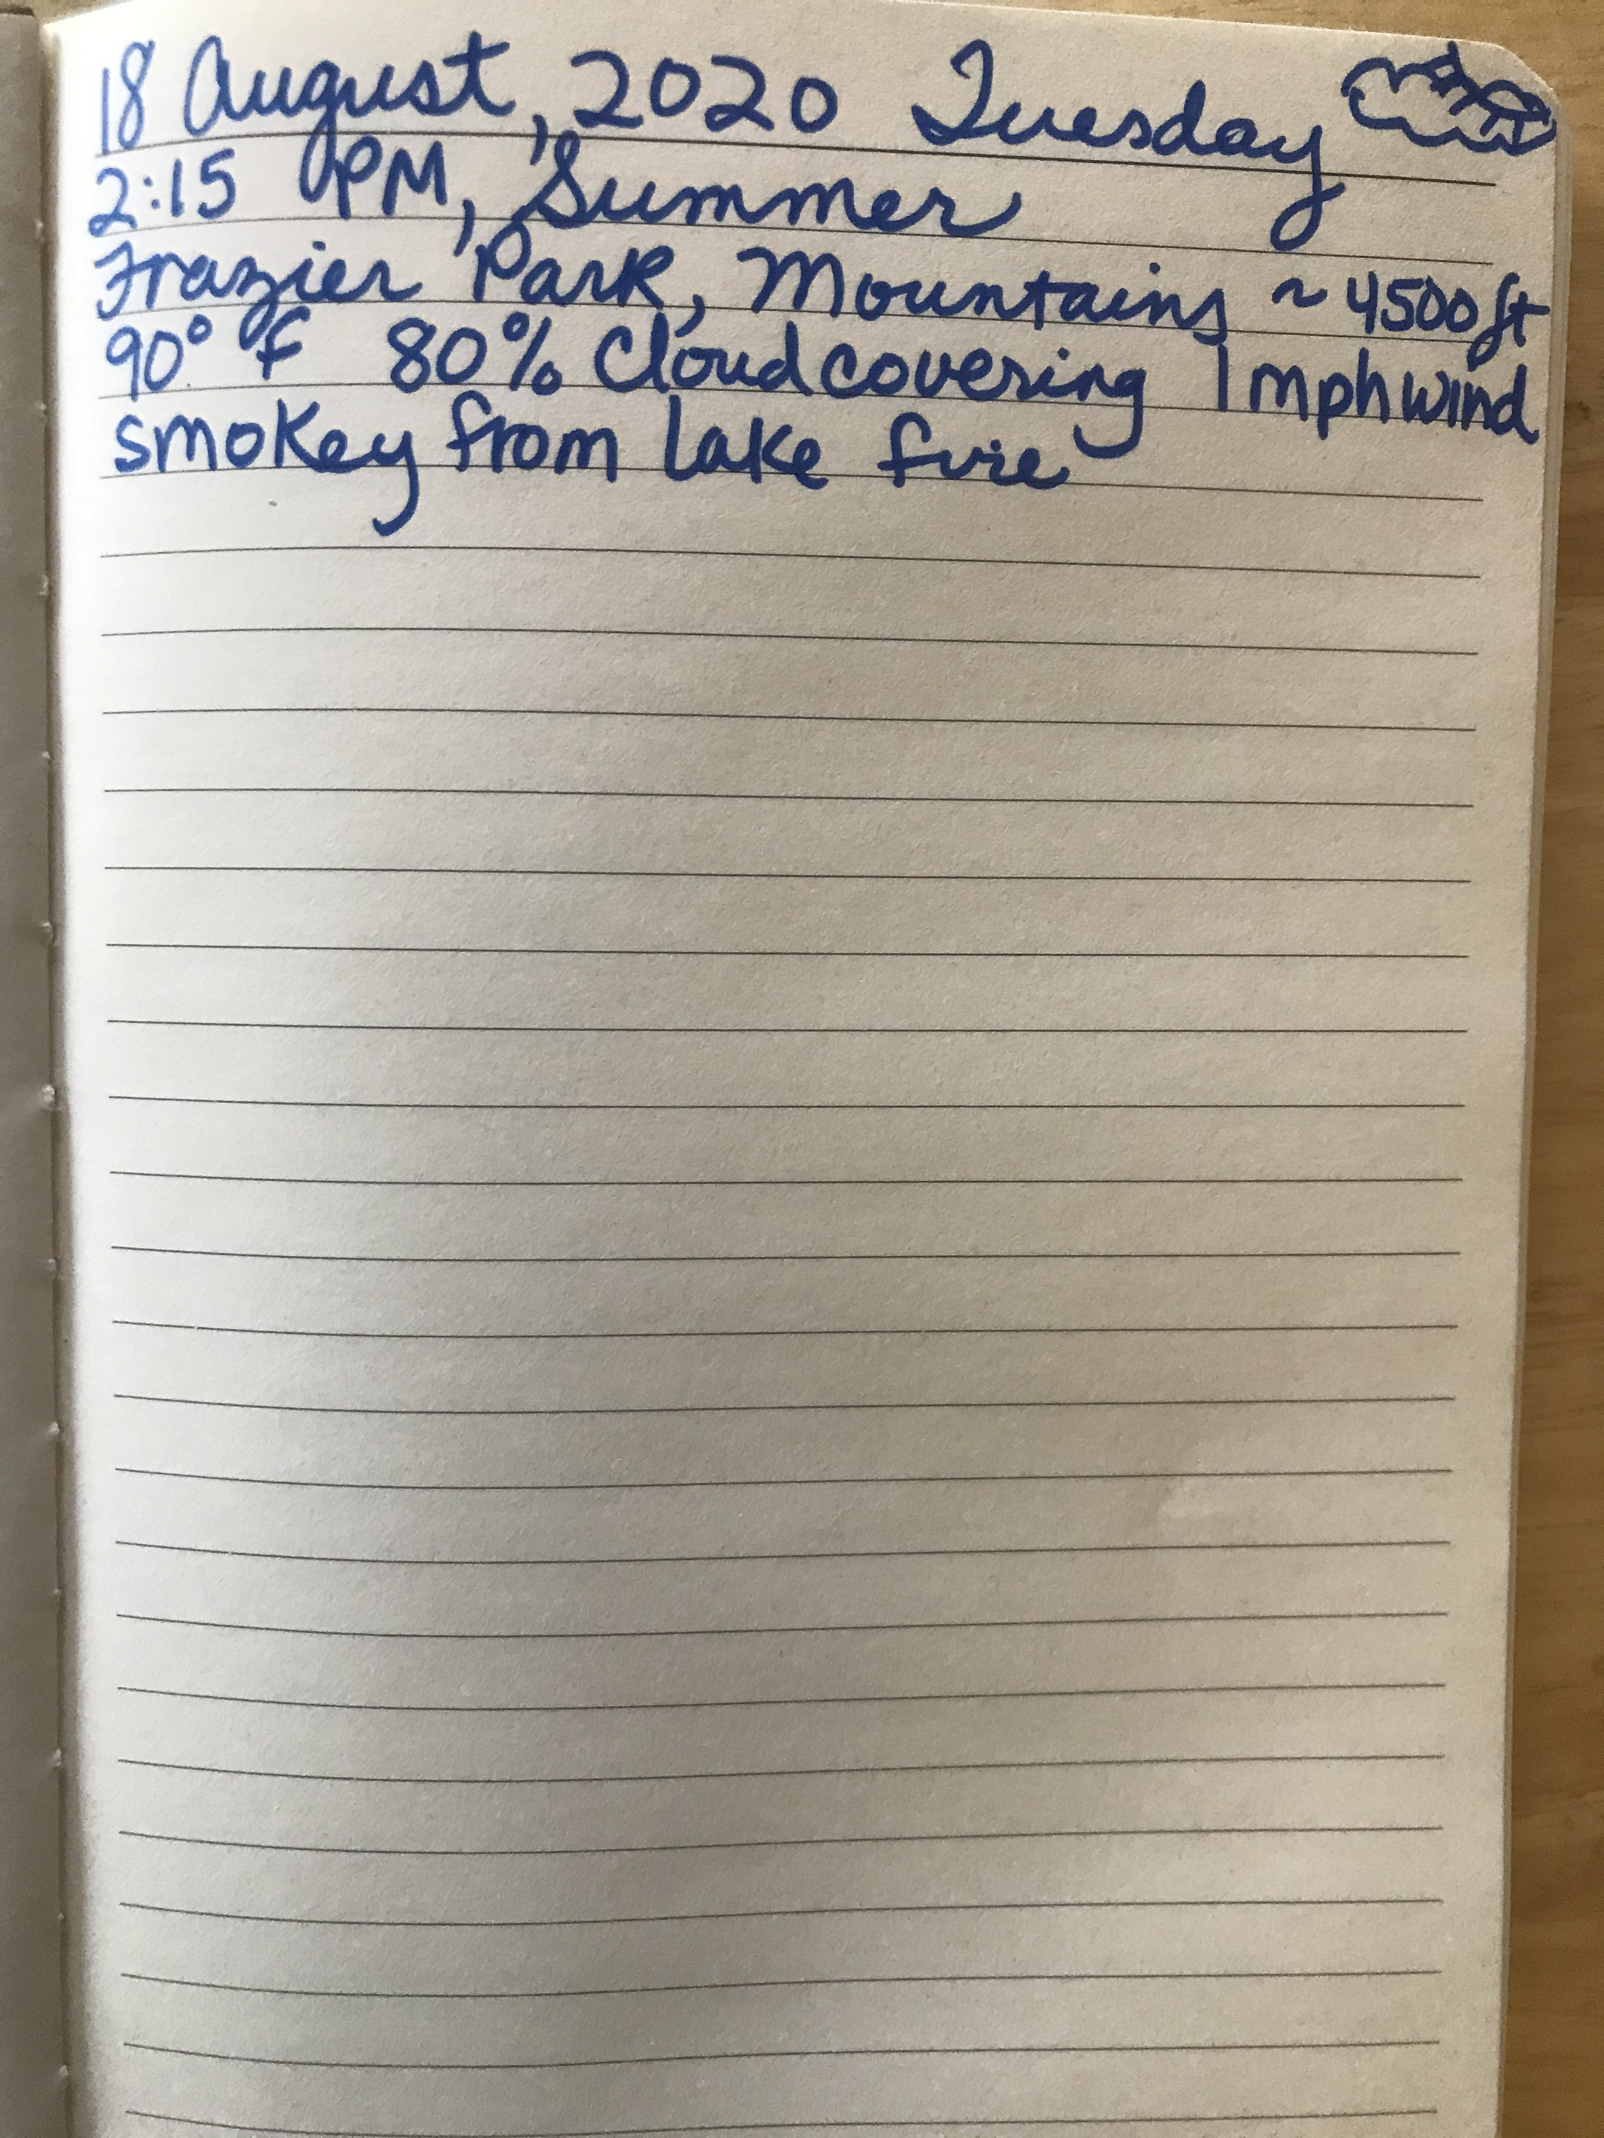
Lesson 2:
Your First Notebook Entry
Start with your heading:
Date, Day, Time,
Location,
Temperature,
Wind Speed,
% Cloud Covering

Slide 2
TAKE TIME TO OBSERVE
Observe your subject for a long time, 2-5 minutes at least. The longer you observe, the more you’ll see.
Use your senses, sight, hearing, smell, touch
Talk to yourself OUTLOUD.
  I Notice…
  I Wonder…
  This reminds me of…
Each of those sentence frames need to be repeated and repeated and repeated.
Do this for 2-5 minutes – DON’T STOP! You’re never finished, keep observing and commenting.

Slide 3
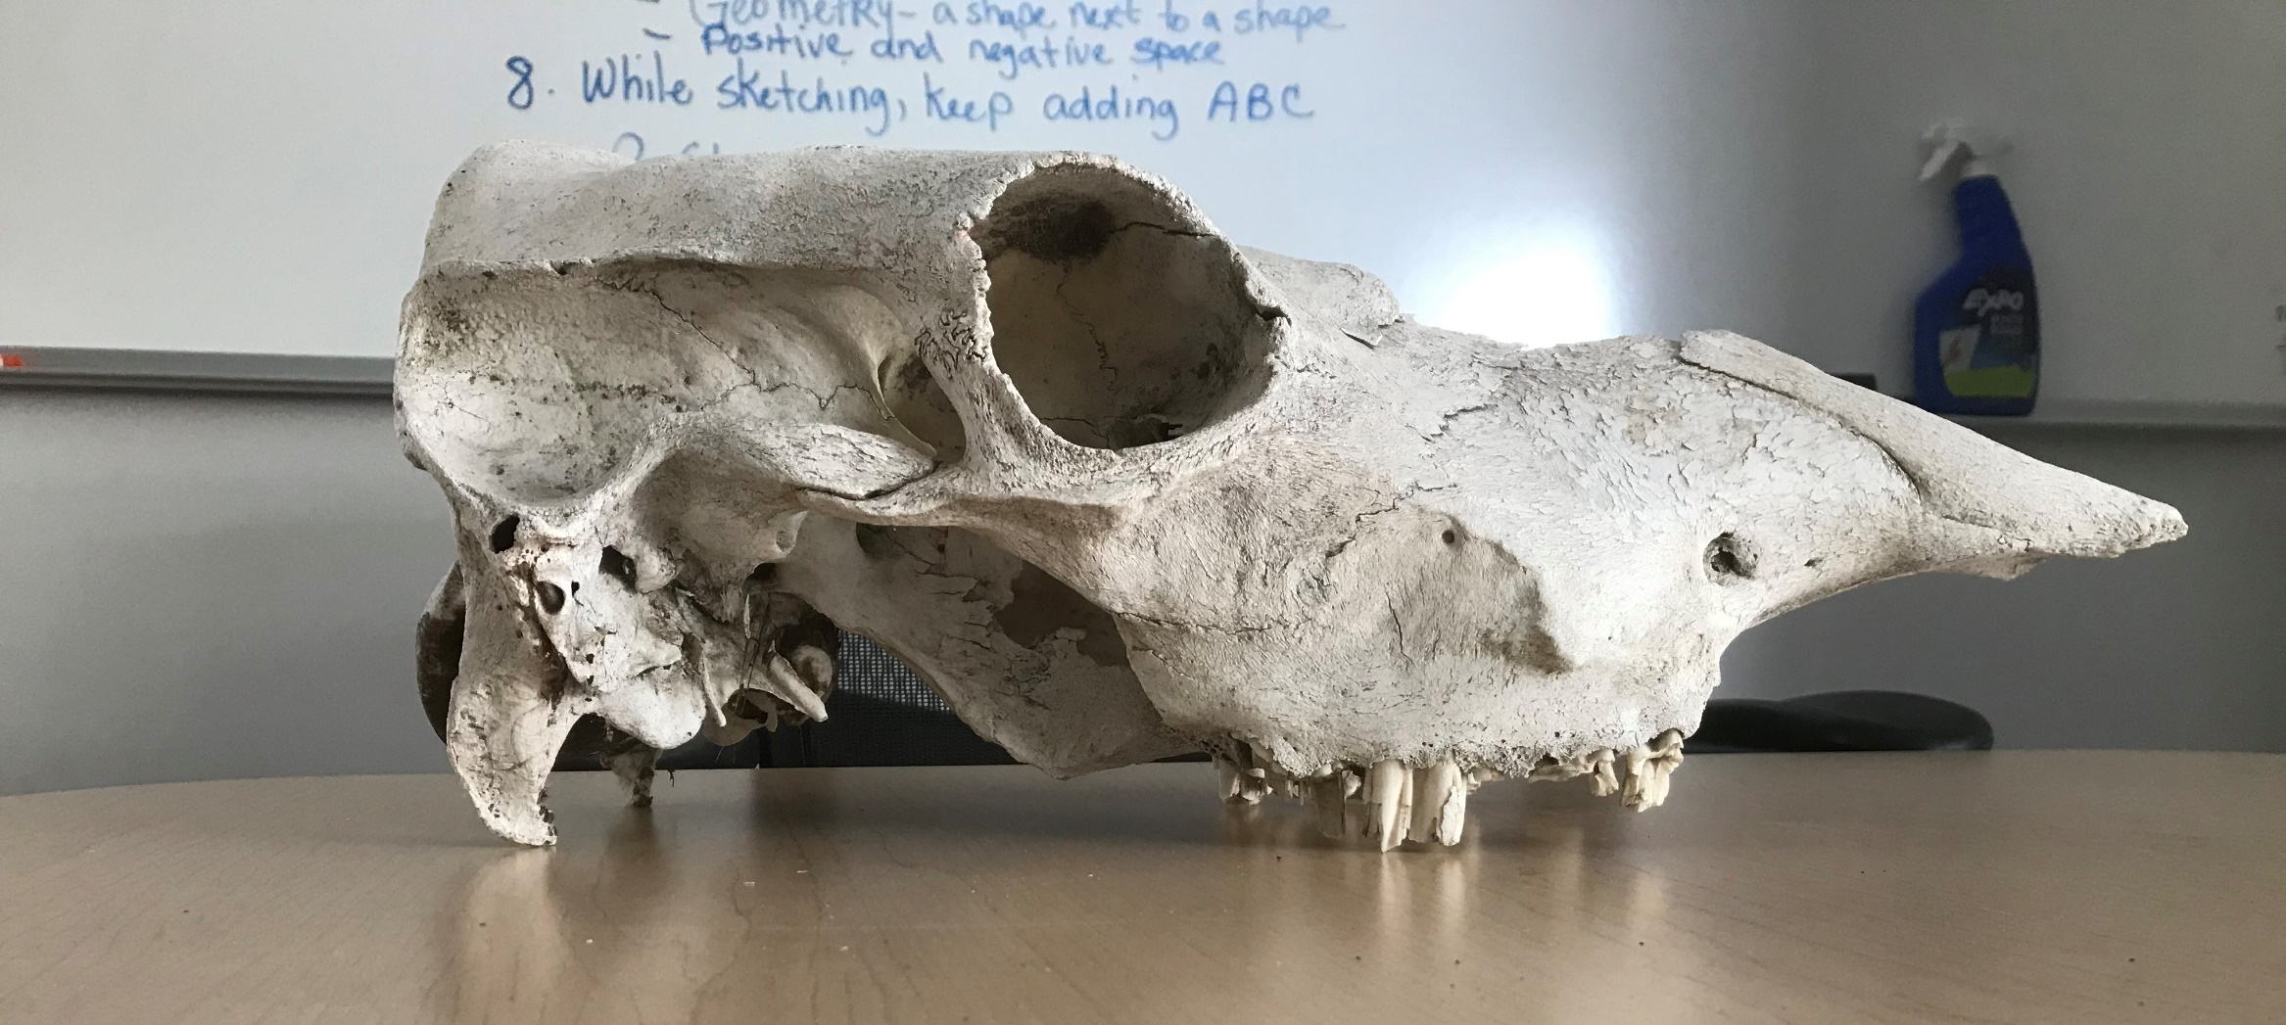
Here’s your subject. Start talking to yourself!

Slide 4
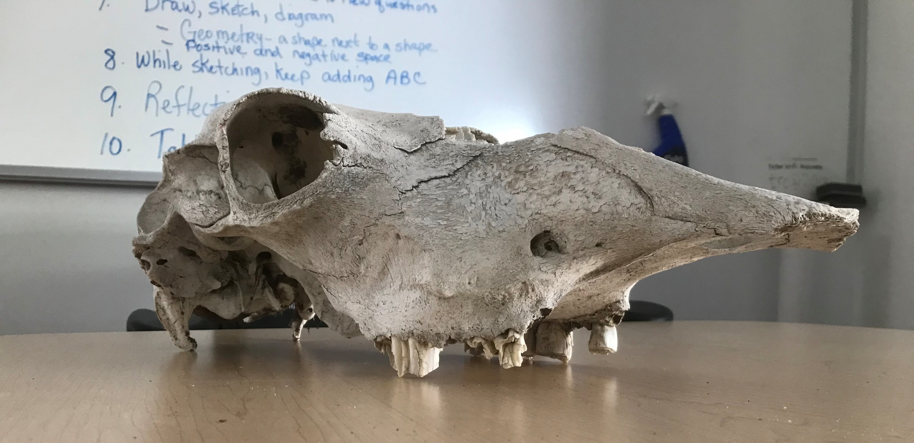
KEEP OBSERVING:
I notice… I Wonder… This Reminds me of…

Slide 5
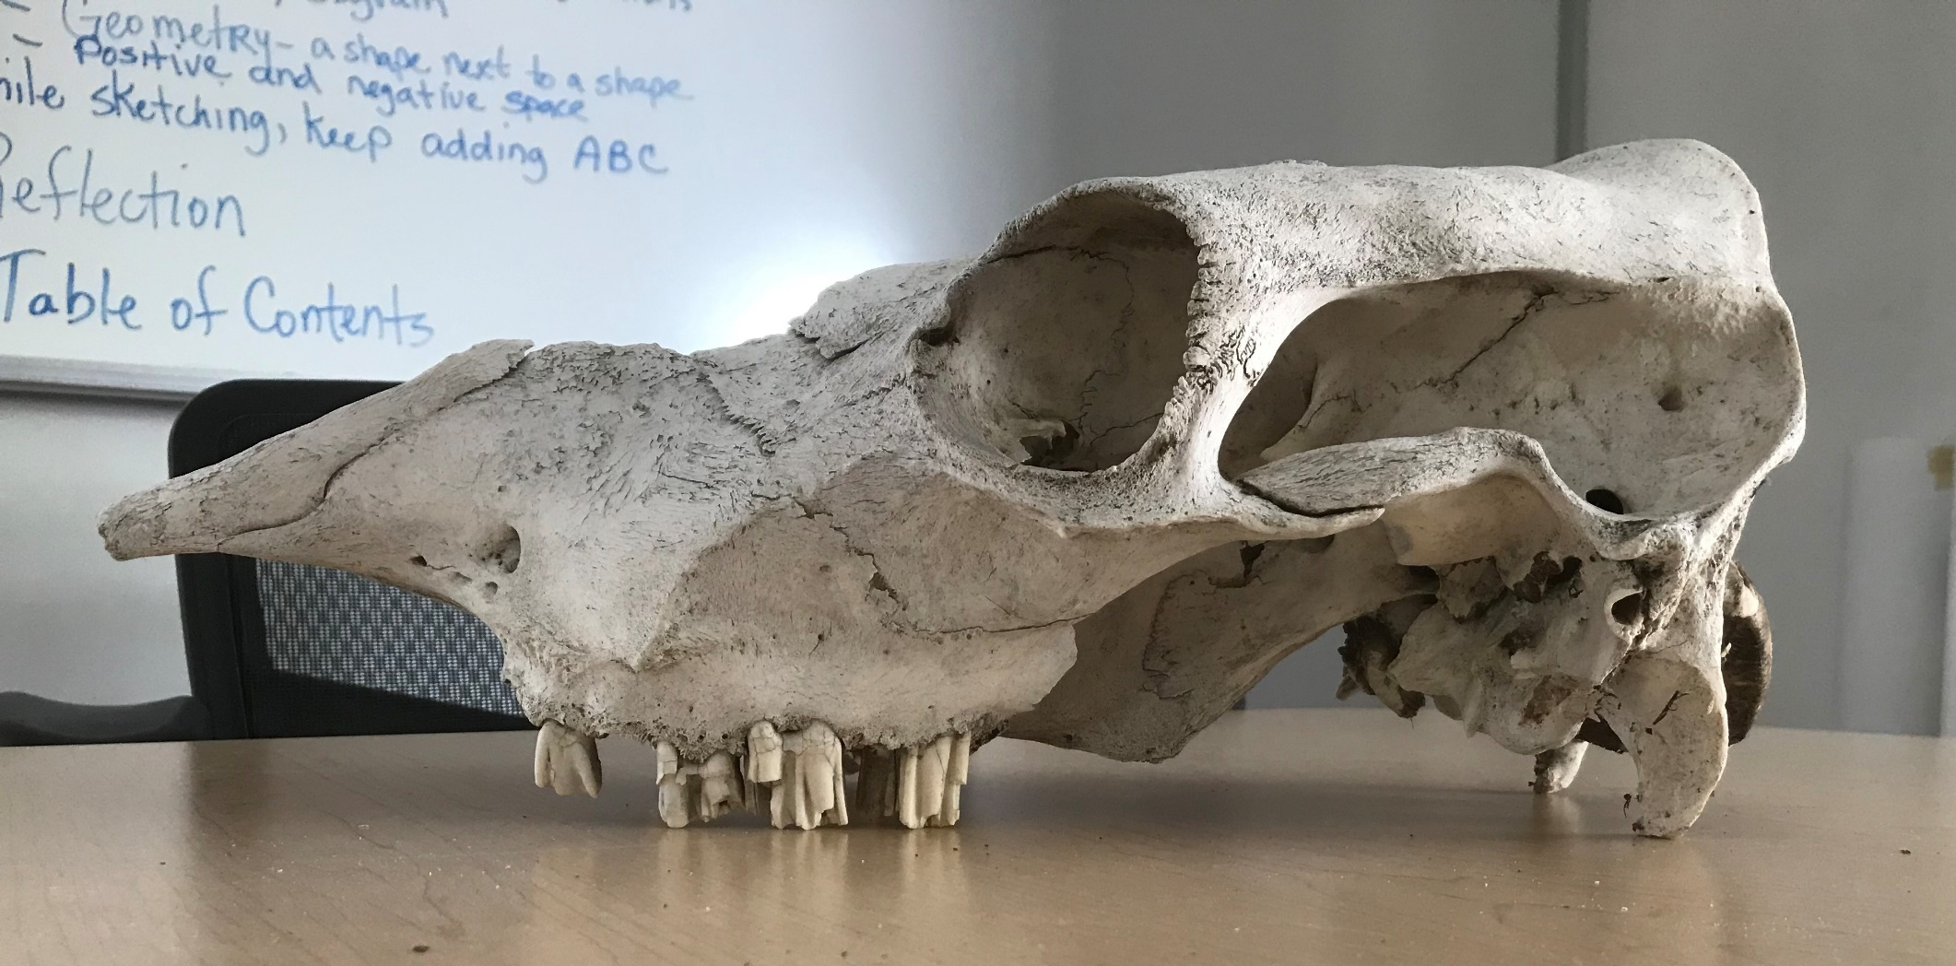
KEEP MAKING YOUR OBSERVATIONS…

Slide 6
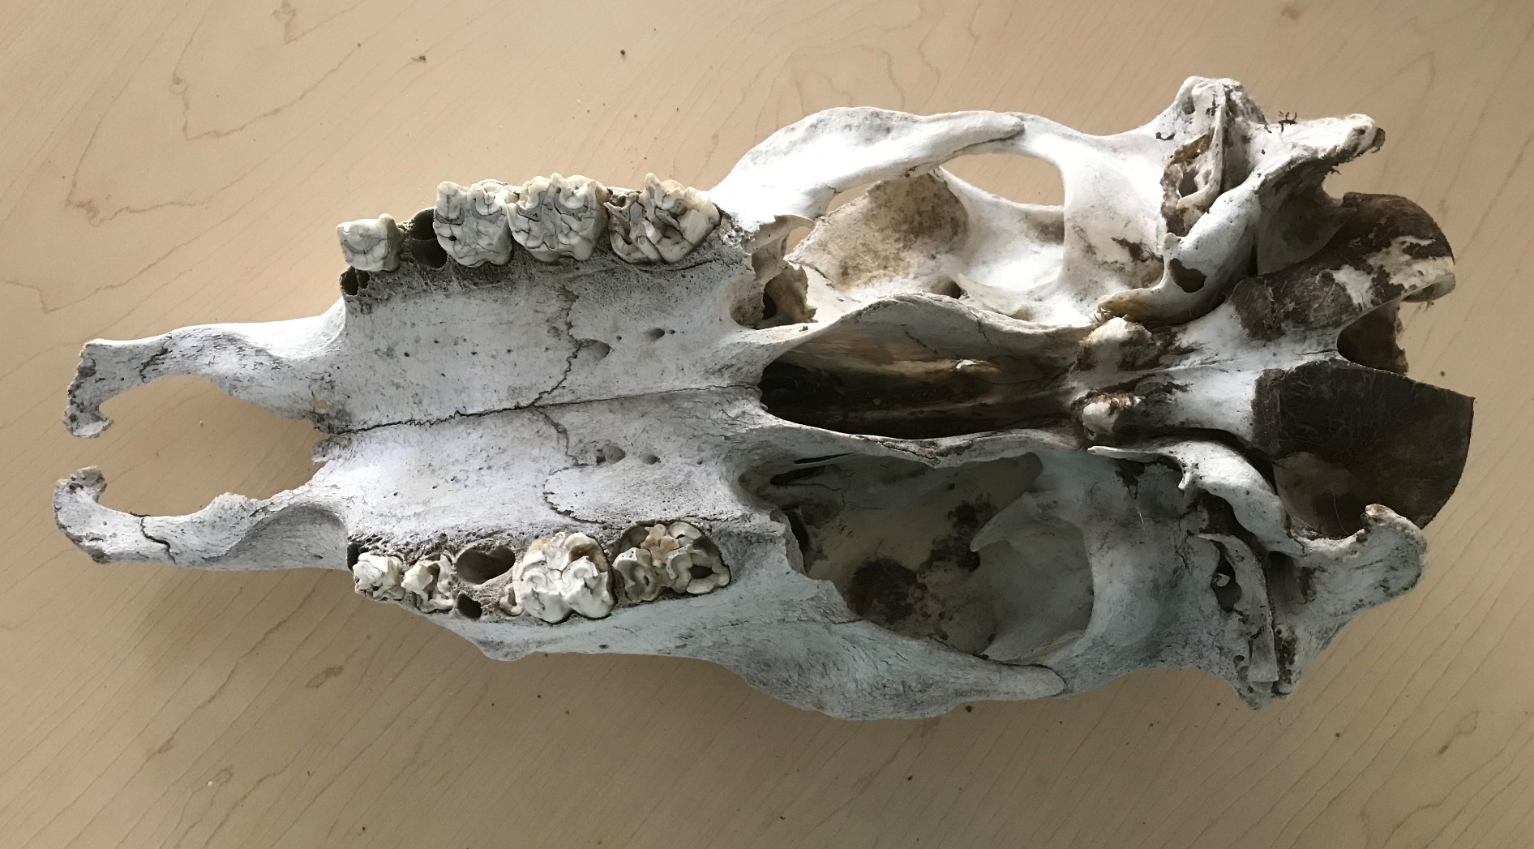
Look at those teeth…

Slide 7
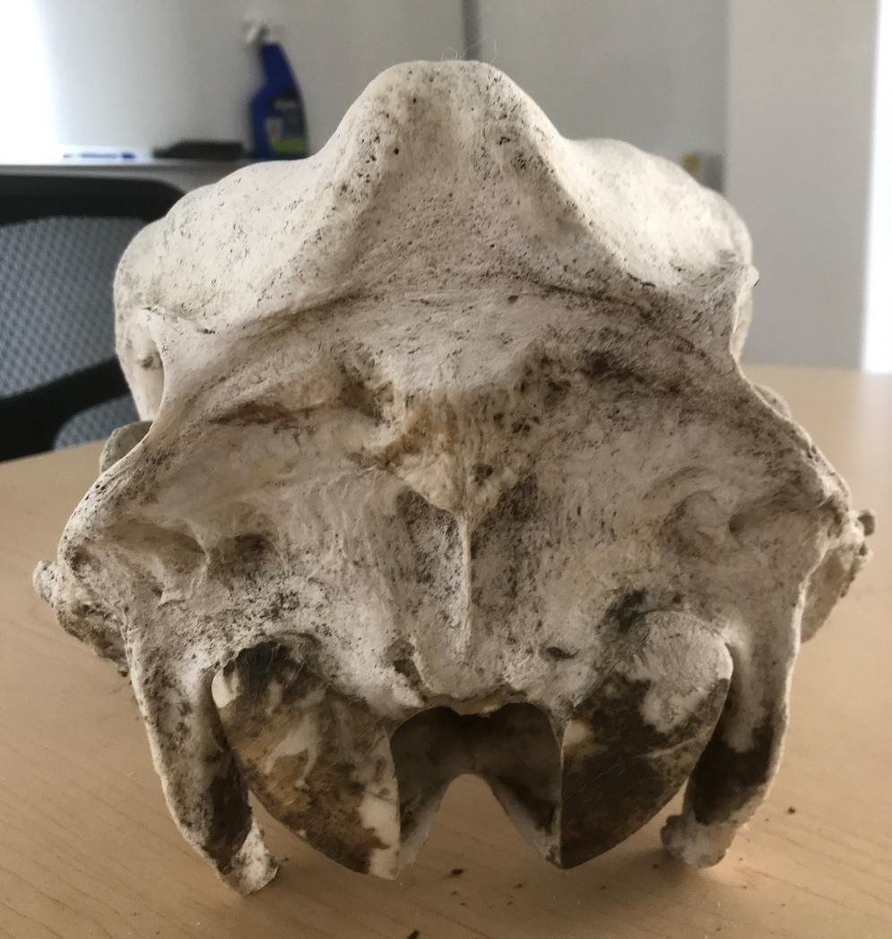
View from the back of the skull

Slide 8
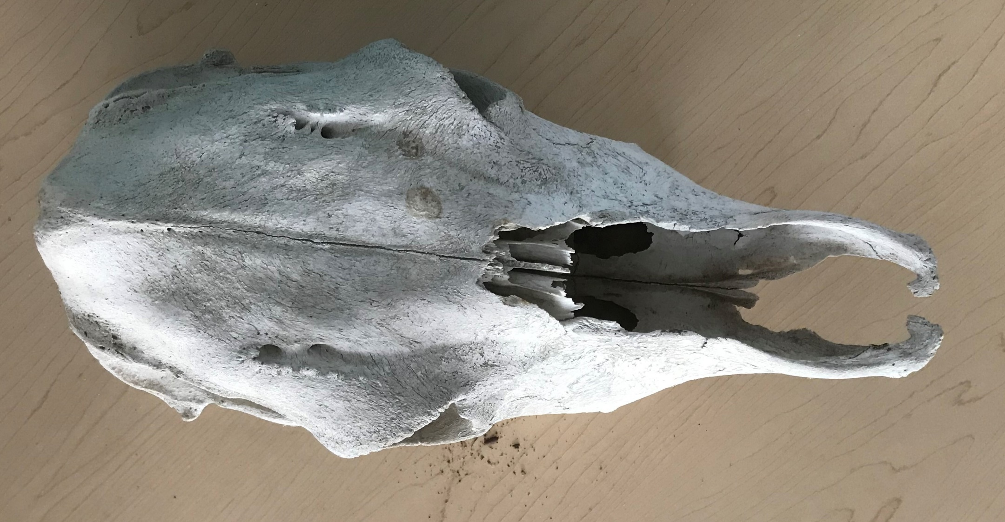
Top View

Slide 9
How to Start Writing your ABC’s
Two approaches:
Write your I Notice, I Wonder, This Reminds Me Of… Comments into your journal.
One way: You can make a listing of things:
  I notice… *The eye sockets are on either side of the skull
            *The eye socket is very large
            *The teeth are all flat/molars
            *The skull is gray/white, with lots of scratch marks
But maybe you want to do it differently…

Slide 10
Another approach
Another way: You might want to combine them, like you’re having a conversation in your journal:
  I notice the teeth are all flat/molars. I don’t see any canine teeth.
  I wonder if this animal is an herbivore since it only has grinding teeth.
  I notice there aren’t any canine teeth that you would see on an omnivore or carnivore.
  Could it be this is the skull of an ungulate?

Slide 11
Now Write Your Observations in your Journal

Slide 12
Now do your 123’s (your metrics)
Take some measurements.
You can’t measure from a picture, so I’ll give you some measurements for your journal:
  Skull is 8” wide, 19” long. Eye sockets are 3: in diameter
  Since this is science, and scientists measure in metrics, I’ll convert this for you:
  Skull is 20.32 cm wide, 48.26 cm long, Eye sockets are 7.62 cm in diameter
  The weight of the skull is approximately 3 pounds
  The weight of the skull is approximately 1.3 kilograms

Slide 13
Introduction to Inquiry:
Try to Answer some of you
“I wonder…” statements
Looking at your “I wonder…” statements, can you answer any of them now that you’ve had some time to observe?
Make some hypotheses. Use this statement:
  Could it be…?
  List as many hypotheses as you can come up with.
    Could it be this animal is an ungulate?
    Could it be this animal was hunted?
    Could it be this animal is an herbivore?
    Could it be this animal’s eye placement helps it see better when looking for predators?

Slide 14
Eliminate your hypotheses as you observe
As you continue to write in your notebook and observe your subject, if you can eliminate some of your hypotheses, you’re on the road to answering your questions.
Follow your questions: Sometimes, you can use your questions to come up with additional questions:
  Could it be this animal is an herbivore? If it’s an herbivore, could it be an ungulate? If it’s an ungulate, could it be it’s an animal in the deer family? If it’s not in the deer family, could it be in the Bovinae family?

Slide 15

Time to Draw, Sketch or Diagram
Now sketch the following profile
Technique:
  Use geometry: Think of the skull as a geometric shape next to a geometric shape. In this case, looking at its profile, think of a rectangle next to a triangle:
  Sketch lightly with a pencil. Adjust your drawing with details, use your eraser to correct your proportions

Slide 16
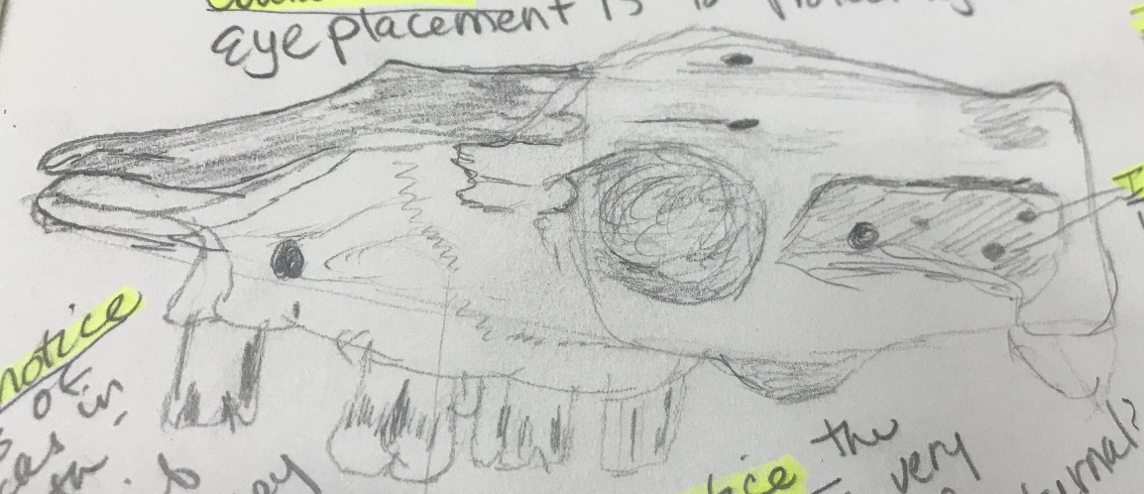
More on drawing/sketching/diagramming
Start with geometric shapes
Adjust your proportions
Use an eraser to make corrections
Think about positive and negative spaces.
  Positive spaces are the bones
  Negative spaces are the areas without bones, like the eye sockets

Slide 17
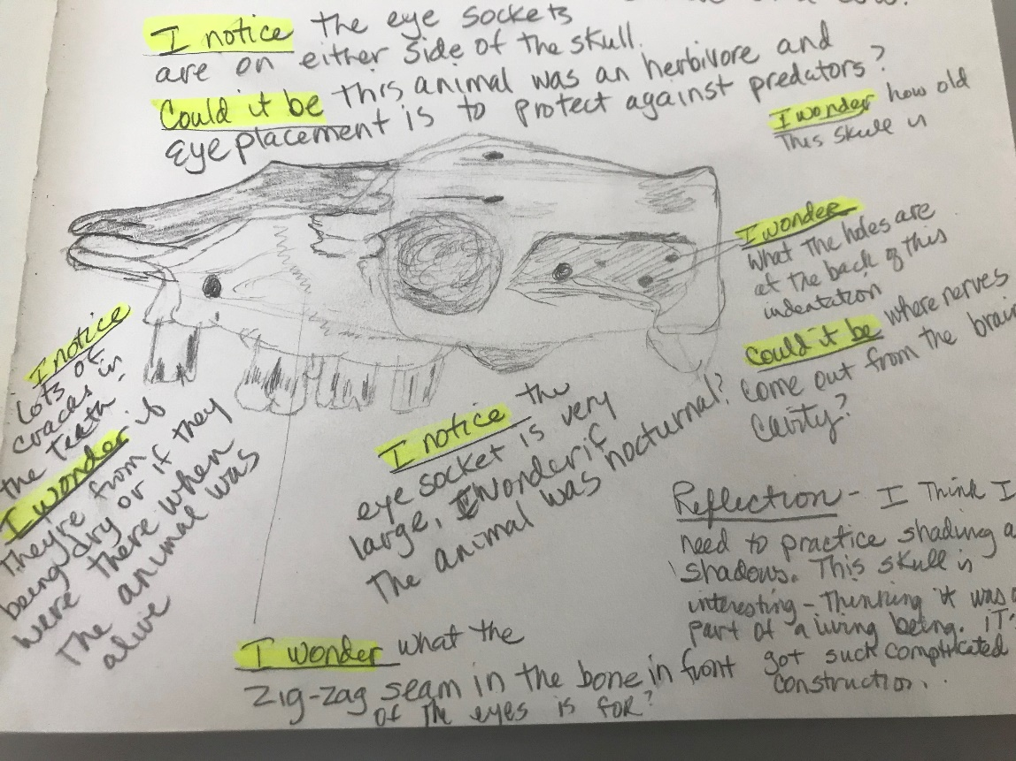
Keep Thinking and Observing
While you sketch, you’ll notice lots of new things.
Add more ABC’s
  I Notice…
  I Wonder…
  This Reminds me of…

Slide 18
TEN MINUTES TO DRAW

Slide 19
REFLECTION
You’re finishing up. Now it’s time to reflect on what you’ve experienced.
Write a short reflection about:
  what you’ve learned,
  what you want to know more about,
  how you feel
Write a short story, a diary entry, a plan list, a bunch of questions, a poem, draw a picture, it can be anything. A reflection helps you remember what you’ve learned and experienced.

Slide 20
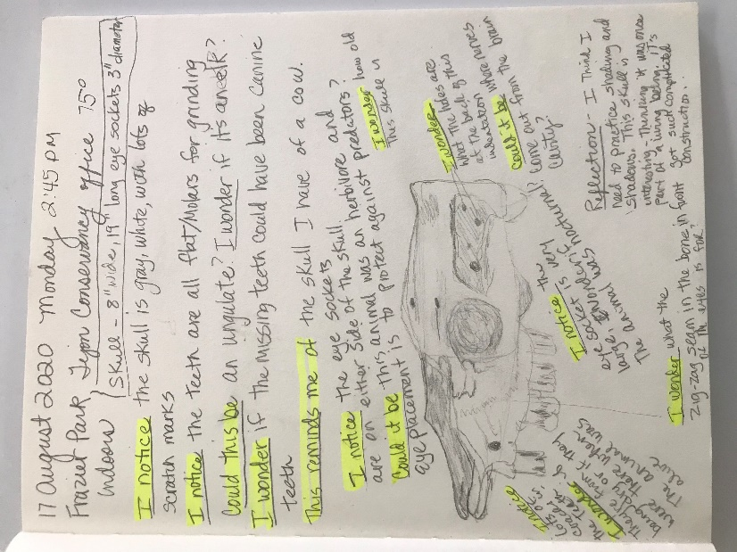

Your Completed Notebook Page
Everyone’s journal page is going to look original and unique. Use your own style. Remember to put all the elements into it but where they are on your page is up to you.
  Heading
  I Notice…I Wonder… This Reminds Me Of…
  ABC, 123,
  Reflection
  Add to Table of Contents

Slide 21
Here’s mine

Slide 22
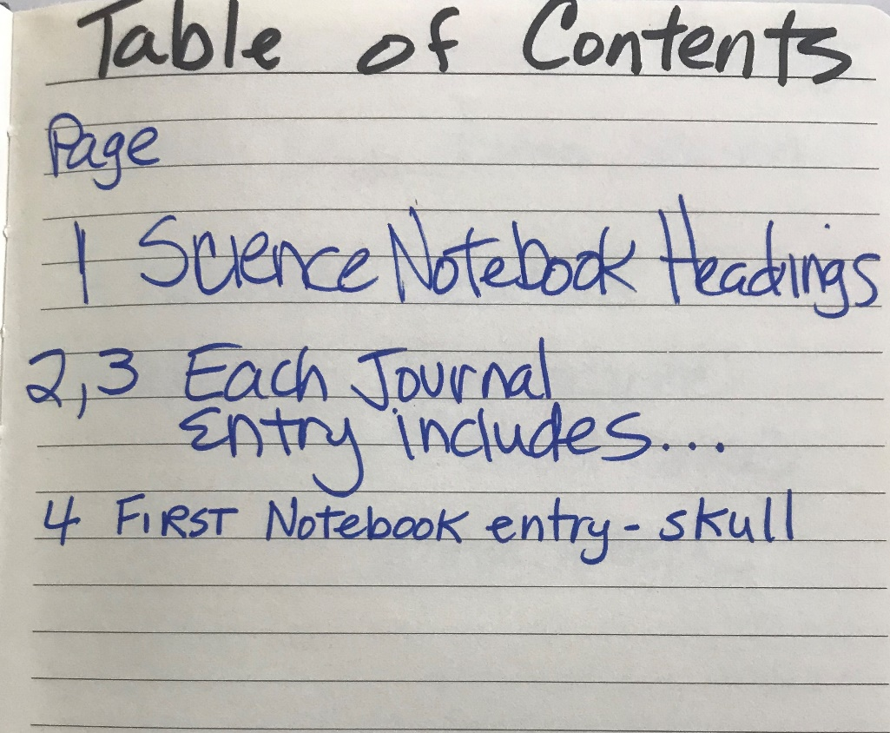
DON’T FORGET YOUR TABLE OF CONTENTS
Come up with a cool title
Now that you’re done, don’t forget to add this journal page to your table of contents.

Slide 23
ASSIGNMENT: Three Journal Entries
Go outside and find interesting things to study. They can be a plants, animals, rocks, etc.
Do three different science notebook entries.
Send a copy of the finished pages to your teacher.
HAVE FUN!

