Slide 1
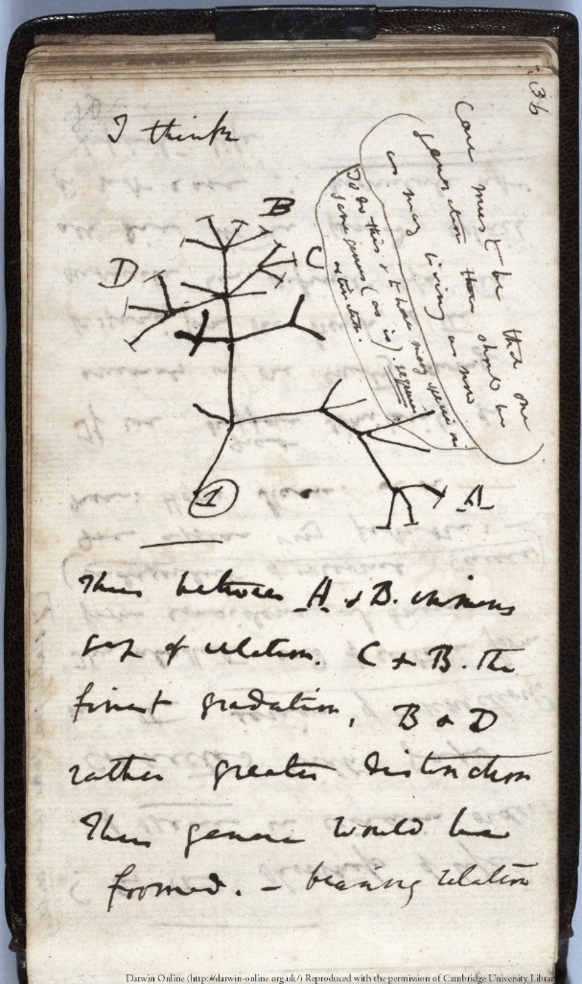
Science Notebooks A Little History
Scientists, naturalist, and students have been keeping science notebooks throughout scientific history. Here are three examples:
Charles Darwin
1836
Darwin’s “Tree of Life” sketch, from his notebook
Darwin sailed around the world as a naturalist

Slide 2
Science Notebooks in History
1943 Then-graduate student Albert Schatz’s notes on the experiments that led to the discovery of Streptomycin

Slide 3
Sir Isaac Newton
Newton’s so-called “Waste Book” – the notebook in which he works out his ideas for Calculus. 1664

Slide 4
Science Notebook Supplies
Regular Pencil
Colored Pencils
Sharpener and eraser
Notebook –
Composition book
Spiral notebook
Sketchpad

Slide 5
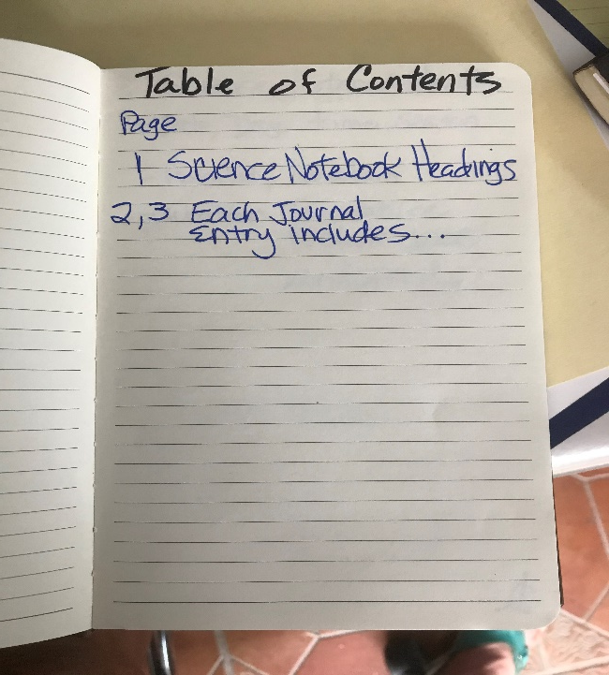
SET UP YOUR SCIENCE NOTEBOOK/JOURNAL
LEAVE THE FIRST PAGE BLANK (FRONT AND BACK)
WRITE “TABLE OF CONTENTS” ON NEXT PAGE and skip the next two
pages to fill in later
NUMBER YOUR NOTEBOOK PAGES AFTER THAT (START WITH PAGE 1)

Slide 6
Copy the Notes
From the following slides, copy these notes onto your notebook pages.
Start with Page 1 and go on to page 2 and 3. If you need more pages, keep going.
You’ll complete your table of contents with these entries when you’re done copying down the notes.

Slide 7
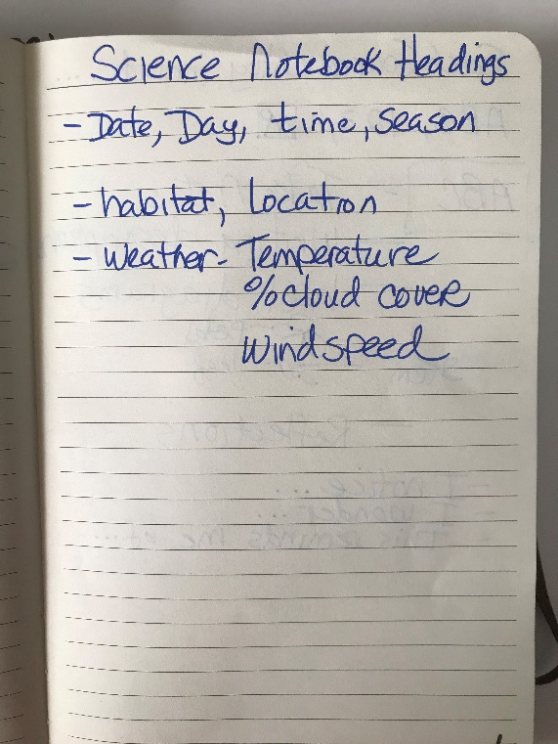
On Page 1, Write the following Title: SCIENCE NOTEBOOK HEADINGS
Head your notebook each time you start a page (This is called Metadata)
Date, Day, Time, Season
Location, Habitat (example: mountain, grassland, streambed)
Weather – Include
Temperature (estimate)
Wind Speed (it will usually be between 1mph and 10mph)
Percent of Cloud Cover (if there is a medium amount of
clouds but still blue sky, it might be something like 50%)

Slide 8
Copy these instruction on Page 1 in your notebook.

Slide 9
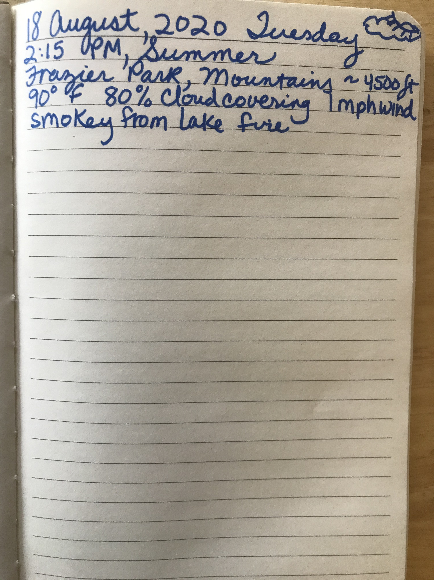
Science Notebook Heading (Metadata) on each new page will look something like this example:

Slide 10
Page 2 & 3: Write the Following Title: Each Journal Entry Includes…ABC, 123,
ABC
ABC: Take notes, Write Descriptions, Label diagrams, Reflections
I Notice…
I Wonder…
This Reminds me of…
(As you do your observations, you will say and write numerous of these sentence frames)
Reflection: At the end of every notebook entry, write a reflection, thinking about what you learned and want to know. Form can be a diary entry, a few sentences, a poem, a drawing, anything. But don’t forget to do it.

Slide 11
Continue copying these notes into your notebook.
123
123 : Metrics (measurements)
Some metrics are in your heading
Examples of some metrics: size, height, speed, elevation, % of coverage, weight, distance, GPS Coordinates
Sketch, drawing, diagram (remember to label the parts of your diagram)
Start with pencil, drawing lightly so you can erase, finish with colored pencil

Slide 12
Page 2 & 3 Should look something like this:

Slide 13
Now fill in your Table of Contents with Page 1, 2, 3

