Slide 1
MY SECRET PLANT PART 1
STUDY THE PHOTOGRAPHS OF THE 6 DIFFERENT PLANTS.
CHOOSE ONE PLANT TO JOURNAL.
REMEMBER METADATA, ABC, 123, PICTURE
BE PREPARED TO SHARE YOUR JOURNAL WITH A FRIEND. THE FRIEND WILL HAVE TO STUDY YOUR JOURNAL TO DETERMINE WHICH OF THE 6 PLANTS YOU STUDIED.
YOU WILL KNOW IF YOU WERE SUCCESSFUL IF YOUR FRIEND IDENTIFIES THE PLANT CORRECTLY.
IMPORTANT: DO NOT DO YOUR REFLECTION UNTIL AFTER YOUR FRIEND IDENTIFIES YOUR PLANT. YOUR REFLECTION WILL BE ANSWERING SPECIAL QUESTIONS THAT YOU WILL SEE AT THE END OF THIS PRESENTATION.

Slide 2
DIRECTIONS: AS YOU OBSERVE, SAY ALOUD: “I NOTICE…, I WONDER…, THIS REMINDS ME OF…” MANY TIMES FOR EACH SLIDE.
STUDY THE FOLLOWING SIX SLIDES.
SELF-TALK ABOUT WHAT YOU SEE IN THE PICTURES. TALK FAST! YOU’LL HAVE 30 SECONDS FOR EACH SLIDE.
AS YOU STUDY THE SLIDES, DECIDE WHICH ONE YOU WANT TO JOURNAL.
AFTER THE SIX SLIDES, YOU’LL SEE ONE SLIDE THAT HAS ALL SIX PLANTS. CHOOSE ONE AND START JOURNALING.

Slide 3
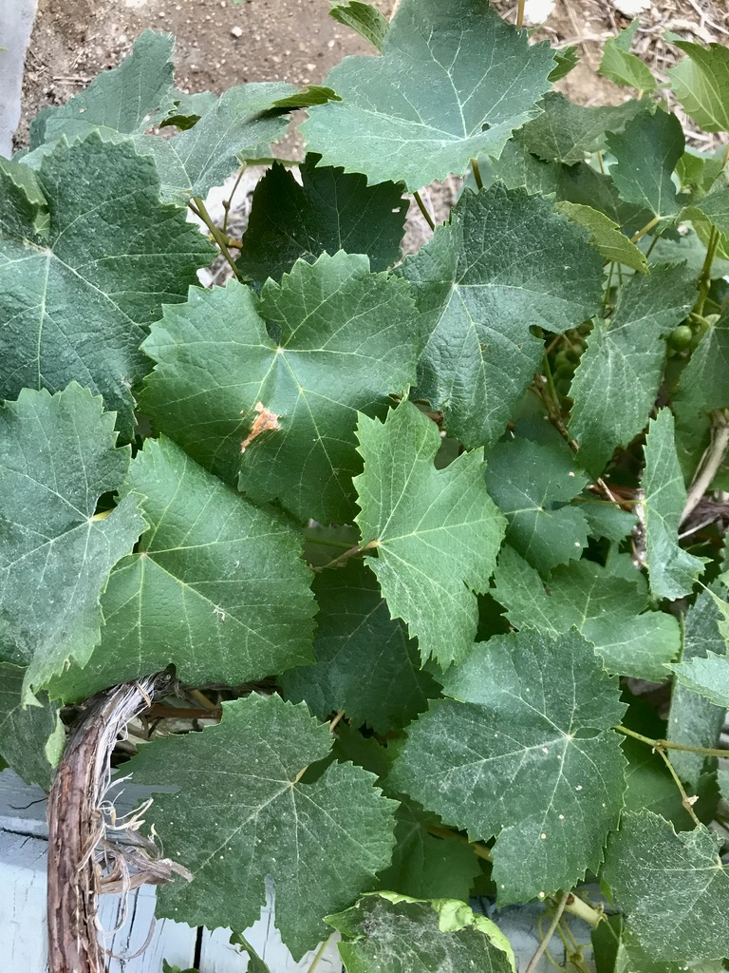
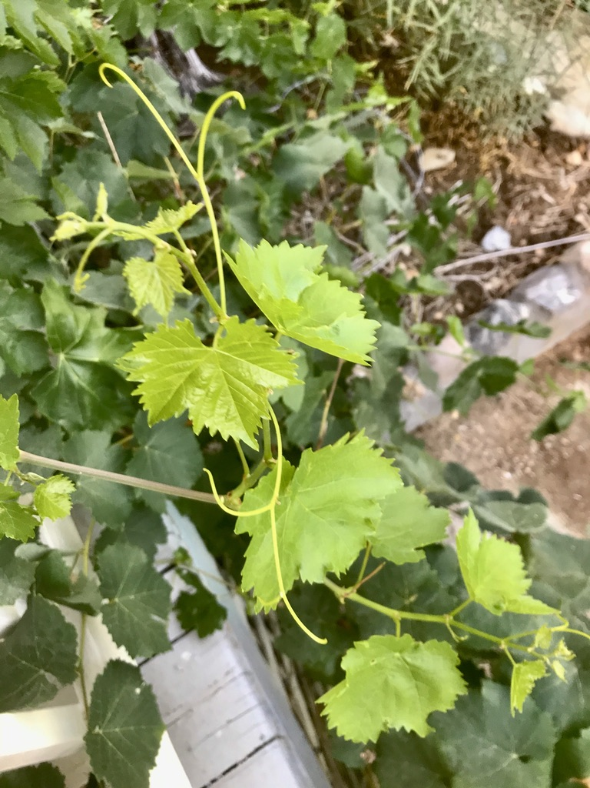
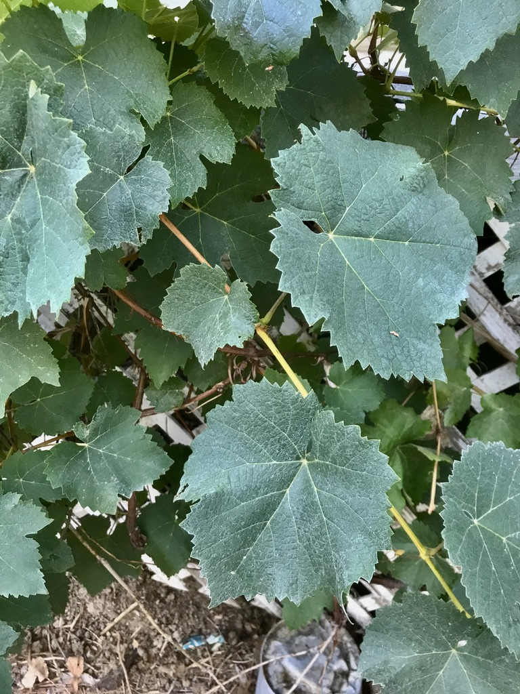
PLANT #1

Slide 4
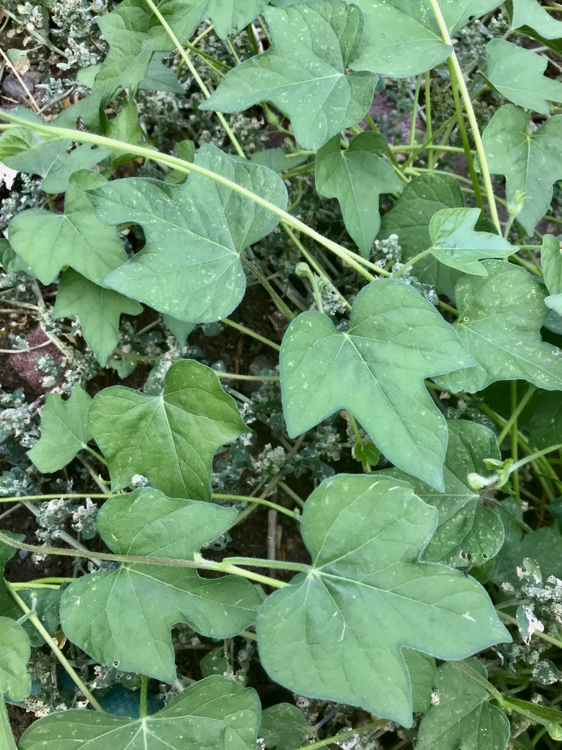
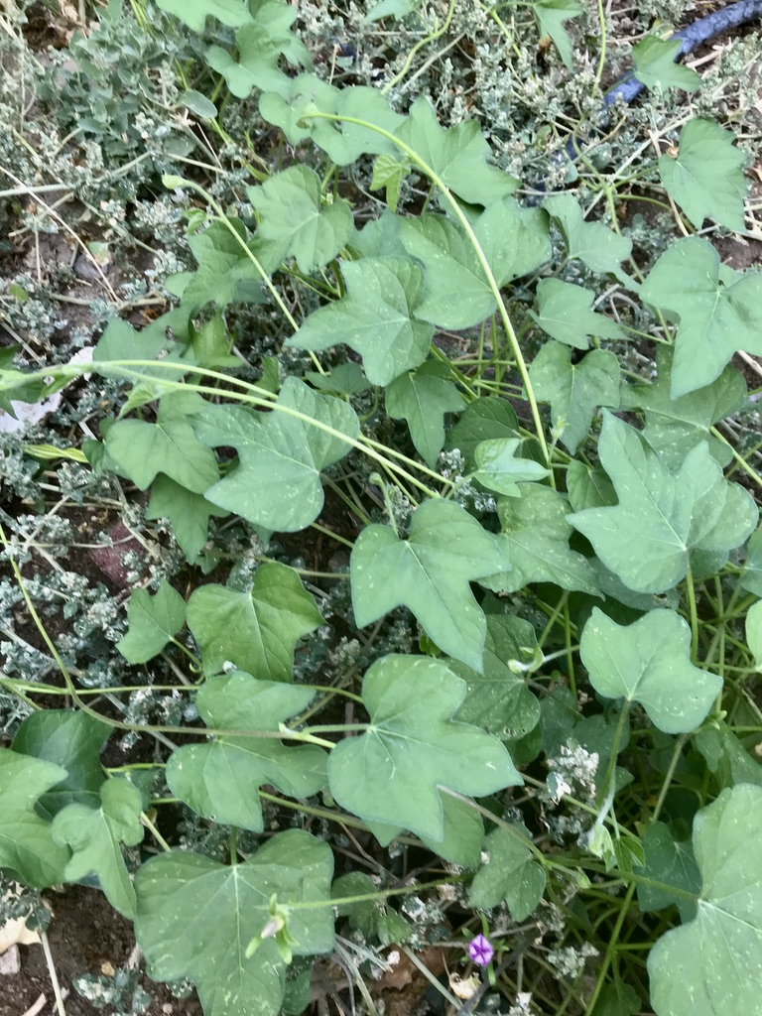
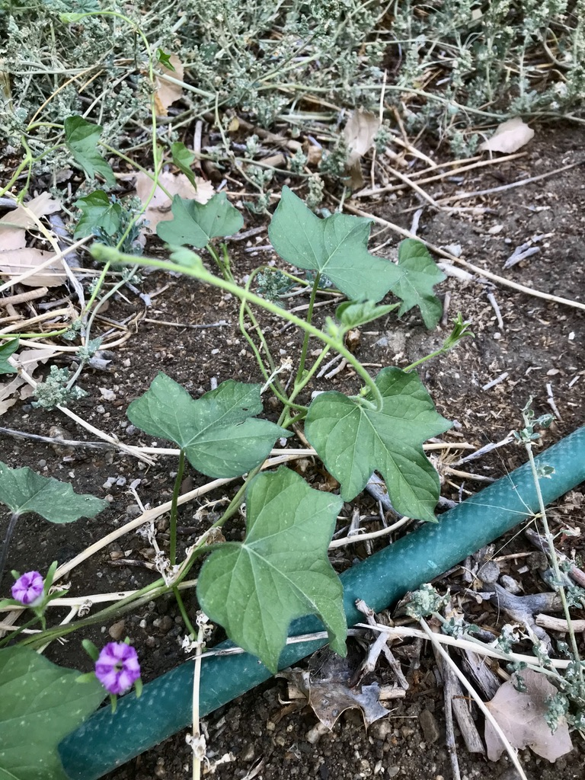
PLANT #2

Slide 5
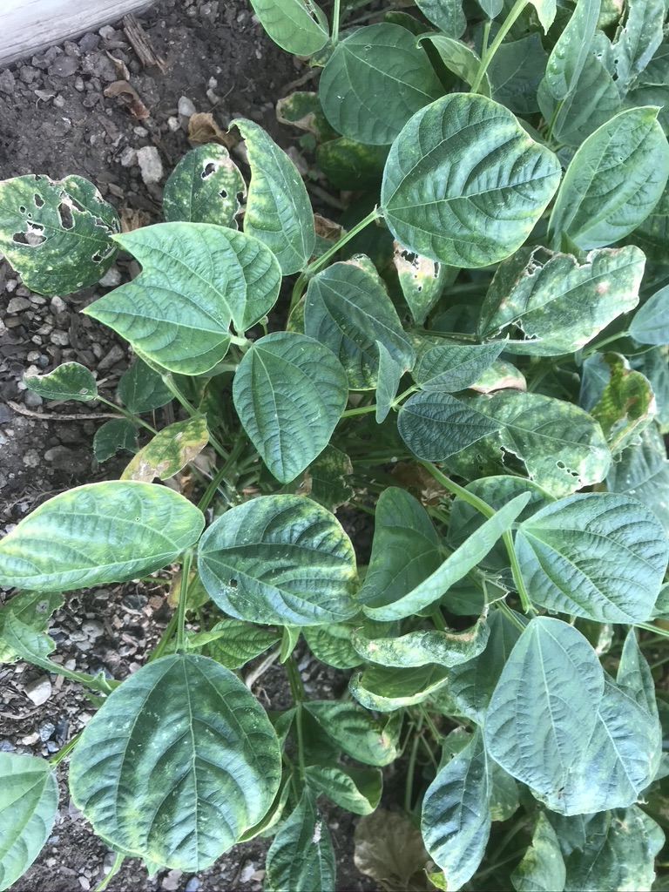
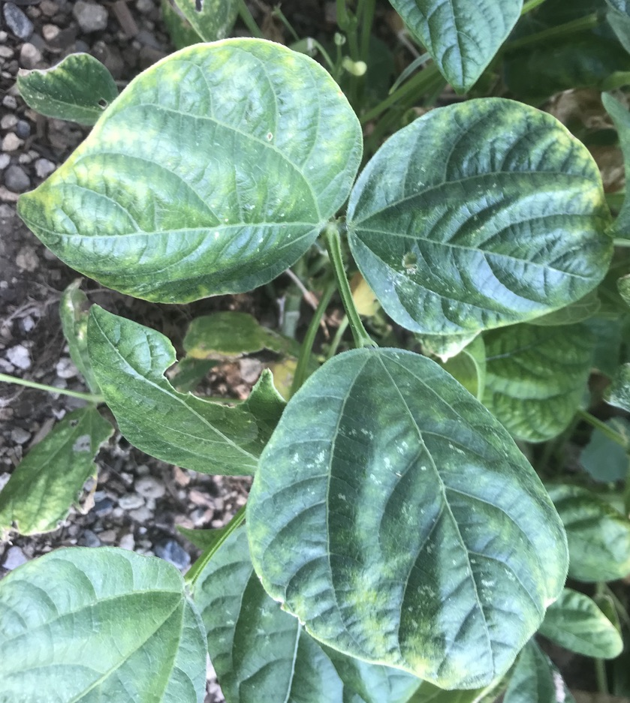
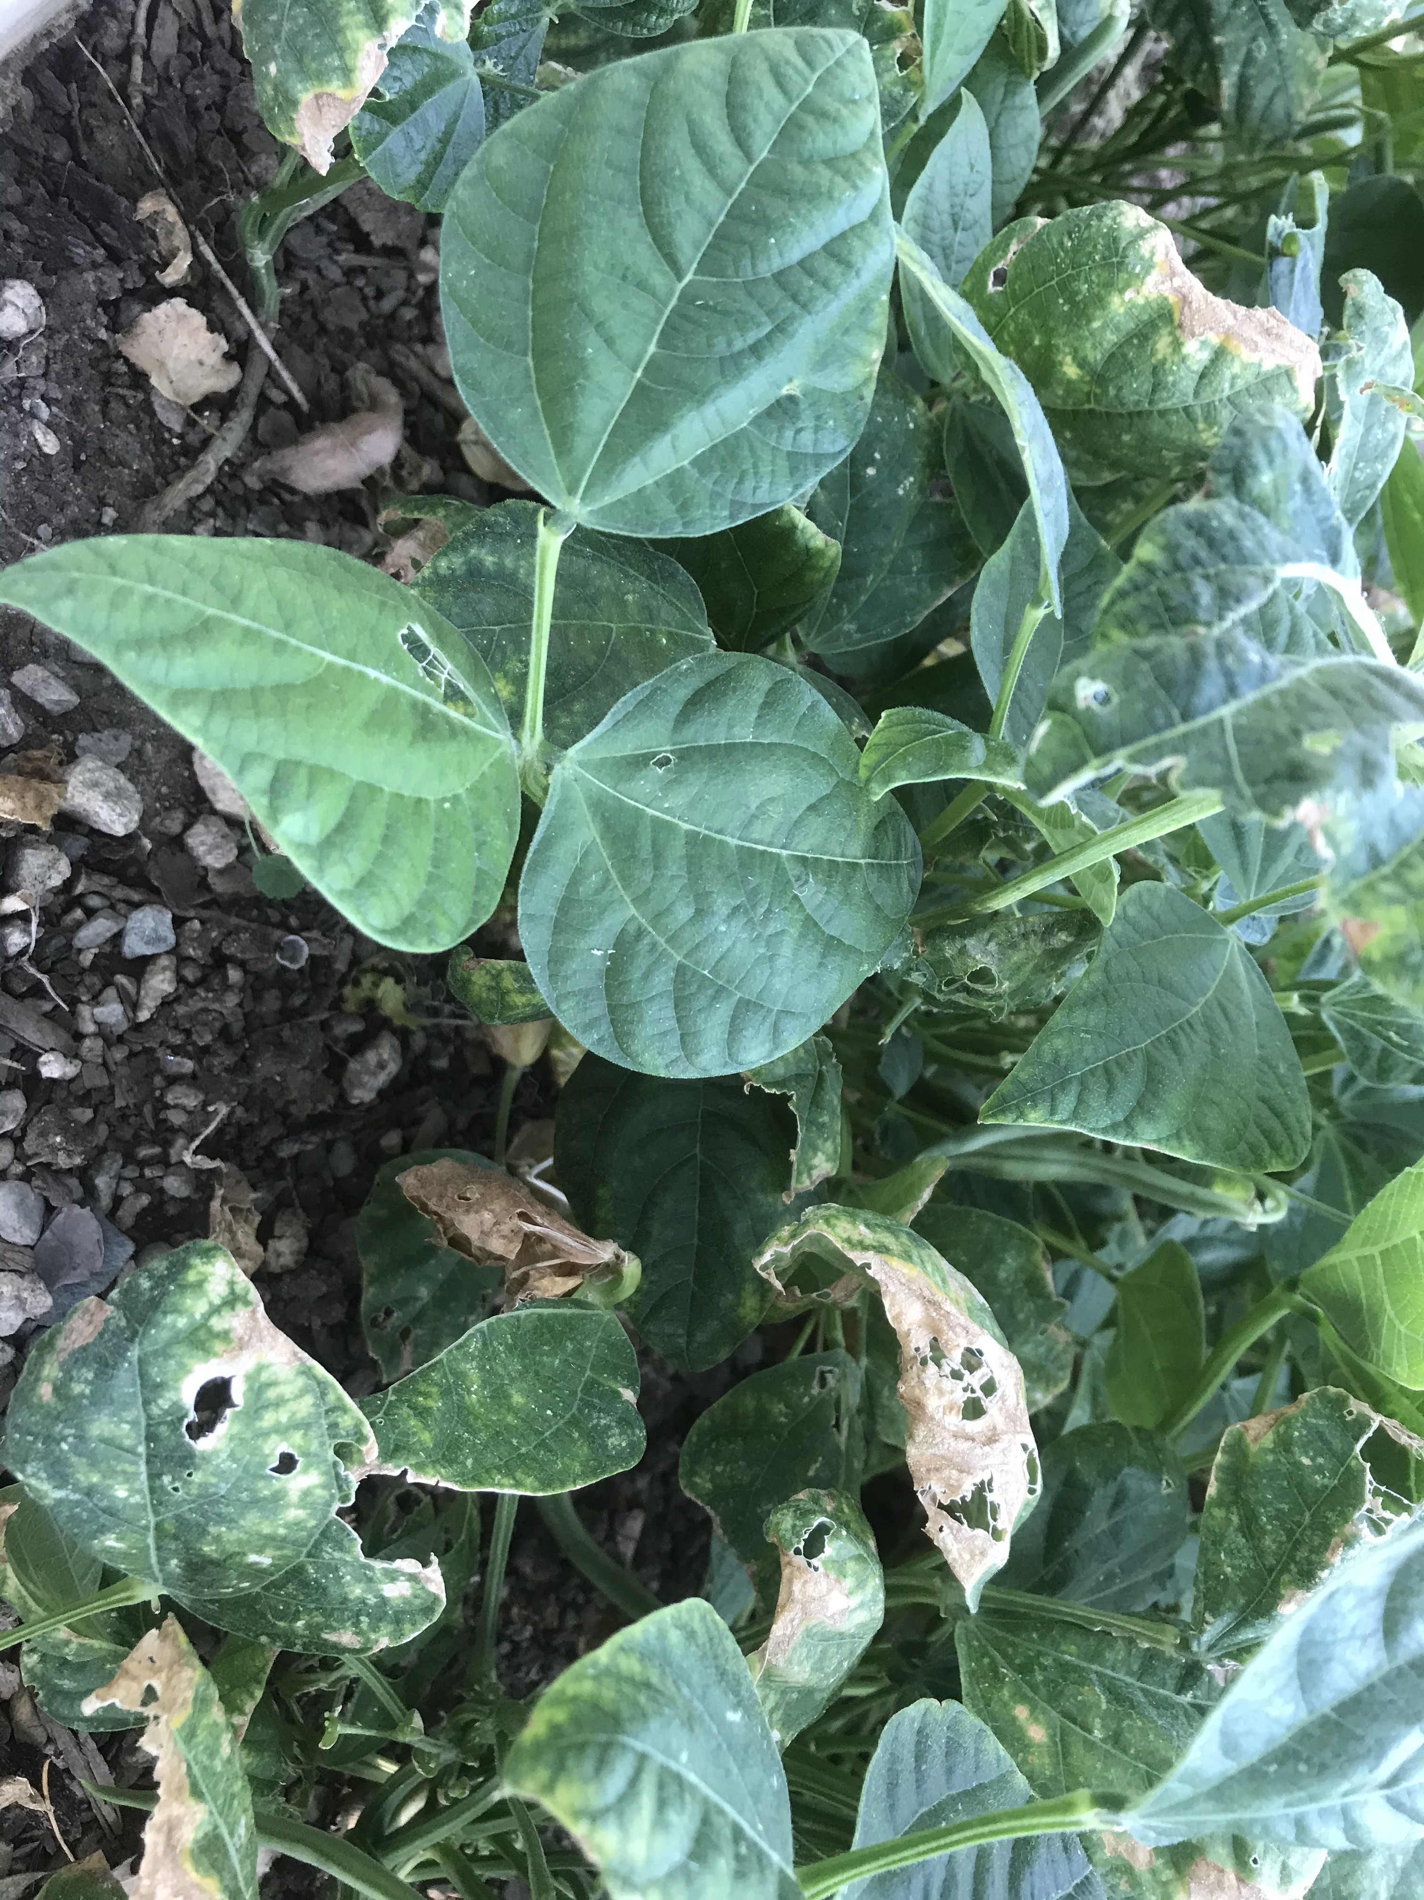
PLANT #3

Slide 6
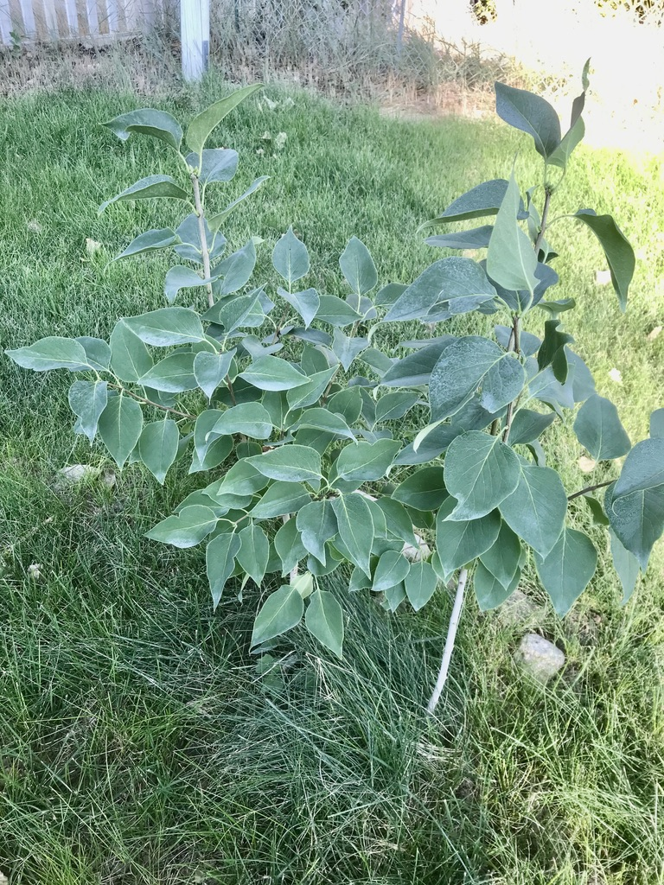
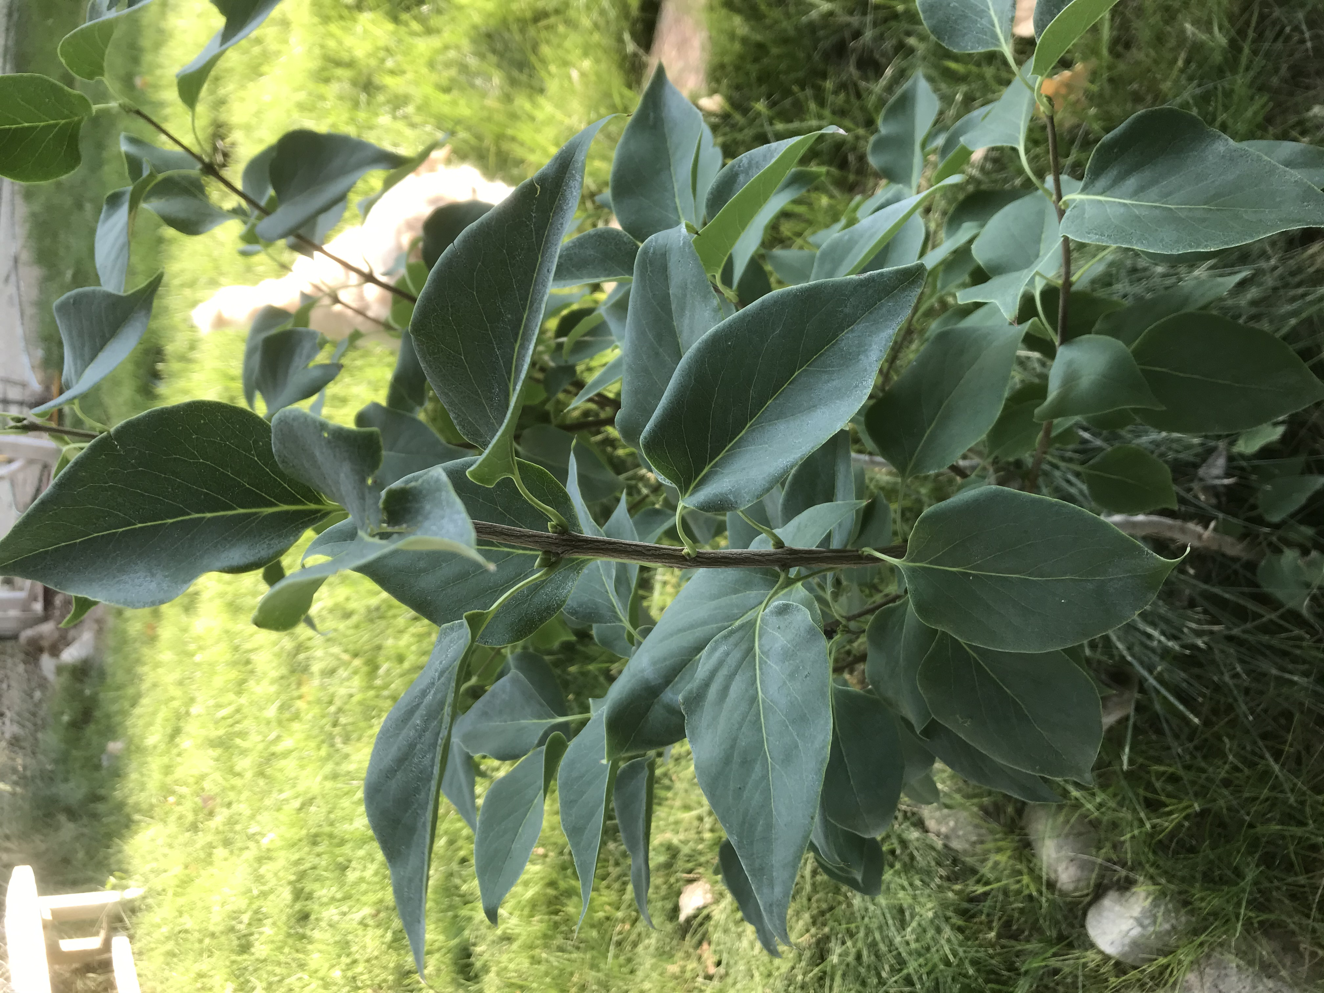
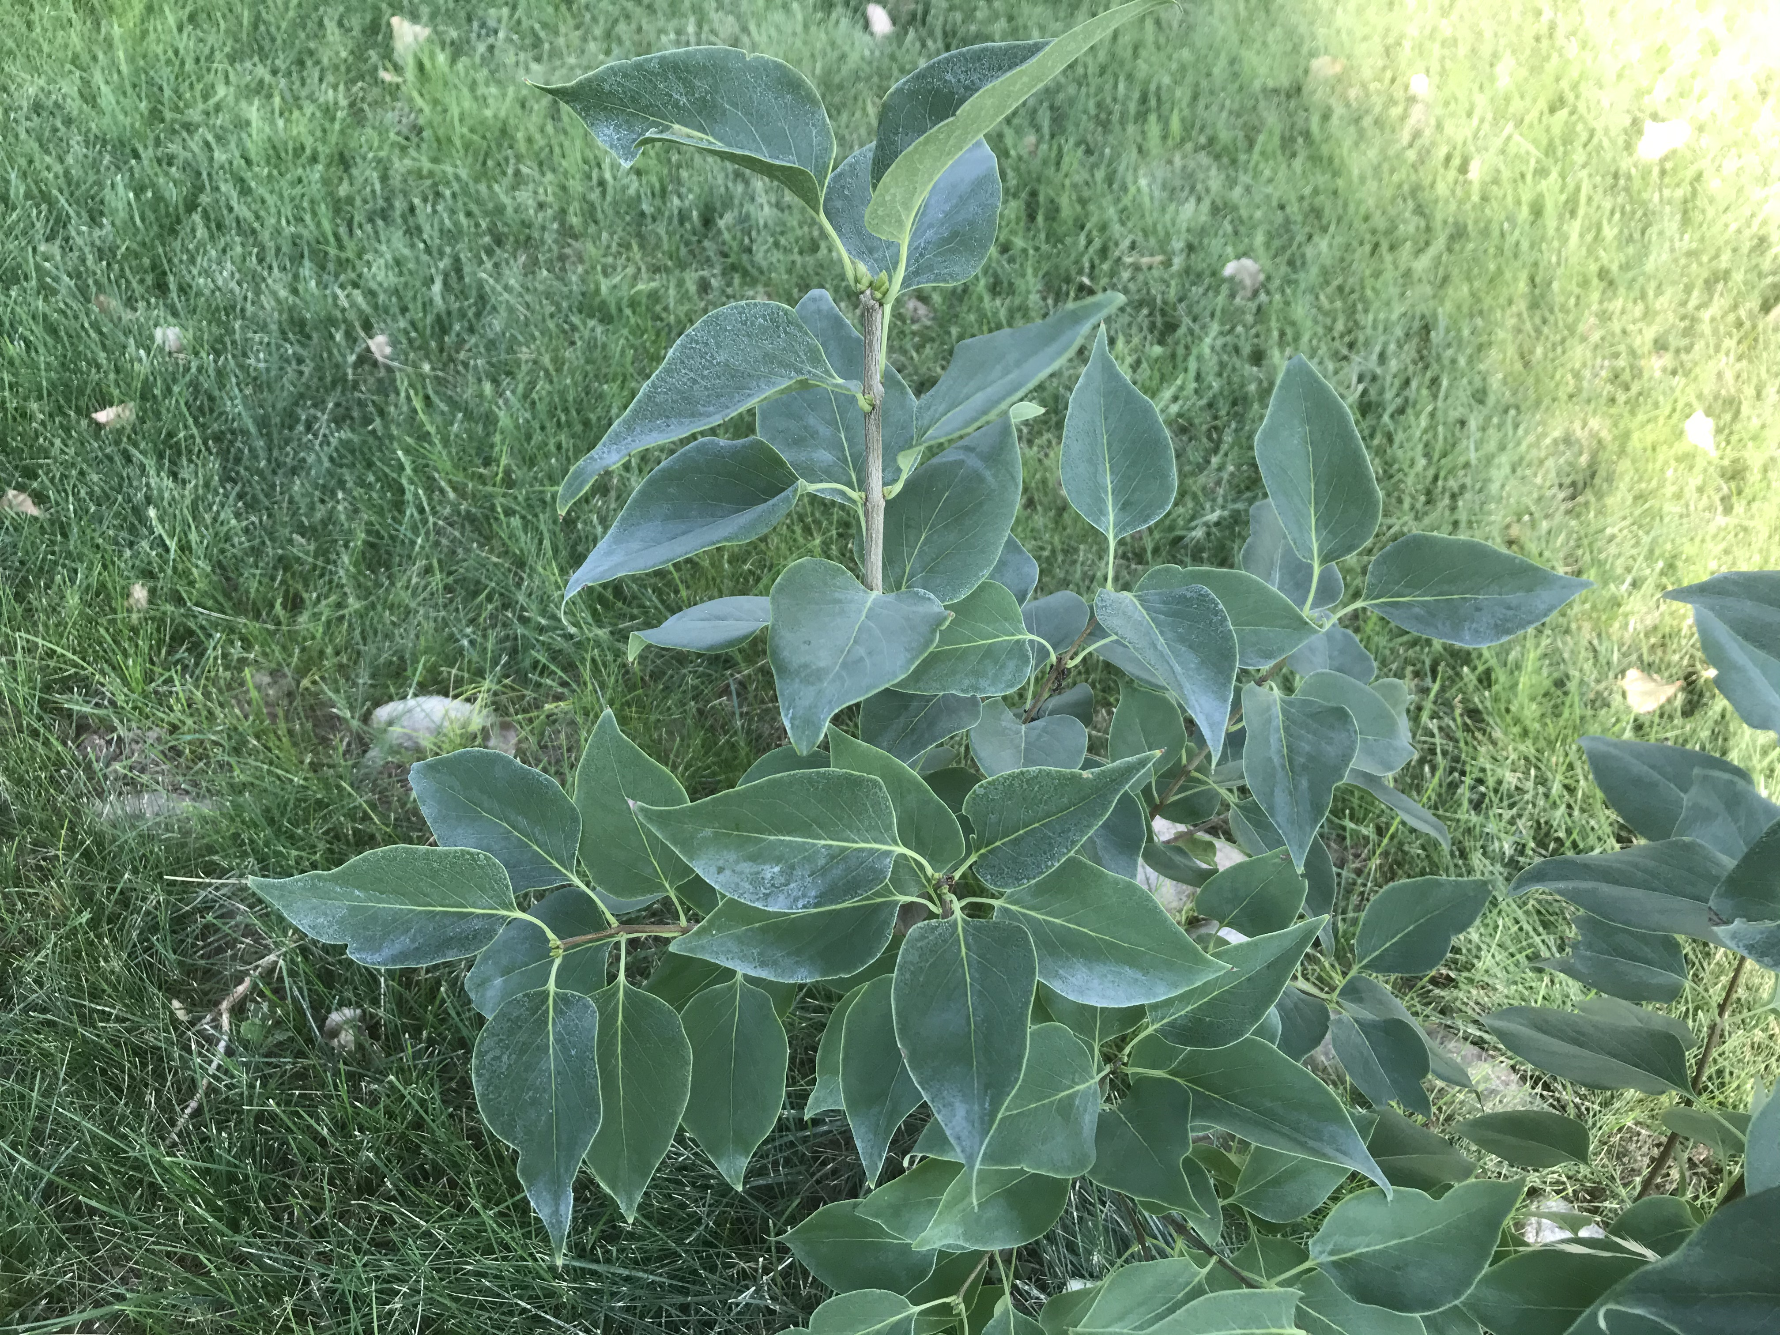
PLANT #4

Slide 7
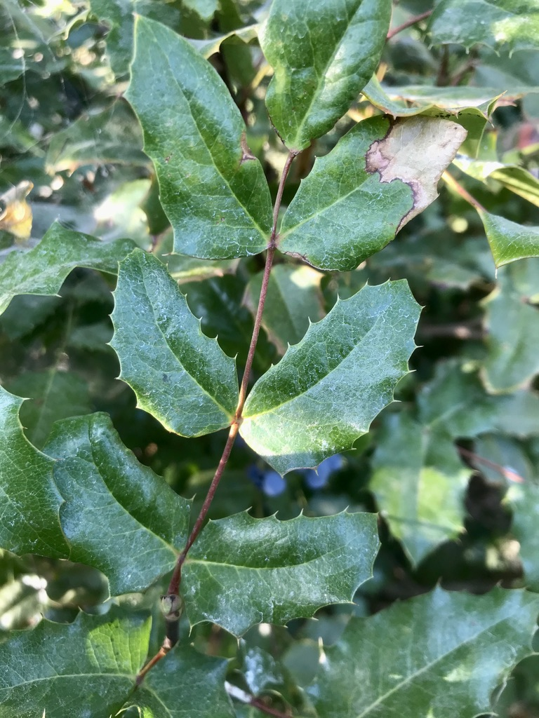
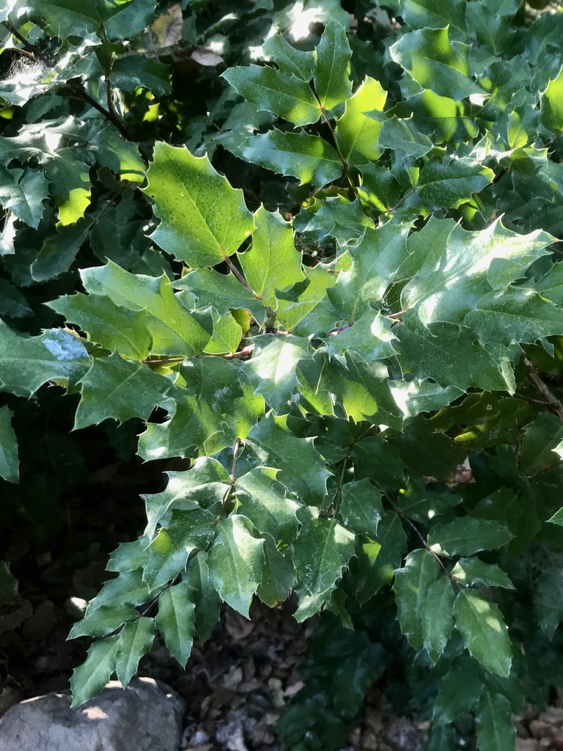
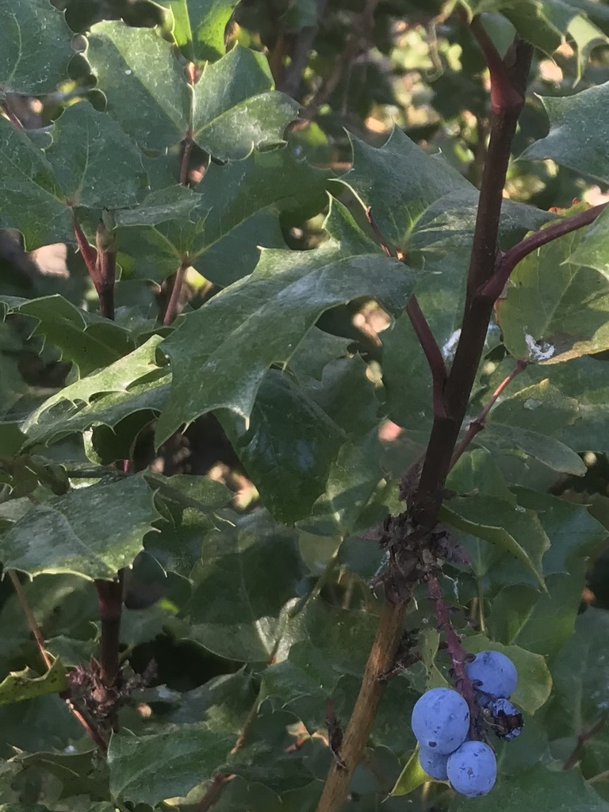
PLANT #5

Slide 8
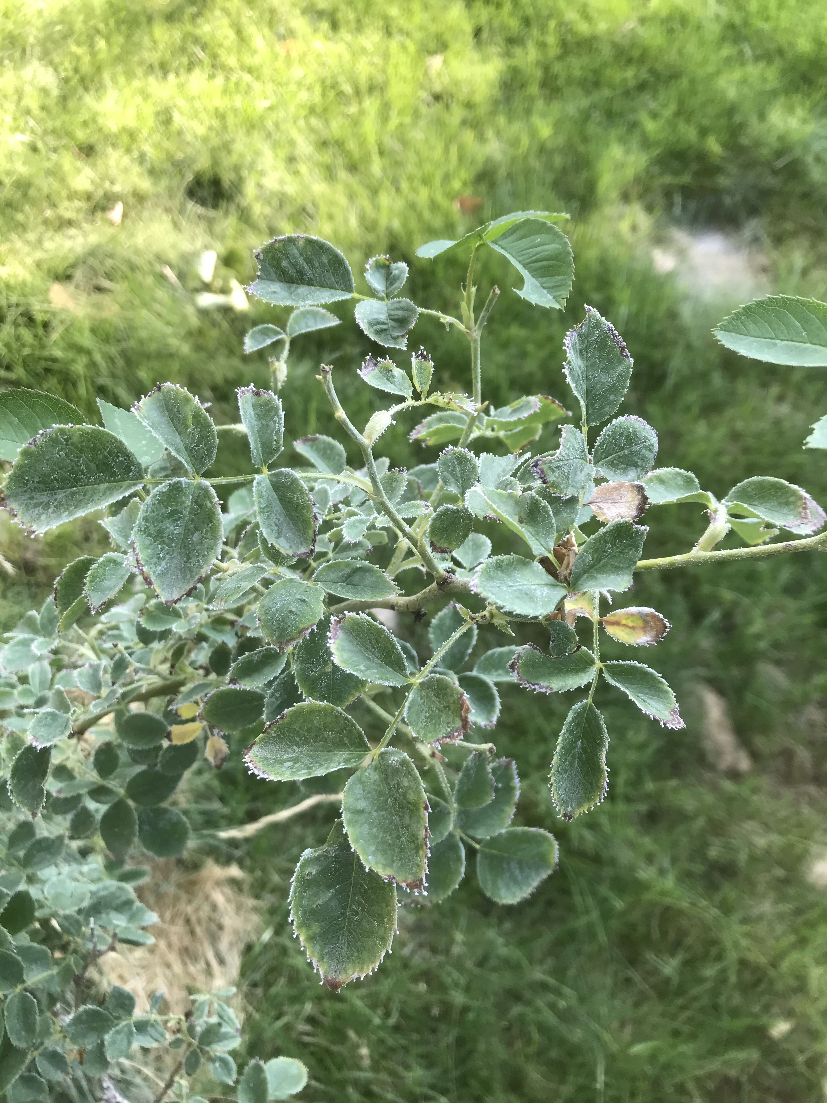
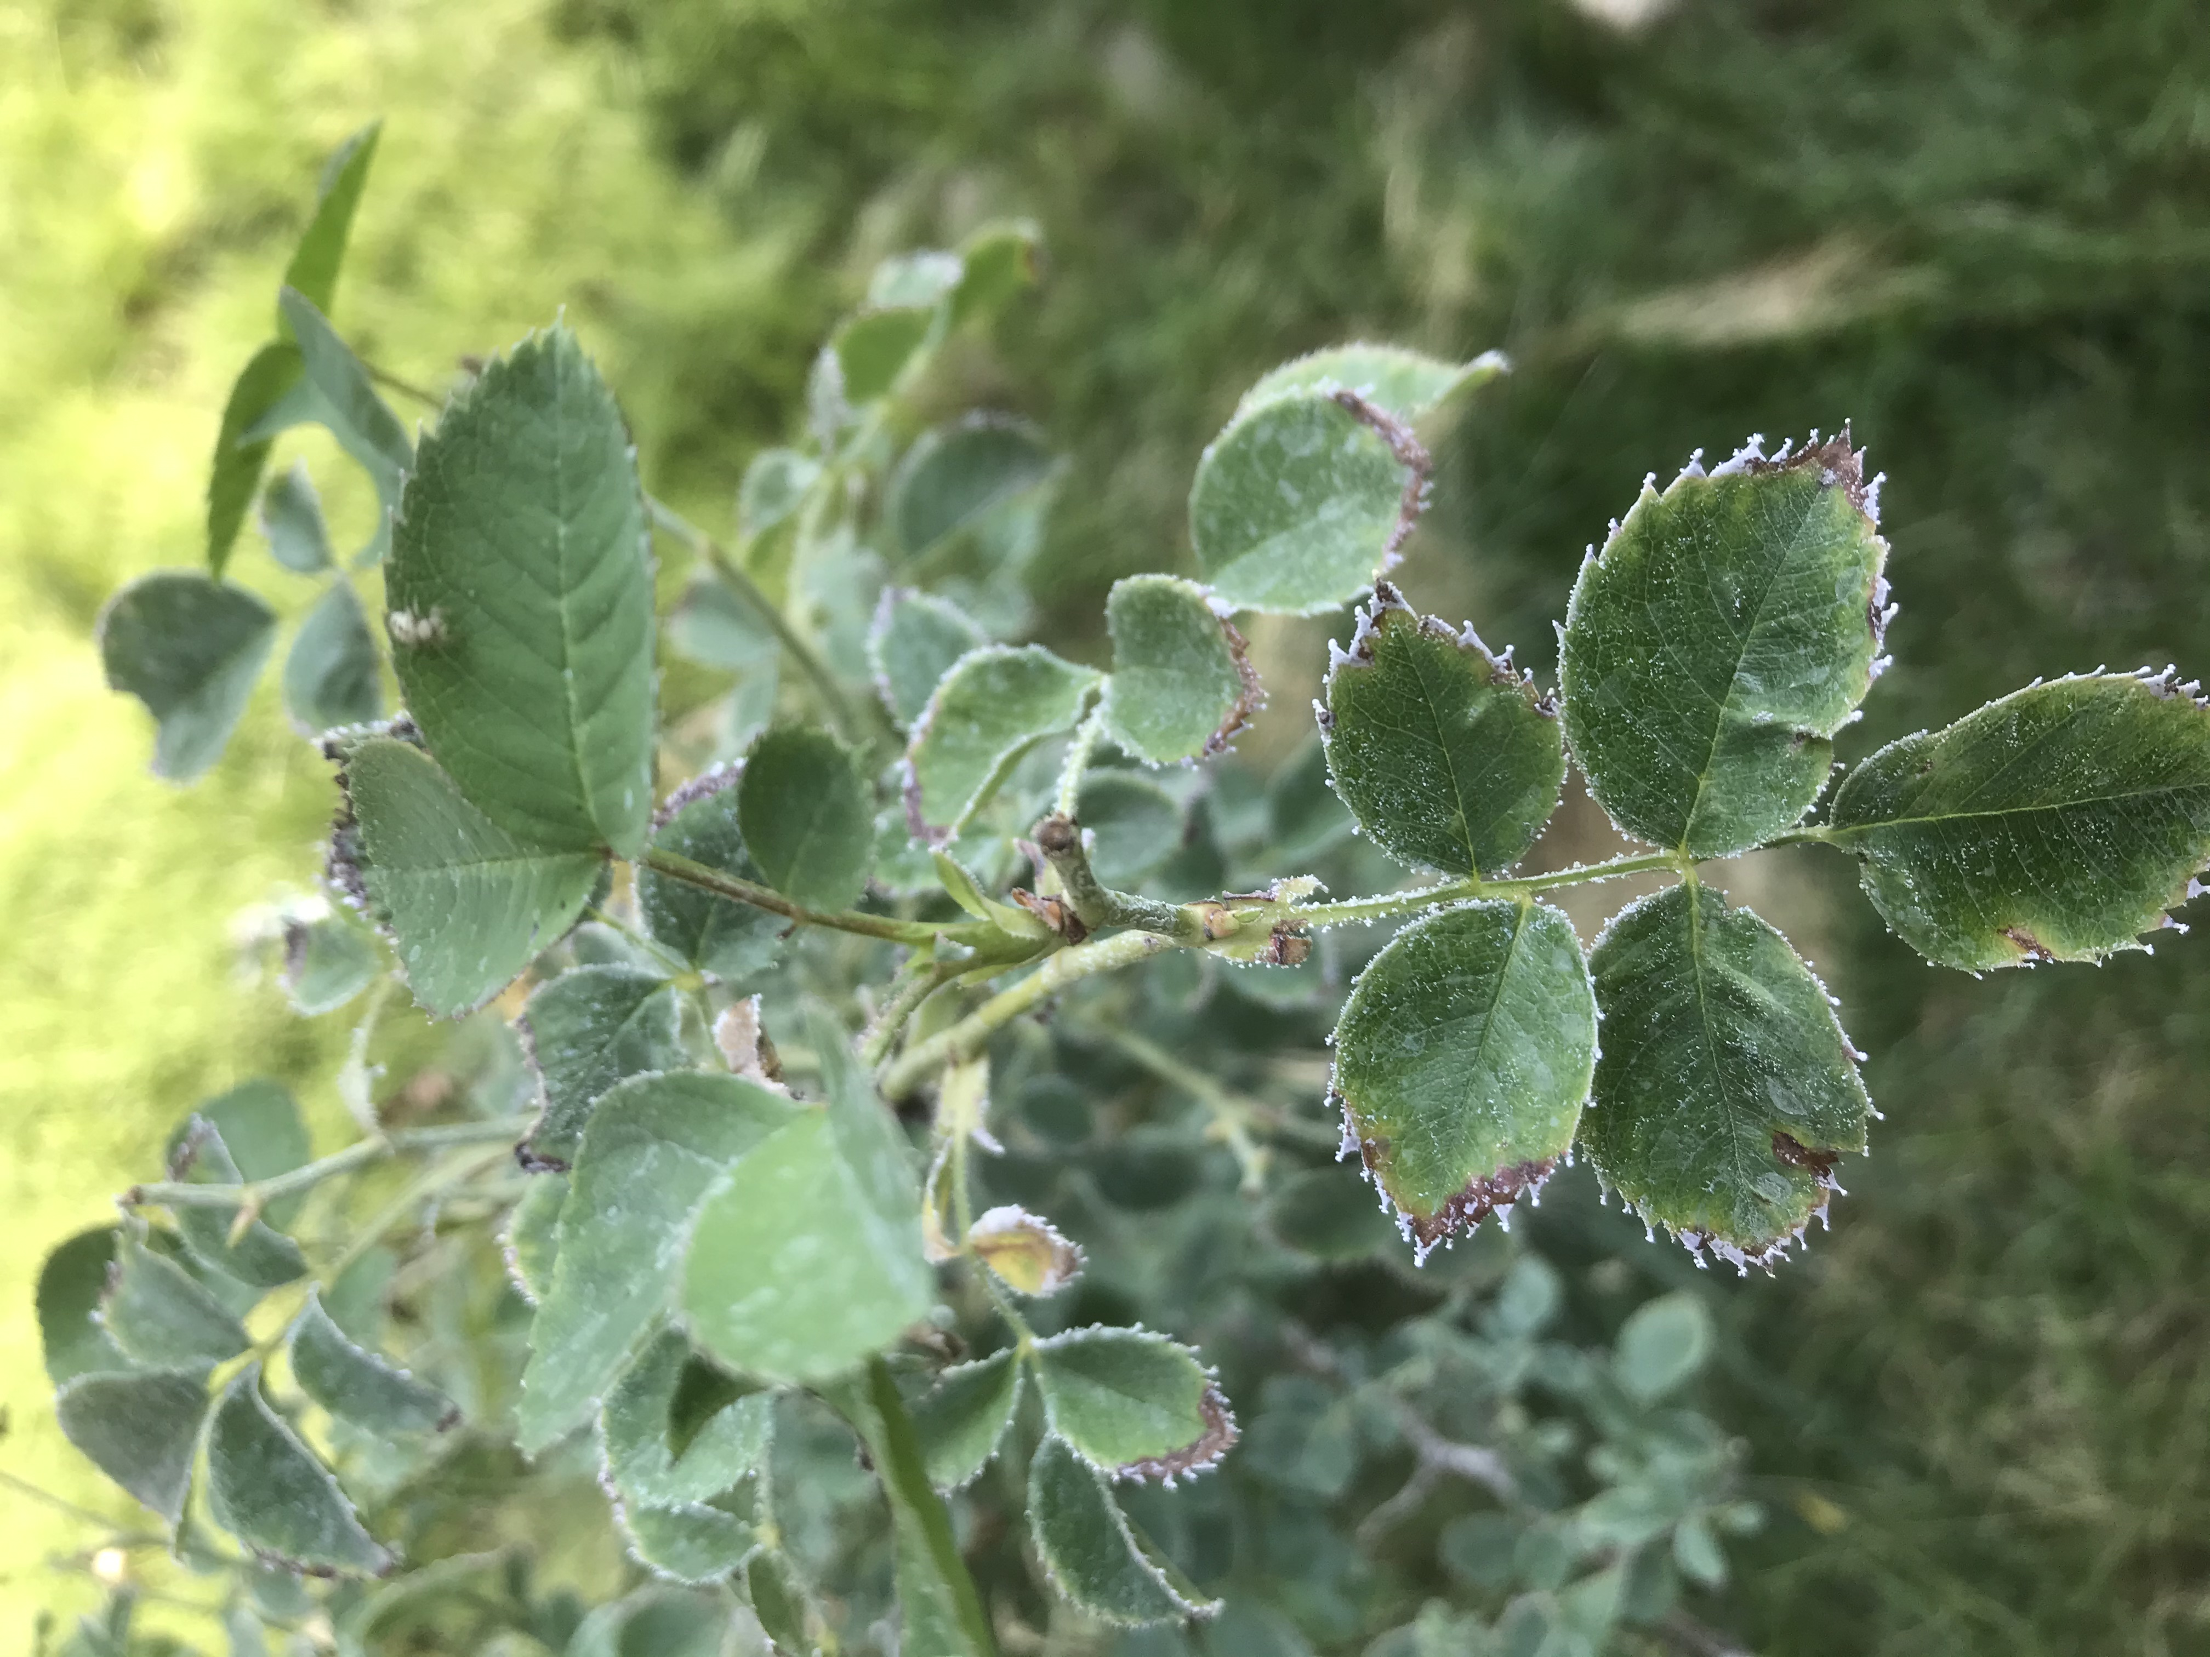
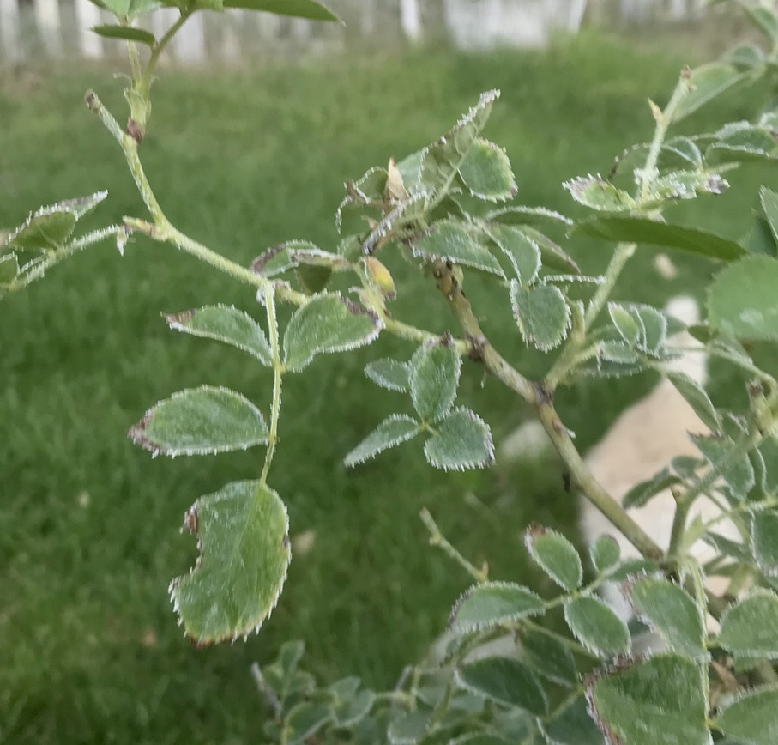
PLANT #6

Slide 9
TIME TO JOURNAL!
THE FOLLOWING SLIDE HAS ONE PICTURE OF EACH OF THE SIX PLANTS.
CHOOSE ONE OF THE PICTURES AND JOURNAL THAT PLANT.
DO ALL PARTS OF THE JOURNALING (ABC, 123, )
REMEMBER, DON’T DO THE REFLECTION YET.

Slide 10
1
2
3
4
5
6

Slide 11
Test your success
Now share your journal with someone nearby. Show them the six choices and have them try to determine which of the six plants you were studying. They need to look at your ABC’s, 123’s and the sketch or diagram before they decide.

Slide 12
1
2
3
4
5
6

