Slide 1
MY SECRET PLANT PART 2
NOW THAT YOU HAVE WORKED WITH A PARTNER TO TEST YOUR JOURNALING SKILLS, LET’S FOCUS ON
REFLECTION.
IN THIS SECTION, YOU’RE GOING TO FINISH YOUR JOURNAL ENTRY BY ANSWERING QUESTIONS THAT HELP YOU REFLECT ON WHAT YOU’VE LEARNED.

Slide 2
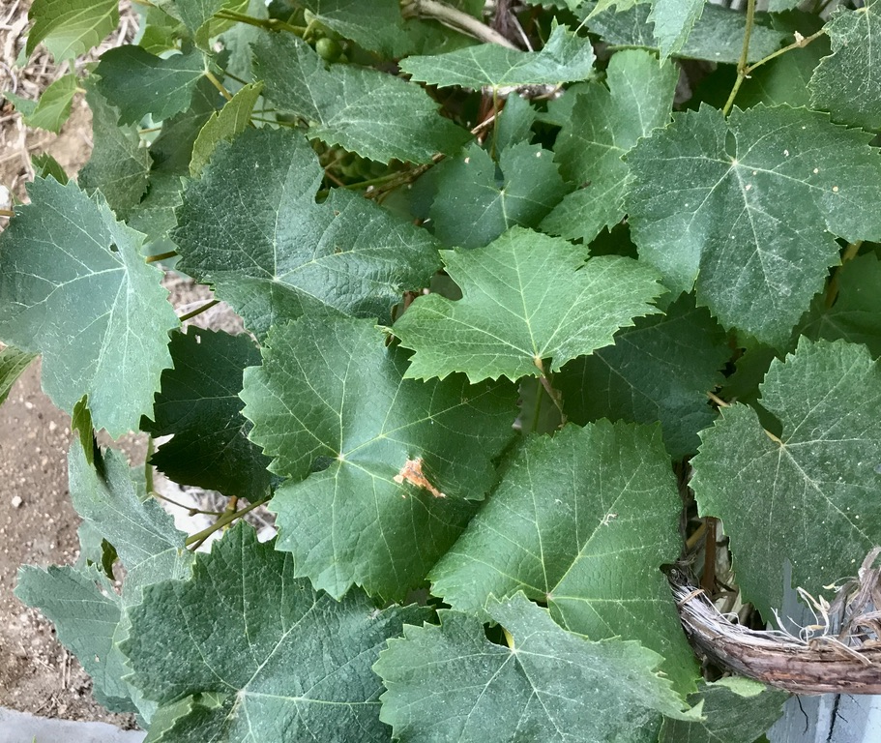
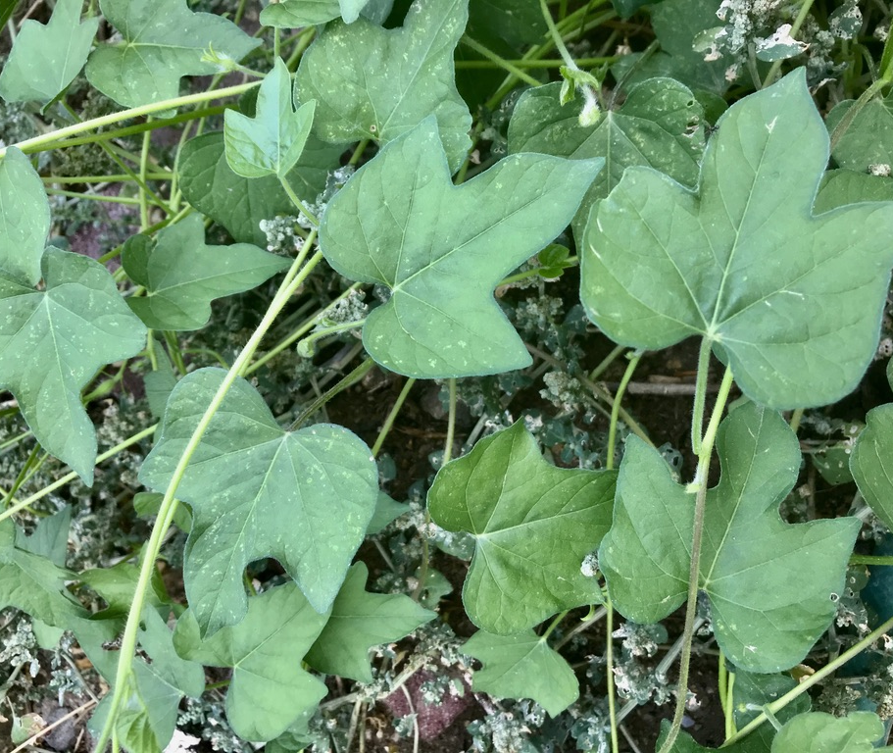
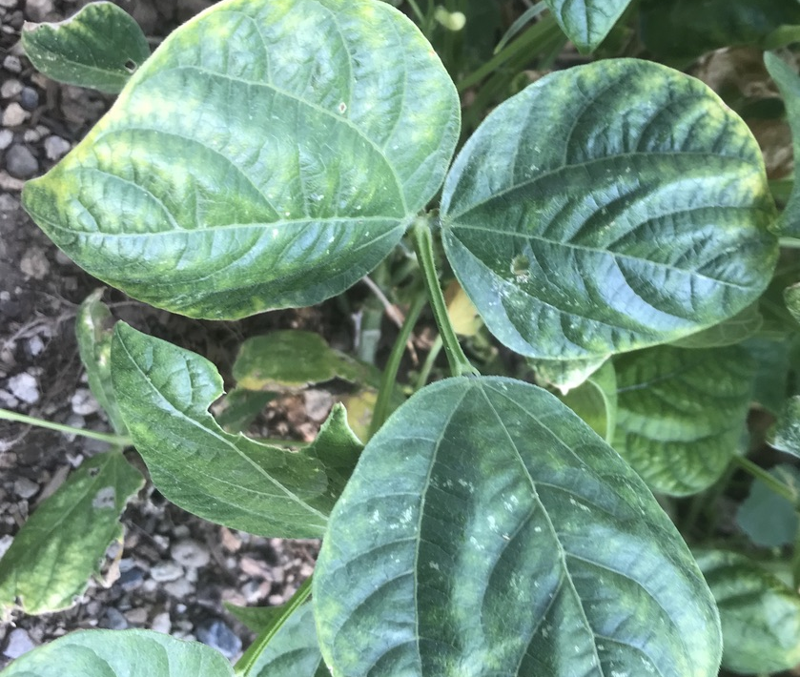
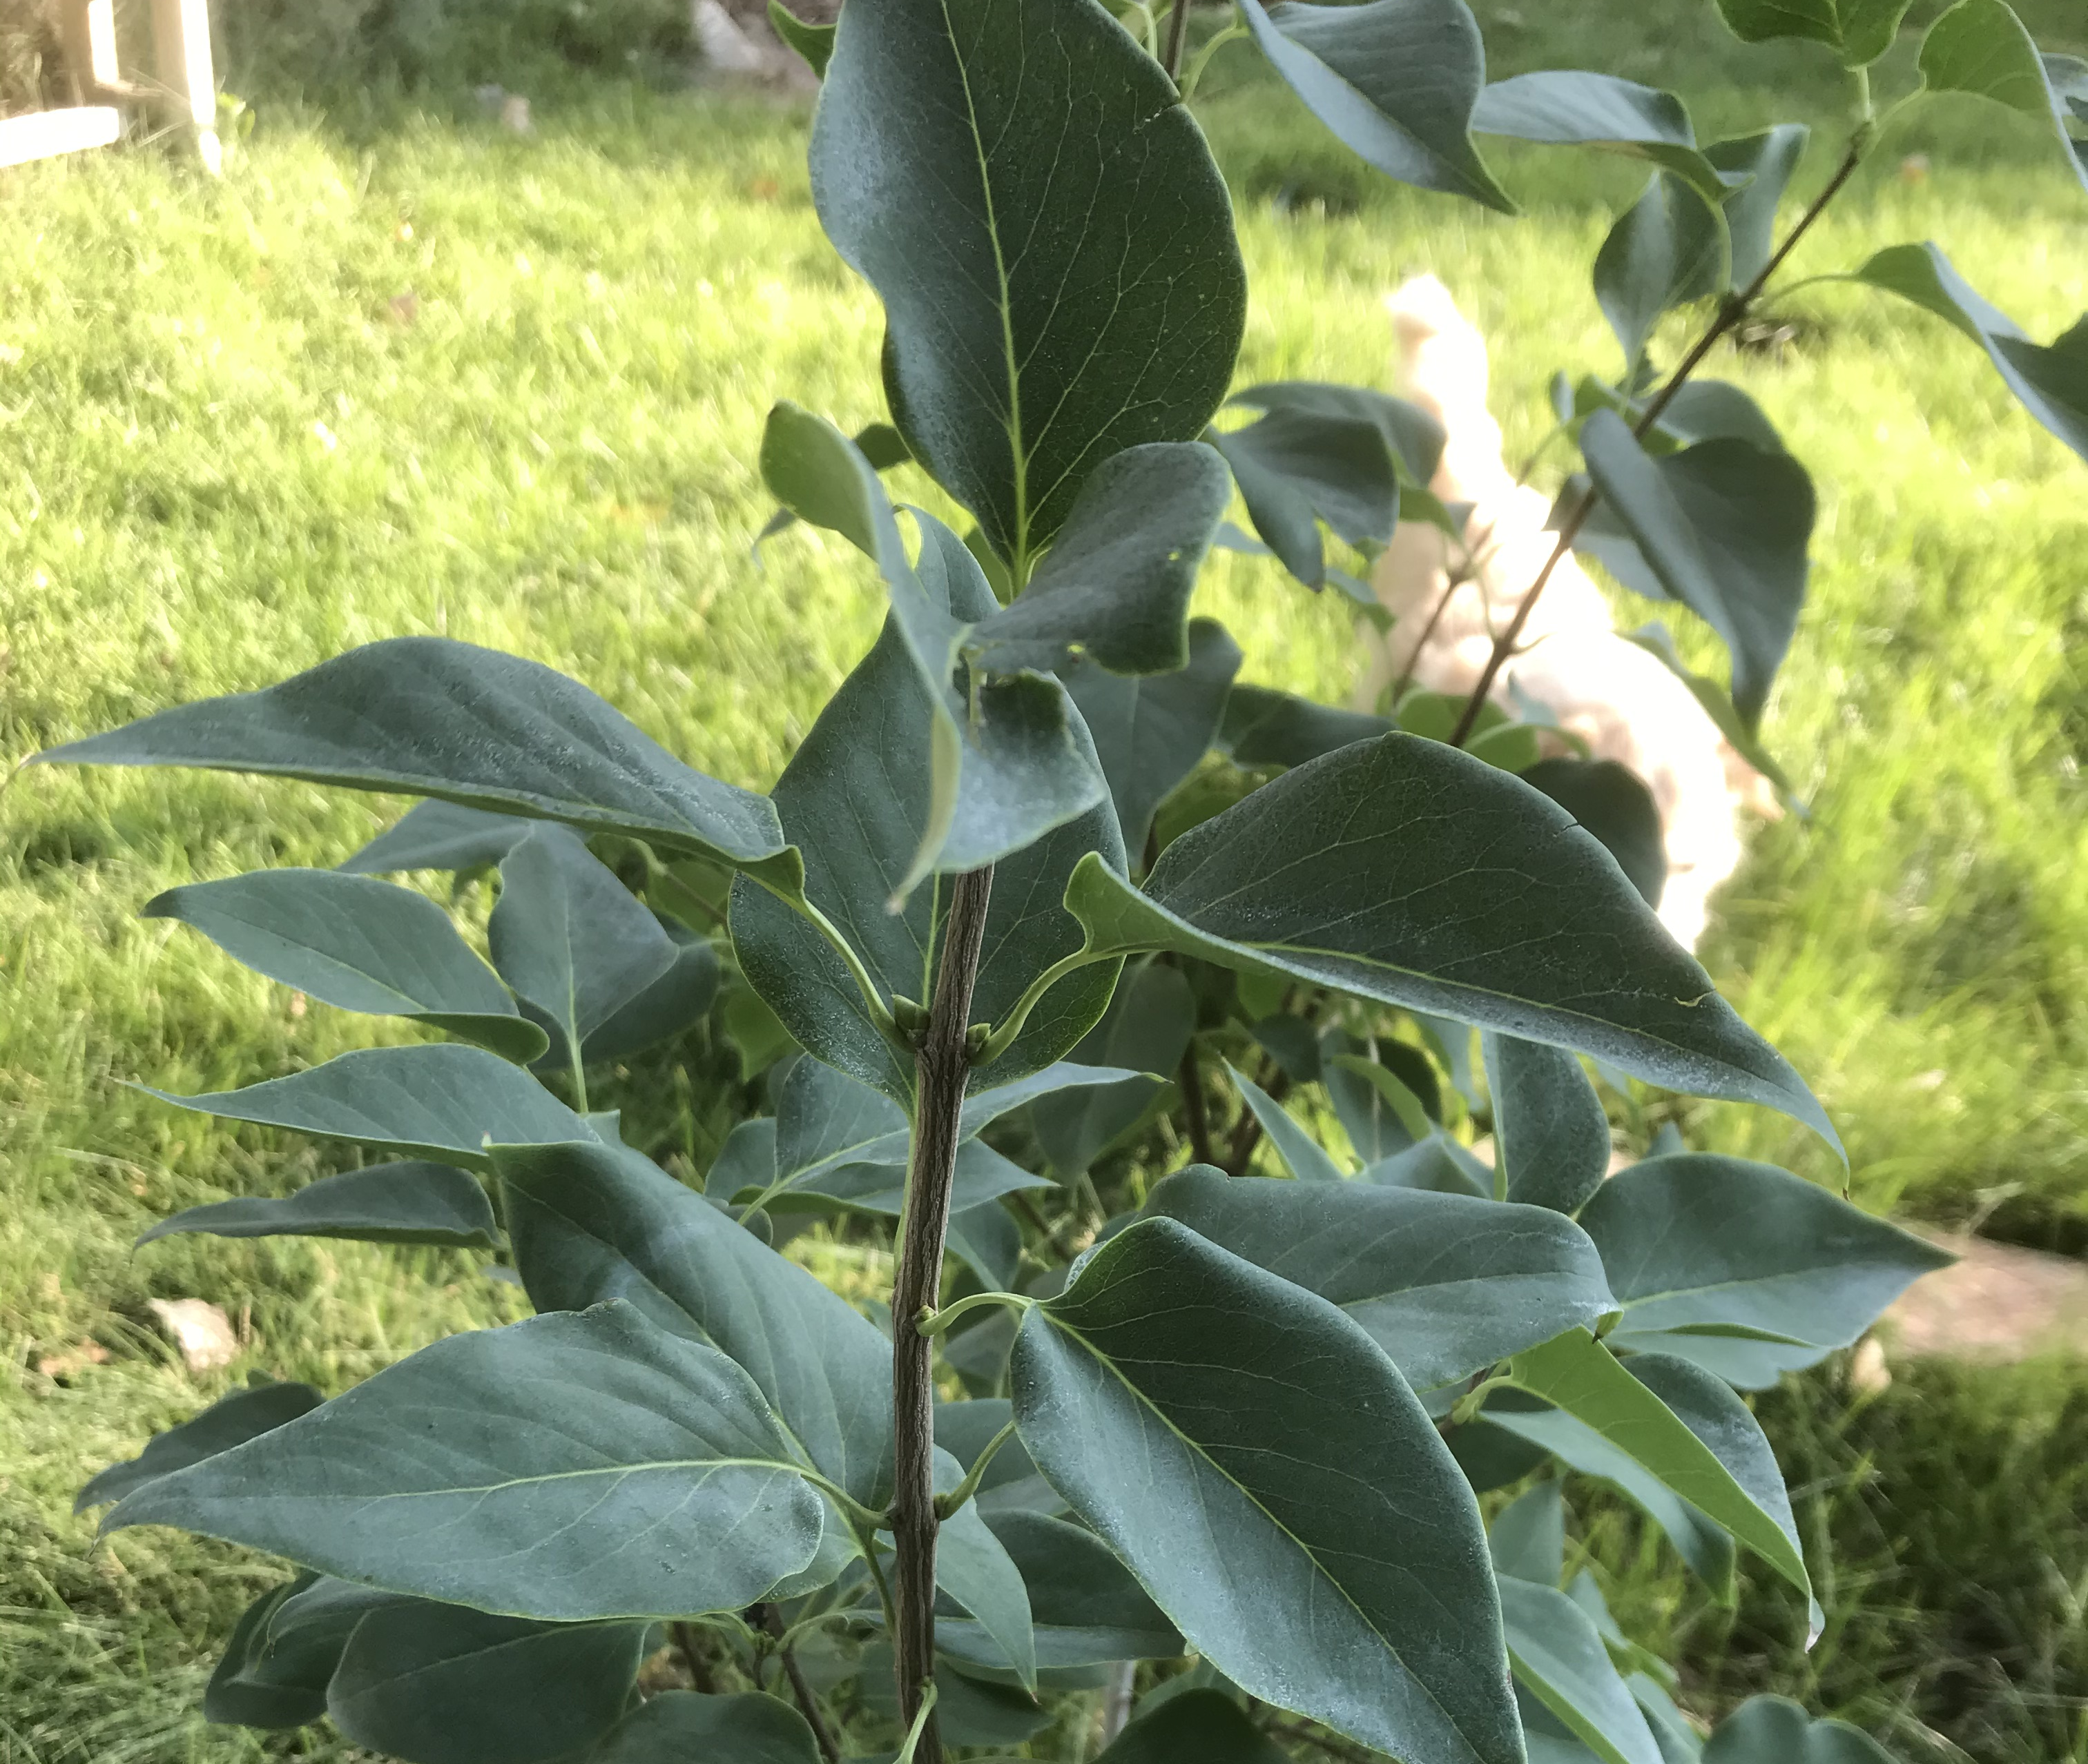
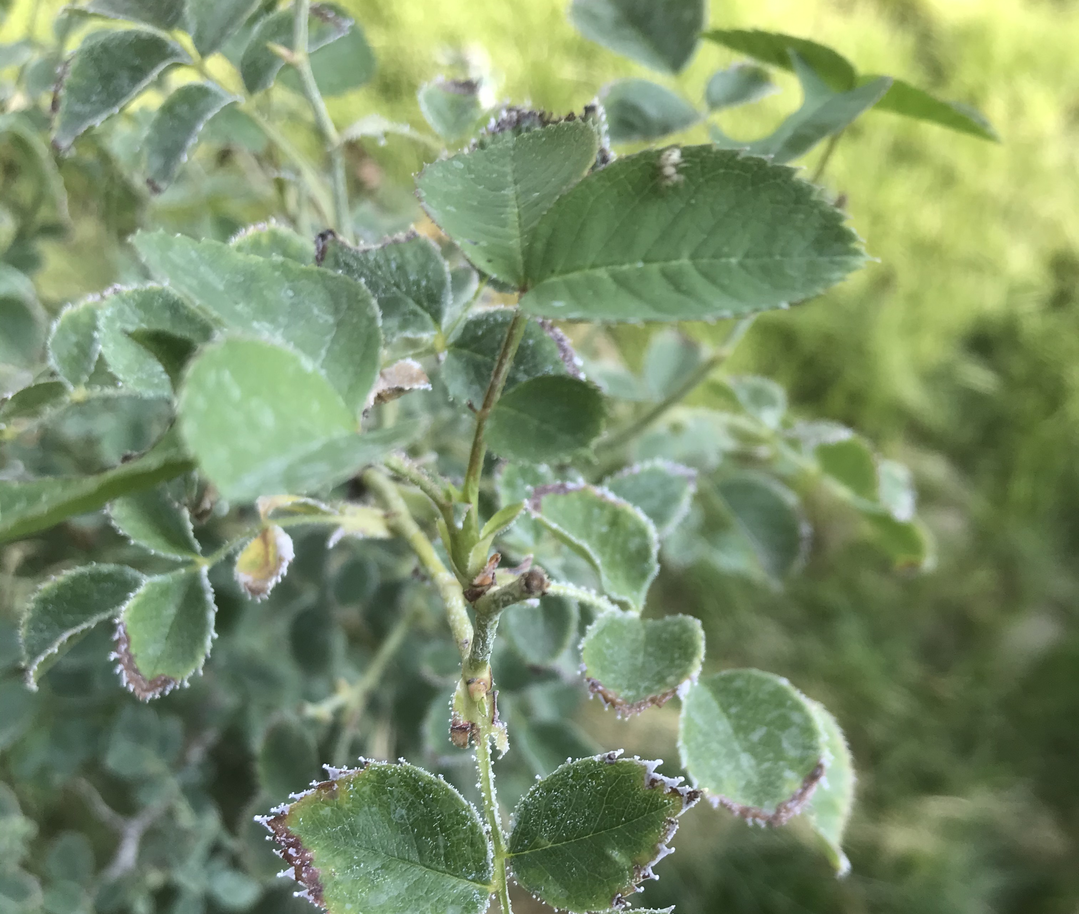
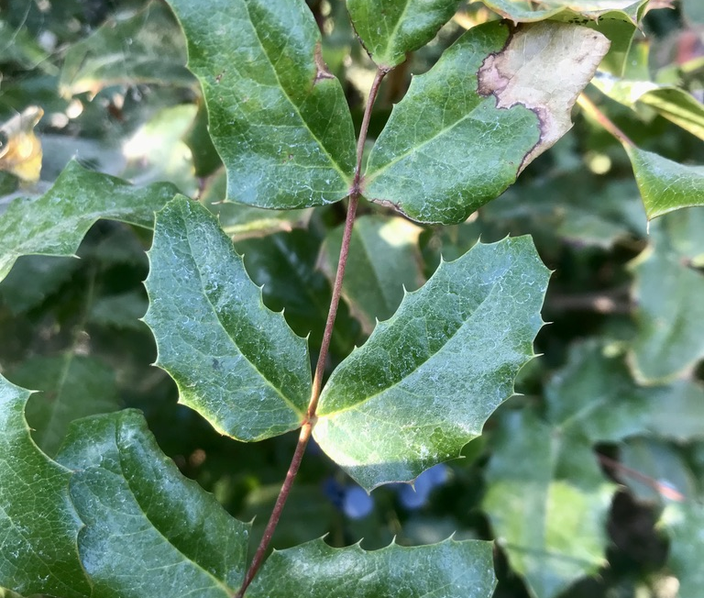
1
2
3
4
5
6

Slide 3
REFLECTION
ANSWER THE 6 QUESTIONS THAT FOLLOW AS YOUR REFLECTION.
ANSWER EACH QUESTION IN COMPLETE SENTENCES, PUTTING THEM TOGETHER INTO ONE FULL PARAGRAPH.
USE QUESTION/ANSWER FORM

Slide 4
QUESTION/ANSWER FORM
USE AS MANY WORDS FROM THE QUESTION IN YOUR ANSWER.
EXAMPLE: WHAT STATE DO YOU LIVE IN?
Q/A FORM: THE STATE I LIVE IN IS CALIFORNIA.

Slide 5
REFLECTION QUESTION #1
Q. WHAT WERE SOME DETAILS THAT HELPED YOUR PARTNER FIND YOUR PLANT?
Q/A FORM: THE DETAILS THAT HELPED MY PARTNER FIND MY PLANT WERE…

Slide 6
REFLECTION QUESTION #2
Q: WERE THERE ANY DETAILS YOU WISHED YOU HAD INCLUDED IN YOUR JOURNAL?
Q/A FORM: THE DETAILS I WISHED I HAD INCLUDED IN MY JOURNAL WERE…

Slide 7
REFLECTION QUESTION #3
Q: WHAT KINDS OF DETAILS MIGHT BE HELPFUL TO RECORD IN FUTURE JOURNAL ENTRIES?
Q/A FORM: THE KINDS OF DETAILS THAT MIGHT BE HELPFUL TO RECORD IN FUTURE JOURNAL ENTRIES ARE…

Slide 8
REFLECTION QUESTION #4
NGSS CROSS-CUTTING CONCEPT: PATTERNS
Q: WHAT PATTERNS CAN YOU SEE IN THE PLANT YOU STUDIED?
(THINK ABOUT FORMS OF GROWTH, BRANCHING, LEAF SHAPE, LEAF COLOR, LEAF ARRANGEMENT – ALTERNATE, SPIRAL, OPPOSITE OR WHORLED)
Q/A FORM: THE PATTERNS I CAN SEE IN THE PLANT I STUDIED WERE…

Slide 9
REFLECTION QUESTION #5
NGSS CROSS-CUTTING CONCEPT: CAUSE & EFFECT
Q: LOOK AT UNIQUE FEATURES YOU RECORDED ON YOUR PLANT, (LIKE HOLES, SPOTS, TEARS, SHAPES OR UNEXPECTED PATTERNS OF GROWTH). WHAT MIGHT HAVE CAUSED SOME OF THESE FEATURES TO OCCUR?
Q/A FORM: THE UNIQUE FEATURE (NAME THE FEATURE) THAT OCCURRED ON THIS PLANT MIGHT HAVE BEEN CAUSED BY…

Slide 10
REFLECTION QUESTION #6
NGSS CROSS-CUTTING CONCEPT: STRUCTURE AND FUNCTION
Q: PICK AN INTERESTING STRUCTURE OR PART OF THE PLANT YOU DREW IN YOUR JOURNAL. HOW MIGHT ITS SHAPE, TEXTURE OR OTHER FEATURE HELP IT FUNCTION IN ITS ENVIRONMENT?
Q/A FORM: AN INTERESTING STRUCTURE OF THE PLANT IS ________ ITS FEATURE (NAME IT) MIGHT HELP IT FUNCTION IN ITS ENVIRONMENT BY_______________________

Slide 11
Here are your questions again:
WHAT WERE SOME DETAILS THAT HELPED YOUR PARTNER FIND YOUR PLANT?
WERE THERE ANY DETAILS YOU WISHED YOU HAD INCLUDED IN YOUR JOURNAL?
WHAT KINDS OF DETAILS MIGHT BE HELPFUL TO RECORD IN FUTURE JOURNAL ENTRIES?
WHAT PATTERNS CAN YOU SEE IN THE PLANT YOU STUDIED?
LOOK AT UNIQUE FEATURES YOU RECORDED ON YOUR PLANT, (LIKE HOLES, SPOTS, TEARS, SHAPES OR UNEXPECTED PATTERNS OF GROWTH). WHAT MIGHT HAVE CAUSED SOME OF THESE FEATURES TO OCCUR?
PICK AN INTERESTING STRUCTURE OR PART OF THE PLANT YOU DREW IN YOUR JOURNAL. HOW MIGHT ITS SHAPE, TEXTURE OR OTHER FEATURE HELP IT FUNCTION IN ITS ENVIRONMENT?

Slide 12
NOW REWRITE YOUR ANSWERS BY COMBINING THEM INTO ONE LONG PARAGRAPH:
Review the questions and your answers.
What is the best order for your six answers if you want them to go into a paragraph? They need to connect to each other in a way that gives meaning.
Number each question based on that order.
For the answer you want to write first, put a #1 by it. Put a #2 by the one you want to go next, and so on.
Write an introductory sentence about this assignment. Then connect the answers together by writing them into a paragraph in the order you chose.
Finish your reflection with a closing sentence about the assignment.

Slide 13
Here’s what it might look like:
In this assignment, I journaled about one plant, then had a partner review my journal to figure out which plant I studied. The details that helped my partner find my plant were _________. The details I wished I had included in my journal were ___________. The kinds of details that might be helpful to record in the future journal entries are ___________________. The patterns I can see in the plant I studied were_____________________________. The unique features (name the feature) that occurred on this plant might have been caused by_________________________. An interesting structure of the plant is____________________________________. Its feature (name it) might help it function in its environment by___________________ . This was a challenging assignment and I learned a lot.

Slide 14
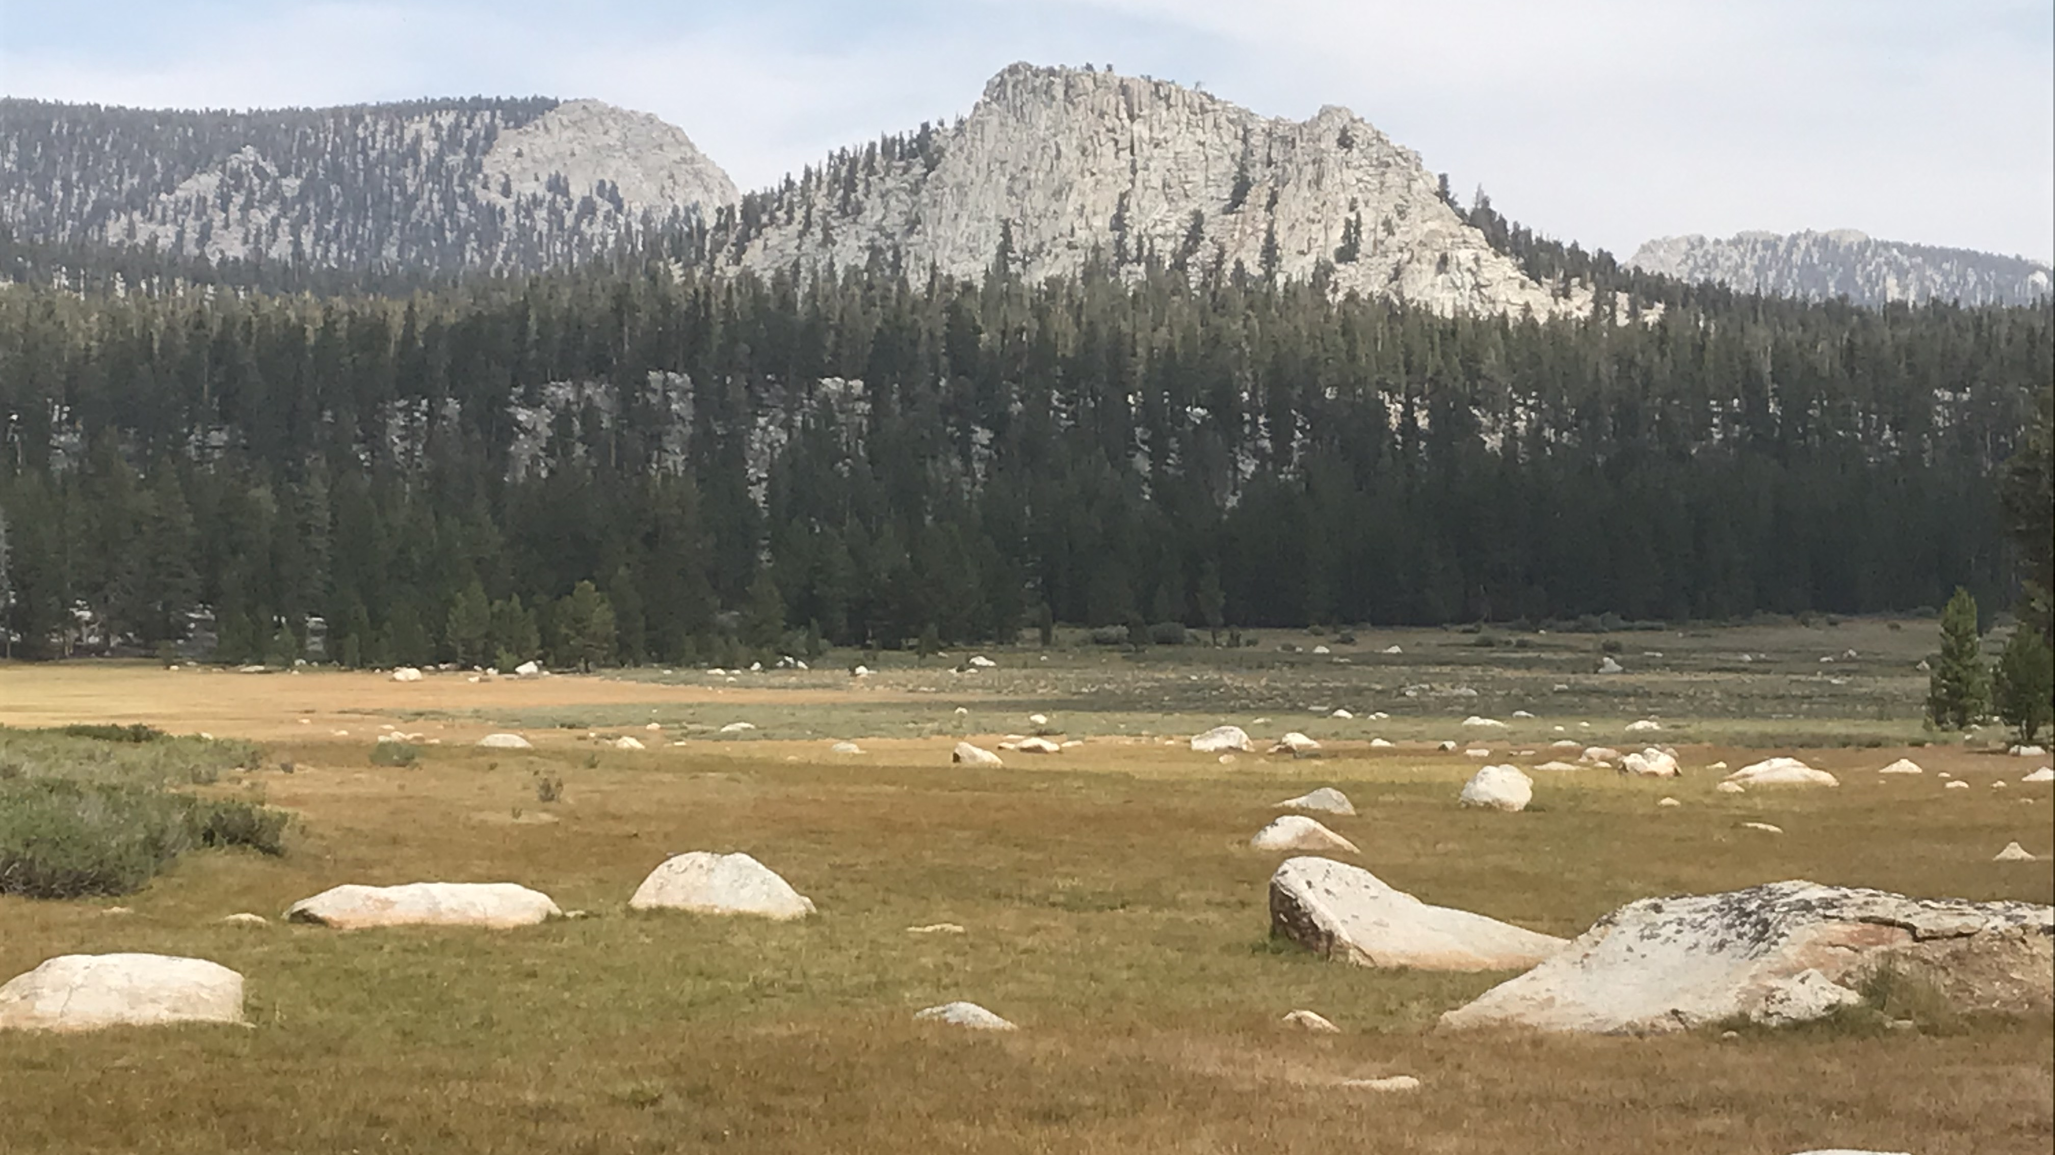
CONGRATULATIONS!
YOU ARE NOW AN EXPERT AT QUESTION/ANSWER FORM AND COMBINING IDEAS TO MAKE A MEANINGFUL PARAGRAPH
REMEMBER, THERE ARE MANY WAYS TO WRITE A REFLECTION. ANSWERING YOUR TEACHER’S QUESTIONS IS ONE OF THOSE WAYS.

Slide 15
BYE FOR NOW. THANKS FOR JOINING ME.

