Slide 1
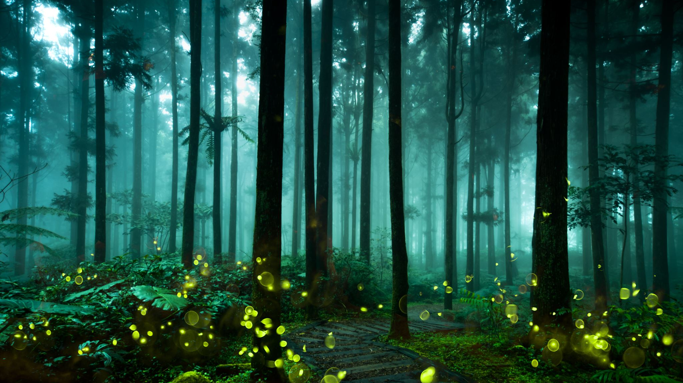
Lesson 7 STRING SAFARI Part 1
DISCOVER A WORLD OF WONDERS WITHIN THE BOUNDARIES OF A LOOP OF STRING.

Slide 2
CONNECT WITH A SMALL PATCH OF LAND and explore your own “tiny world”
USE MAPS, DRAWINGS AND DIAGRAMS TO DESCRIBE YOUR DISCOVERIES

Slide 3
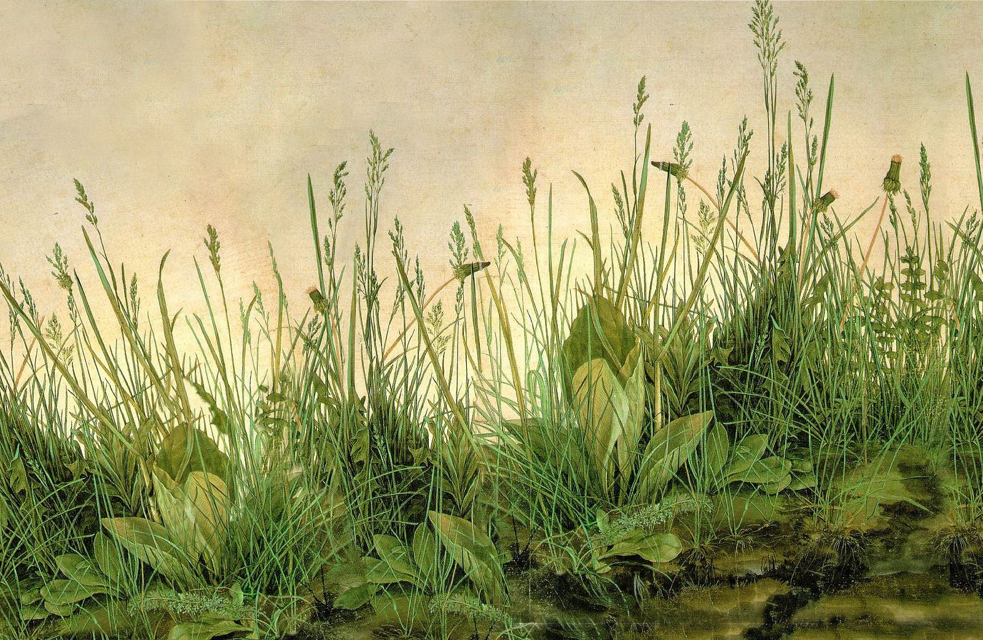
Albrecht Dürer - The Great Piece of Turf, 1503 Take one minute to observe the details in this painting. Say aloud: I NOTICE… I WONDER… THIS REMINDS ME OF…

Slide 4
Discover surprising wonders and treasures
This activity can be done in any outdoor area with varied ground cover.
A field or vacant lot
Any natural area
Look for spots with different species of weeds and other small plants, and unusual objects such as pinecones, lichens, mushrooms, or rocks.
YOU WILL NEED:
Your journal
Length of string about 1.5 – 3 meters or 5-10 ft.
Colored pencils
Hand Lens

Slide 5
PROCEDURE
Put your loop of string on the ground.
The string is the BOUNDARY of your “tiny world.”
Use writing and drawing to record observations about as many subjects as you can within the loop.
Look for plants, animals, natural objects, evidence of animals, or any other interesting treasures you can discover in your loop of string.
Observe closely to discover as much as you can within the string boundary.
Use numbers to record amounts of interesting subjects (populations).
You can make a small map to show where the subjects appear in the circle. You don’t have to make a detailed drawing of every subject.

Slide 6
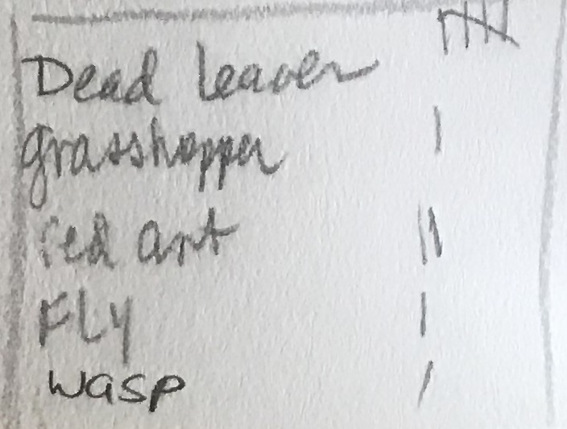
Create a Chart or Graph
If you find a lot of some kind of object, such as a lot of pinecones or rocks, count them and observe similarities and differences.
You can create a graph or chart for your counts.

Slide 7
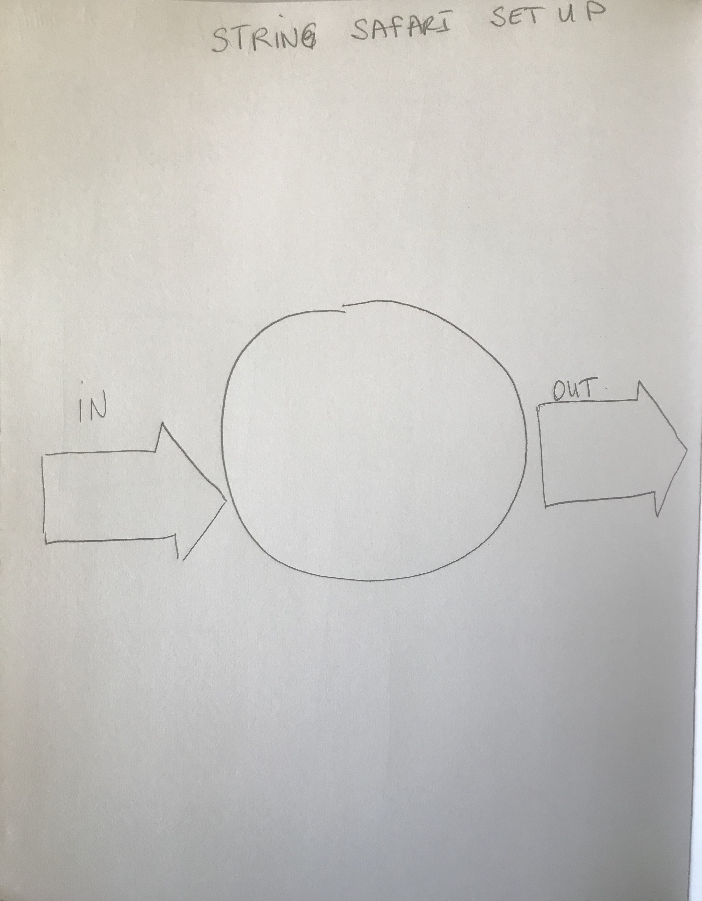
Page Set-up
Draw a circle in the center of your page as your study area.
Draw two arrow boxes on either side of the circle, one pointing in, the other pointing out.
You will be writing INSIDE the boxes in Part 2 so make them large enough to list three or four things.

Slide 8
Go beyond “done.”
Around your circle, make individual, magnified drawings of interesting things you find within the loop of string.
Use arrows and labels to describe where they are found.
You might find one object or organism that is very intriguing to you, and if you get lost in observing it and recording observations about it, that great!
Even if you feel “DONE,” keep looking for things. The feeling of being done is JUST A FEELING. It’s not real. See what interesting things you discover AFTER you feel you are done.
Add that to your journal and mention that you found it AFTER you thought you were done.

Slide 9
I selected this rock surrounded by a moss-like plant.

Slide 10
Look for these things:
I left the two arrows (In and Out) blank
Lower righthand side, I made a chart of the things I counted.
I magnified the plant, the flower, and the grasshopper.
I went beyond “DONE” and that’s when I noticed the tiny flowers and what might be seed pods.
The longer I stayed there, the more insects came to rest inside the string circle.

Slide 11
Now it’s your turn
Create a journal entry titled “STRING SAFARI.”
Use your string to create a boundary and focus on your “tiny world.”
Create a map or diagram of the area you are studying.
Make a chart or graph of populations within your string boundary.
Create magnified drawings of things that you find particularly interesting.
Use arrows and labels.
ABC, 123, .
GO BEYOND “DONE.”

Slide 12
Plan Your Page
Heading first (METADATA), then title (STRING SAFARI)
Draw a circle in the middle of the page, add “IN” and “OUT” arrows on either side of the circle, (To be completed in Part 2).
Include ABC’s, 123’s, for each subject
Use the next page for your reflection questions/paragraph
When you finish, remember to add this journaling project to your Table of Contents.

Slide 13
Begin with your metadata (Heading)
Date, Day, Time
Location, habitat
Weather
Temperature
Wind
% Cloud cover

Slide 14
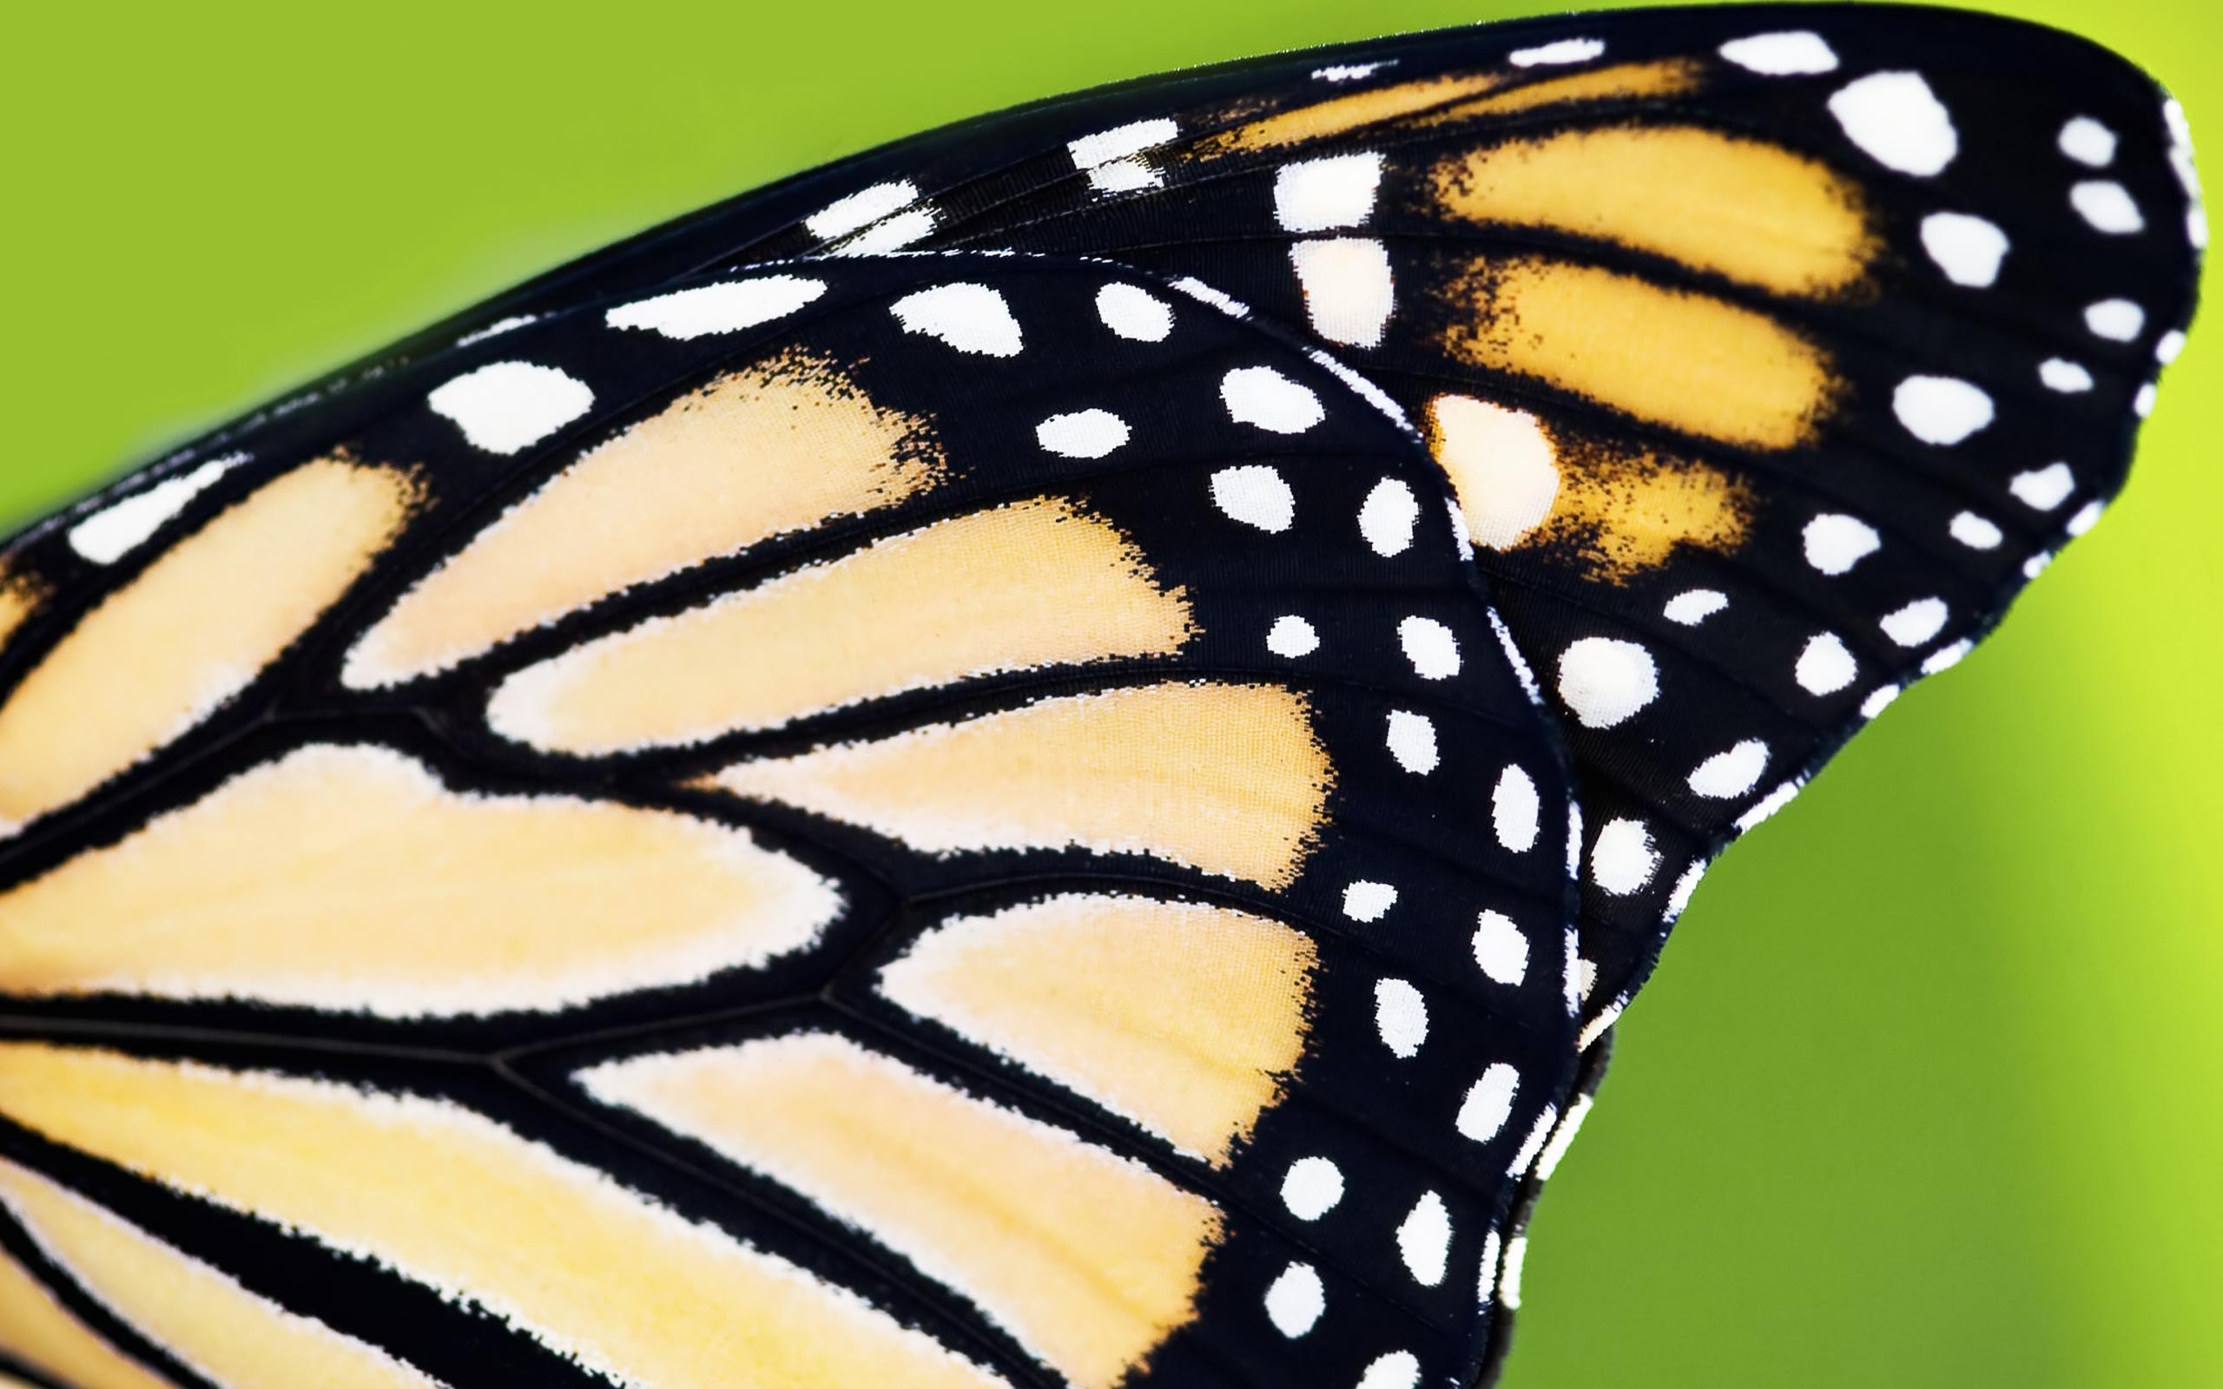
Could it Be…
For each “I wonder”, Write one or two hypotheses by completing the sentence frame:
“Could it be…”

Slide 15
Include the things you’ve already learned from previous lessons to get the most out of your journaling experience.
COMPARE AND CONTRAST
ZOOM IN/ZOOM OUT
PATTERNS
CAUSE AND EFFECT
SYSTEMS AND SYSTEM MODELS
STRUCTURE AND FUNCTION

Slide 16
REFLECTION
Question/Answer
Question/Answer form (Put as many words from the question into your answer.)
Answer
Answer all questions, then put them in an order that makes sense for a paragraph.
Topic Sentence
Begin with a topic sentence (“I studied a ‘tiny world’ inside a circle of string.”)
Closing Sentence
End with a closing sentence (“I was surprised about all the things I saw within such a small area of space.”

Slide 17
REFLECTION QUESTIONS
How did limiting your observations to the area inside the string affect the way you observed?
What questions do you have about what you found in your loop of string?
What did you discover when you went “BEYOND DONE?”
Did you see any evidence of things that are changing in your observation area? How can you tell?
If you came back in one week, do you think you would notice any changes in the area you studied? What might they be?

Slide 18
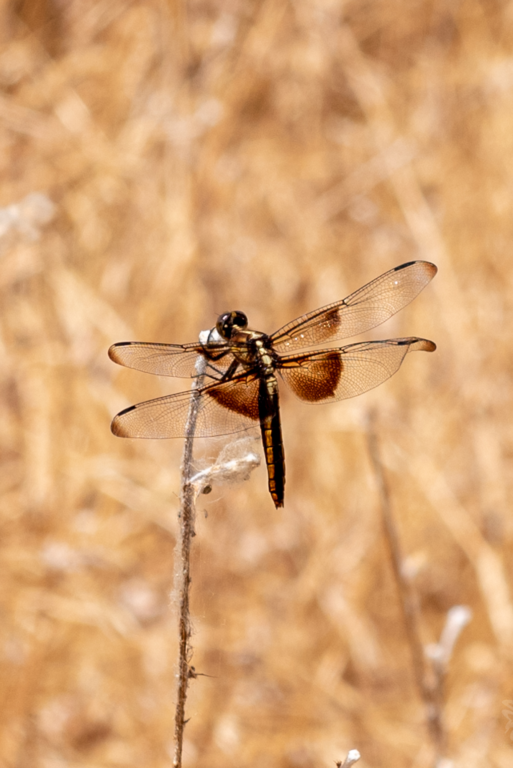
BYE FOR NOW. THANKS FOR JOINING ME.

