Slide 1
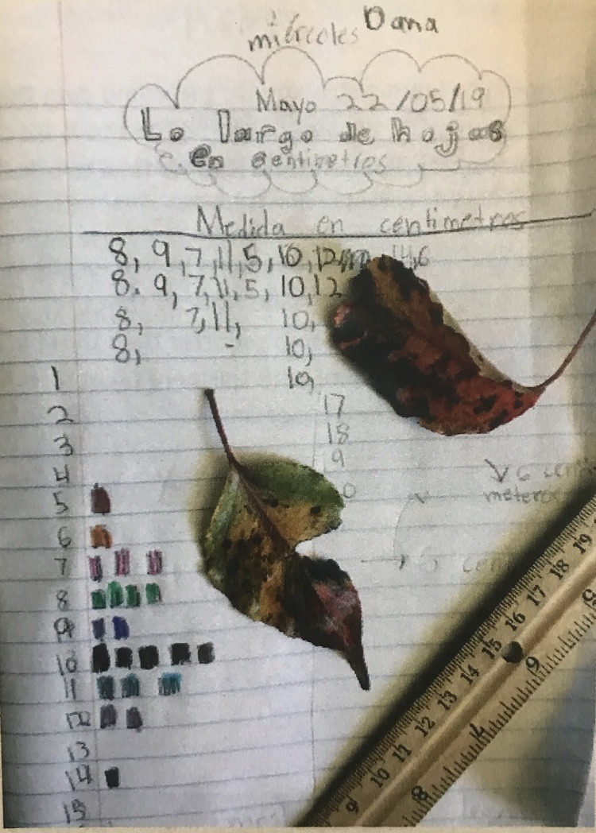
Lesson 15:Quantification and Mathematical Thinking
When you discover the numbers in your observations, and practice counting, measuring, timing, and estimating, you can make your investigations more scientific, answer more questions, and discover more patterns.
Adding numbers to your journal page will spark more questions while you study a phenomenon.
Quantification is needed for answering questions and collecting data.

Slide 2
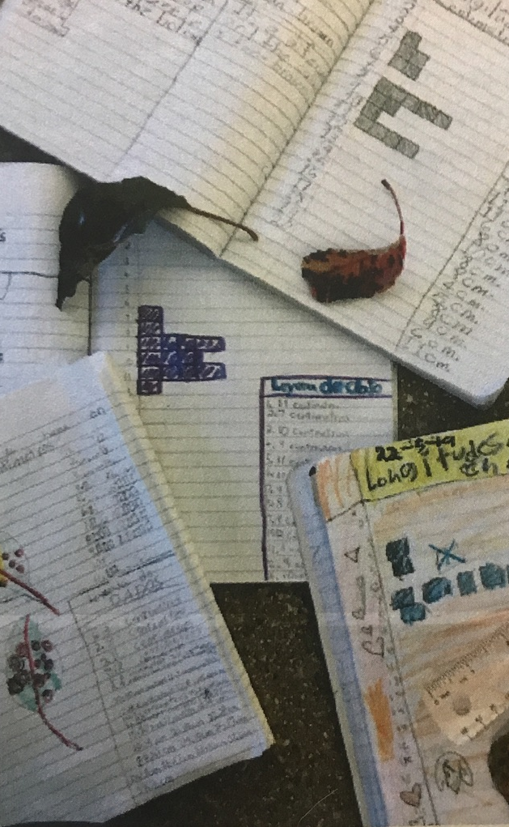
Best Practices
Use numbers to show observations, discover patterns, generate and answer questions.
Use numbers to quantify features of drawings or written descriptions.
Collect samples of data by making more than one measurement, and record sample size when describing variations.
Standardize sampling methods (using the same method each time).
Randomize samples to avoid bias.
Display data using histograms, bar graphs, stem-and-leaf plots, or scatter plots.
Manipulate data by calculating ratios or averages or simplifying fractions.
Use numbers or symbols to create formulas to explain or describe phenomenon.

Slide 3
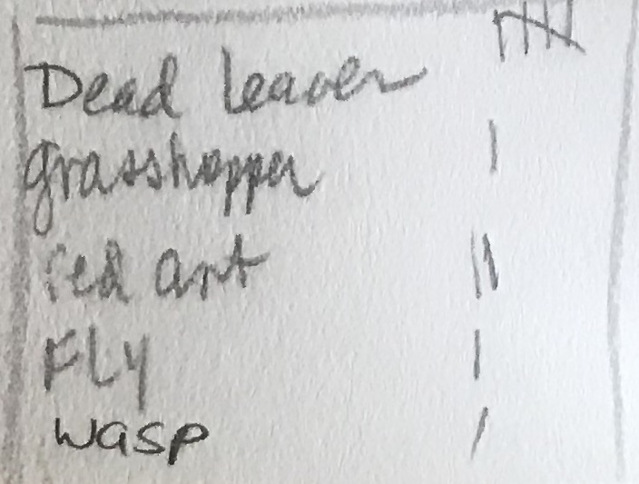
COUNTING
You can count numbers of
individual organisms (ducks, newts, etc.)
Parts of organisms (petals, leaves, etc.)
Count clouds, numbers of rough vs smooth rocks in a part of a stream, repeating landscape features such as ridges on a mountain.
Record the time and location of your data collection.
Quantify were and when:
25 ladybugs on a single branch
25 ladybugs in a single day
25 ladybugs in twenty minutes
Avoid confusion by being explicit.

Slide 4
MEASURING
Recording the exact size of an object
Enables us to compare it to other similar things
Helps us track change over time
Brings a degree of precision to our observations and journaling.
Metric vs Standard
The metric system is the preferred system for scientific investigations.
US “standard” system is anything but standard
There is no consistency among the units of measurement, making calculations confusing:
Inches are divided into sixteenth
There are twelve inches in a foot
Three feed in a yard
1,740 yards in a mile.

Slide 5
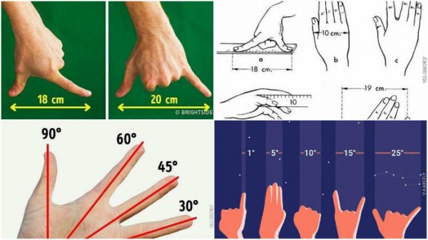
Measuring Tools
Biometrics
Biometrics are body measurements and calculations related to human characteristics.
Stride and paces
Pinky length
Joint to tip of your finger
Shoe size
Arm length
Degrees of Arc
Measure spacing of objects in the sky or on the landscape using our outstretched hands. Make these measurements in terms of the number of degrees of a circle that separate them.
Time on a clock (the tree is located at 2:00 from the rock outcropping.)

Slide 6
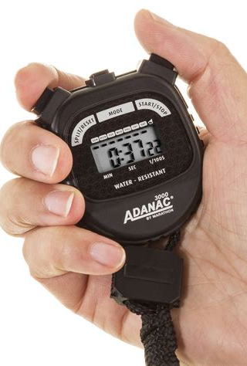
TIMING
Anything that moves or shows a periodic behavior can be timed.
How long a loon stays underwater after it dives or times between dives,
How long it takes for clouds to move past a landmark,
Interval between owl calls,
How far a slug moves in one minute (speed measured by cm/min).

Slide 7
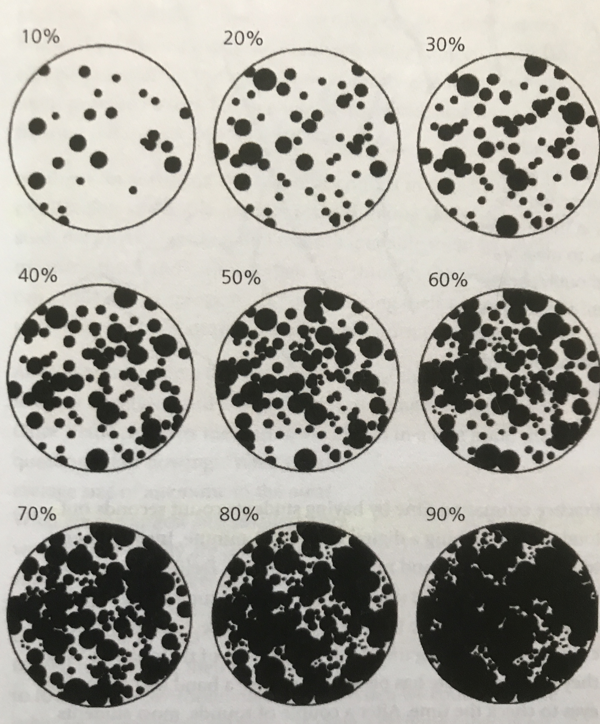
ESTIMATING
You can’t always make an exact measurement or count
Estimate your numbers in chunks (10, 50, 100, 500)
Round your numbers, maintaining a level of precision – not a random guess
If you see approximately 400 geese in one field by counting clusters of 100, then you see 10 more, your answer is “approximately 400,” or “Between 400- and 450.”
Estimating numbers takes practice – start estimating groups, crowds, numbers, whenever you can so you’ll get better at estimating.
Estimate Percent of Cover
How much of the sky is covered in clouds?
How much of the ground is covered in grasses?
Paste some tools into your journal to help you
figure out numbers.

Slide 8
Tools to paste into your journal These will help in making your estimations of number and percentage of cover.
Percent of cover
Estimating large numbers
From https://johnmuirlaws.com/product/naturalist-tools-journal-insert/

Slide 9
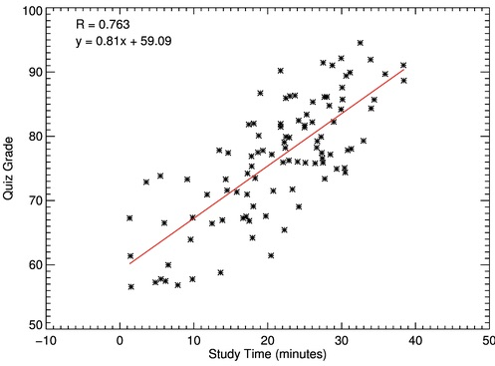
VISUALIZING YOUR DATA Scatter plots, histograms, bar graphs, tally bar charts, tally histograms and stem-and-leaf plots
These are easy ways to collect and display the shape of data.
Scatter plots help you see the relationship between two related variables, where one factor may affect or influence the other.
Example: Time of day and number of birds singing, counted every 10 minutes starting 1 hour before sunrise to 1 hour after sunset.
Here’s a scatter plot showing grades on a quiz
compared to how long students took to complete
it.

Slide 10
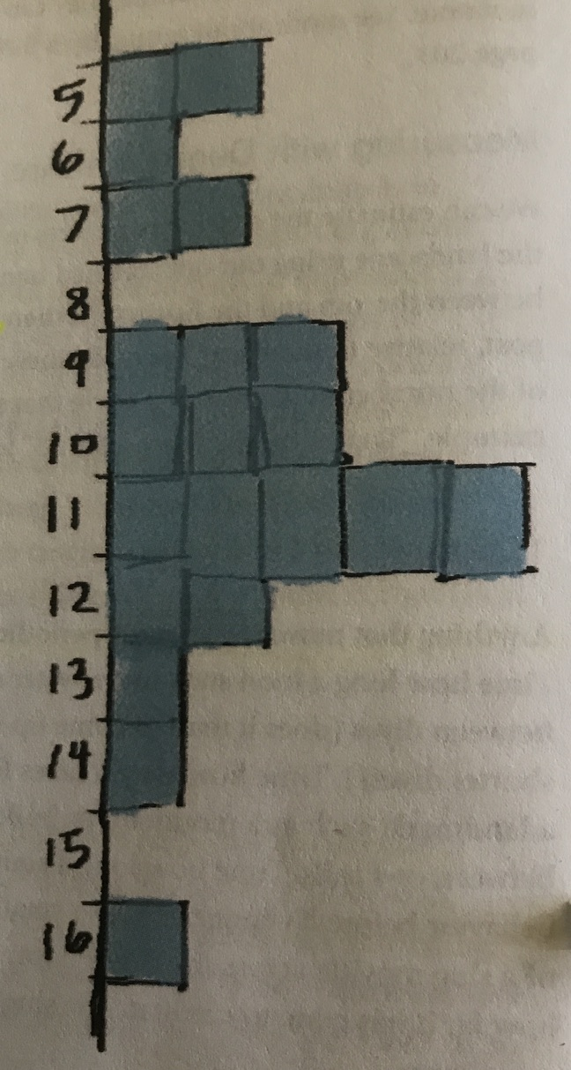
Histograms and Bar Graphs
If you collect measurements, speeds, or any other variable in a data table, you can convert the data to a histogram or bar graph by stacking each observation from the baseline.
Round your numbers, such as to the nearest centimeter.
Create a number line from your lowest value to your highest and stack the observations out from the line.

Slide 11
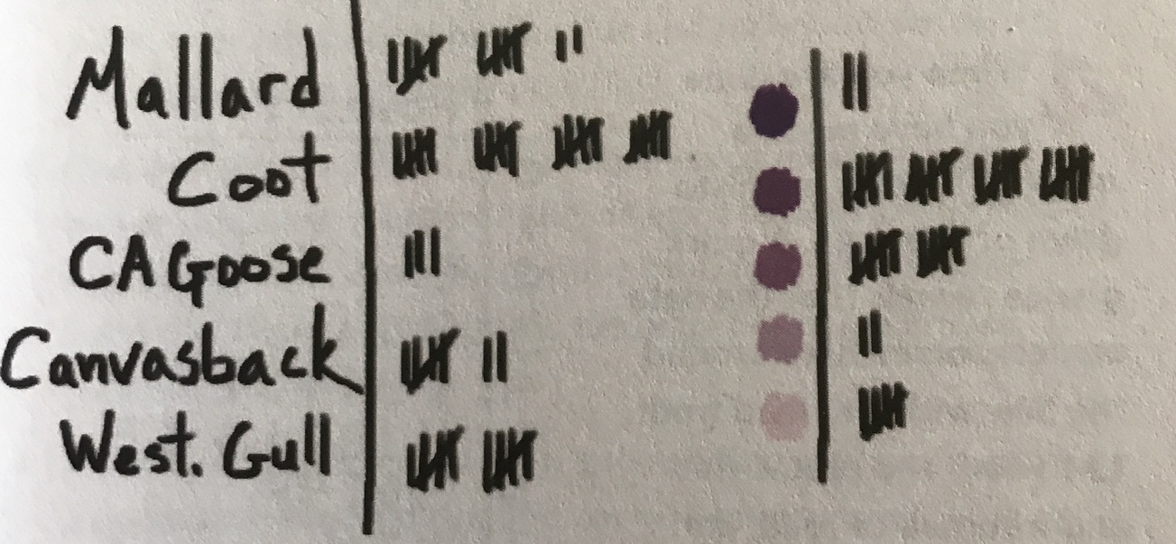
Tally Bar Charts and Tally Histograms
If you’re counting different types of objects, make a vertical list of the objects.
Draw a vertical line down the right side of the list.
As you count, add tally marks to each category
Keep them even distance from one another, aligning each tally mark or group of five vertically.
The result is a set of numbers that also visually shows the spread and any clusters of data.

Slide 12
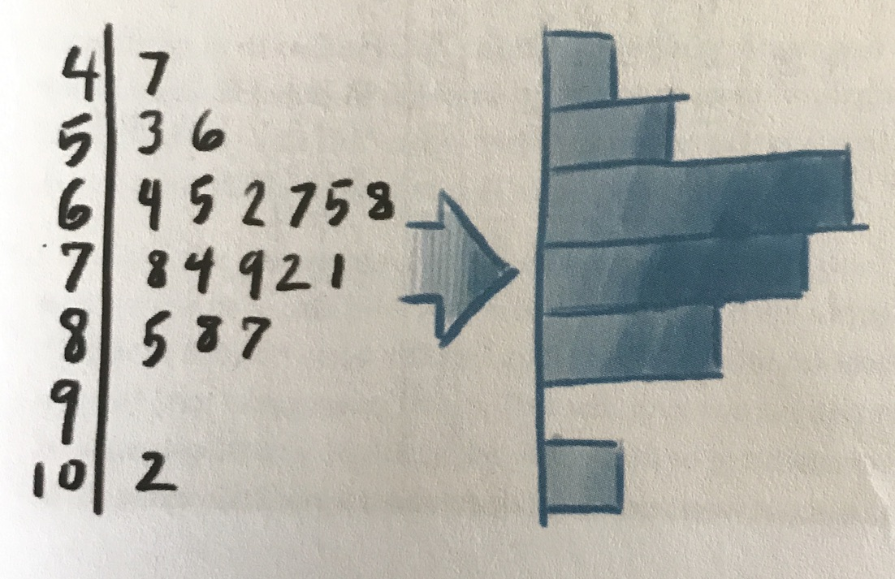
Stem-and-Leaf Plot
Stem-and-Leaf plots preserve original numerical data and visualize it at the same time making them efficient and fast to create.
The length of the data rows automatically form a graph, showing the shape and overall pattern of the data and can easily be converted into a histogram or bar graph.
Draw a vertical line. On the left, write numbers for your tens place (in this example, 4=40, 5=50, 10=100 and so on).
Then write the ones place numbers on the right side of the vertical line. Add to the ones place each time you have data for the same tens place number. Thus, you’ll see a bar graph form as you add data. Example – look at the 6 on the left side (60), notice there’s a 4, 5, 2, 7, 5, and 8 on the right of it. The 4 represents 64, the 5 represents 65, the 2 represents 62, and so on.

Slide 13
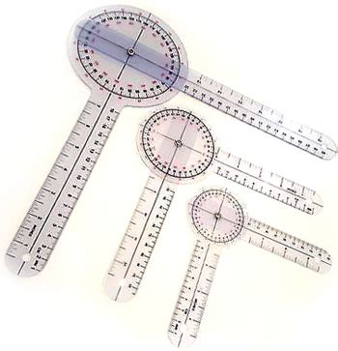
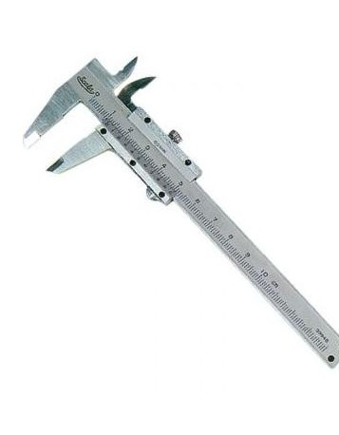
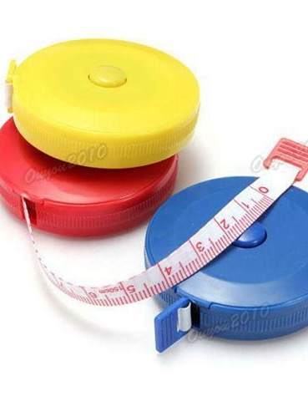
Tools for measuring
There are several interesting and useful measuring tools you can use when you journal.
Short ruler
Retractable measuring tape in centimeters
Goniometer: like a protractor, it measures angles, use it to measure the angle of a slope, leaning tree, branches of a plant…
A watch with a second hand. You can time observations and convert counts to rates such as the number of seconds a slug takes to go 10 centimeters and dividing to get cm/second. (An app on your smart phone works very well.)
Vernier calipers: This tool is used for more accurate measurements of small objects and small diameters.

Slide 14
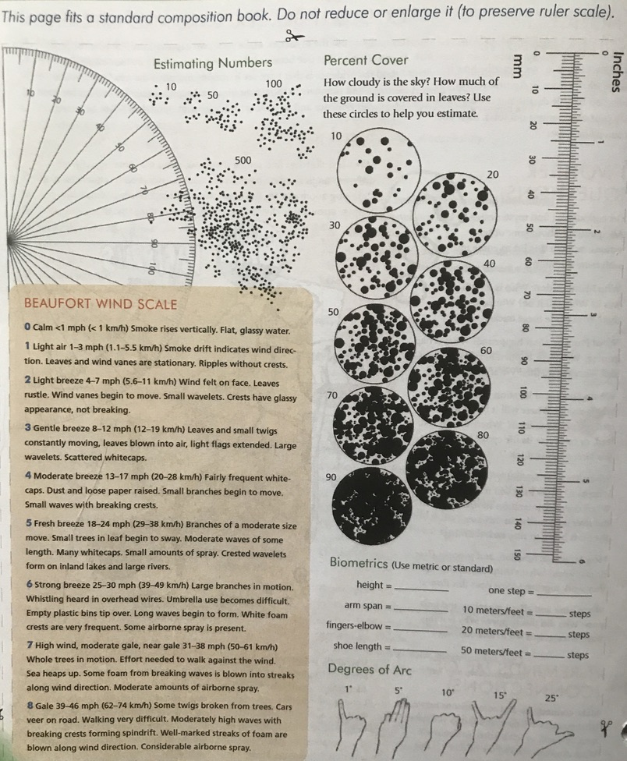
John Muir Laws’ Quantification Tool Kit
This fits an 8 ½ x 11 journal. Paste it into the journal. Don’t reduce the size, as there’s a ruler that won’t be accurate if you change the size of the paper.
If your journal is smaller, fold it and paste half to the back of the journal. Unfold it as needed.
You can find this and other tools at
https://johnmuirlaws.com/store/

Slide 15
Have Fun with Measuring and Quantification
Measuring and quantification add more scientific accuracy to your journal pages.
Lots of fun questions will arise when you measure.
Thanks for joining me. See you next time for more measuring activities!

