Slide 1
Lesson 17 BIODIVERSITY INVENTORY
In this quantification activity, you will record the diversity of plant species in TWO study areas, (compare and contrast) and use graphs to describe and analyze the data you collect.
Many scientists calculate species richness (the number of different species in an area) and species evenness (the relative numbers of individuals of those species).
They analyze these values by creating graphs and using algebra and logarithms.
You will explore patterns and ideas by using math to describe the study areas.

Slide 2
What you will do
Find two natural areas with a diversity of trees, shrubs, and herbs
Make the two study areas the same size and spend the same amount of time collecting in each.
The size of your study areas should depend on the density of plants.
If the area is not very diverse, make the study area larger so you can work with a bigger range of species.
If there are a lot of species, make the area smaller so that you aren’t overwhelmed.
This activity will take about three days.
Plan to observe on two different days.
Take a third day to create your graphs and plots.

Slide 3
Procedure Summary
Make a biodiversity inventory of the species in the area.
Record some simple drawings and text for each species so you remember it. You don’t need to know the names of each species.
Count the numbers of each species within each study area. Use tally marks in your journal.
Create graphs and plots to help you analyze the species richness and evenness for each plot you survey.

Slide 4
Procedure Step-by-Step
Take about thirty to forty minutes for each study area to record every kind of tree and shrub in your selected study zone and the number of each species.
Record each species through drawing, words and measurements in your journal
A quick sketch will be helpful to capture just enough information so you an identify the plant later.
Record important details such as leaf shape, any fruits or flowers, and the form of the plant growth.
A fast way to capture information is to trace the leaf, then draw in the veins.
Using tally marks, record the numbers of each species in your journal next to each sketch. If there are too many of a species, use an approximation.
Set up the boundaries of your survey area before you start.

Slide 5
Consider these questions while journaling
Stability and Change:
Ecologists have found that ecosystems with more diversity tend to be more stable. Why might this be the case? Do you consider your study sites more or less stable?
Which of the two systems you studied might change the most over the next five years? Why? What would cause the changes.
Compare/Contrast:
What are some of the similarities and differences between the two study areas?
What are some explanations for those differences?
This Photo by Unknown Author is licensed under CC BY-SA

Slide 6
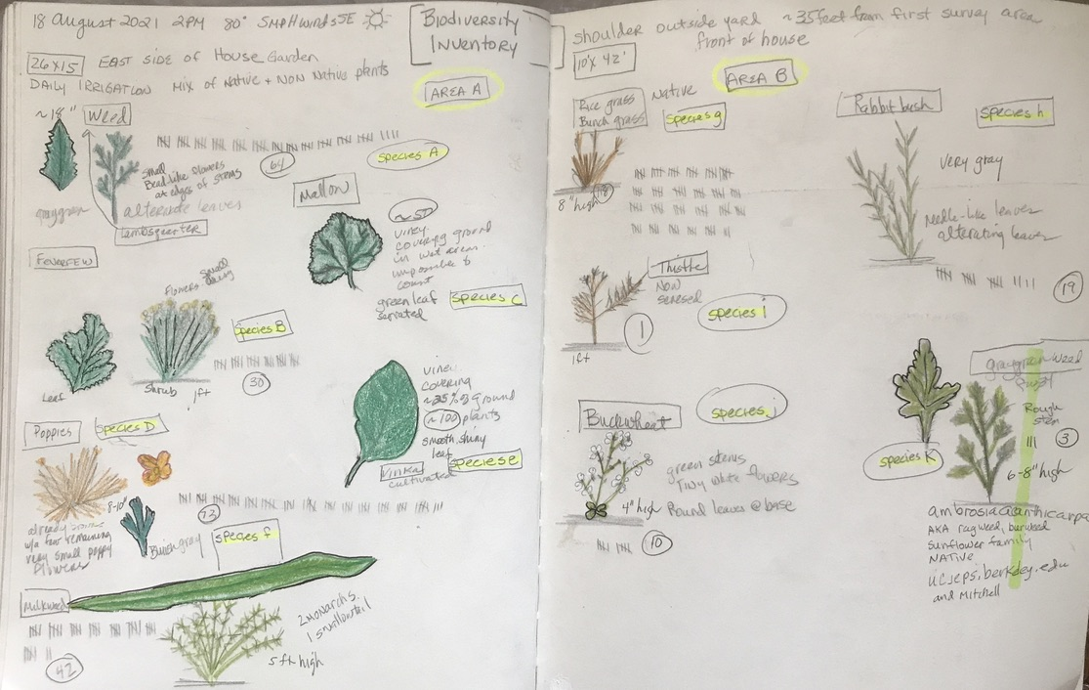
Metadata
Identify the study area and its approximate size.
Use two pages. First page is for Study area A, second page is for Study area B.
Trace the leaves and provide a description, including height, width, whatever helps you to identify it later.
Using tally marks, count the number of each plant in your study area.
Label each plant in your study area using letters. You don’t need to know the name of each plant.

Slide 7
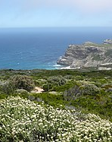
Species Richness and Evenness
The number of different species you find in an area is species richness.
We made a species richness inventory when we recorded the different plants in this area.
In your journal, write “Species Richness” at the bottom of the page with the number of different species you found.
When you made tally marks next to each species, you were collecting species evenness or abundance data.
Count up the number of tally marks you recorded for each and every species in each of your study areas. At the bottom of each study area page, write that total number of all the species you studied.
Once you have collected your evenness and richness data, it’s time to go back indoors and start organizing that data so you can analyze it.

Slide 8
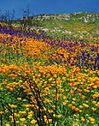
Diversity Richness and Evenness Analysis
Give each species a letter code, starting with A, B, C, and so on.
Now let’s use your diversity data to make a bar graph.
On the horizontal (x) axis, list all the species you found by their letter code, starting with the plant with the most abundance.
On the vertical (y) axis, make a scale that goes as high as the species that was most abundant. You may count by 5’s or 10’s, etc. to cover the most abundant species.
Draw bars to show the number of individual plants you observed for each species.

Slide 9
Notice at the top of each bar, the percentage of abundance is calculated. This is done very simply by dividing the total number of plants of each species by the total number of plants altogether.
In this case, there were 510 plants in total.
Example: Plant G=120 plants.
120 / 510 = .23 = 23%
We’ll create a chart in the next slide that will include the percentages so you’ll be able to add them to your bar graph.
In this example, the graph was created in the order of abundance. Therefore, you’ll see the letters on the X axis appear randomly, rather than in sequential order.

Slide 10
Making a Rank/Abundance chart
Label your study areas A and B. Make a chart for each of your study areas.
In the first column, list your species by letter as you identified them in your journal.
In column 2, write the total number you counted for each species.
In column 3 let’s do the math. Divide the total number of each species by the total number of plants you counted altogether (smaller number divided by the larger number). In this example, there were a total of 359 plants counted altogether. Therefore, Sample A had 64 plants:
64 / 359 = .178. I’m rounding to the hundreds place, so the total will be 18 %.
In column 4, rank the abundance of each plant in each Area. (The highest number is ranked #1.)
Because I identified each plant, I added that information and also whether or not the plant was native. This gave me some additional information that I found interesting. But you don’t have to identify the plants.

Slide 11
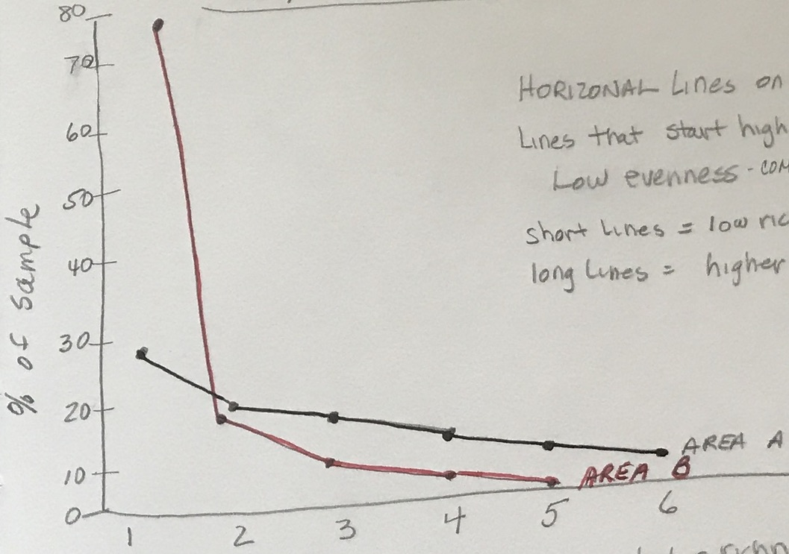
Rank/Abundance Curve
Now we’re going to create a line graph that will help us easily see the abundance of the species in each study area.
Label your X axis “Ranking in Abundance” and number it to the total highest number of species you studied. In my sample, my Area A had 6 species so I numbered the X Axis up to 6
Label your Y axis “Percentage of Sample” and number that up to the highest percentage of the most abundant species. In my sample the most abundant plant in Area B was 78%, so I labeled my X Axis up to 80% counting by 10. (10, 20, 30…)
Now plot the percentages by rank for Area A. Then connect the lines.
Next, plot the percentages for Area B. Then connect those lines using a different color. Label the lines ”Area A” and “Area B.”

Slide 12
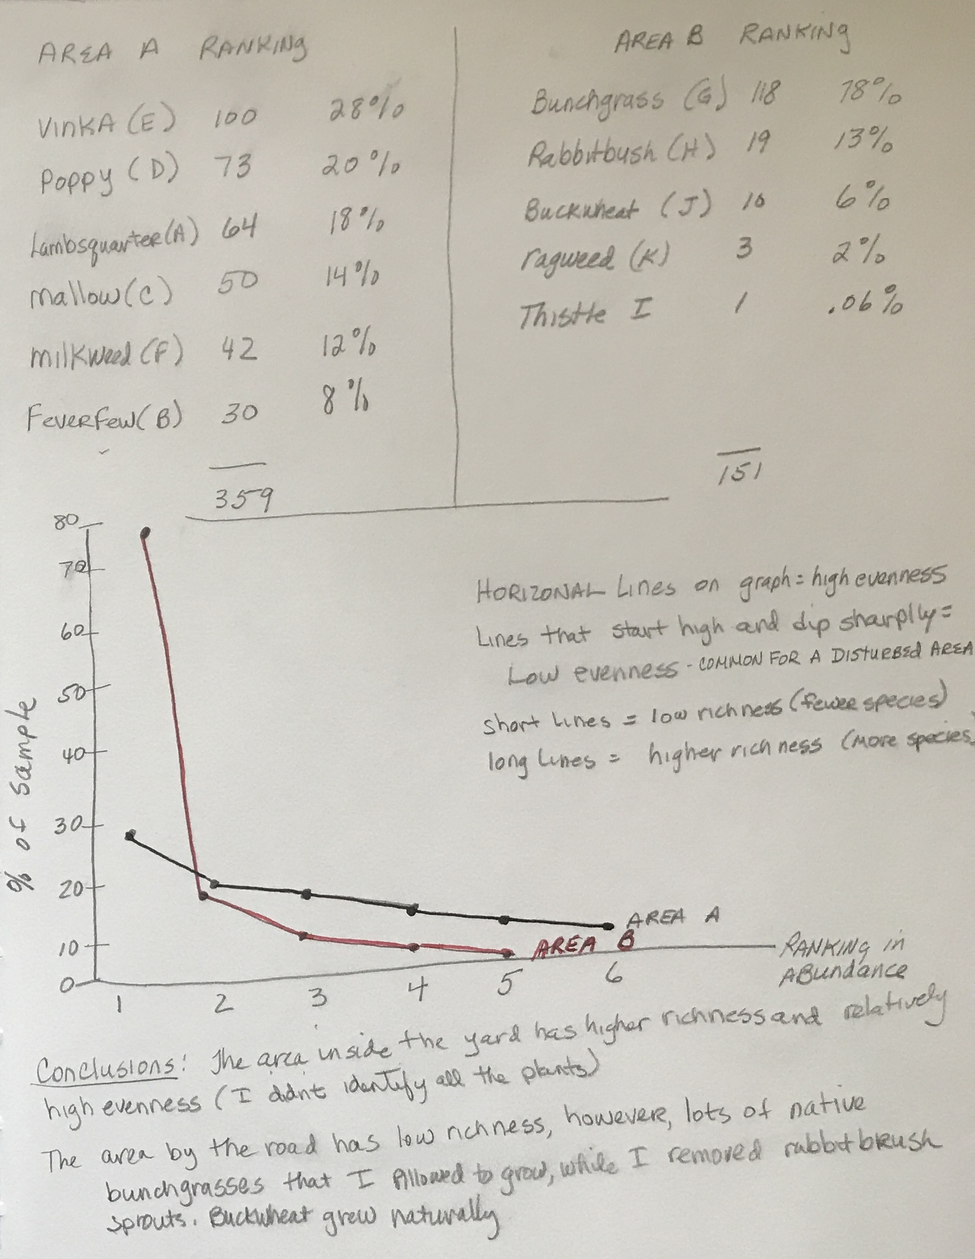
I made a chart of the data at the top to make creating the graph easier.
Y Axis shows the percentage in 10’s.
Area A is plotted in black ink and labeled Area A.
X Axis is numbered 1-6, identifying the ranking of each of the 6 plants in Area A.
Definitions and explanations, so I understand what the lines indicate.
Area B is plotted in red ink and labeled Area B.
Study your graph and think about some conclusions you can make.

Slide 13
Drawing conclusions
Now that you have created all your charts and graphs, take a look at the results and make some conclusions.
On your line graph, a horizontal line shows high evenness (similar numbers of each species). A vertical line shows low evenness (different numbers of each species).
In this case, Area A is relatively even in number for each species. However, area B, shows a very high number of bunch grass and the other numbers are pretty low. Therefore, there is very low evenness in Area B. This is common for an area that is often disturbed, and in this case, it’s the side of the road, so it is frequently disturbed.
Write some conclusions you can make based on your graphs.
One thing I discovered by making the ranking chart: even though Area B is highly disturbed compared to Area A, there are more native plants there than Area A, which has a higher number of non-native plants.

Slide 14
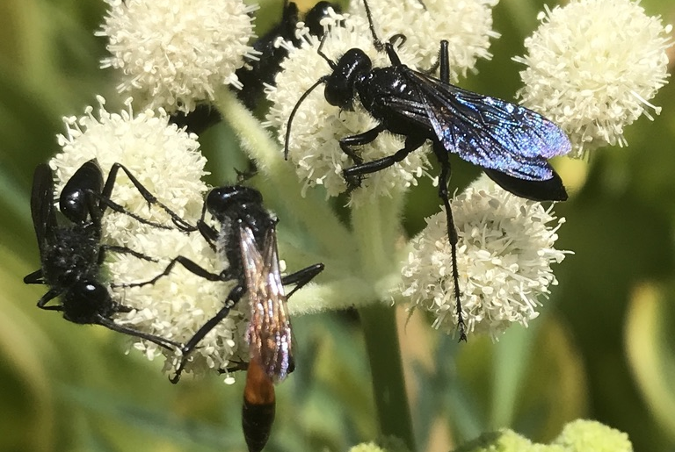
Bye for now. Thanks for joining me.

