Slide 1
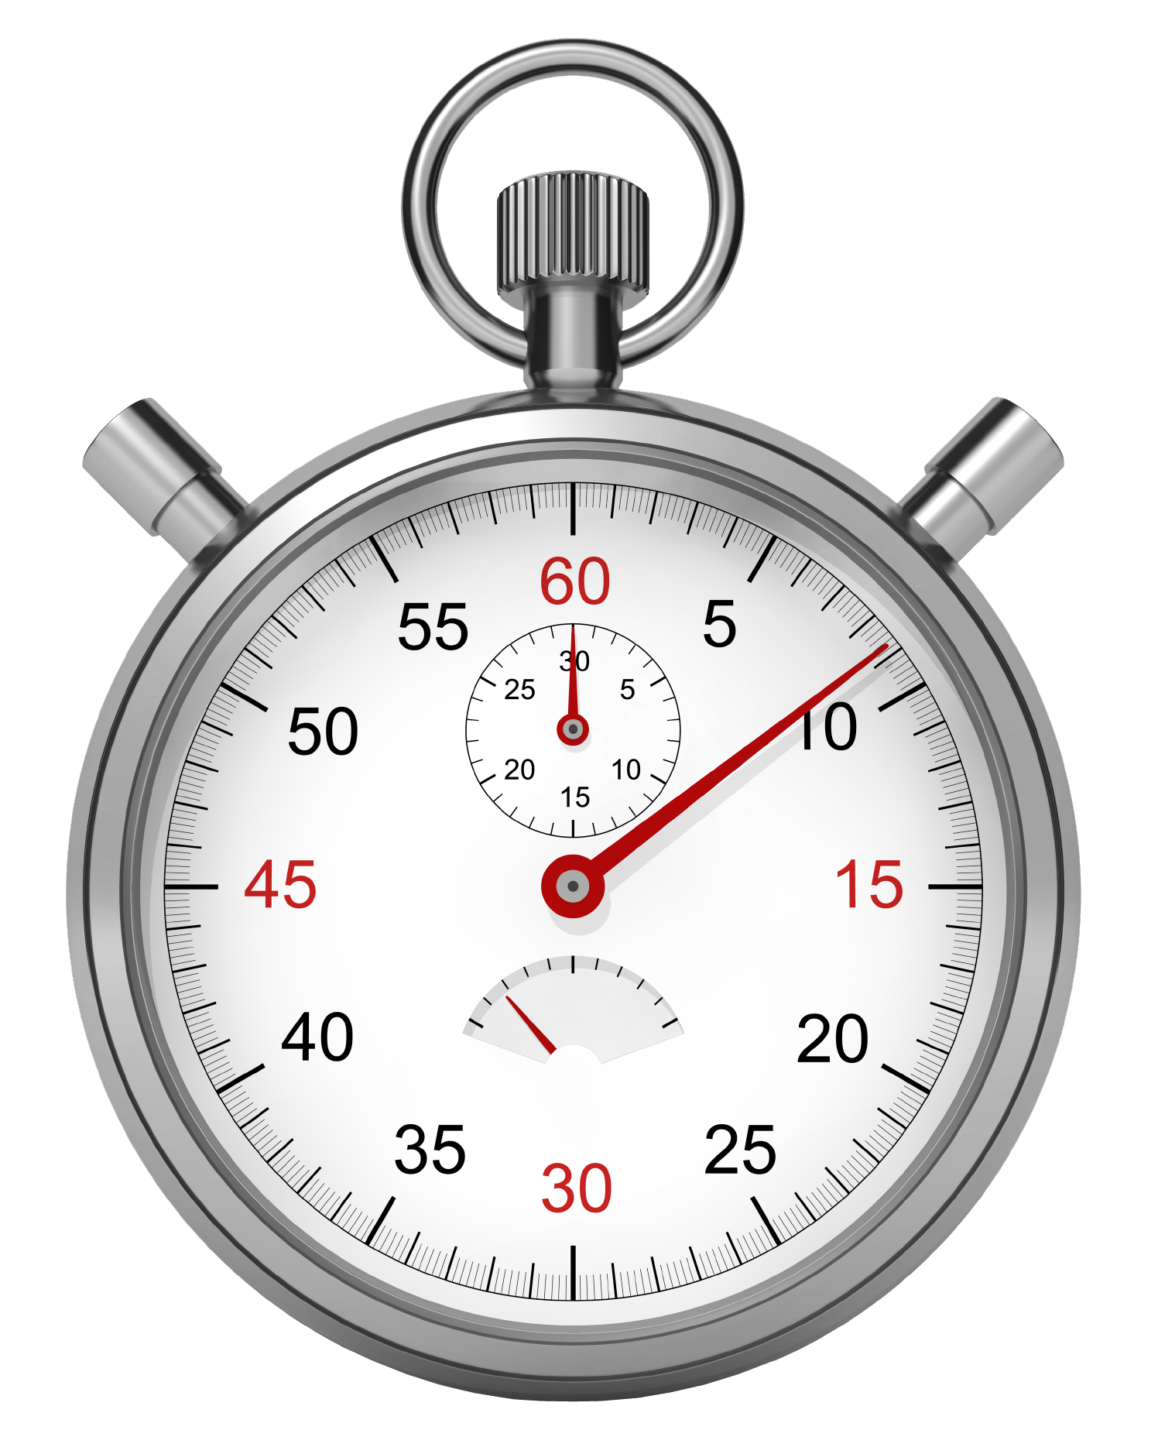
Lesson 18 Timed Observations
Observe the behavior of a group of animals and use a sample protocol to quantify what you see.

Slide 2
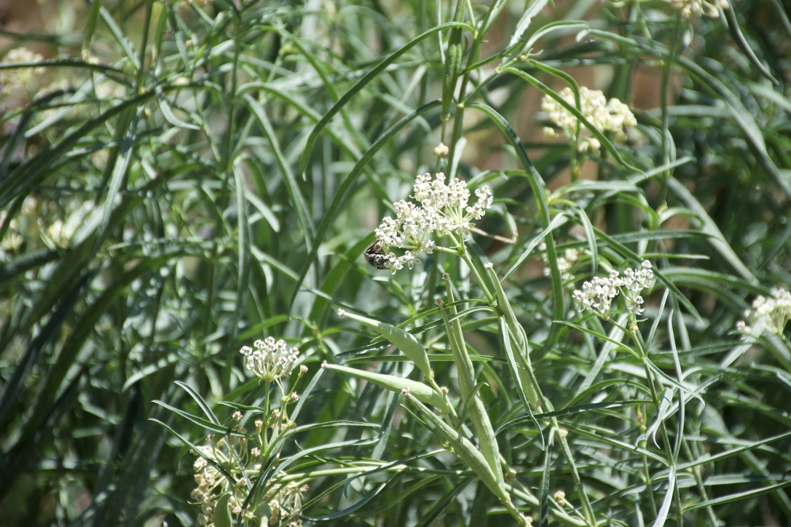
Numbers are another way of visualizing and modeling things we observe.
Conducting timed behavioral observations of animals is a way of using numbers to help learn about an organism.
This turns general observations into more precise data that can be used for deeper analysis and understanding of the animal.
Quantitative data on animals’ behavior offers a window into patterns that we otherwise might not be able to see.

Slide 3
Natural Phenomena
Find a group of animals that can be easily observed.
This could be a flock of birds, ground squirrels, deer, lizards or other cooperative species
Animals that exhibit repeated behavior and are less likely to run away, hide, or fly off are ideal.
Try to find animals that are not so far off you need binoculars, or so close they will be disturbed by your presence.

Slide 4
Procedure Summary
Record the behaviors of five different individuals every 20 seconds.
At every 20-second mark, make a tally next to each type of behavior you observe.
Graph the data.

Slide 5
Procedure Step-by-Step
Observe the animal species for five minutes.
Make a list of the kinds of behaviors you see.
Be sure you focus on making observations, not trying to explain behaviors.(4-10 categories)
Create categories in your journal of the behaviors you observed.
Now look at twenty second intervals and tally the behaviors you see.
If you’re doing this with others, create three jobs:
an observer, a recorder, and a timekeeper.
Observe and record for 10-15 minutes.

Slide 6
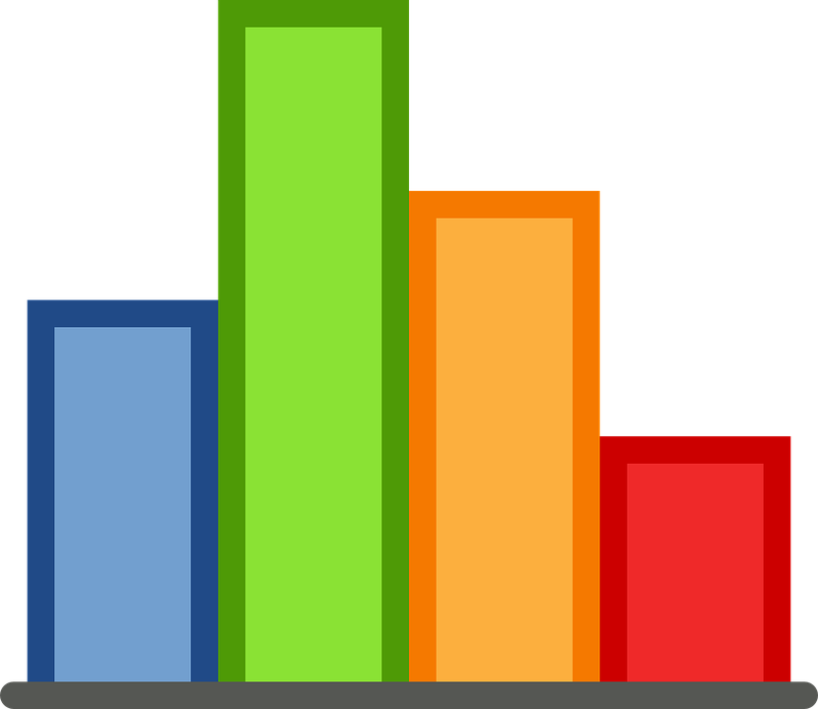
Graph your data
Make columns for each behavior on the x-axis and the frequency of each behavior on the y-axis.
Figure out how high the longest bar will go first, to make sure you have enough room for your graphs
. Then mark the units of measurements on the horizontal (x) axis.

Slide 7
EXAMPLE In this journal entry we study the behaviors of Monarch butterflies among milkweed flowers.

Slide 8
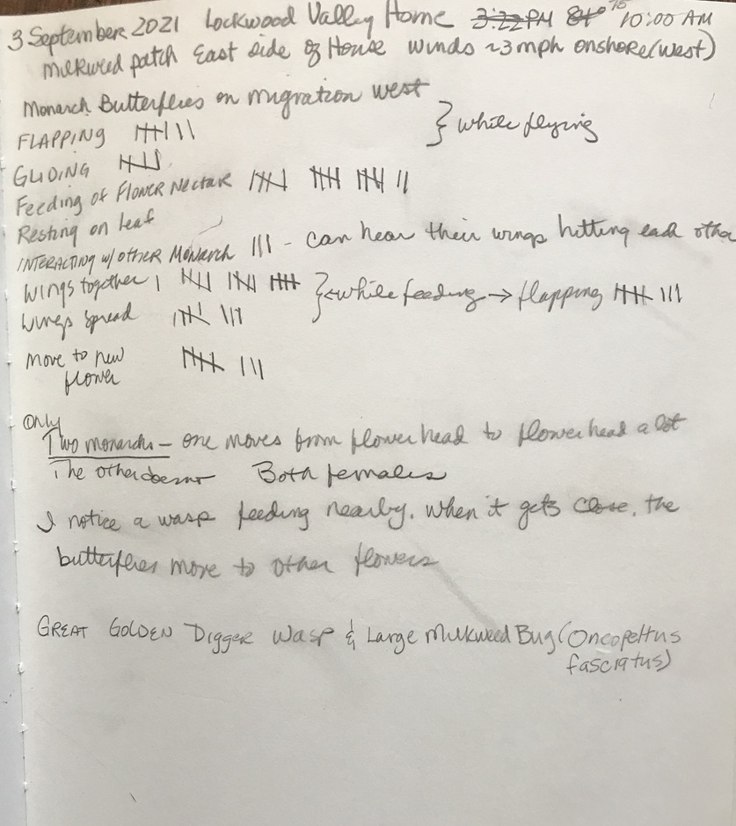
Gathering the Data
Using one journal page, we head it with our metadata.
After observing behaviors for five minutes, we write them down.
Next, we start timing 20 second intervals, watching for behaviors during that time.
After each 20 second period, we use tally marks to indicate how many times we observed the behaviors.
We do this for 15 minutes.

Slide 9
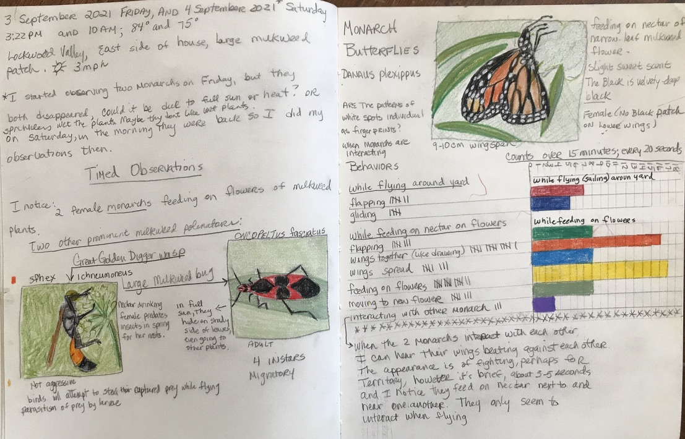
Next Journal Page
Once we have gathered the data, it’s time to create our journal page.
Going to the next page in your journal, include the
ABC’s
123’s
Drawing, sketch or diagram
Part of your 123’s will be the data you collected. We copied the data we collected onto the new page, then created a bar graph to create a visual of the data.

Slide 10
In this example, the graph was created directly across from the recorded behaviors and tally marks.

Slide 11
Metadata
ABC’s
Drawing
123’s

Slide 12
BYE FOR NOW, THANKS FOR JOINING ME

