Slide 1
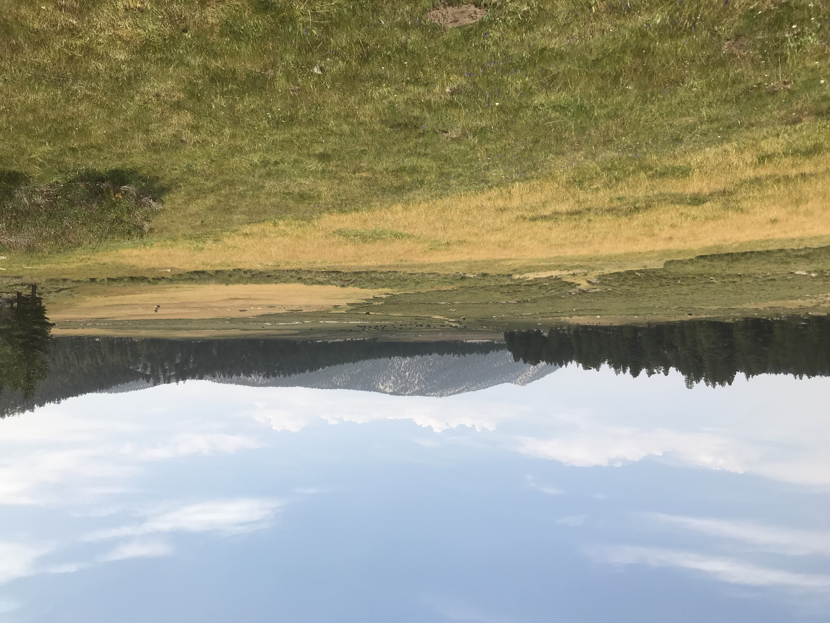
Lesson 7 Part 2 String Safari
Making a System Model

Slide 2
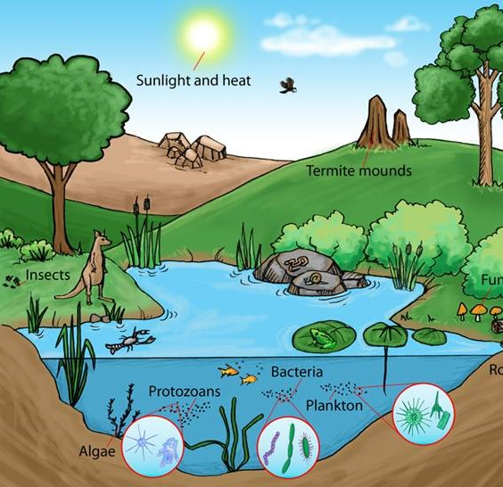
Systems
A system is a group of related parts that work together.
Parts of the system interact and affect each other.
A system can be any size, from the digestive system contained in one small organism, to a small pond, to an entire forest, to climate systems that encompass the entire earth.
You can think of parts of nature, such as a tree, as a system. Parts of a tree interact with and impact each other.

Slide 3
What is an ECOSYSTEM?
An ecosystem is a geographic area where plants, animals, and other organisms, as well as weather and landscape, work together to form a bubble of life.
Ecosystems contain biotic factors or living parts, as well as abiotic factors, or nonliving parts.
Biotic factors include plants, animals, bacteria and other organisms.
Abiotic factors are non-living parts of an ecosystem. They might include temperature, light, and water, salinity and ocean currents, soil, rocks, air, climate.
Abiotic and biotic factors work together to create a unique ecosystem.

Slide 4
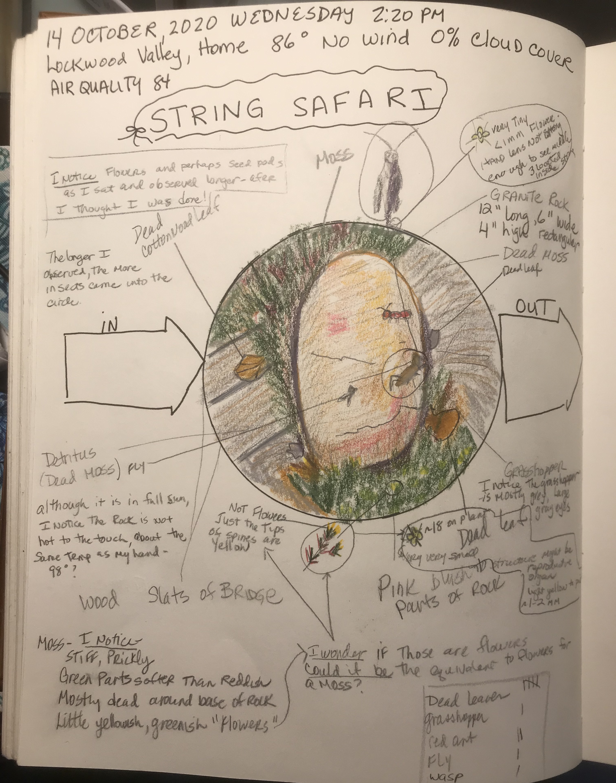
Here is an example of the previous lesson’s journal page.
We drew two arrows.
One points into the circle and is labeled “IN.”
One points out of the circle and is labeled “OUT.”

Slide 5
Our “Tiny World” as a System
To practice thinking about things as a system, we are making these loops of string the boundaries of our systems.
Draw a dotted line around all the things on your page to represent the boundary of this system. (The circle, plus your detailed close ups.)
Think about the parts of the system in your loop of string and in what ways those parts interact with each other.
Draw arrows between elements in the system that you think interact with each other. Label the arrows with a brief description of the interaction it represents.

Slide 6
Draw a dotted line around all the things on your page to represent the boundary of this system. (The circle, plus your detailed close ups.)
Draw arrows between elements in the system that you think interact with each other. Label the arrows with a brief description of the interaction it represents.

Slide 7
INPUTS
Think about the forces outside the loop of string that interact with the system and how those forces affect the system. These are things you cannot see, the things that may have happened in the past but that you don’t see going on now.
List three or four forces that are outside the loop in your arrow box pointing into the circle.

Slide 8
OUTPUTS
What are some things that leave the loop of string? Does your system create or produce anything? (Think about things you can and cannot see.)
These are called OUTPUTS
Write down three or four outputs inside the arrow pointed away from the circle.

Slide 9
Inputs and Output listed inside arrows.

Slide 10
REFLECTION QUESTIONS MAKING PREDICTIONS
Any part of a system with lots of arrows pointing to it (INPUT) interacts with many other parts of the system. Any changes in that one part of the system can greatly affect everything else.
Use the following questions to hypothesize about what would happen if changes occurred.
Answer each question in Question/Answer form.
Then write your answers into a paragraph. Remember to write a topic sentence and closing sentence to complete the paragraph.

Slide 11
Changes to a System Model
What might happen to the parts of the system if the inputs, such as water, increased or decreased in quantity?
How might those changes, in turn affect the outputs of the system?
If you changed the boundary of your system, either larger or smaller, how would the inputs and outputs change?

Slide 12
Bye for Now Thanks for Joining Me.

