Slide 1
BUILDING NEW SKILLS: BASIC DRAWING EXERCISES
Although these seven exercises are introduced in one presentation, practice each one as a separate lesson.

Slide 2
Practice will develop your drawing skills
Think of the following exercises as warm-ups and drills.
Just as you get better at basketball with practice and repetition of basic skills, so too with drawing.
The more you practice making marks, the more you will naturally understand what your hand and pencil can do.

Slide 3
Lesson 1: Building Eye-Hand Coordination
Training your fingers to do what you see in your mind is one foundation of drawing.
The more pencil miles you put in, the more you train your fingers to respond to what you see.
We can practice drawing simple shapes (triangles, circles, squares), learning to fill areas with a solid or graded tone, and making light to bold lines.
These are important parts of every artist’s repertoire.

Slide 4
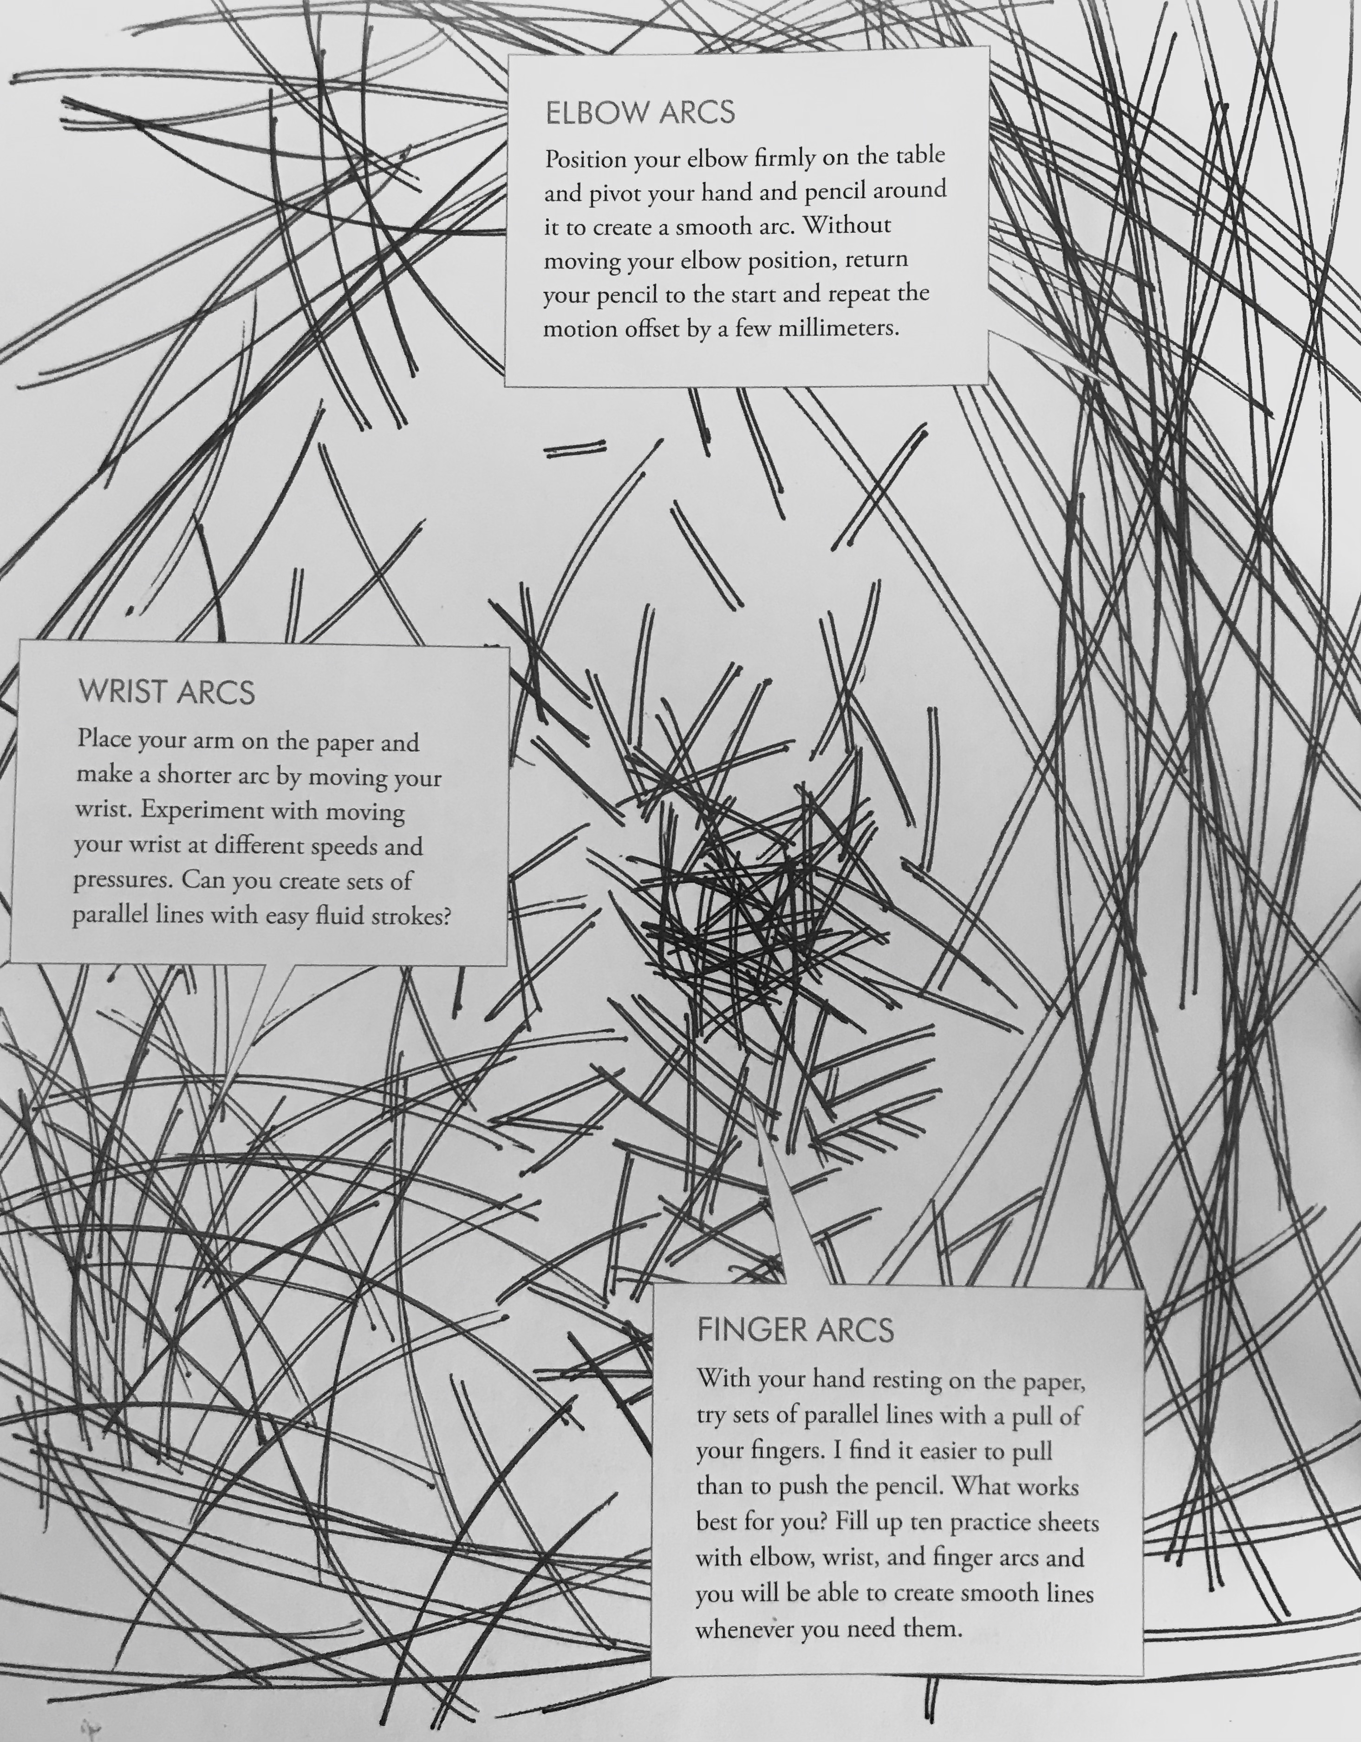
Elbow Arcs
Position your elbow firmly on the table and pivot your hand and pencil around it to create a smooth arc.
Without moving your elbow position, return your pencil to the start and repeat the motion offset by a few millimeters.

Slide 5
Wrist Arcs
Place your arm on the paper and make a shorter arc by moving your wrist.
Experiment with moving your wrist at different speeds and pressures.
Practice until you can create sets of parallel lines with easy fluid strokes.

Slide 6
Finger Arcs
With your hand resting on the paper, try sets of parallel lines with a pull of your fingers.
It is easier to pull than to push the pencil.

Slide 7
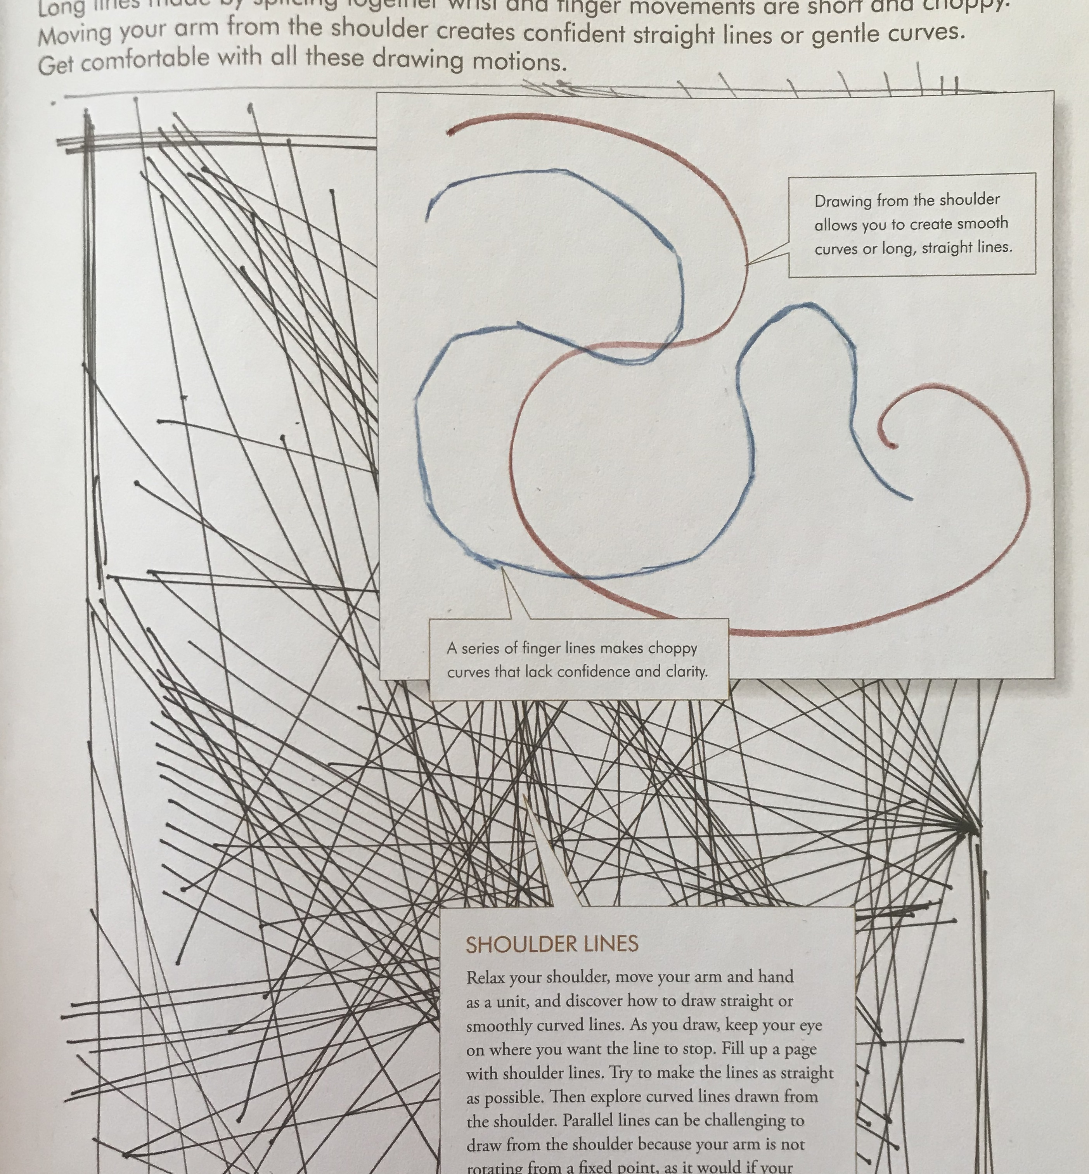
Shoulder Lines
Relax your shoulder, move your arm and hand as a unit and you will be able to draw straight or smoothly curved lines.
As you draw, keep your eye on where you want the line to stop.
Try to make the lines as straight as possible
Then create a variety of curved lines drawn from the shoulder.
Parallel lines can be challenging to draw from the shoulder because your arm is not rotating from a fixed point as it would if your elbow were locked on the paper.

Slide 8
Practice #1 Line Exercises
On two facing journal pages, practice making elbow arcs, wrist arcs, finger arcs and shoulder lines.

Slide 9
Practice #2 Drawing Geometrical Patterns Step 1
Doodling is great practice. Fill a page with random geometrical patterns.
Make some lines dark, others light, some thick, some thin. Make variable lines. Make circles, squares, triangles, long straight lines, smooth curves and elbow and finger arcs.
*Practice drawing these shapes focusing on moving only your shoulder, only your elbow, only your wrist, only your finger, as you did in Practice #1.
When you have drawn all your lines and shapes, go back and label them as finger, wrist, elbow, and shoulder drawings. Make sure you have LOTS of each.

Slide 10
Practice 2, Drawing Geometrical Patterns
Step 1
Draw geometrical shapes
Light and dark lines
Thick and thin lines
Circles, squares, triangles
Long straight lines, smooth curves
Elbow and finger arcs
Label finger, wrist, elbow, and shoulder lines.
Make sure you have LOTS of each kind.

Slide 11
Practice #2 Drawing Geometrical Patterns
Step 2
Fill in spaces with tone, grading and texture. Fill in some of the spaces with even, continuous tone, or a smooth graded tone going from rich dark to as light a value as you can make.
Fill boxes with hatched lines and cross hatching.
Invent textures: A hairy surface, a bumpy surface, a pitted surface, a pebbled surface, dry cracks.
Use only one color but vary the texture and pressure to create color and tone.
With this training, you will be able to draw straight lines, smooth curves, and sets of parallel lines, which are great for plant stems.

Slide 12
Practice #2, Step 1
Practice #2, Step 2

Slide 13
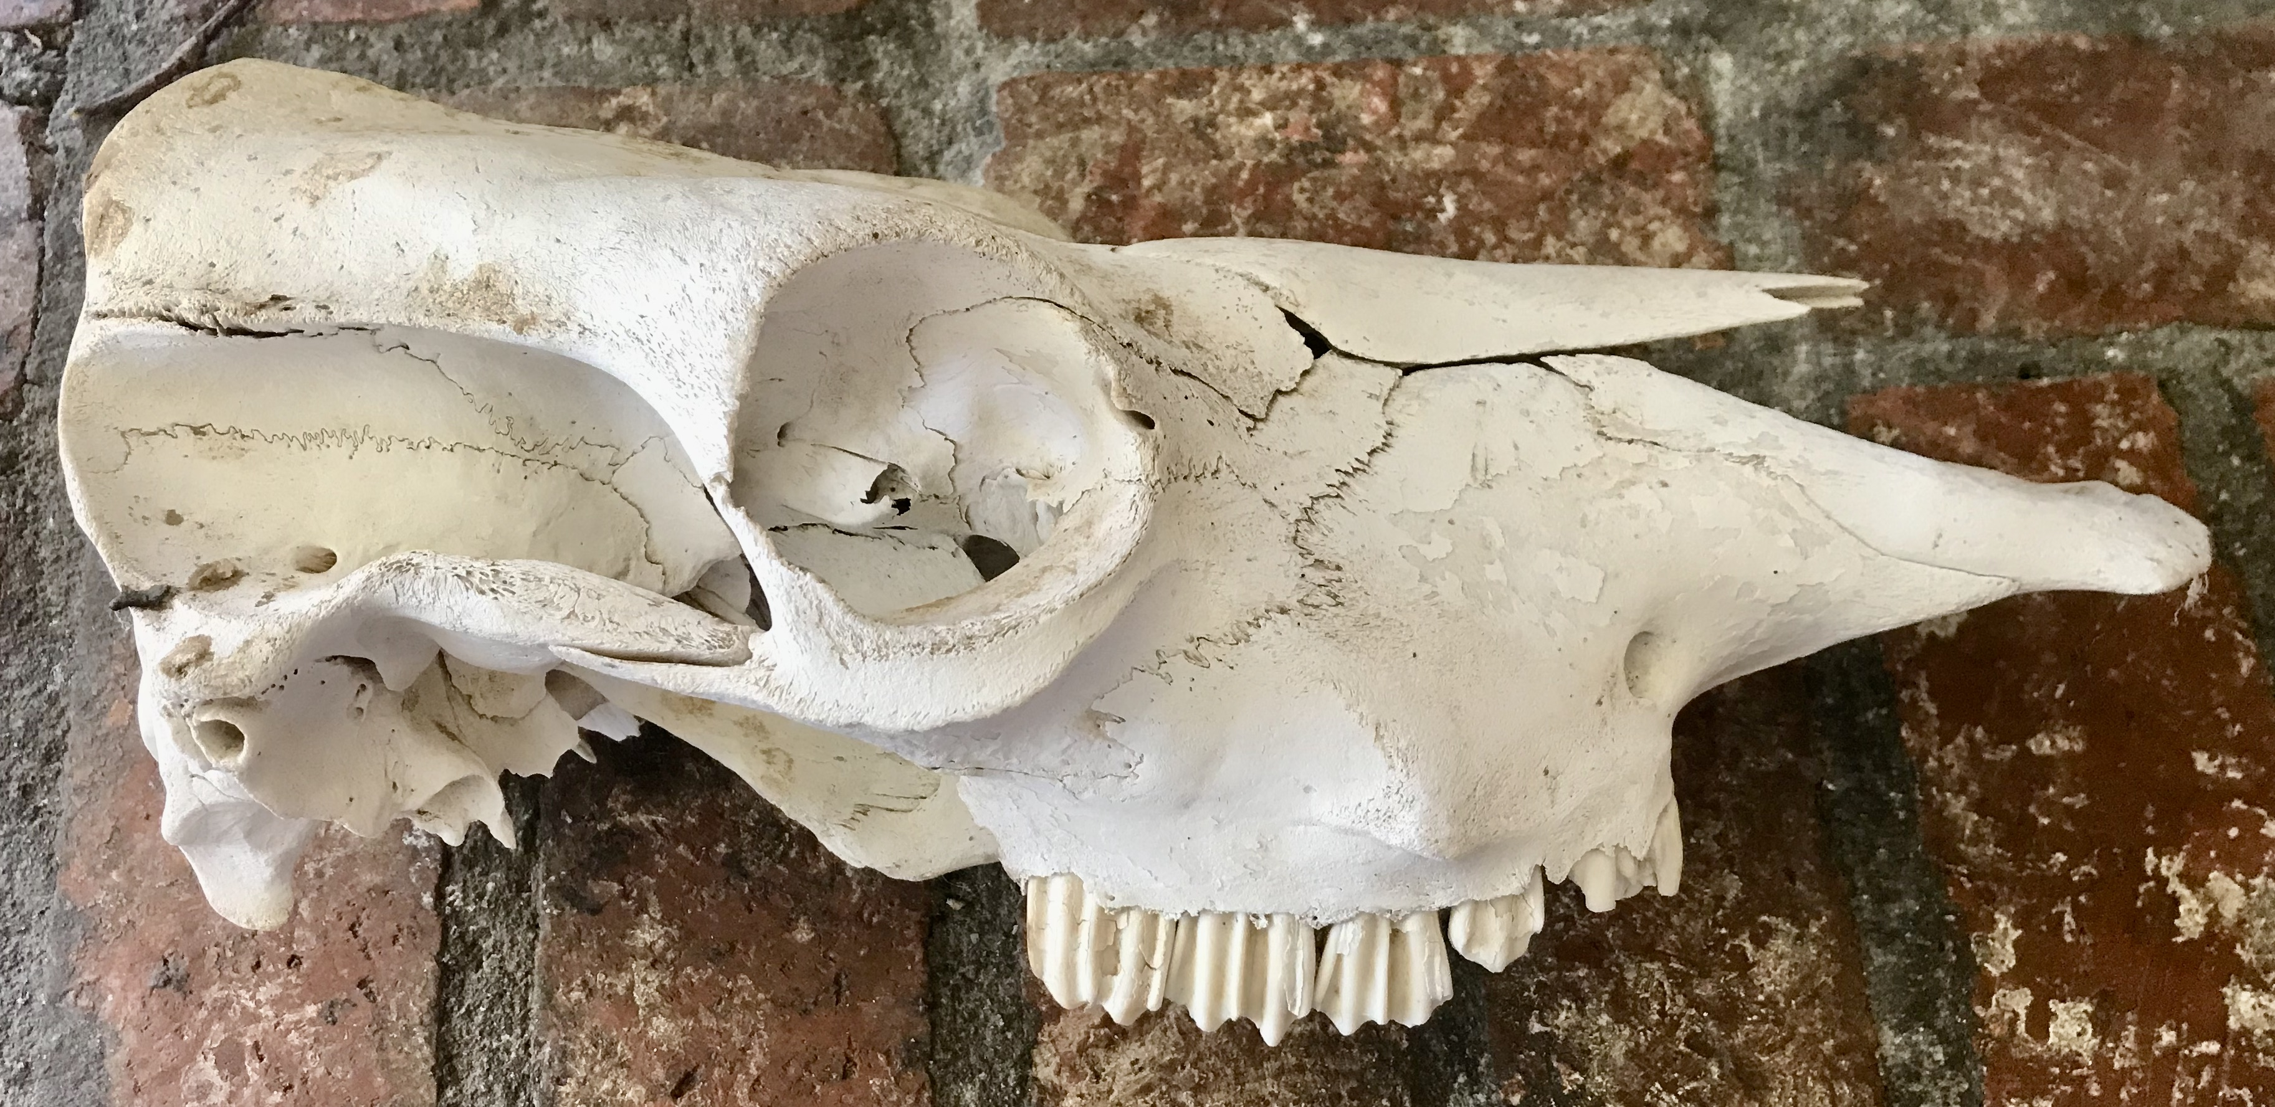
Practice 3: Finger Tracing and Air Drawing
Before you can draw the object, you must train your eye to see angles and changes of contour. The goal is to draw the shape that is in front of you, not the one in your imagination.

Slide 14
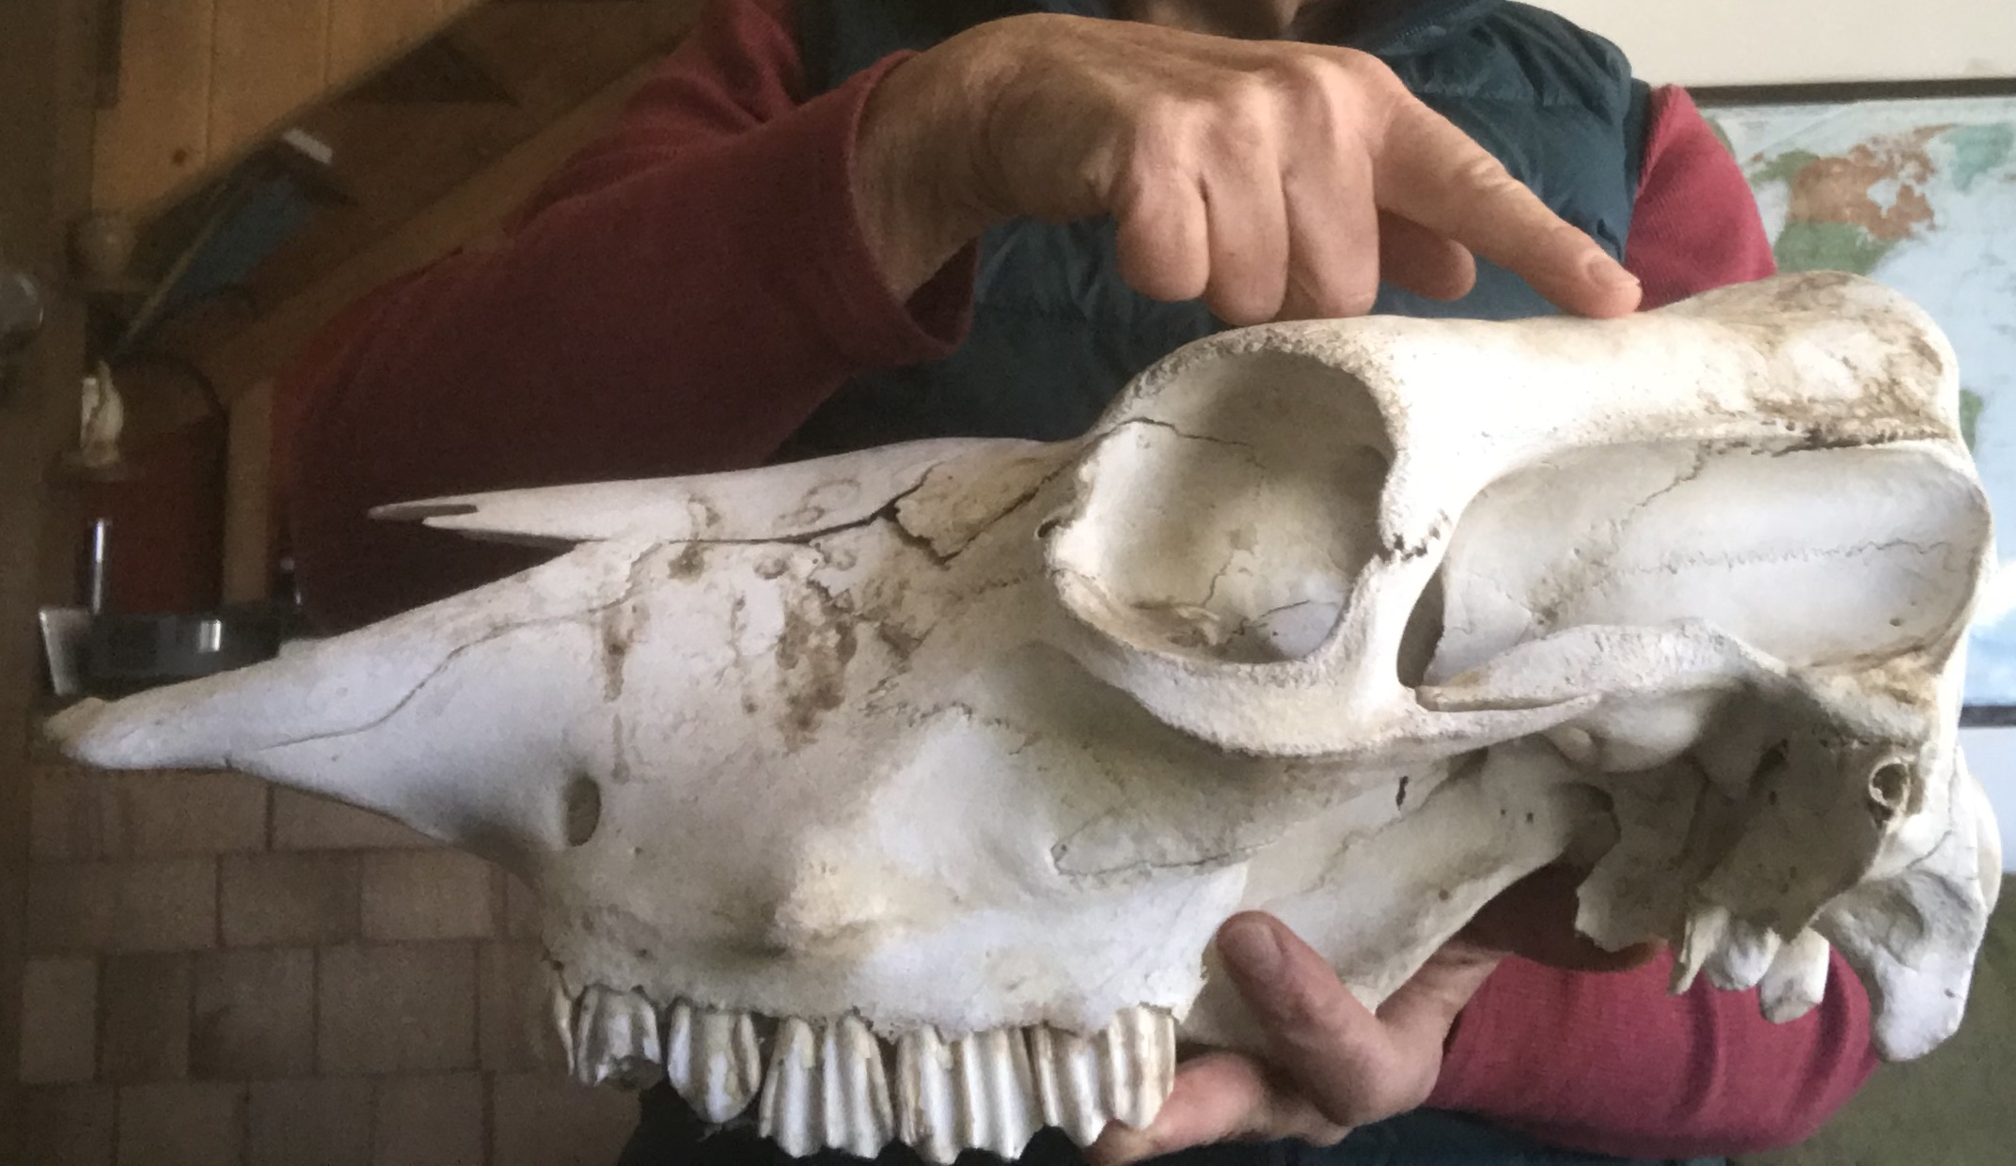
Practice 3: Finger Tracing and Air Drawing
Hold an object in one hand or place an object in front of you.
Close one eye and trace the edges with a finger of the other hand.

Slide 15
Practice 3: Finger Tracing and Air Drawing
As you trace the edges, describe out loud the new angle each time your finger changes direction.
For example: “Straight down, sharp right turn, short flat edge, starting to curve down, little bump, now straight out at an angle.”

Slide 16
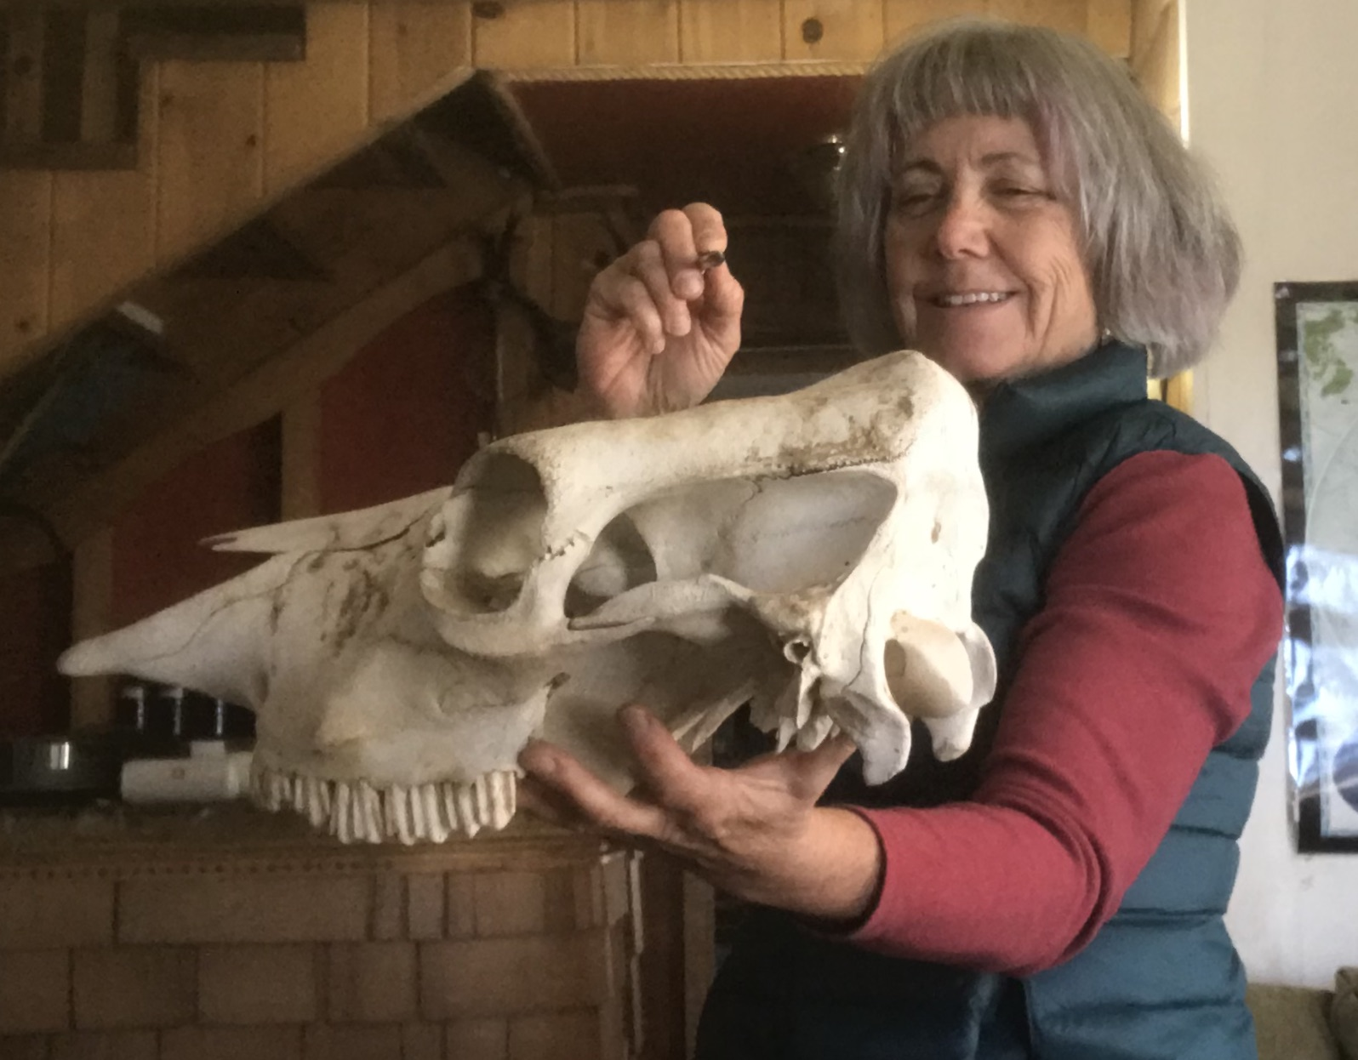
Practice 3: Finger Tracing and Air Drawing
Now do this with a pencil in your hand.
This time, trace the shape in the air with the tip of the pencil. Imagine a line being inscribed on the wall behind the object.
Each micro change or pencil direction or line-segment length is a decision. You want to notice each decision as you move around the object.

Slide 17
Practice 4: Learning to Draw Lightly
Learning to draw lightly is a skill we can develop with a little practice.
The energy behind this kind of drawing will be used again and again in observational drawing.
Using one journal page, get ready to warm up!

Slide 18
Practice 4 Learning to Draw Lightly
Use the following sequence as a warm-up to drawing.
Start by loosening up. Relax your shoulders, arm and hand. And draw a circle on your paper.
Drop your shoulders, unclench your jaw, loosen up on your pencil grip and move your pencil grip back a little.
When you draw, move your whole arm, not just the fingers. Draw another circle, then another.

Slide 19
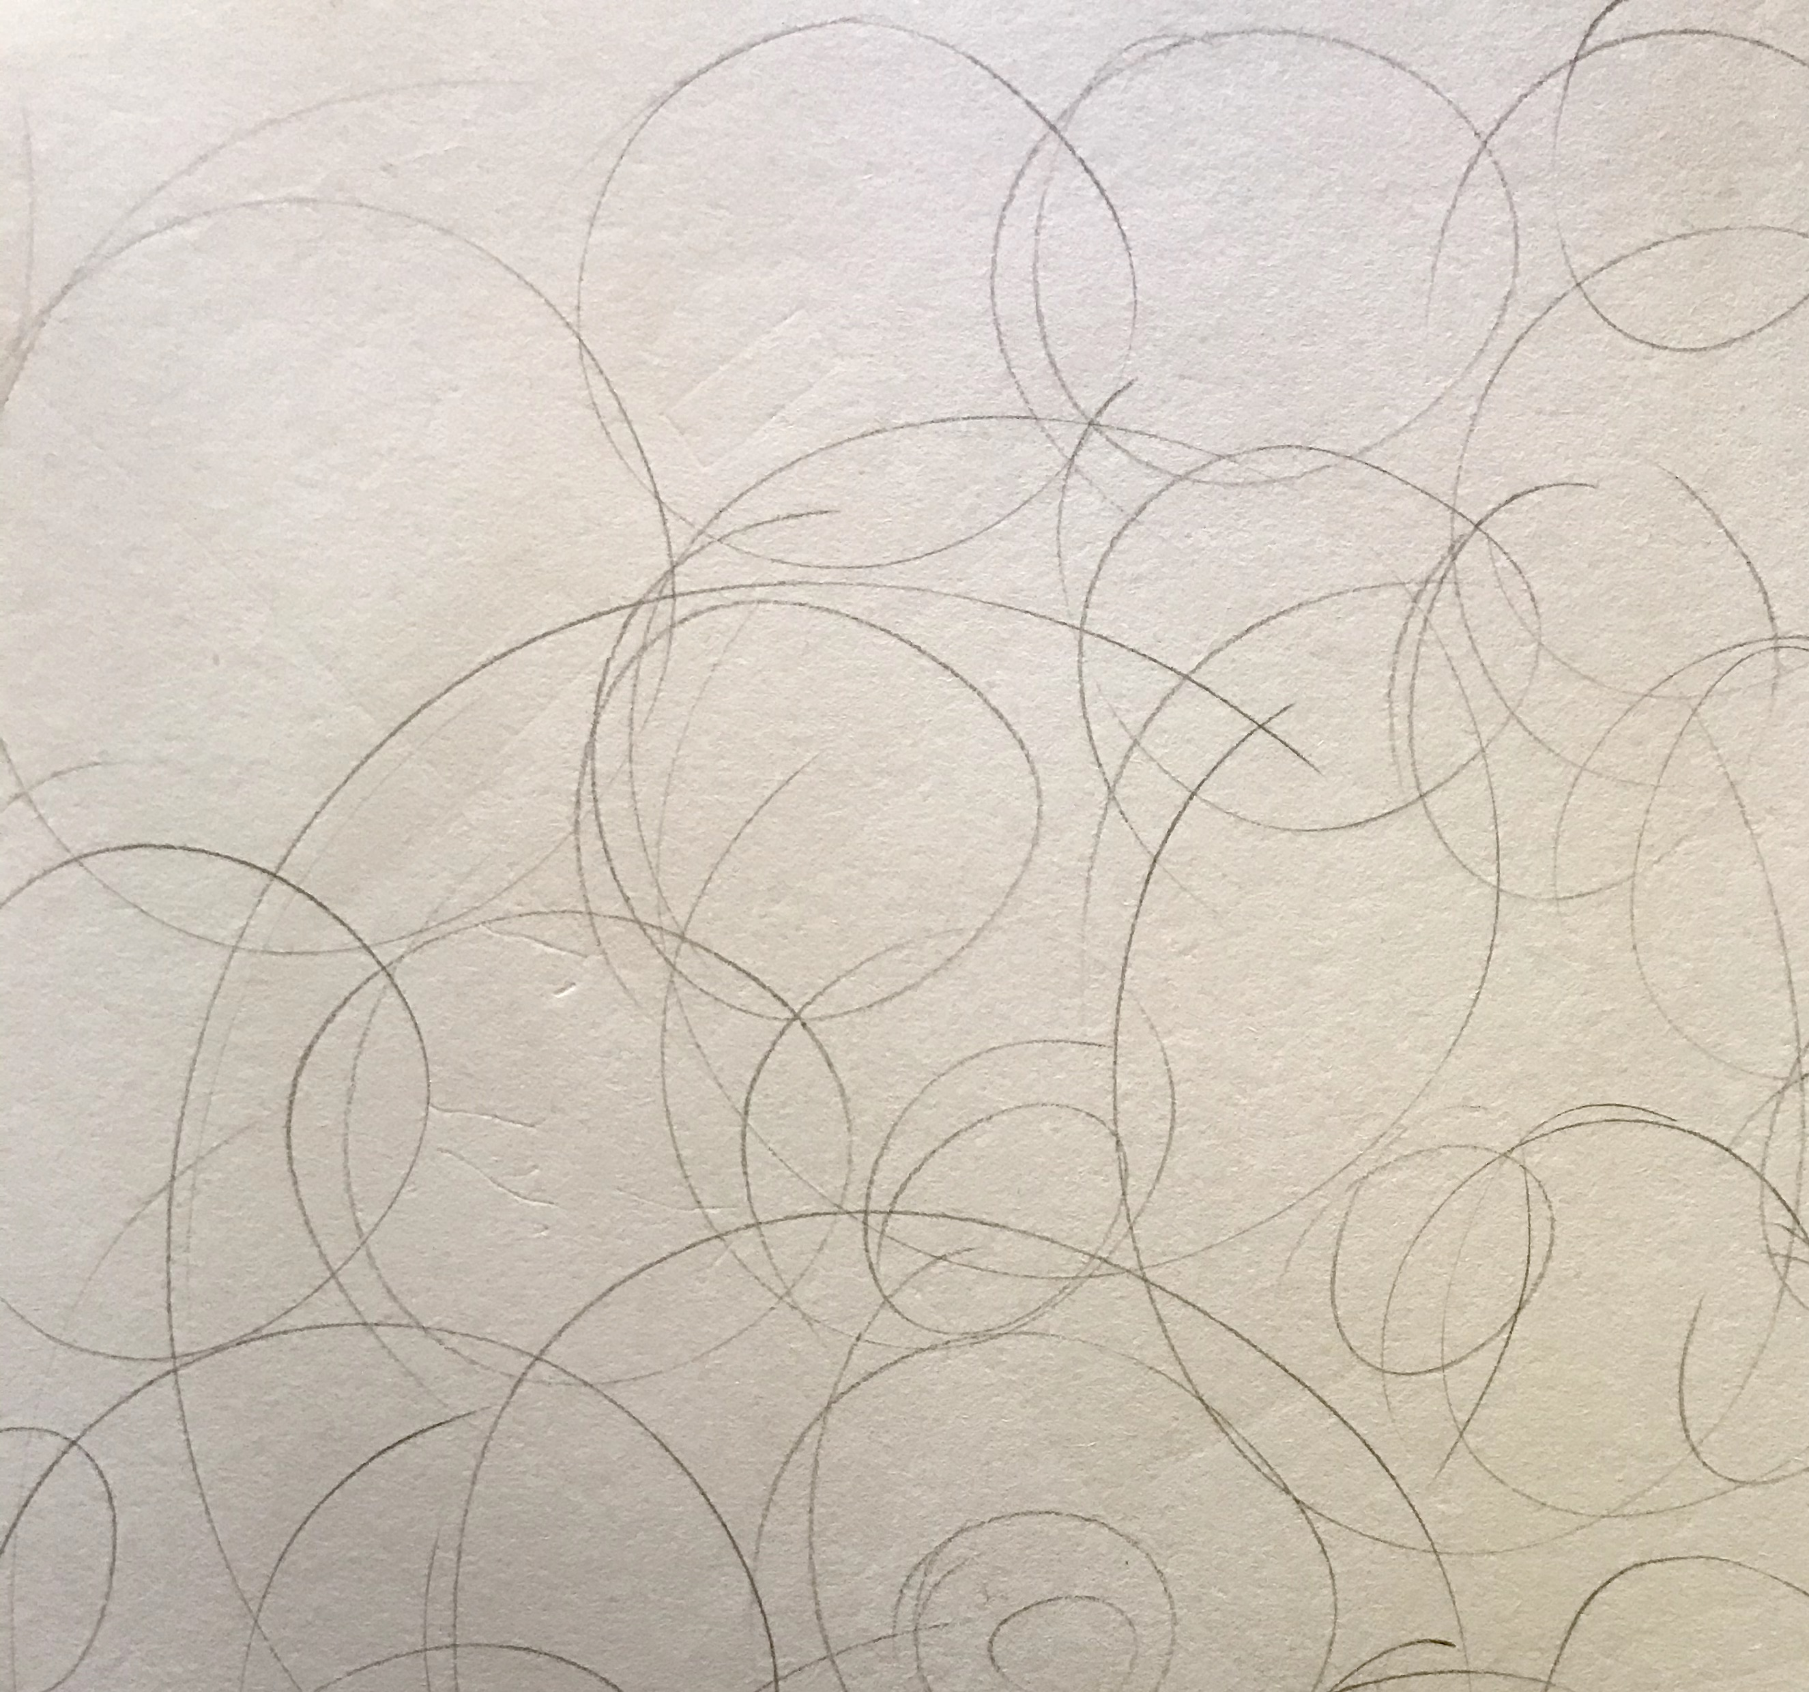
Practice 4: Learning to Draw Lightly
Now lighten up!
Draw a circle as lightly as you can.
Now see if you can draw one that is even lighter.
Fill the whole page with the lightest circles your pencil can make.
Now speed it up. Keep the lines loose and light, but this time the goal is to also make them fast.
Make a series of overlapping circles, scribbles, and flowing lines.

Slide 20
PRACTICE 5: CONTOUR DRAWING
Contour drawing is a way to train yourself to look at drawing shapes
The most important part of accurately drawing an object is to look at it carefully.
Too often we rely on our mental image or what we THINK our drawing subject SHOULD look like, instead of observation.
Contour drawing is the most powerful way to train yourself to look at the subject.

Slide 21
BLIND CONTOUR DRAWING
The point of blind contour drawing is not to draw, but to see. It’s a fun exercise that will train the connection between your eye and your pencil.
Select an interesting object to draw.
Stare at the object and slowly begin to draw its shape without looking at the paper. Let your eye crawl slowly along the contour (outline) of the object.
Let your pencil creep along your paper moving up or down, following the curves and angles that you see.
DO NOT LOOK AT YOUR PAPER!
5. With every change in angle, let your pencil respond with its own change of direction. Do not lift your pencil or look down to see where you are.
TAKE YOUR TIME!

Slide 22
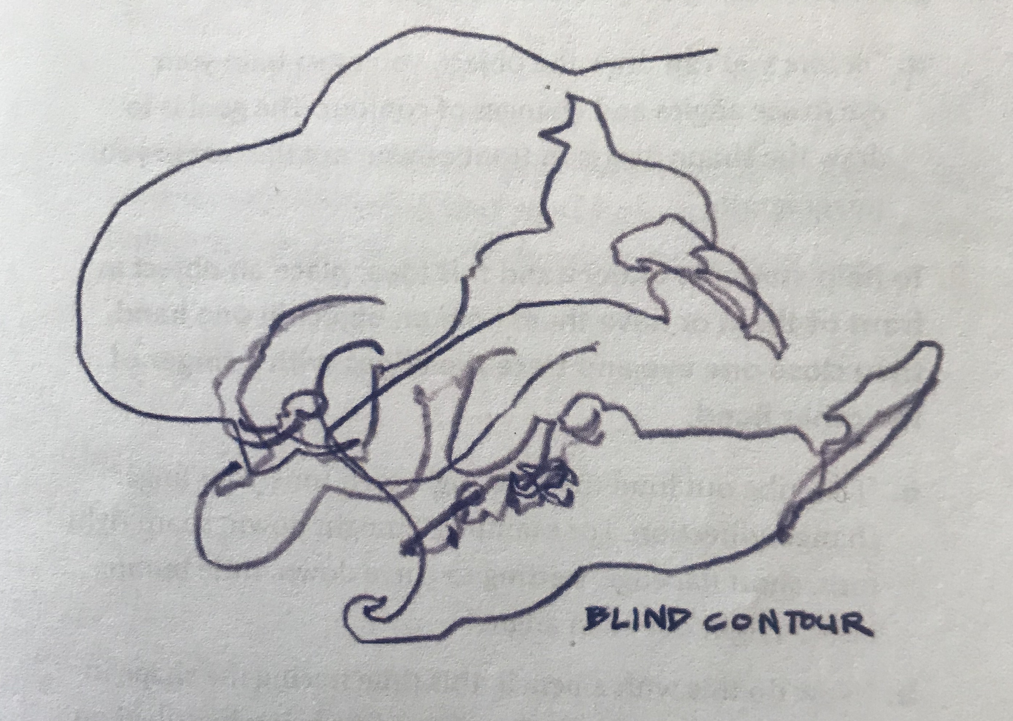
BLIND CONTOUR DRAWING (continued)
When you are done, take a look. The results might be comical and fascinating. Look for places where your lines reveal subtle changes or aspects of the real object.
You can continue practicing with other objects. This will train your hands to respond to what your eyes see.

Slide 23
MODIFIED CONTOUR DRAWING
A modified contour drawing also helps us hone our observations but results in a drawing that looks much more like the object.
The process is the same, only this time, you get to peek. Every now and then, you can glance down at your paper to allow yourself to relate the spacing and size of the lines to each other.
You can also pick up your pencil and move it to another spot. To keep the energy of the contour drawing, keep your eyes on the object as you draw.

Slide 24
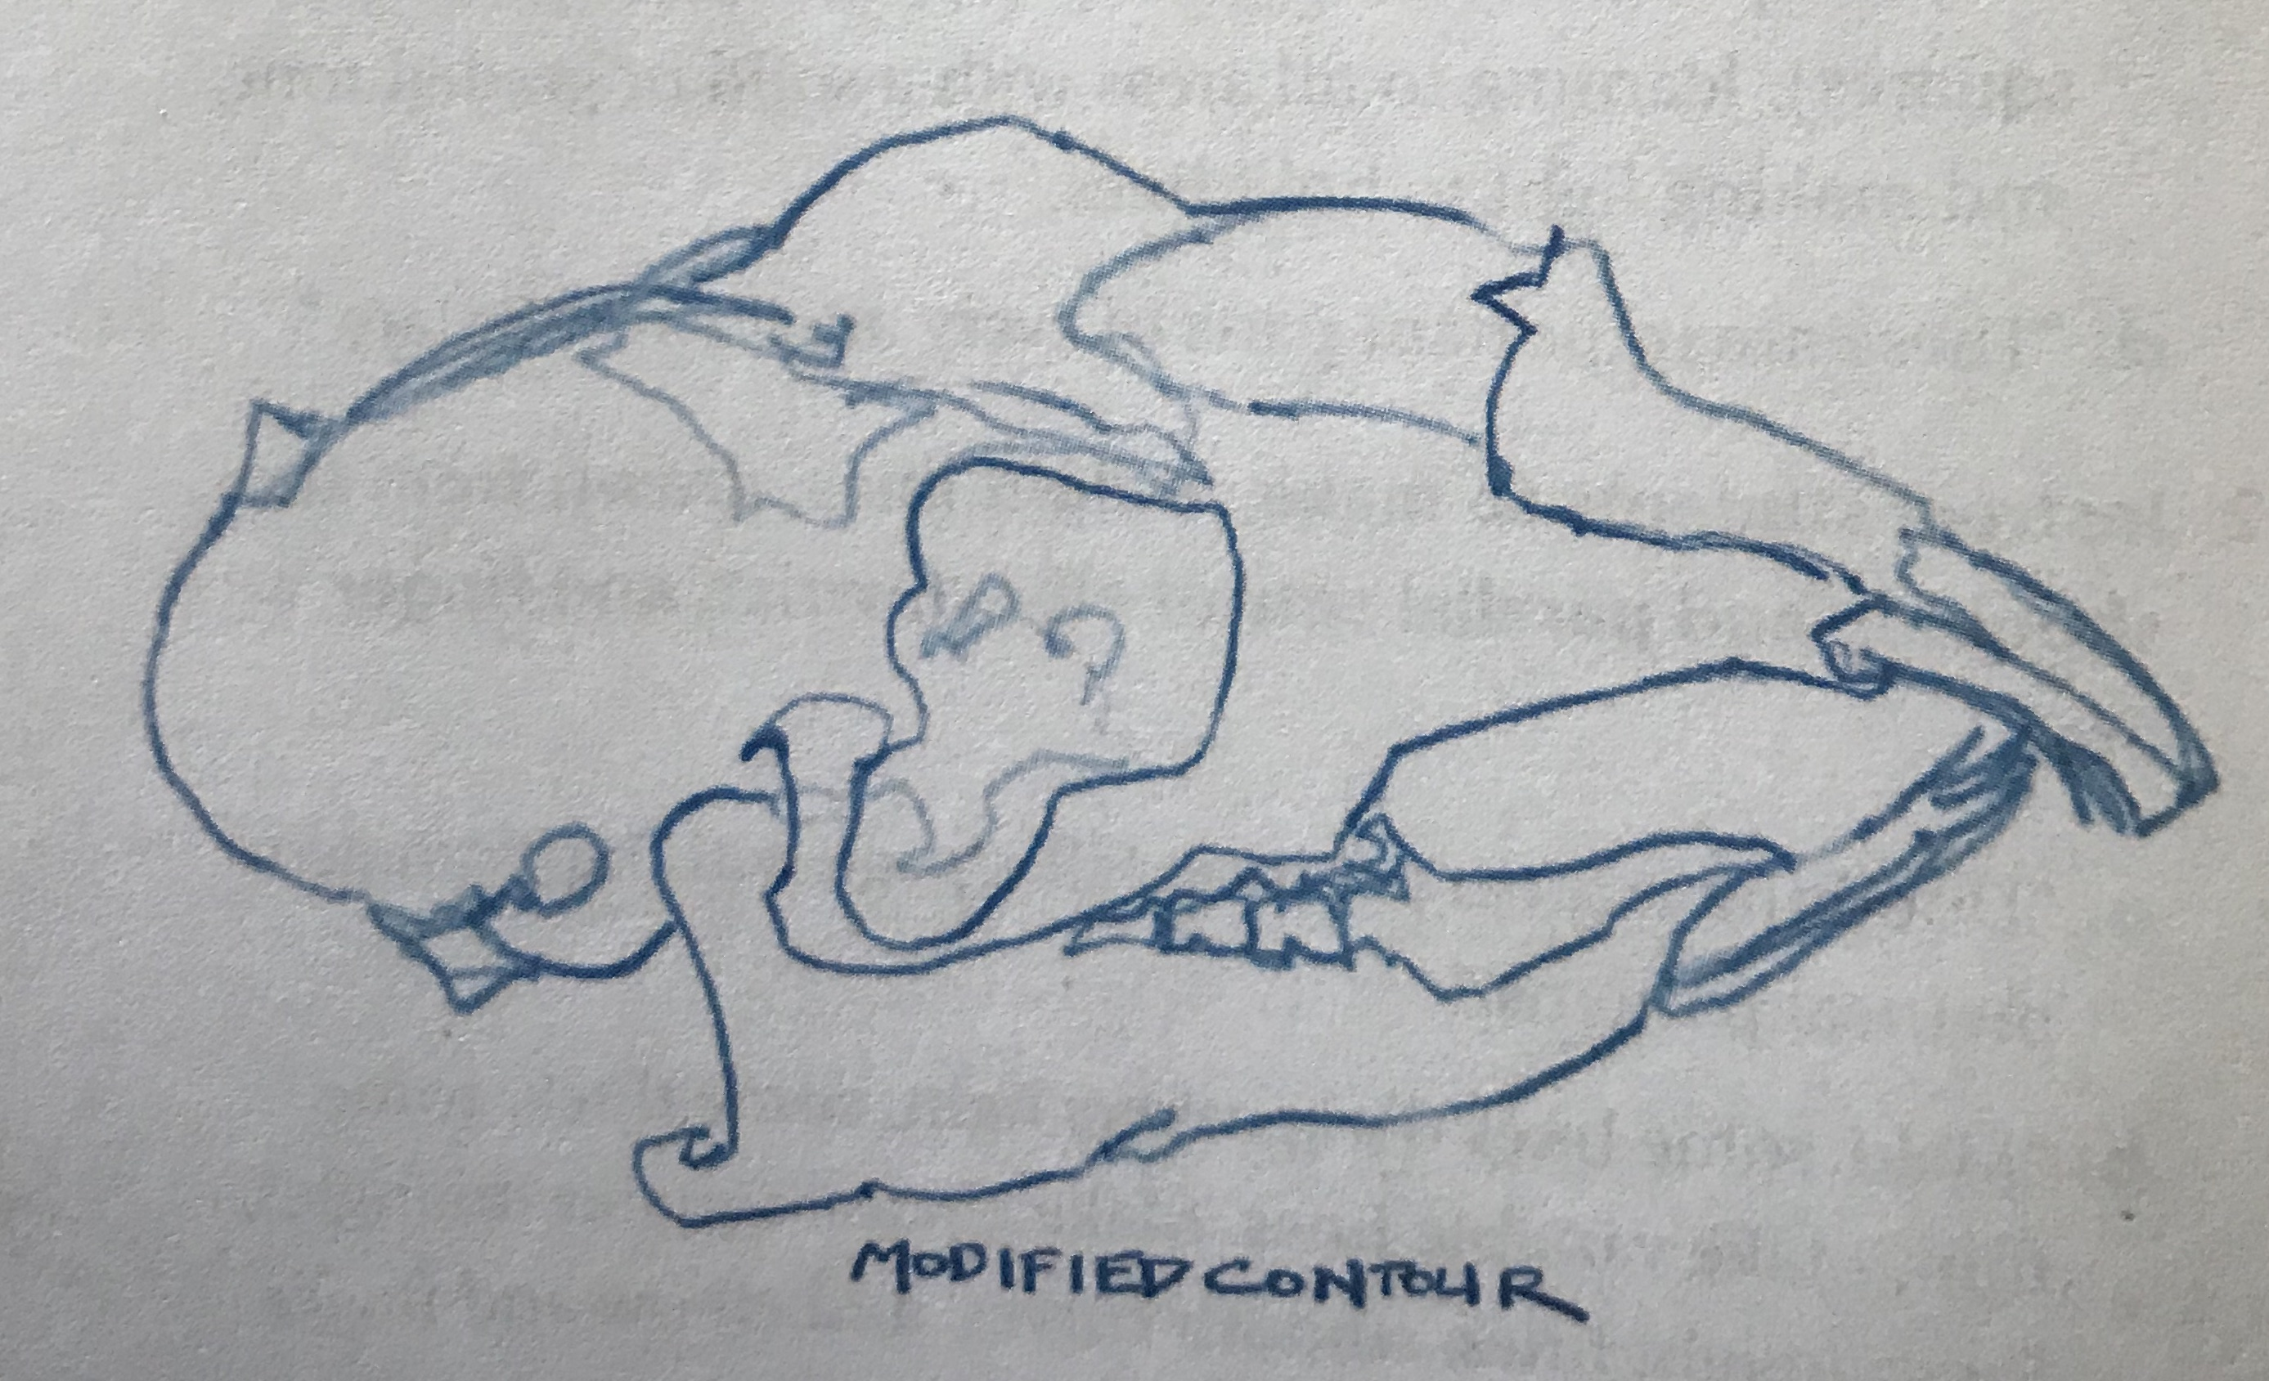

Slide 25
Practice 6 Learning to Use Negative Shapes
Negative shapes are the shapes that occur between the objects we are drawing. In approaching a subject such as a skull, you would probably focus on the shape of the upper and lower jaws.
The negative shape is the shape of the empty space between the upper and lower jaws. The jaws have height, width, and angles, as does the negative space.
By drawing the negative space as an actual shape, you may discover that you drew the jaws too close together or too far apart.

Slide 26
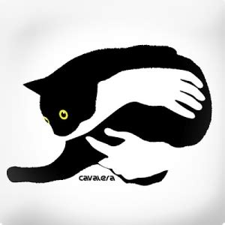
Practice 6: Negative Space
If your negative space does not fit, don’t ignore it and move on. You will have found a valuable indication that something is off with your proportion.
Find out what is wrong and fix these errors before continuing to draw. Using negative space is one of the most powerful but underused tricks in the artist’s tool kit.

Slide 27
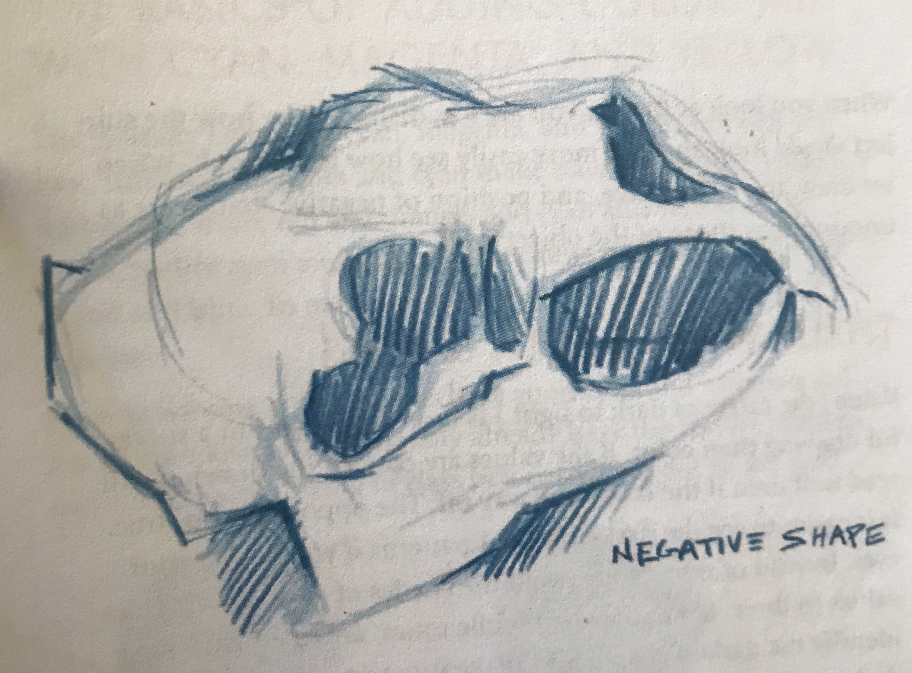
Exercise 6: Negative Space
Use the object you used for contour drawing.
Sketch it again, this time using both contours AND negative space.

Slide 28
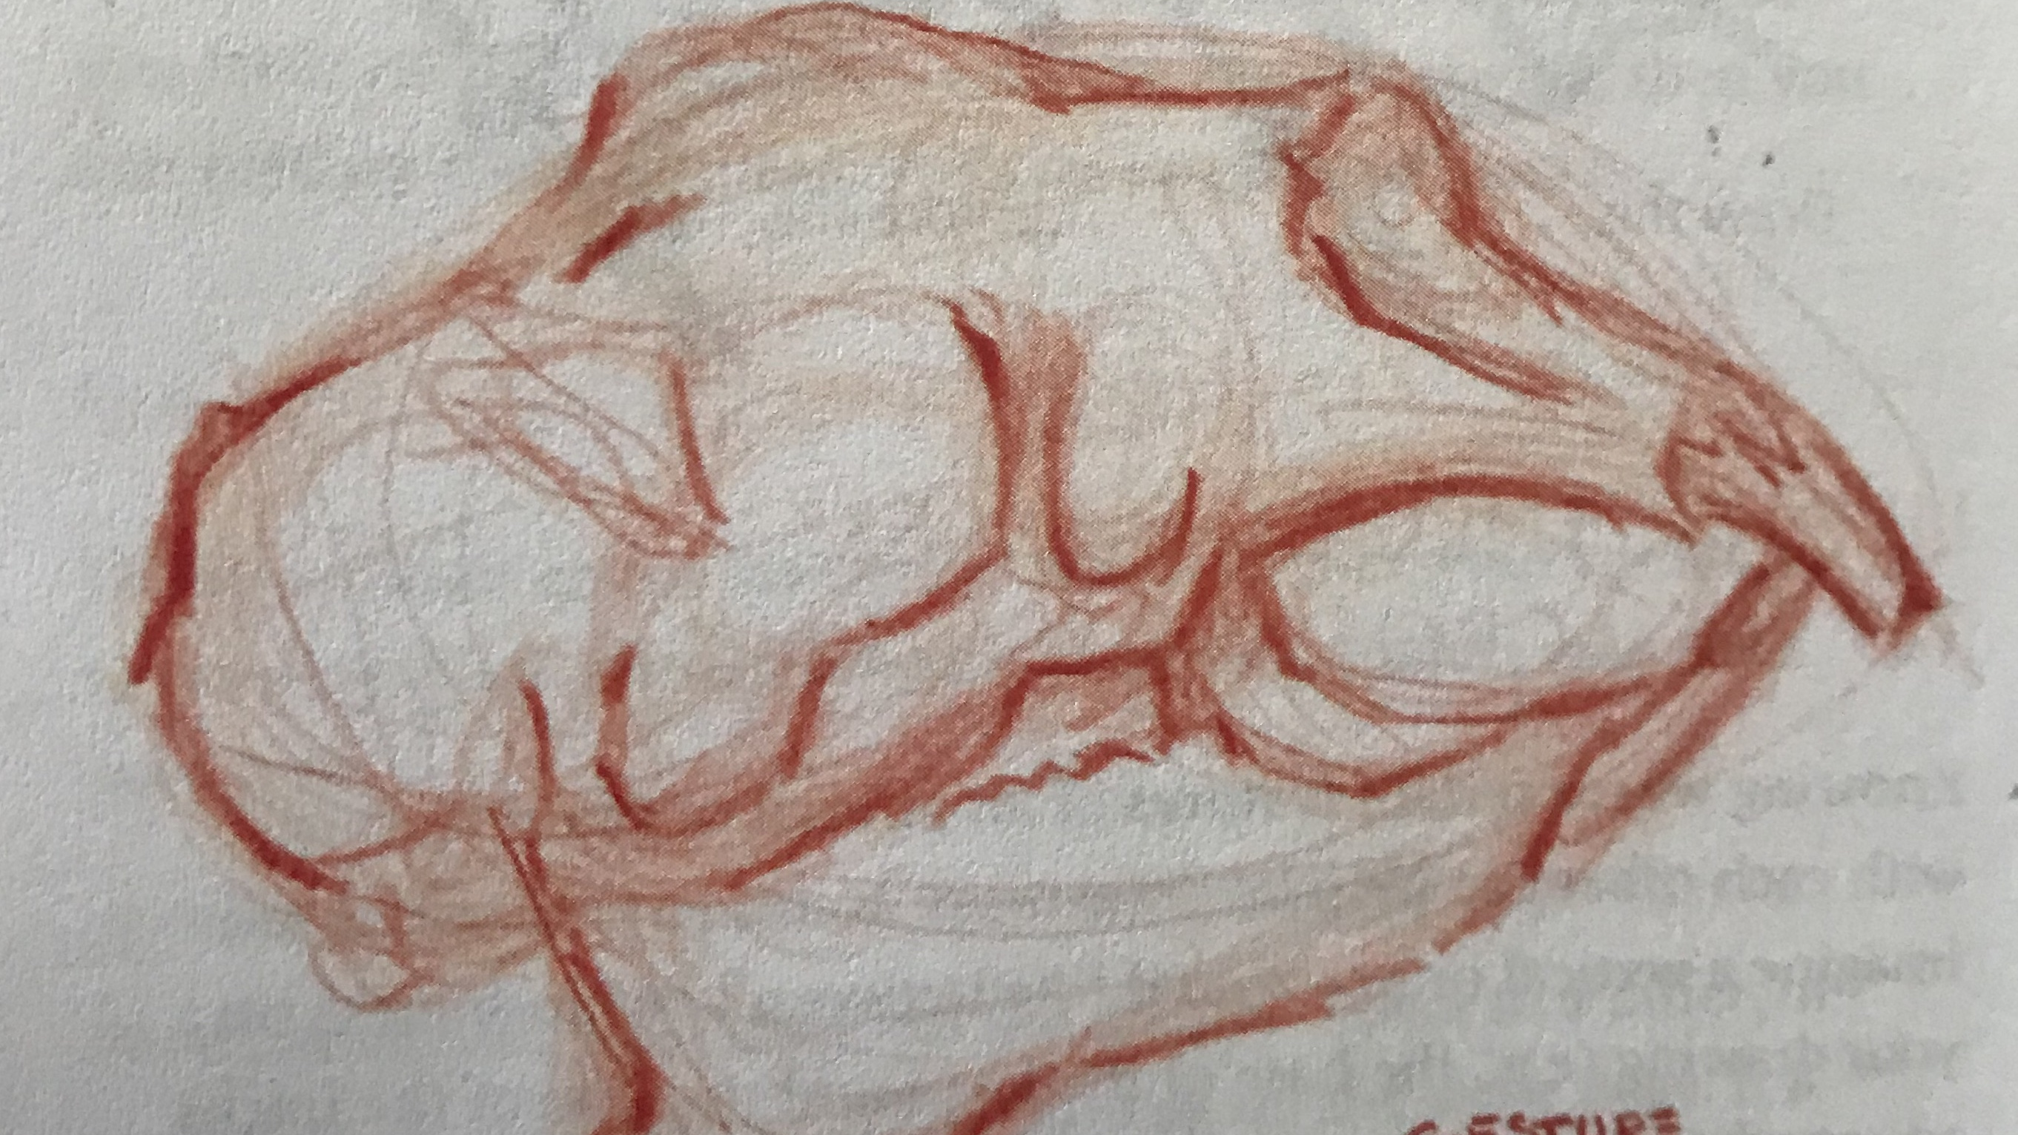
Practice 7: Gesture Drawing

Slide 29
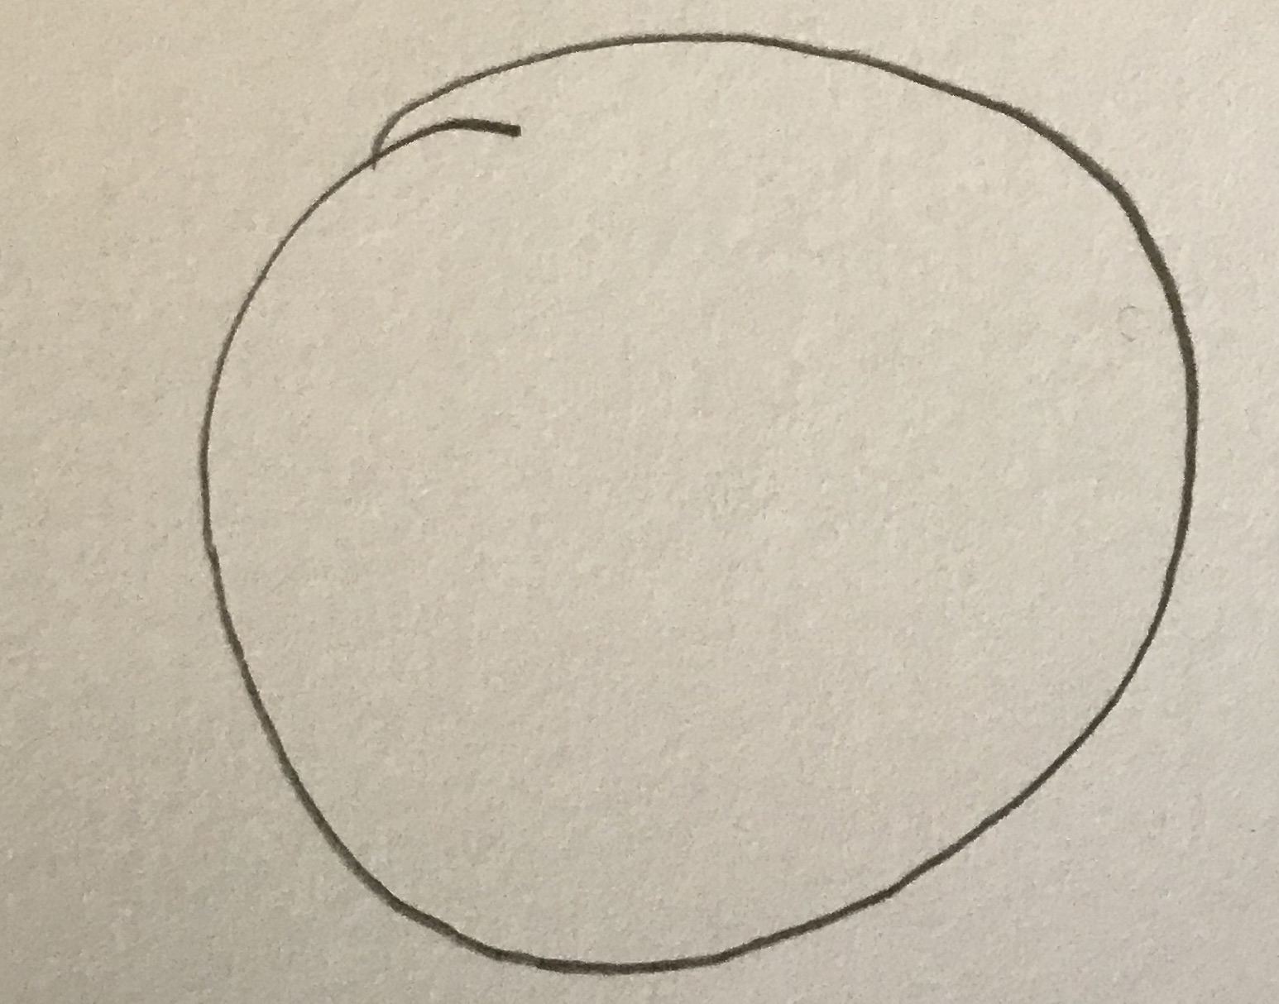
Practice 7: Gesture Drawing
Would you like to draw the perfect circle?
Draw a circle with ONE clean line right now.
Your circle is probably lopsided or uneven. Drawing a circle this way is hard.

Slide 30
Practice 7: Gesture Drawing
Let’s try an easier way
Lightly and loosely draw a circle. It’s OK if it’s a little lopsided.
Now, without erasing, draw over it, correcting some of the imperfections with continued light lines.
Overlap five or more circles, slowing correcting the roundness.
Your brain will gravitate toward the right lines, As it does, you can press a little harder, reinforcing the lines you want to keep. Watch a perfect circle emerge from the page!

Slide 31
Practice 7: Gesture Drawing
The key is to begin lightly, make lots of lines, and reinforce those that seem to be most accurate.
By keeping it light, you let your brain sort between several possibilities as you carve into or add to your original shape.
If you start with bold, hard lines you will feel committed to those lines even if they’re wrong. Us this approach with starting any object.

Slide 32
Practice 7: Gesture Drawing
Notice the many light lines used until the shape was correct.
Then the bold lines drawn over the correct lines.

Slide 33
Bye for Now. Thanks for Joining Me.
Plathemis lydia Common Whitetail adult male

