Slide 1
LESSON 5 ZOOM IN, ZOOM OUT
Investigate and draw an object in three scales:
magnified, life size, and distant

Slide 2
In this activity you will…
Record observations at three scales: close up, life size, and far away.
Use circles to show magnified views for the “zoom in.” In the zoomed-out view, you can include details such as growth forms, where the subject is, or a small map.
Use writing, drawing and numbers to record your observations.
**There’s a lot you can observe by changing your level of focus.

Slide 3
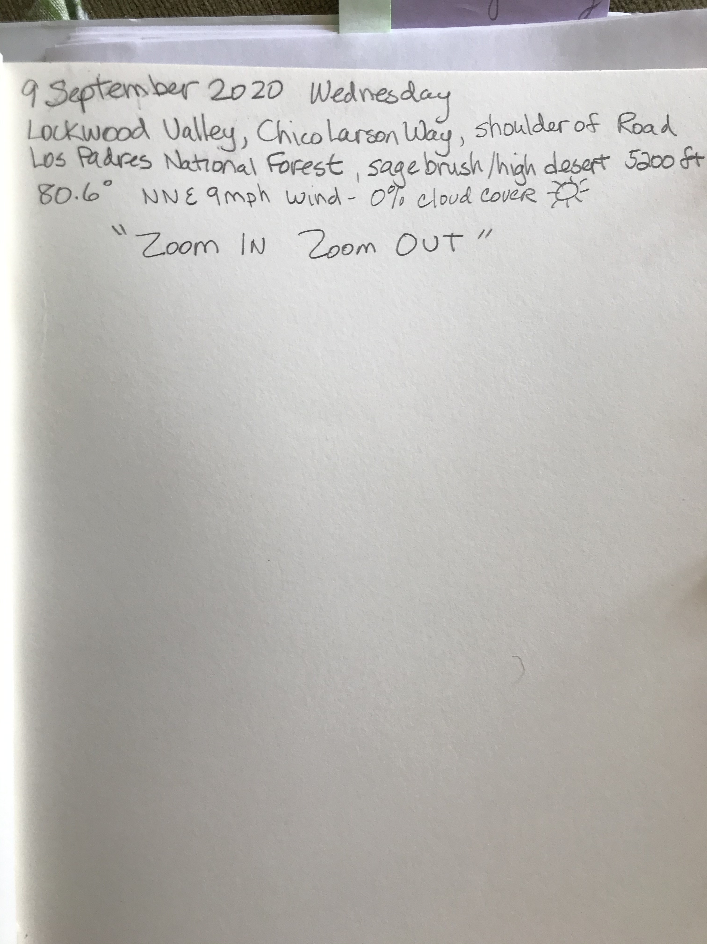
Always begin with Metadata
Begin with your metadata
Date, Day, Time
Weather
Temperature
Wind Speed
Cloud Cover
Location
Place
Habitat

Slide 4
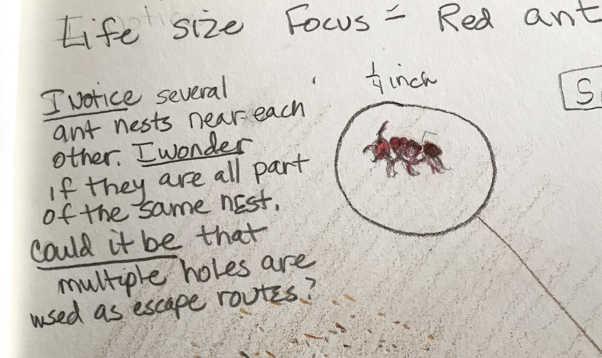
Life size: In the middle of your page, draw a view of your subject that is exactly life size
I included the measurement of the ant.
If it’s bigger than your page, draw a part of it.
Write your ABC’s (I notice, I wonder, This reminds me of…)

Slide 5
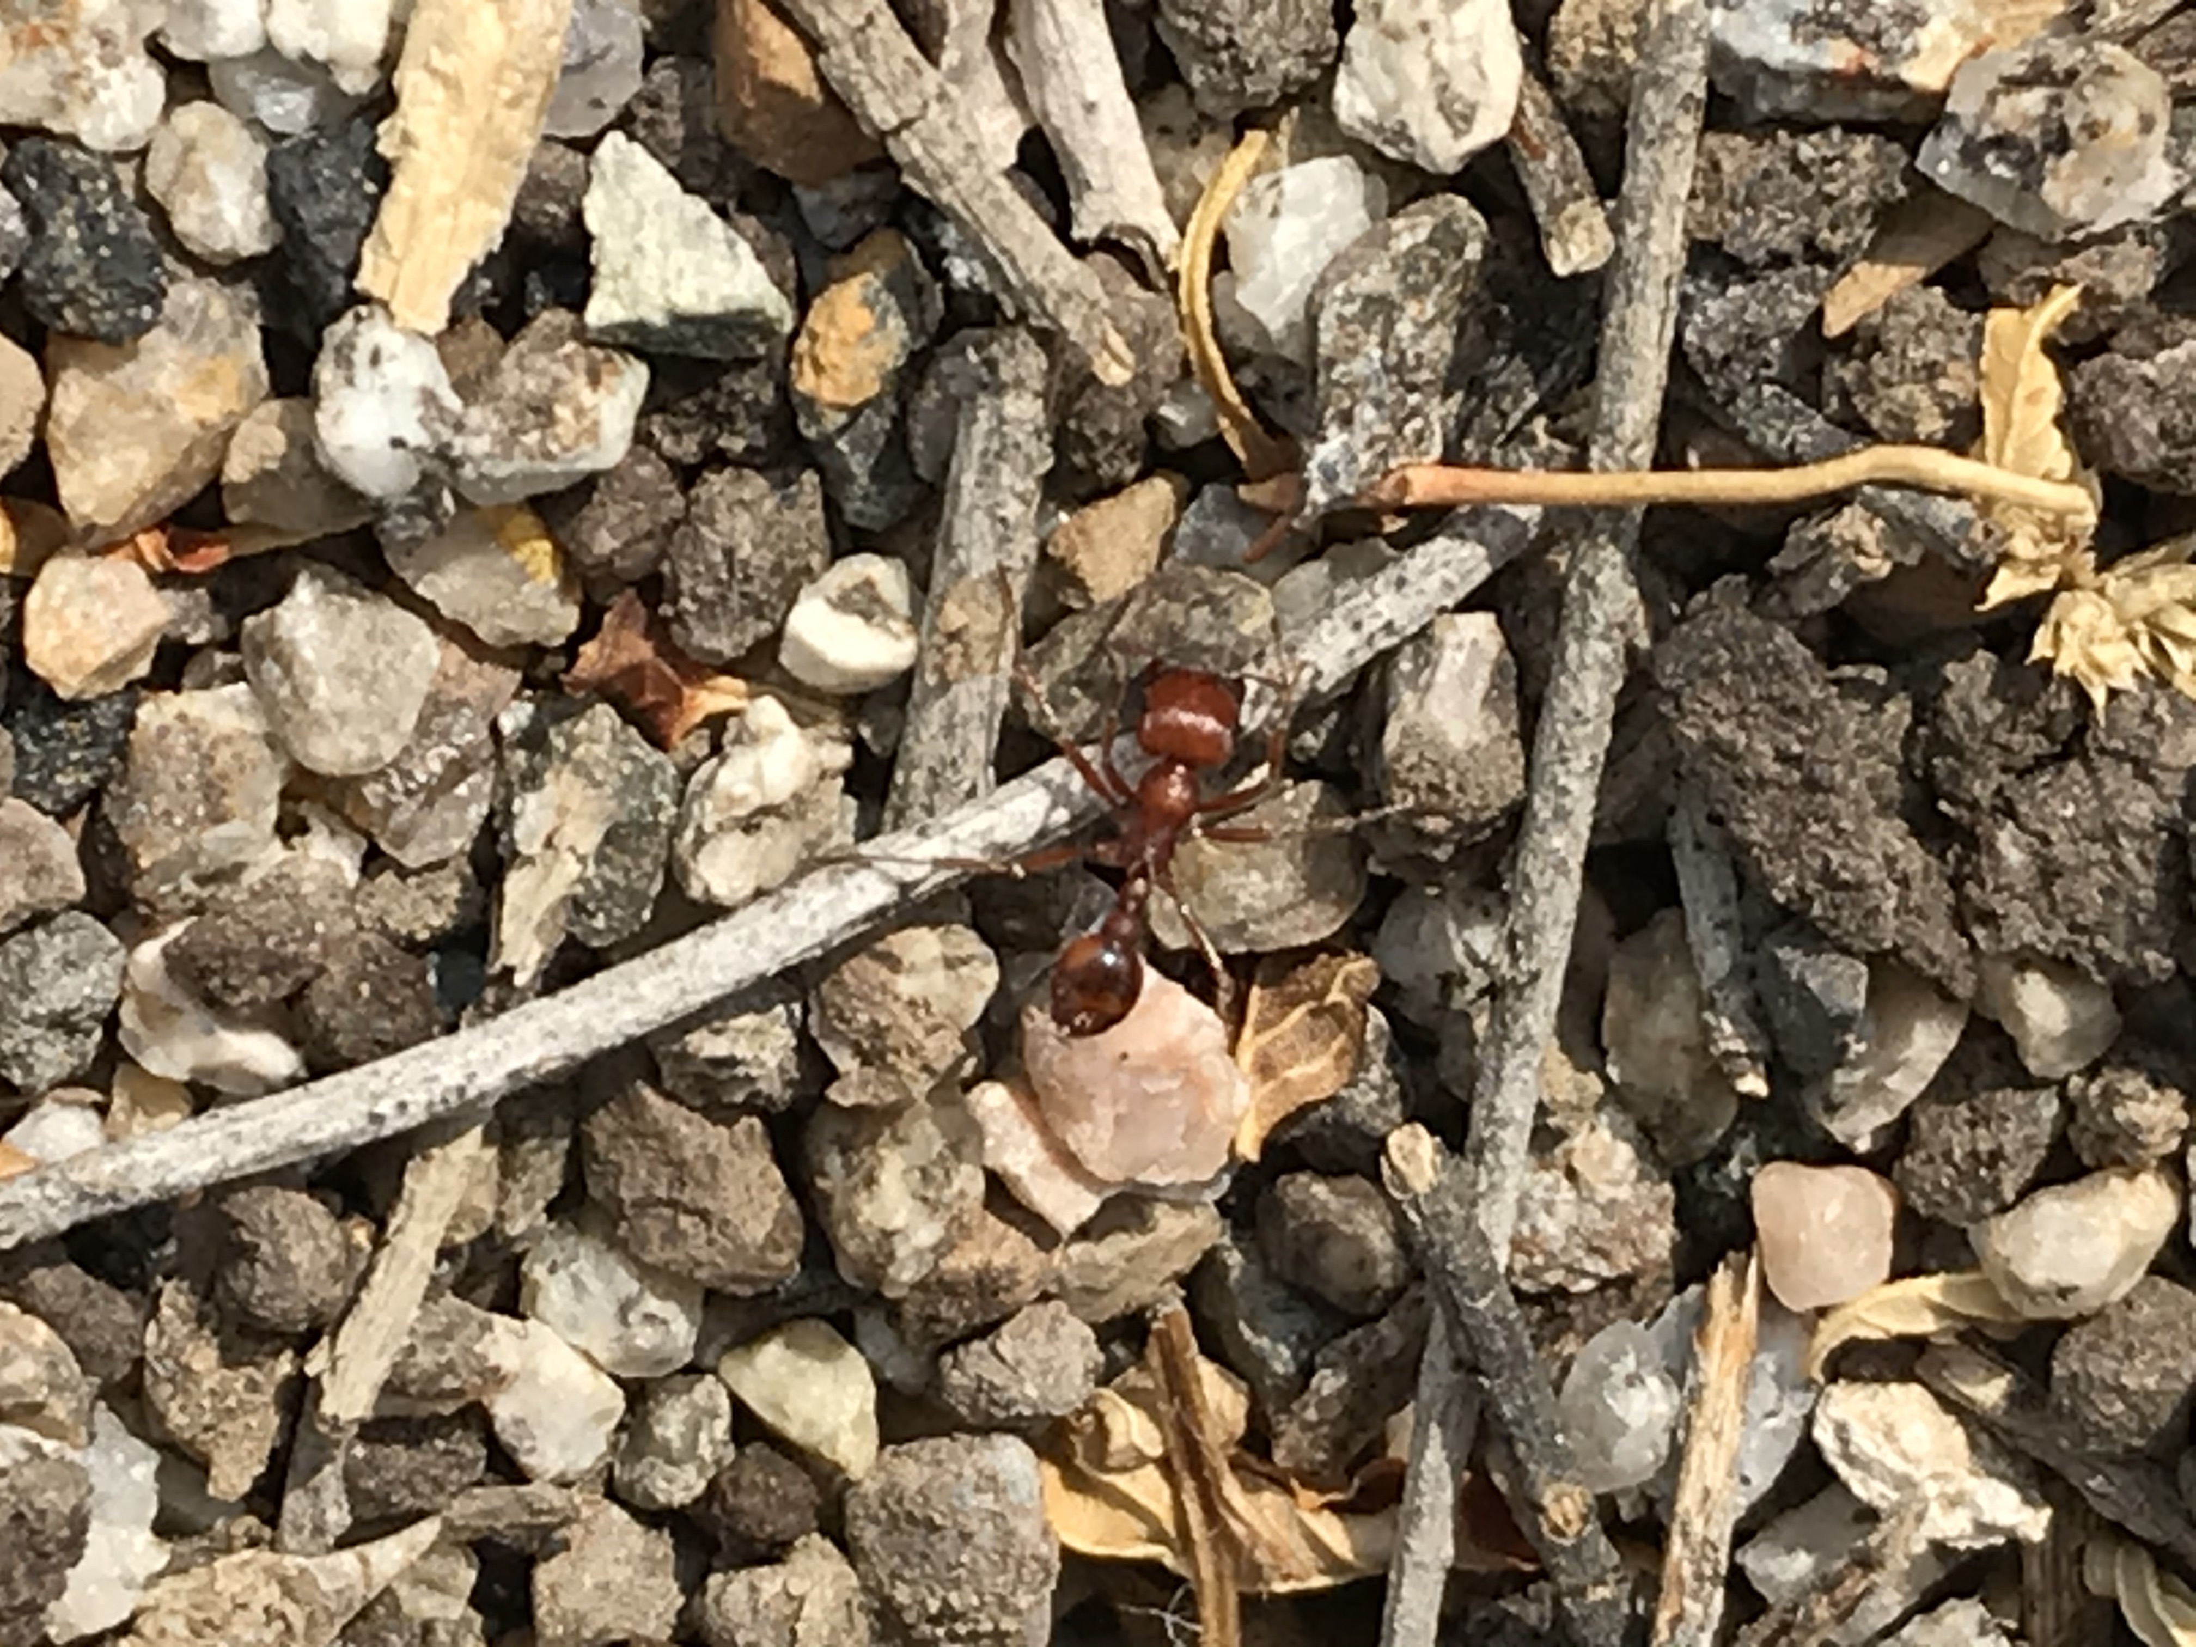
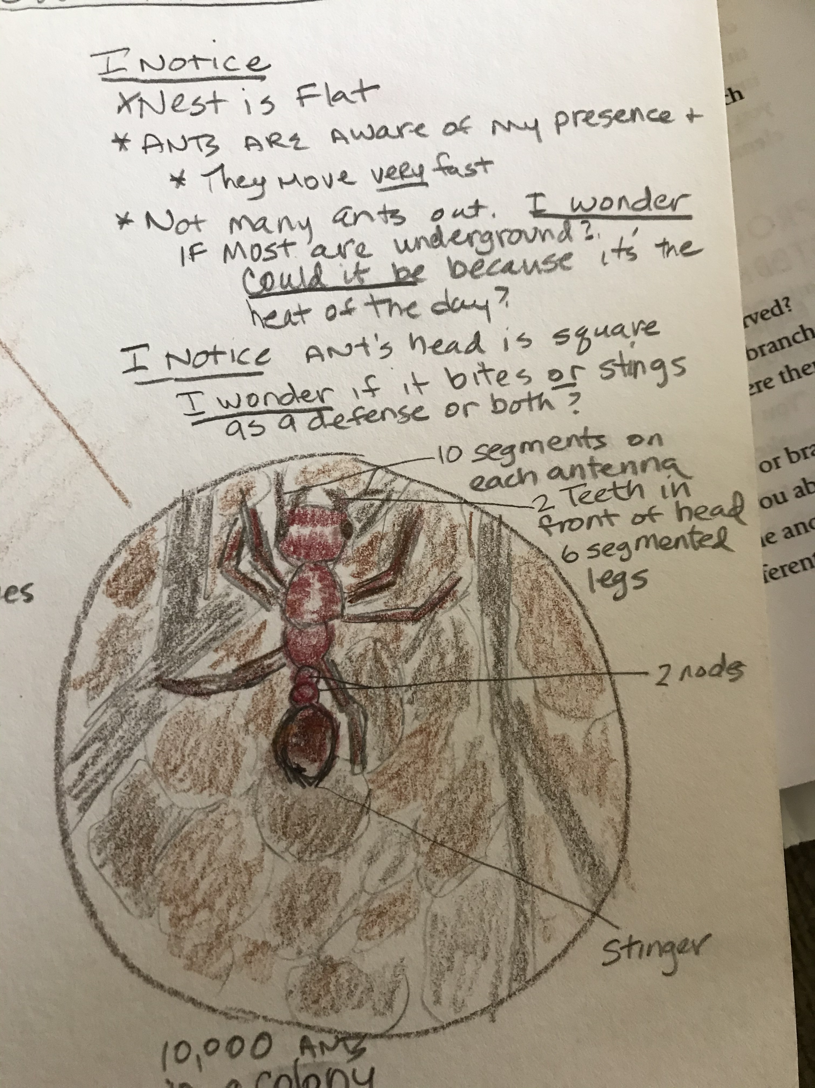
Zoom In
Choose some part of the subject that you find interesting and observe it in detail.
Use a hand lens or magnifying glass if you have one.
To show this view, draw a circle around that part of your drawing. Then draw a larger circle and draw a magnified view of the same area showing details that are too small to be shown in the life size picture.
Write your ABC’s
Note: Because my subject was so small, I chose to draw the entire body, not just part of the subject.

Slide 6
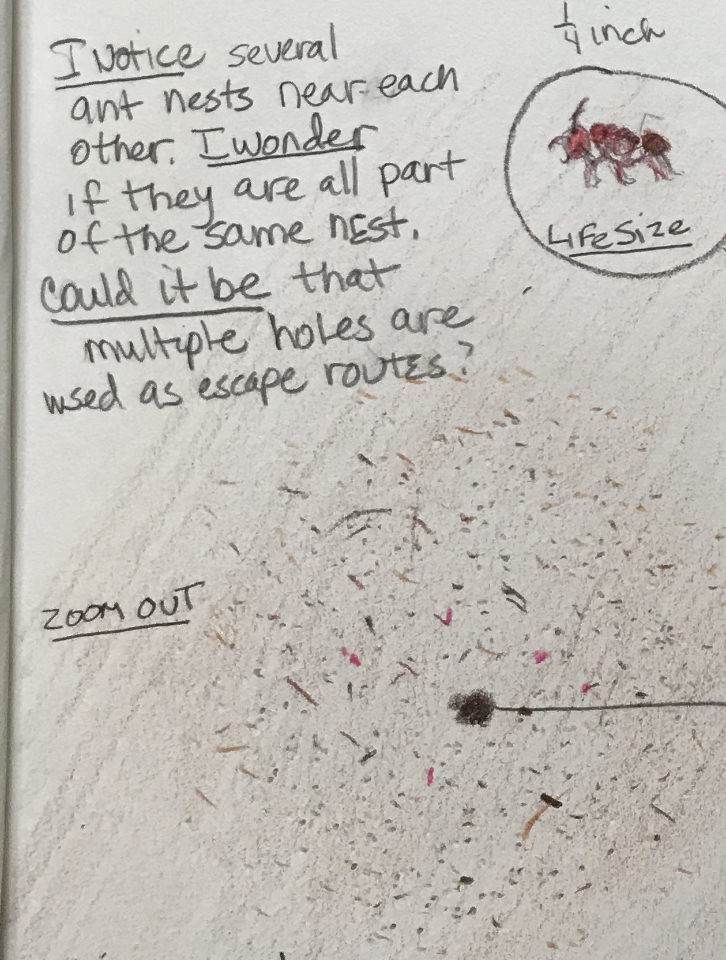
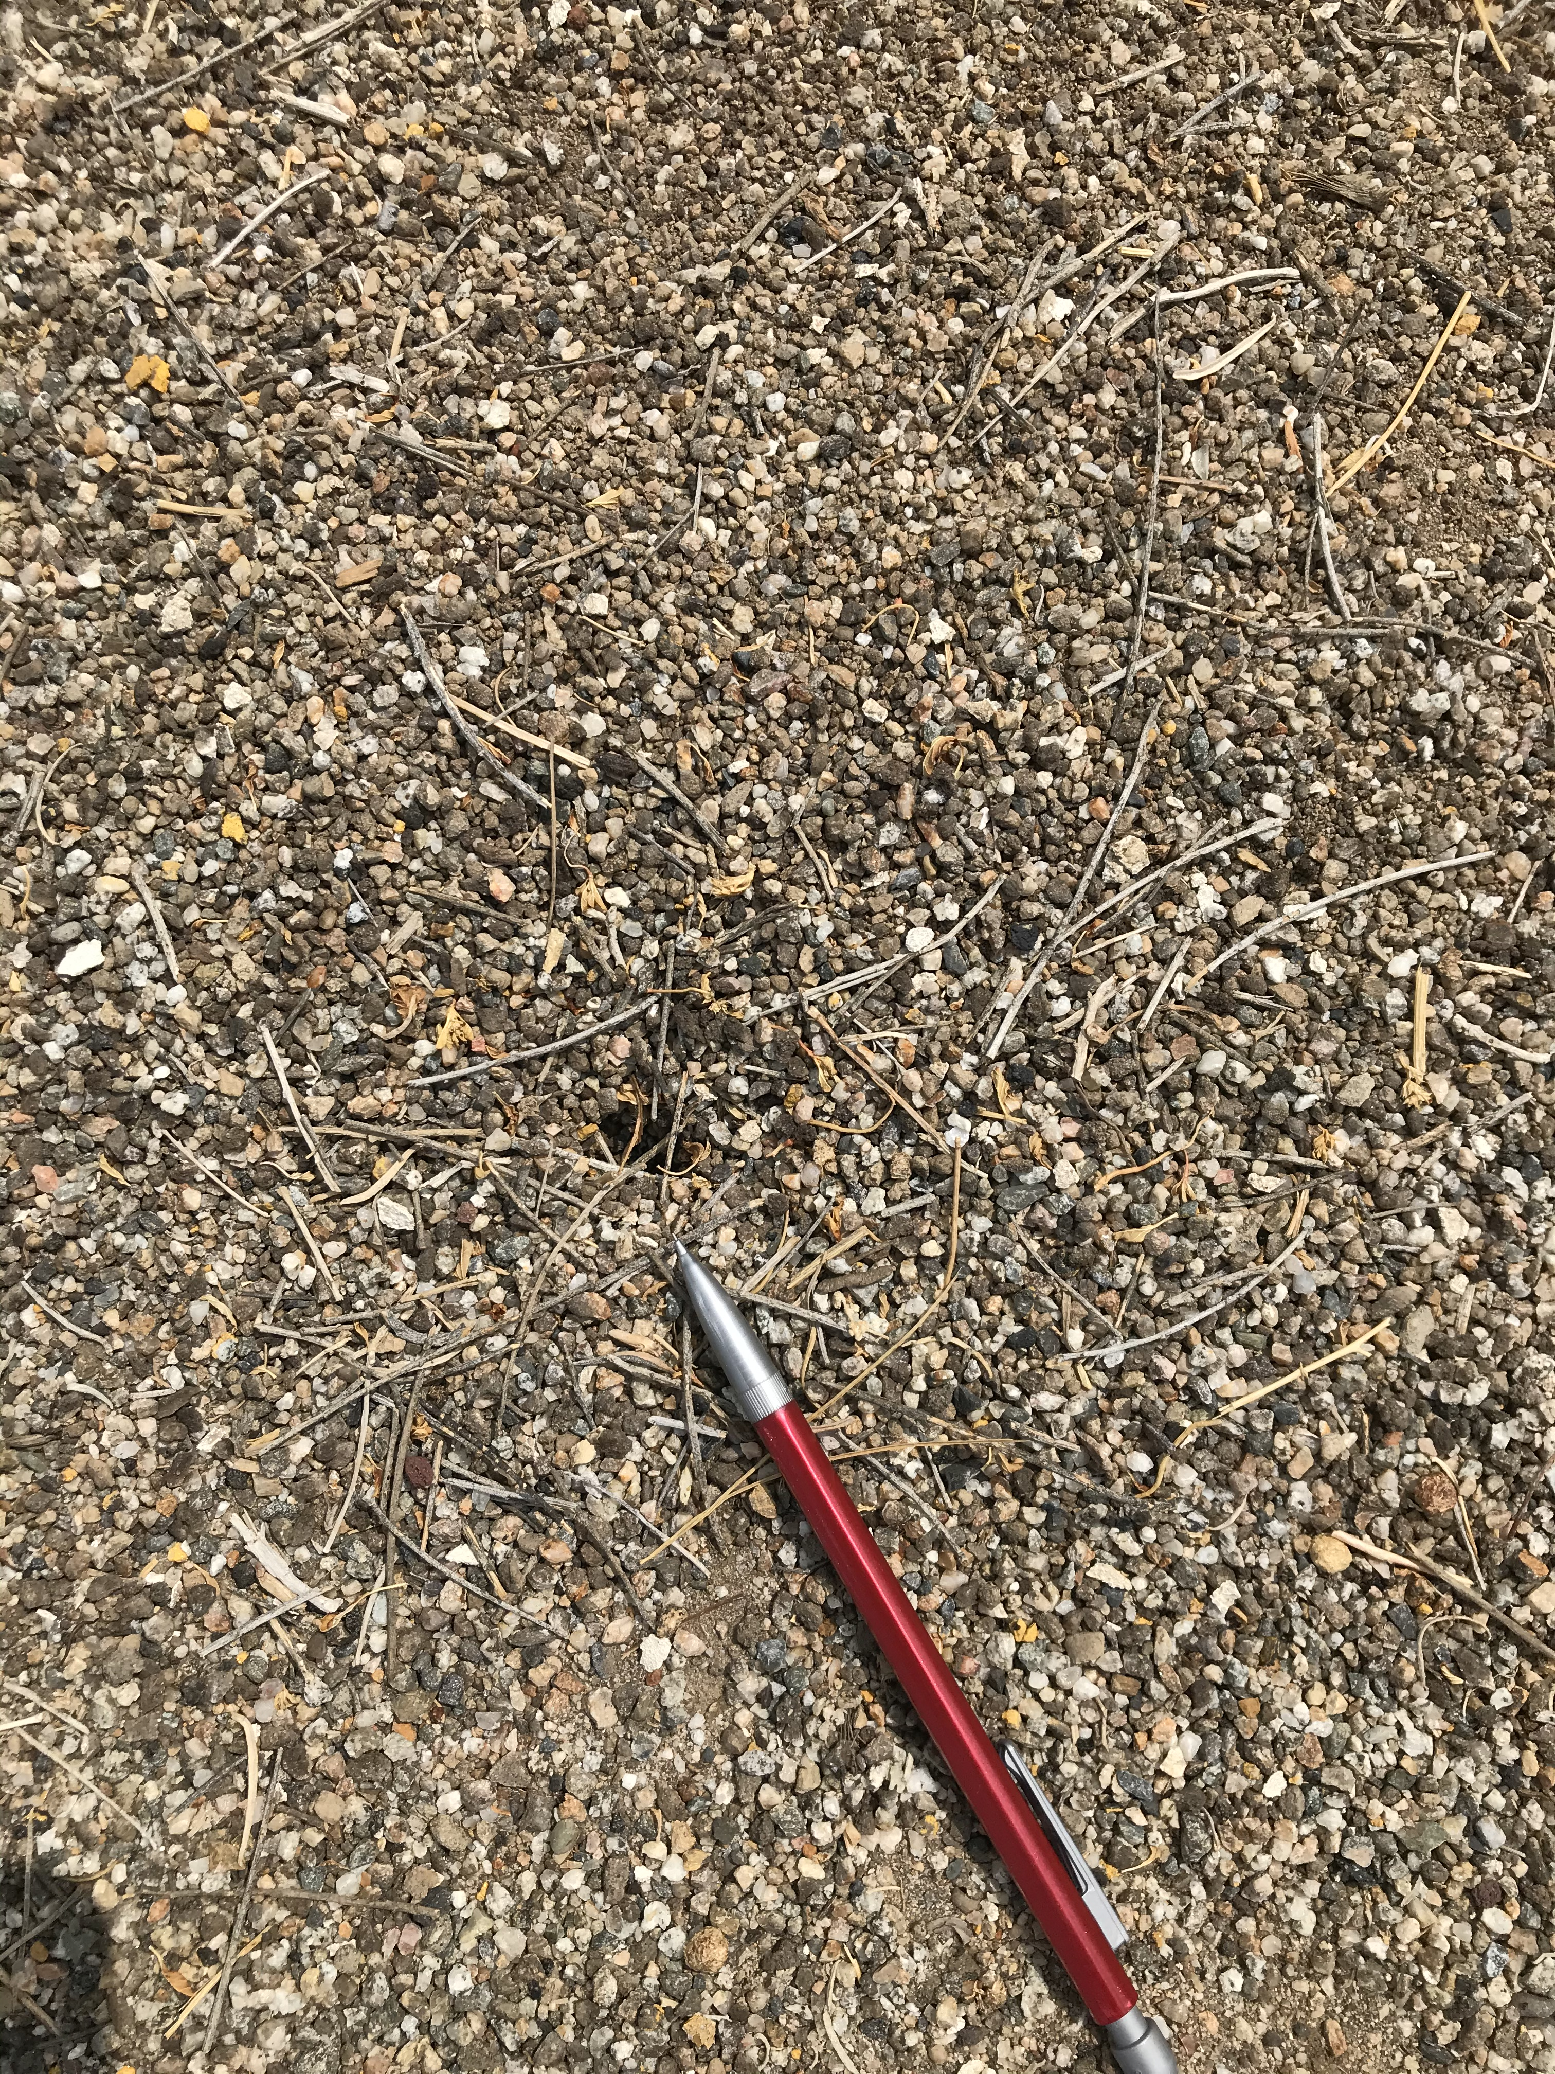
Zoom Out
Step back and make a final sketch, this time zoomed out to take in the whole subject and some of its environment.
Write your ABC’s
At every point of view, use your ABC’s, 123’s and pictures.
Note: I used my pencil as a measuring device to help me determine the size of the ant hill.

Slide 7
Could it be…
Look at your “I wonder…” statements. Can you come up with some hypotheses for them?
Remember to make some suggestions for possible answers by using the sentence frame: “Could it be…”
Try doing a little research after you finish your journal entry to see if you can get any more information about your subject.

Slide 8
Additional Research
If you get information from the Internet, write your sources (where you found the information) .

Slide 9
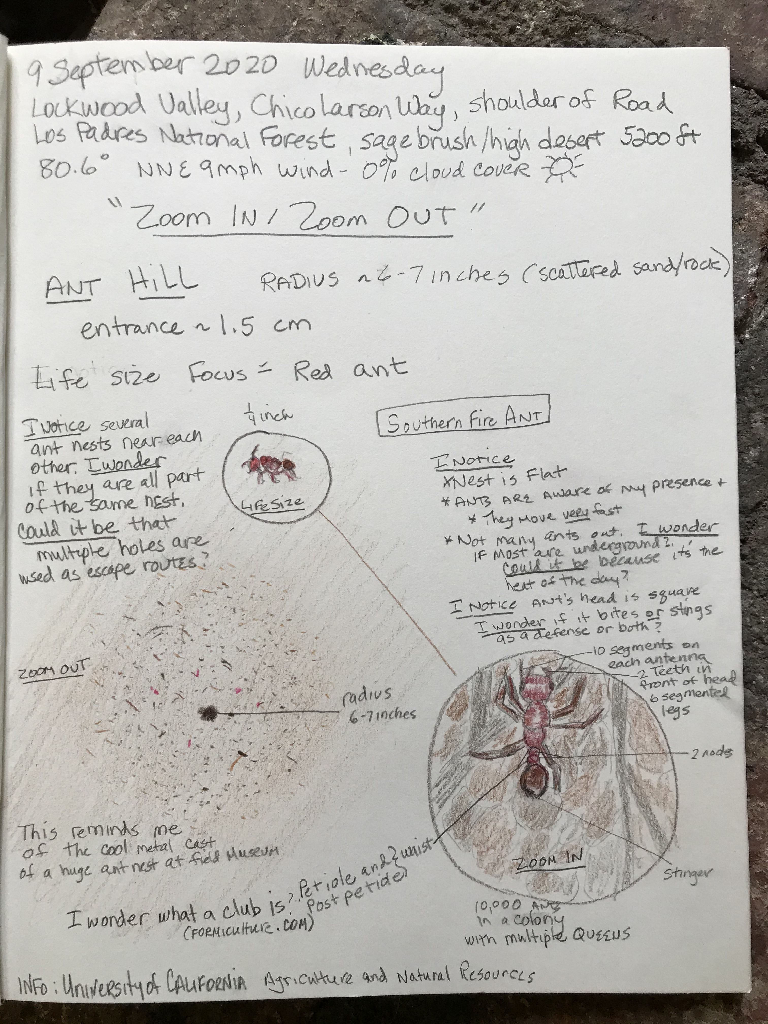
Now it’s time for you
Make your journal entry using the instruction you just saw.
Come back after you completed your page and answer the Reflection Questions that follow this slide.

Slide 10
Time for Reflection Remember to use Question/Answer Form
Start thinking about what you learned from your three different perspectives:
What were you able to learn because you looked at your subject in three different ways?
What did you see from your life size view?
What did you see from your Zoomed-in view?
What did you see from your Zoomed-out view?

Slide 11
Reflection Questions Based on NGSS Cross Cutting Concepts Remember to answer them in Question/Answer Form.
Structure and Function
What are some of the structures or parts you observed at the zoomed-in scale? At the life-size scale? At the zoomed-out scale?
Scale, proportion and quantity
Are there structures or patterns of shapes you’re seeing in the magnified view that are similar to structures you see in the distant view? How are they alike or different?
Cause and Effect
Look at some of the unique features of the subject you focused on in your journal. What did you notice?

Slide 12
Last Step
Order your answers in a meaningful way to put them into a paragraph
Write your paragraph starting with an introductory sentence.
Then write the answers to your 7 questions in the order you chose.
Finish your paragraph with a closing sentence.
Add Lesson 5 to your Table of Contents.

Slide 13
BYE FOR NOW. THANKS FOR JOINING ME.

