Slide 1
BUILDING NEW SKILLS: BASIC DRAWING EXERCISES
Drawing Exercise 7

Slide 2
Practice will develop your drawing skills
Think of drawing exercises as warm-ups and drills.
Just as you get better at basketball with practice and repetition of basic skills, so too with drawing.
The more you practice making marks, the more you will naturally understand what your hand and pencil can do.

Slide 3
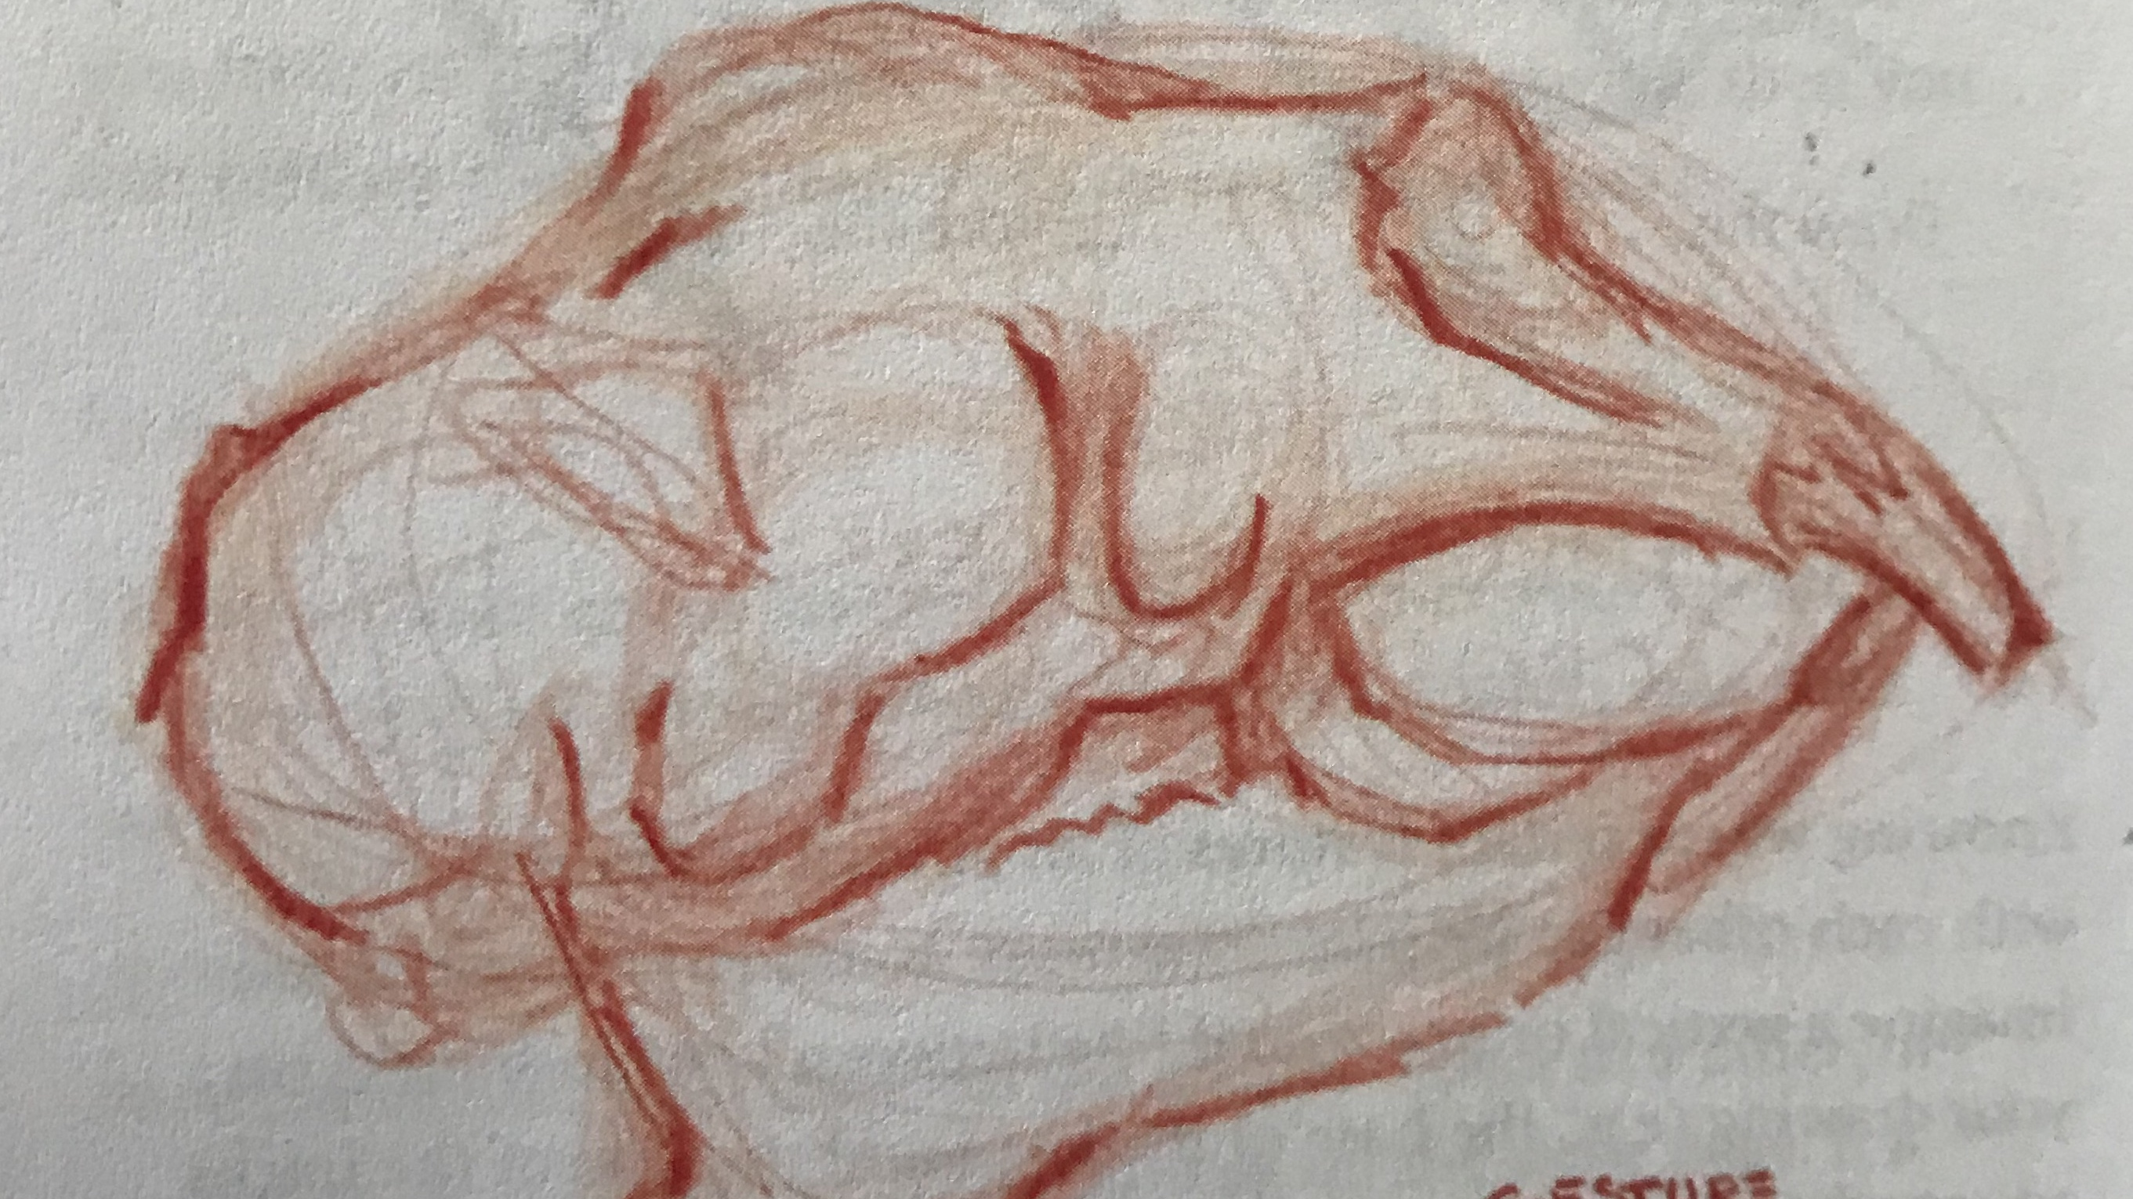
Practice 7: Gesture Drawing

Slide 4
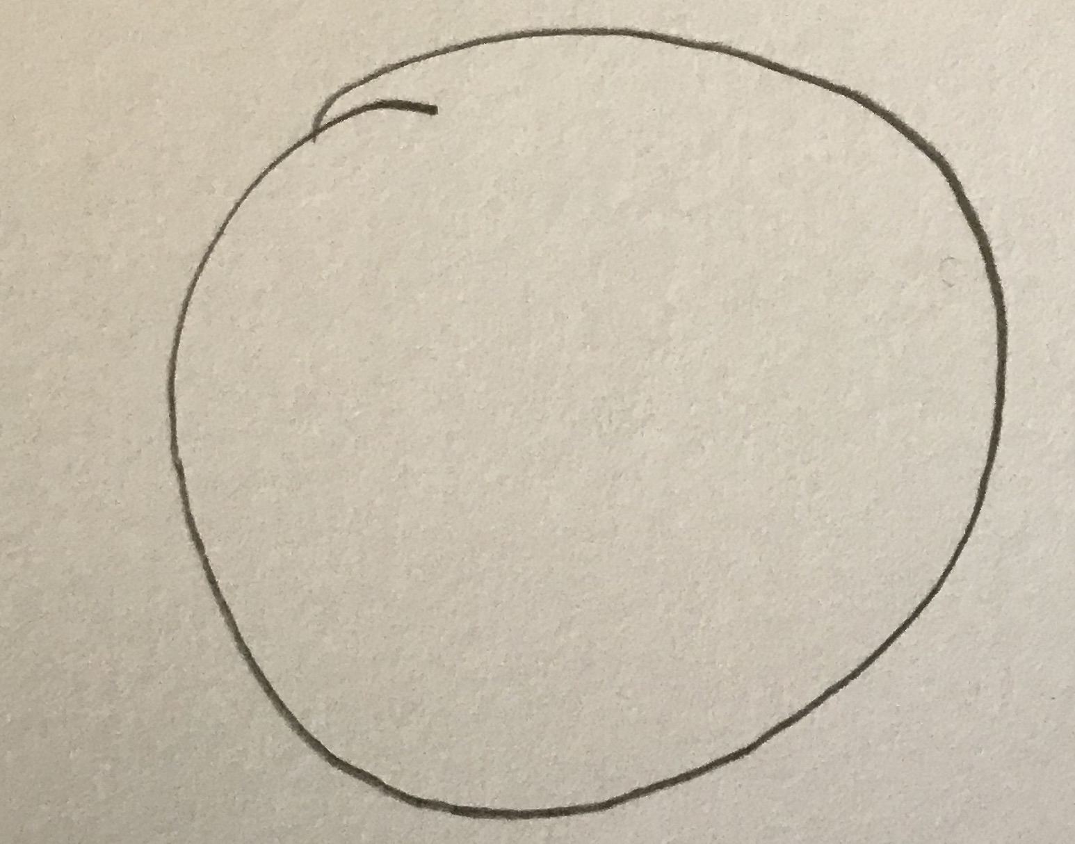
Practice 7: Gesture Drawing
Would you like to draw the perfect circle?
Draw a circle with ONE clean line right now.
Your circle is probably lopsided or uneven. Drawing a circle this way is hard.

Slide 5
Practice 7: Gesture Drawing
Let’s try an easier way
Lightly and loosely draw a circle. It’s OK if it’s a little lopsided.
Now, without erasing, draw over it, correcting some of the imperfections with continued light lines.
Overlap five or more circles, slowing correcting the roundness.
Your brain will gravitate toward the right lines, As it does, you can press a little harder, reinforcing the lines you want to keep. Watch a perfect circle emerge from the page!

Slide 6
Practice 7: Gesture Drawing
The key is to begin lightly, make lots of lines, and reinforce those that seem to be most accurate.
By keeping it light, you let your brain sort between several possibilities as you carve into or add to your original shape.
If you start with bold, hard lines you will feel committed to those lines even if they’re wrong. Us this approach with starting any object.

Slide 7
Practice 7: Gesture Drawing
Notice the many light lines used until the shape was correct.
Then the bold lines drawn over the correct lines.

Slide 8
Bye for Now. Thanks for Joining Me.

