Slide 1
BUILDING NEW SKILLS: BASIC DRAWING EXERCISES
Drawing Exercise 3

Slide 2
Practice will develop your drawing skills
Think of drawing exercises as warm-ups and drills.
Just as you get better at basketball with practice and repetition of basic skills, so too with drawing.
The more you practice making marks, the more you will naturally understand what your hand and pencil can do.

Slide 3
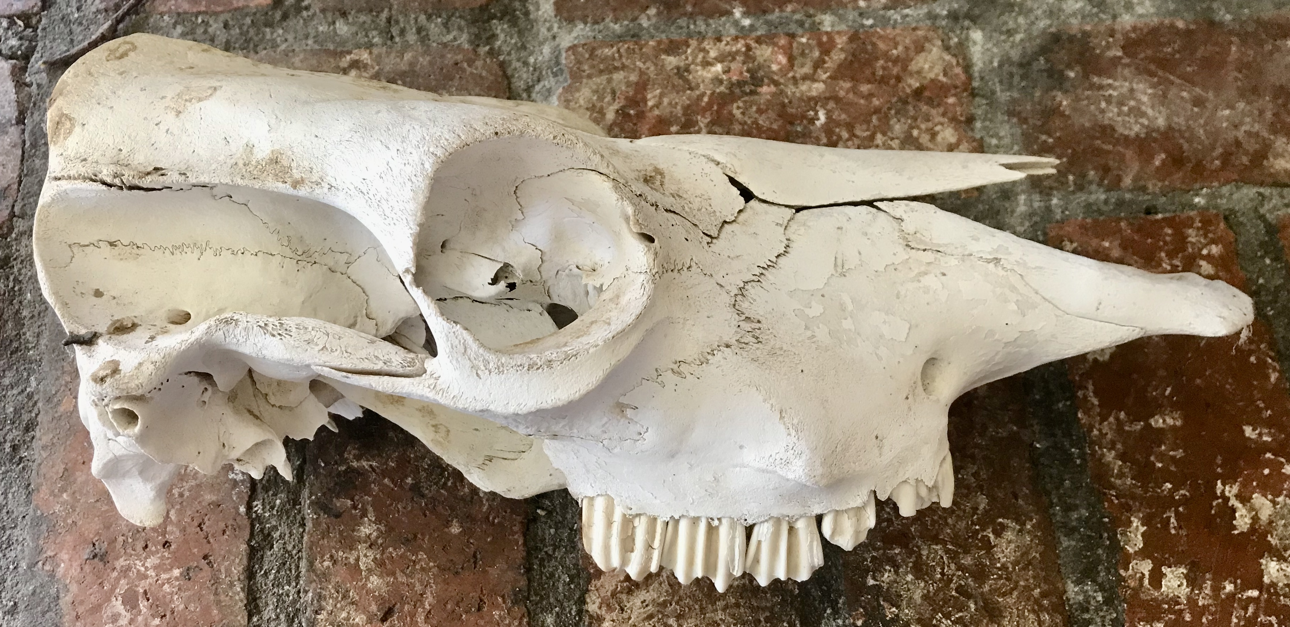
Practice 3: Finger Tracing and Air Drawing
Before you can draw the object, you must train your eye to see angles and changes of contour. The goal is to draw the shape that is in front of you, not the one in your imagination.

Slide 4
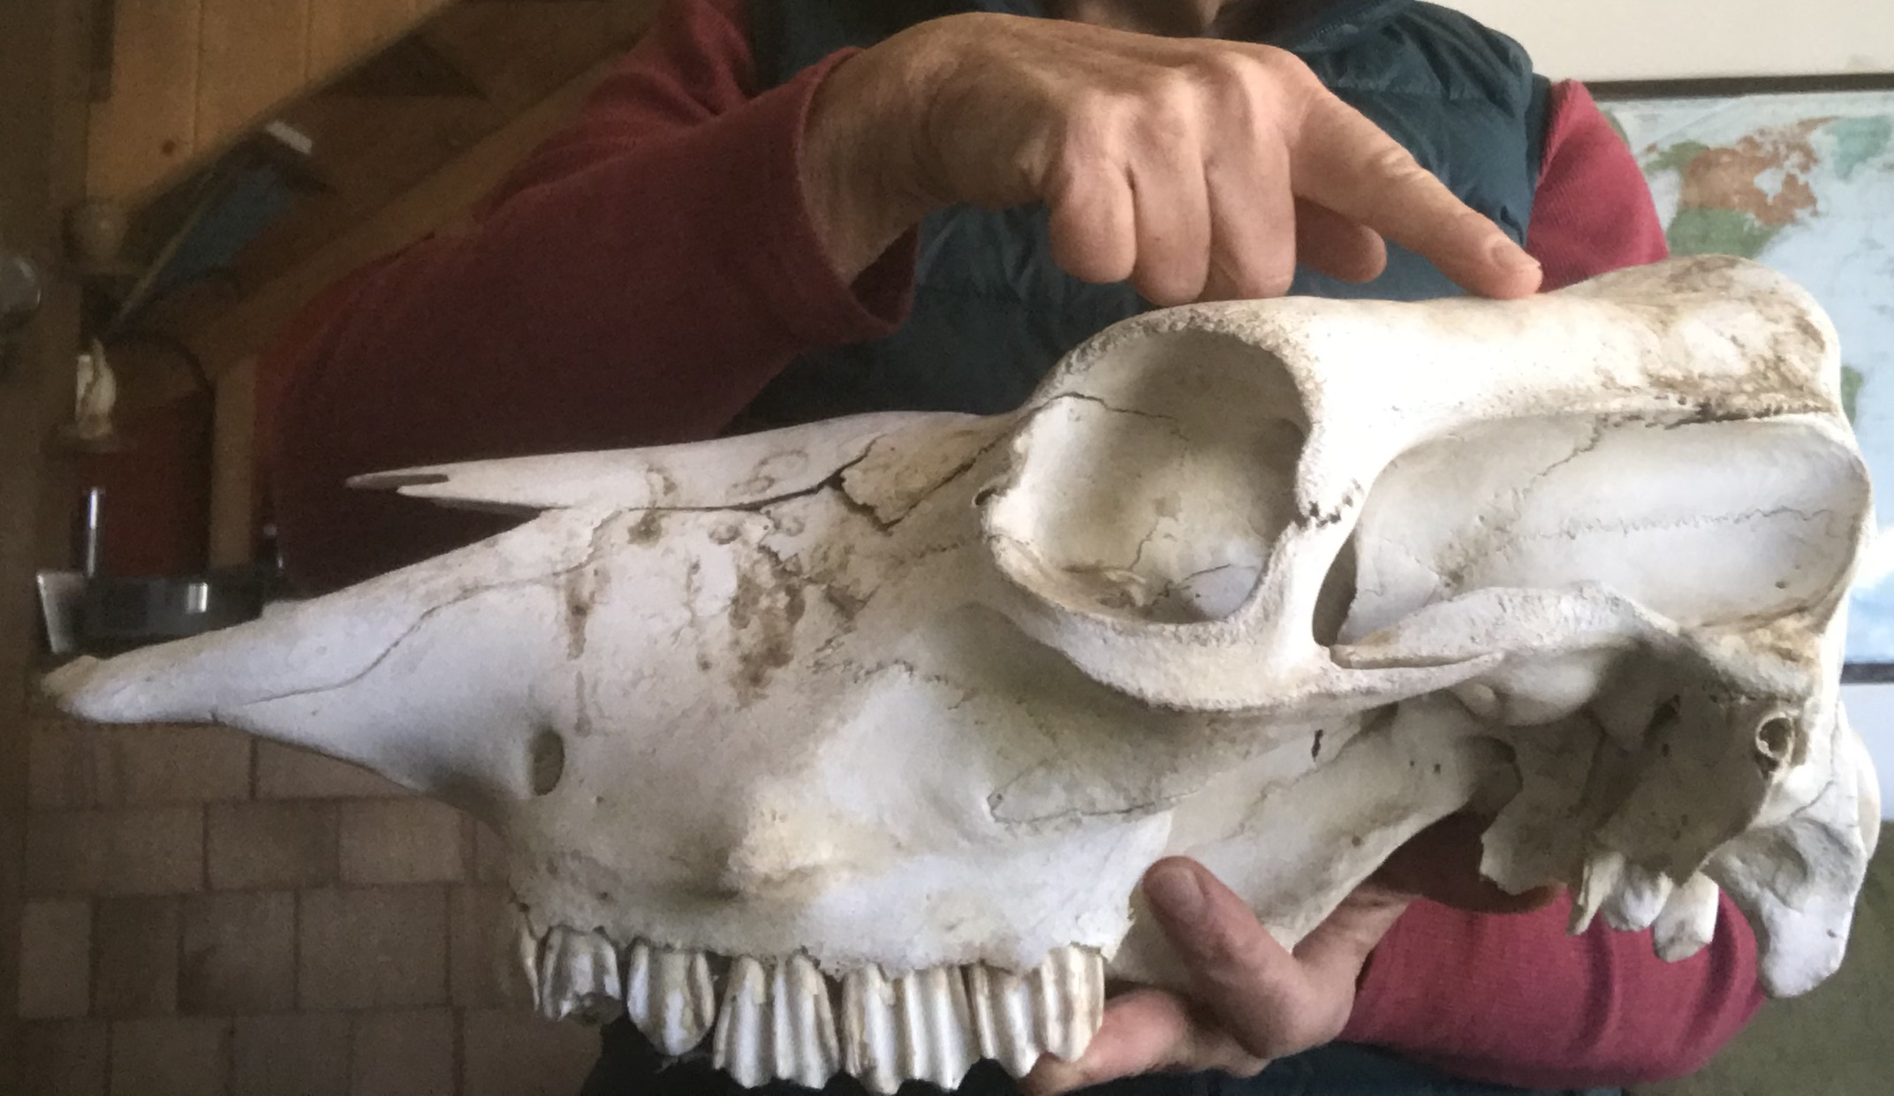
Practice 3: Finger Tracing and Air Drawing
Hold an object in one hand or place an object in front of you.
Close one eye and trace the edges with a finger of the other hand.

Slide 5
Practice 3: Finger Tracing and Air Drawing
As you trace the edges, describe out loud the new angle each time your finger changes direction.
For example: “Straight down, sharp right turn, short flat edge, starting to curve down, little bump, now straight out at an angle.”

Slide 6
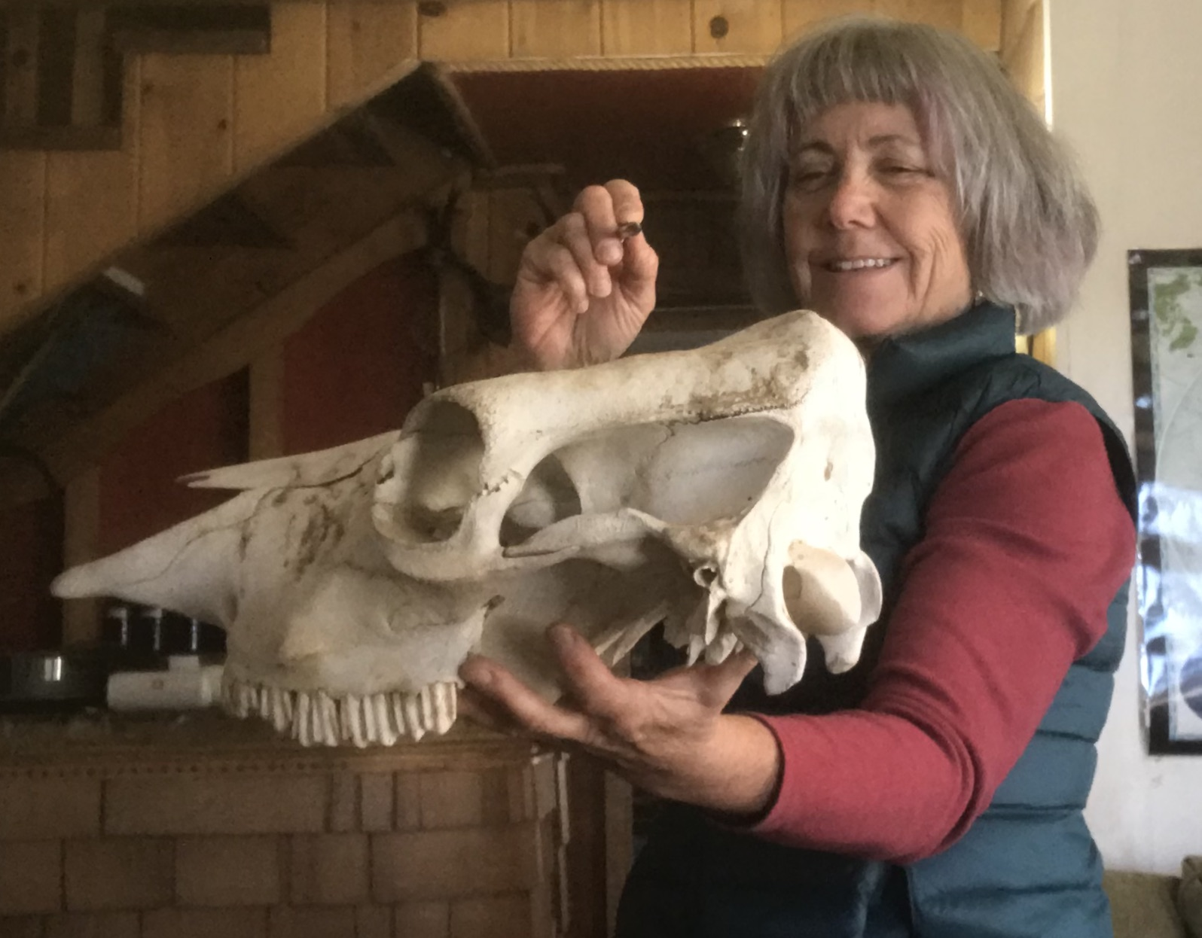
Practice 3: Finger Tracing and Air Drawing
Now do this with a pencil in your hand.
This time, trace the shape in the air with the tip of the pencil. Imagine a line being inscribed on the wall behind the object.
Each micro change or pencil direction or line-segment length is a decision. You want to notice each decision as you move around the object.

Slide 7
Bye for Now. Thanks for Joining Me.

