Slide 1
Observational Drawing Step-by-Step
Study and experiment with this workflow.
Then modify it to fit your individual style.

Slide 2
Step 1 OBSERVE
THE BACKBONE OF AN ACCURATE DRAWING IS SPECIFIC AND CAREFUL OBSERVATION.
It’s easy to start drawing too soon and get focused on what you have on the paper or the way you think the subject “should” look, instead of how it really does look.
TAKE YOUR TIME! Spend a few minutes (2-5 minutes) just looking at your subject.
Begin by talking through your observations aloud before you draw.
Don’t just look at the subject and silently observe.
Say what you see and be specific.
Make observations about shape, angles, proportions (relative measurements such as how big the head is relative to the rest of the body), or where structures are attached before you start drawing.

Slide 3
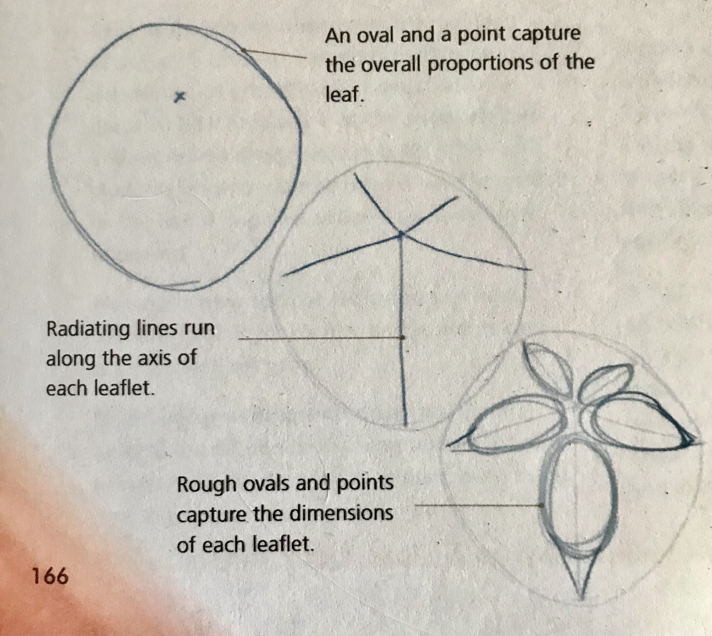
Step 2 BLOCK IN THE BASIC SHAPE
With the lightest possible gesture lines, block in the rough shape of the object with a pencil or non-photo blue pencil (something that applies very, very lightly).
This light framework or “ghost drawing” is the scaffolding on which you will hang your details.
Start with the central axis or tilt of the object with a fluid stroke (one long pencil stroke rather than a lot of little ones).

Slide 4
Step 2 BLOCK IN THE BASIC SHAPE (continued)
Use negative shapes (the shapes of space around an object) in and around the object to further block in the basics.
Add the general proportions
Height vs. width
Relative sizes of the major parts of the object
Use a prominent feature such as a head length to make measurements.
For example, “This bird’s body is 2.5 head lengths.”

Slide 5
Step 3: Check and Modify the Basic Shape
Check the basic shape, looking at the proportions, negative shapes, measurements, and angles of your drawing.
Remeasure parts of the sketch. Look back at the subject, then at your drawing. Correct any inaccuracies before you move on.
This step is REALLY IMPORTANT, but one that drawers of all levels are most likely to skip.
It is only when the drawing is complete that people back off and discover that they made the head too big or the negative space between the legs too long.
These sorts of problems are easily fixed at this early phase of the drawing when you have very light pencil lines.
You do not even have to erase, just draw a new set of lines OVER the existing ones.
Once a hard line is down on the page, you will convince yourself that it is right because you do not want to erase!

Slide 6
Step 4: Draw on Top of the Basic Shape
Now use a regular graphite pencil or pen.
Draw deliberately on top of the light framework, defining edges, contours, and form.
Alternate between seeing the shape of the subject and the shapes of the negative space around and within the subject.
As the drawing progresses, use more pressure, adding accents and reinforcing key lines, or parts of foreground objects.
Vary the boldness of your lines, avoiding the temptation to make every line bold.

Slide 7
Step 5: Clean Up the Drawing
Now pull out the eraser and clean up any extra lines.
Note that erasing comes late in the drawing, very different from the “draw a little, erase a little, draw a little, erase a little” approach.
Erasing at the end is about calling attention to the intentional lines you have drawn throughout a slow process.
Erasing as you go is not as effective.

Slide 8
Step 6: Add Value
Many artists simply color the drawing from here, but this can result in a flat, coloring-book look.
Getting the values, the patterns of dark and light, is more important than matching the color.
Squint at both your subject and your drawing to blur detail and help your brain focus on value.
Shade in the darkest area and middle tones.

Slide 9
Step 7: Add Color
Once your values are defined, you can tint them with color.
As you get more experienced, you can start to apply both value and color at the same time.

Slide 10
Step 8: Add Detail
Think of detail as a spice to be added carefully at the END of a drawing.
If you add detail too early in a drawing, it becomes obscured by shading, color, erasing, or the smudging that happens as you draw.
Add more detail with a sharp graphite pencil.
Put detail in areas of focus and interest, and in the foreground.
This will guide the eye of the viewer and give a greater sense of depth.
**Detail everywhere will flatten your drawing.

Slide 11
Step 9: STOP BEFORE YOU OVERWORK THE DRAWING!
It’s hard to know when to stop.
A drawing that is partially complete is more interesting than one that is overworked.
One rule of thumb is to stop drawing before you think you are done.
A partially complete drawing isn’t the same as an incomplete journal entry.

Slide 12
Step 10: Make Another Drawing
This is a process, and each drawing is just practice for the next.
There is no end, no masterpiece, just open-ended practice and ongoing learning.
The more you draw the better you get.

Slide 13
Bye for Now. Thanks for Joining Me!

Slide 14
Bye for Now. Thanks for Joining Me.

