Slide 1
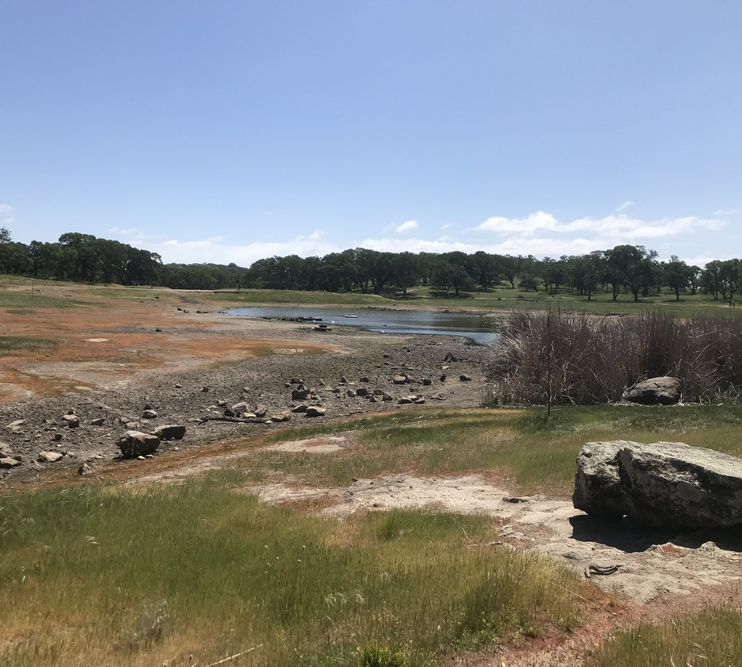
LESSON 13 MYSTERIES AND EXPLANATIONS
Explore nature while digging deep into curiosity. Propose and refine questions and pose possible explanations for what you see, without the need to be right!

Slide 2
Asking questions, finding mysteries, and making explanations are fun and creative ways to interact with nature.
Start making explanations about your questions and observations
By being curious, asking questions, and making explanations, you have the basic scientific inquiry skills.

Slide 3
Think Like a Scientist Ask Questions; Look for Evidence
Scientists come up with questions, explore mysteries, and make explanations too.
Science is about trying to find the best explanation based on all the available evidence, so scientists spend a lot longer, usually months or years, doing research and testing and considering different explanations.
When scientists come upon evidence that contradicts their explanation, they stay open minded and are willing to change their thinking and listen to ideas.

Slide 4
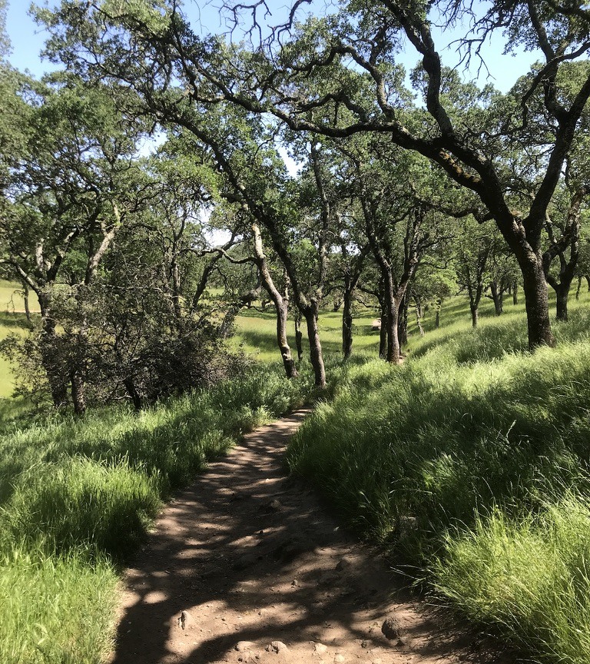
Procedure Summary
Make observations
Ask questions and look for mysteries.
Make multiple possible explanations about your obervations or mysteries.
Support your explanations with evidence.

Slide 5
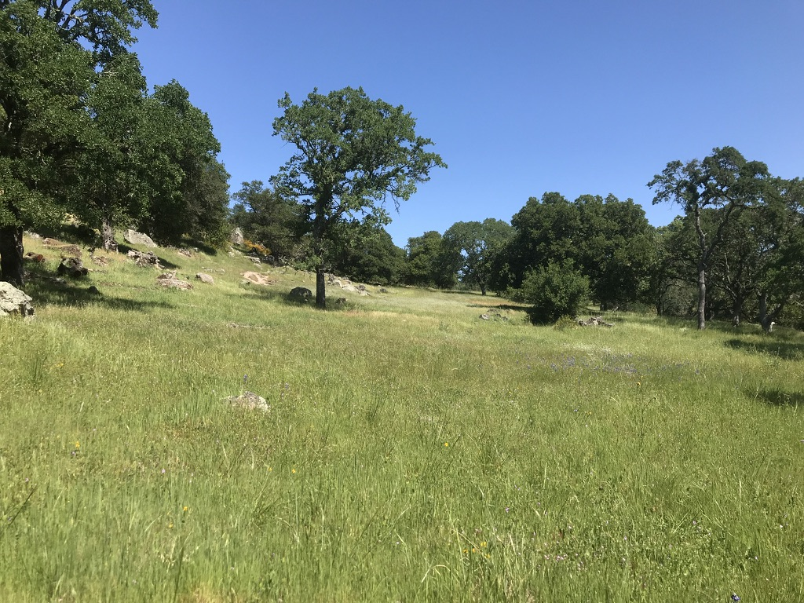
With a partner…
Start by taking a couple moments to make observations of a leaf or other small part of nature.
With your partner, talk out loud about your observations (I notice…)
“I notice this leaf has small brown spots on it.” “ I notice the edges have ridges.”
Next, ask questions based on your observations or “It reminds me of’s.”
“I wonder what caused those brown spots.” “I wonder if those spots occur on top of the leaf or are eaten into the leaf.” “The pointed edges remind me of thorns.”
You don’t need a partner to do this, but it’s fun to observe and discover together. You’ll be surprised how much more you’ll notice together.

Slide 6
Discovering mysteries
Asking questions and making observations is a way to discover mysteries other people might NEVER notice.
Ask as many questions as you can – keep asking as you continue to observe.

Slide 7
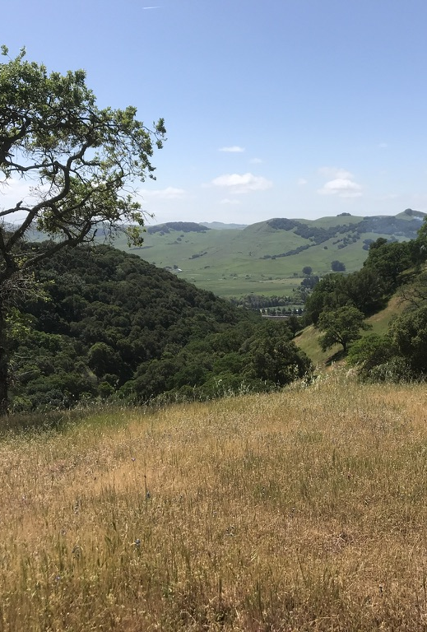
You can try to answer questions by making more observations.
You might be able to answer some of your questions right away by making more observations:
“I wonder if other leaves on this plant have the same spotted pattern.”
If you ask questions that you can answer through more observations, GO FOR IT!

Slide 8
It’s fun to come up with explanations for the observations, questions, and mysteries you find in nature.
There are going to be lots of mysteries you find in nature that you likely won’t be able to answer right away.
It’s fun and interesting to make explanations and try to figure out nature mysteries.
“Maybe the spots are actually small insects attached to the leaf.”
“Perhaps the spots are the result of some kind of chemical that splashed on the leaf.”
“Possibly an insect is biting into the leaf.”
IMPORTANT: Base your explanations on EVIDENCE!

Slide 9
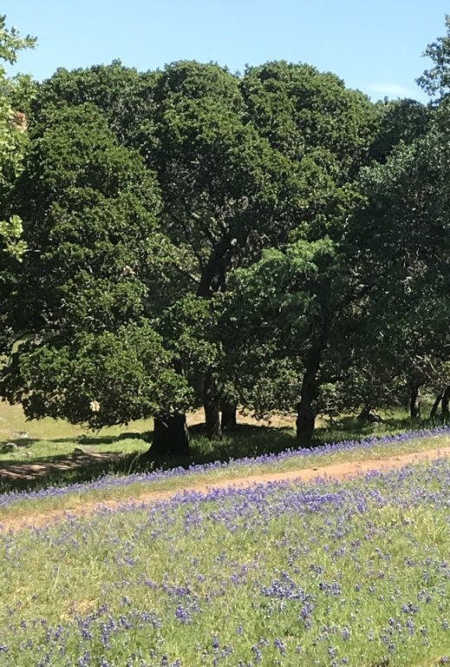
Base your explanations on evidence.
We need to share the evidence and reasoning that make us think that.
“I think the spots were made by small insects, because, using my hand lens, I notice small insects on the underside of the leaf.”

Slide 10
Use the language of uncertainty
This means using words like
MAYBE…
PERHAPS…
POSSIBLY…
as you say your explanation

Slide 11
Go back to your observation…
With your partner:
Now come up with several explanations about your small object.
Make sure you use the language of uncertainty and base your explanations on evidence.

Slide 12
Now do this in your journals on your own
Head your journal with metadata
Find another interesting mystery
Go back and forth between making observations, asking questions and coming up with explanations.
ABC, 123,
If you’re able to answer questions through observation right away, go for it,
Then ask another question.

Slide 13
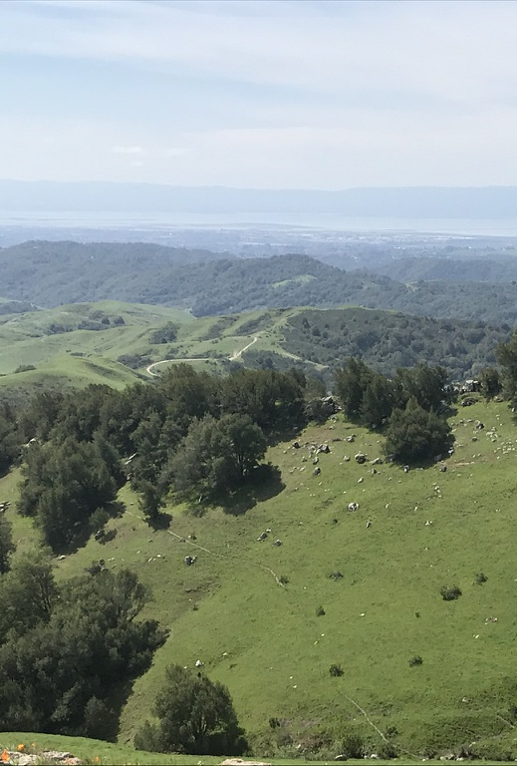
Do it YOUR WAY
You don’t need to be rigid about it or always go in that same order.
You might ask a bunch of questions then come up with many different explanations.
Your explanations might lead you to make more observations, then come up with another question.
Remember to use the language of uncertainty
Make more than one explanation for a phenomenon.

Slide 14
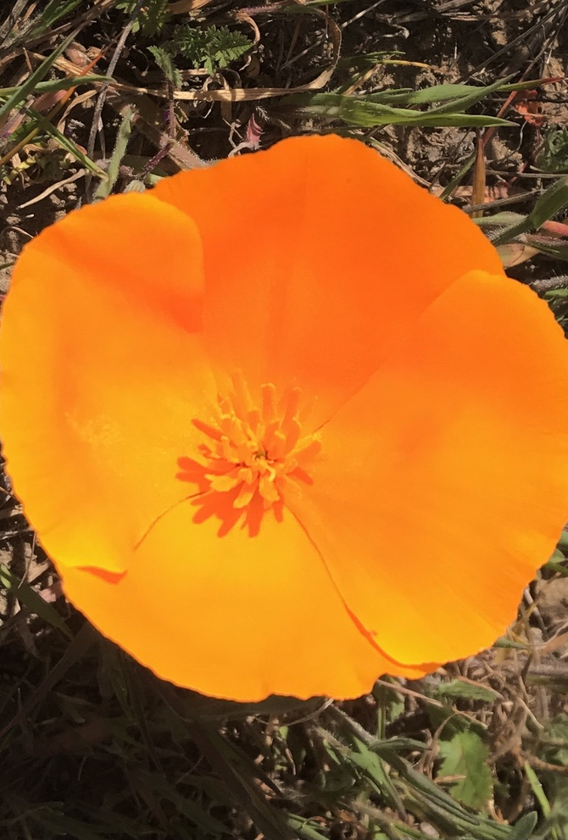
THE BEST PART
You don’t have to be right.
But you do have to think carefully and be sure to support your explanations with evidence.
Have FUN with it.
Share your interesting and exiting explanations with someone. Together, decide which explanation seems most likely based on the evidence.

Slide 15
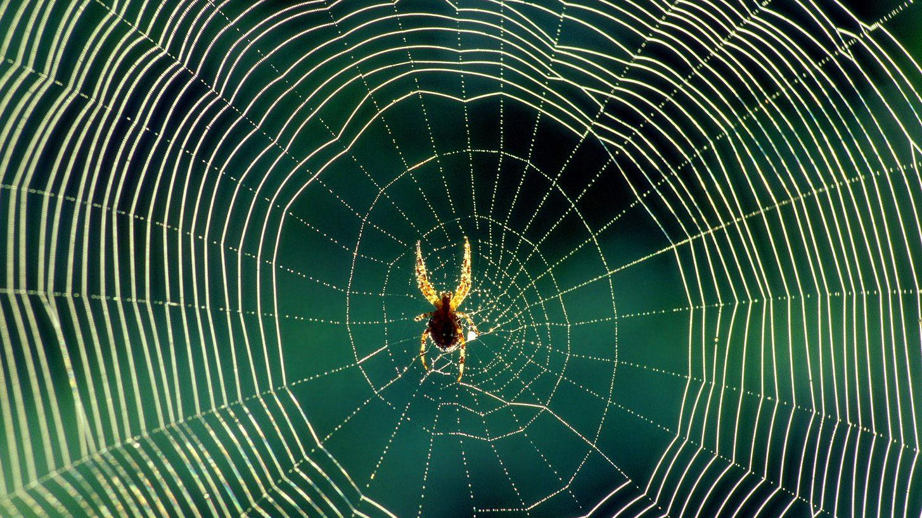
Make a “Why Web”
Choose one of your questions, for which you can think of more than one explanation for a phenomena and write it in the middle of your next journal page.
Write down possible explanations in your journal.
You don’t have to be right.
Be creative.

Slide 16
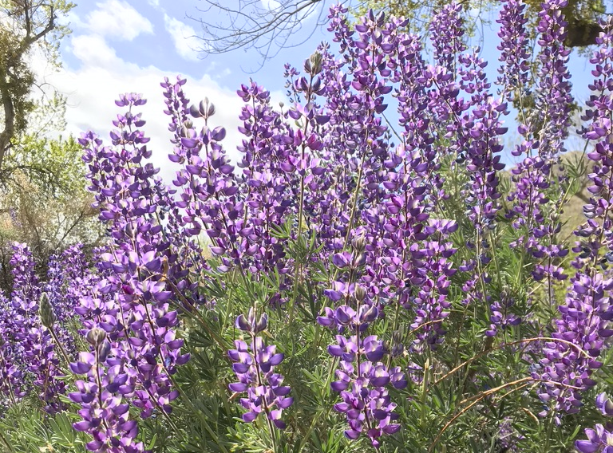
BYE FOR NOW. THANKS FOR JOINING ME.

