Slide 1
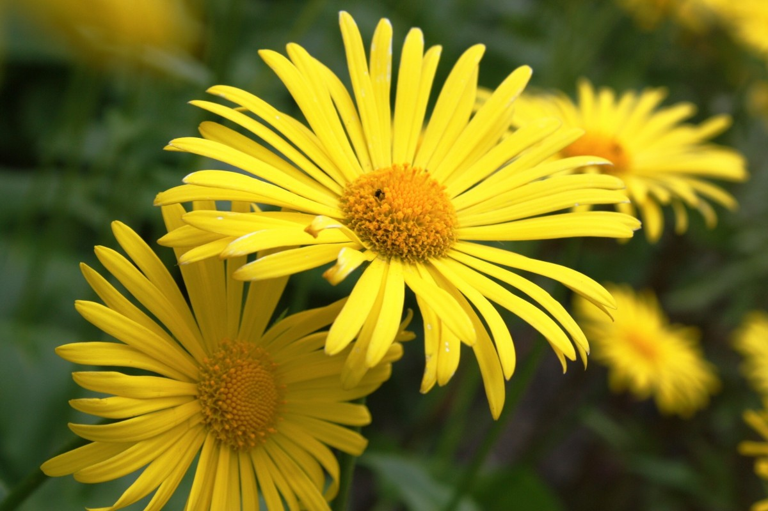
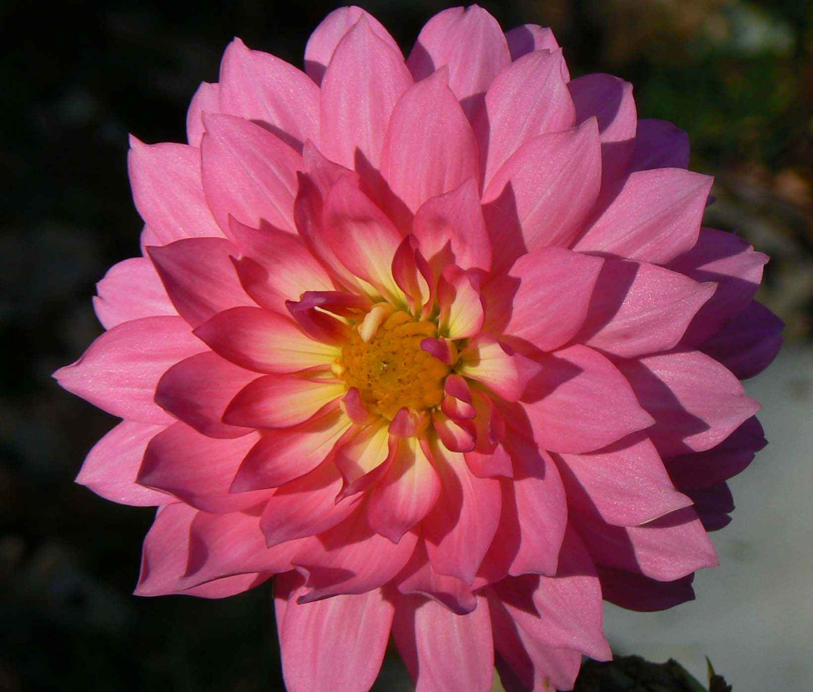
Lesson 16 HIDDEN FIGURES
There are numbers behind our observations.
On a plant
Number of petals on a flower
The height of a plant
Distances between nodes
Number of visitations by pollinators
Number of aphids per leaf
Speed of growth
Find the numbers behind your observation and you have a mathematical way to reveal patterns you might not otherwise notice.
Using mathematics in your observations adds another language and level of precision to your journal page.

Slide 2
COUNTING, MEASURING, TIMING, AND ESTIMATING
In this 5-part lesson, we will use COUNTING, MEASURING, TIMING, AND ESTIMATING to create a journal page.
You will practice each of the four different measuring activities, then do as many measurements as you can in one entry.
The goal of this activity is for you to practice quantifying your observations.
ANY EVENT CAN BE TIMED, ANY OBJECT CAN BE MEASURED, AND THERE ARE THINGS TO COUNT EVERYWHERE.
This Photo by Unknown Author is licensed under CC BY-SA-NC

Slide 3
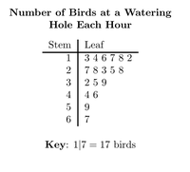
What you will be able to do
Count (time, measure, or estimate) things around you, trying to find different ways to quantify your observations.
Be CREATIVE! There is no penalty for being wrong. Numbers are just another way to describe our surroundings.
Use your journal to record what you quantify.
Create visualizations of your data by making graphs, charts, scatter plots, etc.

Slide 4
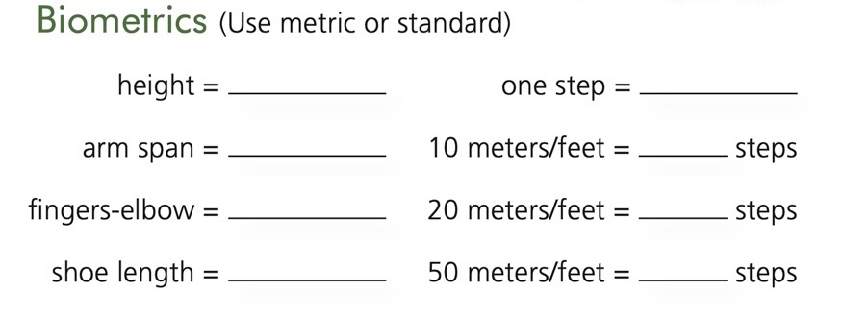
Measuring lengths or distances between things
We can use tools such as rulers, measuring tapes, goniometers, or biometrics such as the length of our finger, arm, or number of paces we walk to determine distance.
Examples: size of leaves on a bush, the distance between leaves, the diameter of holes in the ground, the distance from tree to riverbank.
Create a personal biometric chart
in your journal that you can refer to.
Fill out your information:

Slide 5
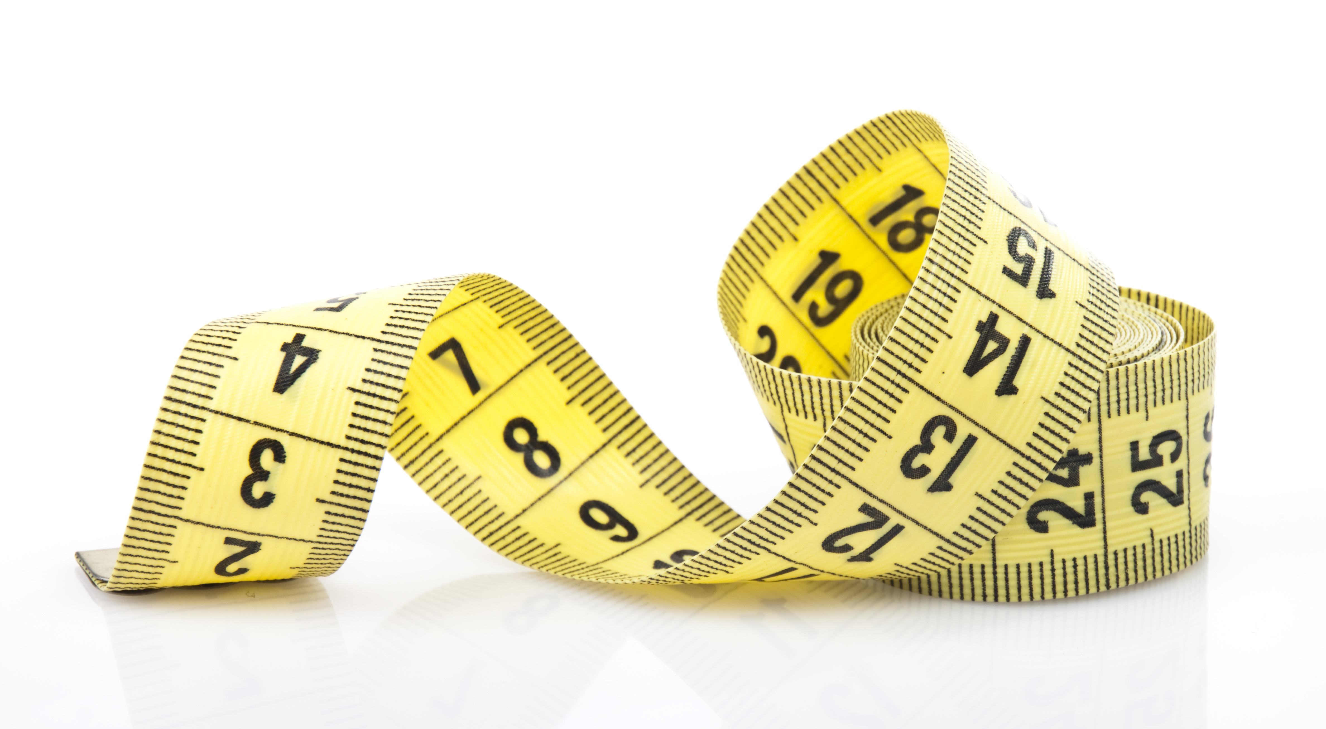
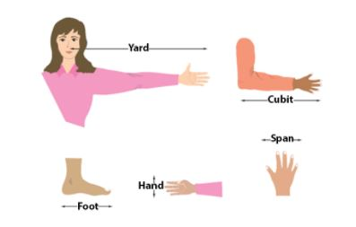
Practice 1: Measuring
Pick a nearby natural object and measure as many parts of it as possible, recording your data in your journal and adding sketches, writing, and questions.
Use both tools and biometrics.

Slide 6
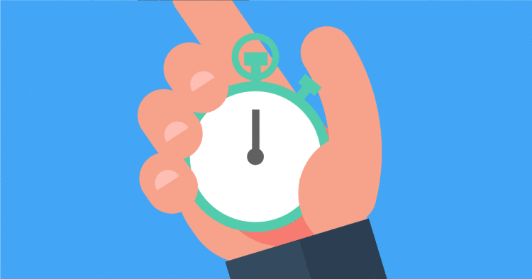
Timing
You can use timing to record anything in motion.
Examples of things to time
If we see an animal repeating a behavior, we can time the intervals between behaviors
If a hawk is soaring above, we can time how long it soars before flapping its wings
How long is the sparrow’s call?
If a duck dives underwater, how long is it until it comes up?
Interesting weather patterns
We can record the amount of time between gusts of wind, or how long it takes one quickly moving cloud to pass over the horizon.
Tools: Stopwatch or you can count seconds yourself
(“one hippopotamus” is 1 second)

Slide 7
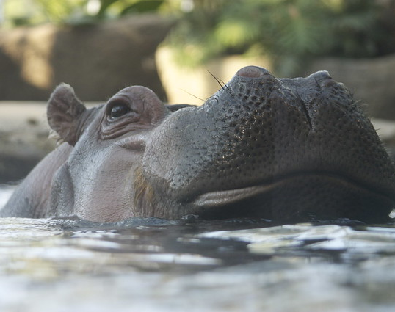
Practice 2 Timing
Find things to time nearby and record your data in your journal, asking questions and using writing or pictures to show your observations.
Count with both a timer and hippopotamuses

Slide 8
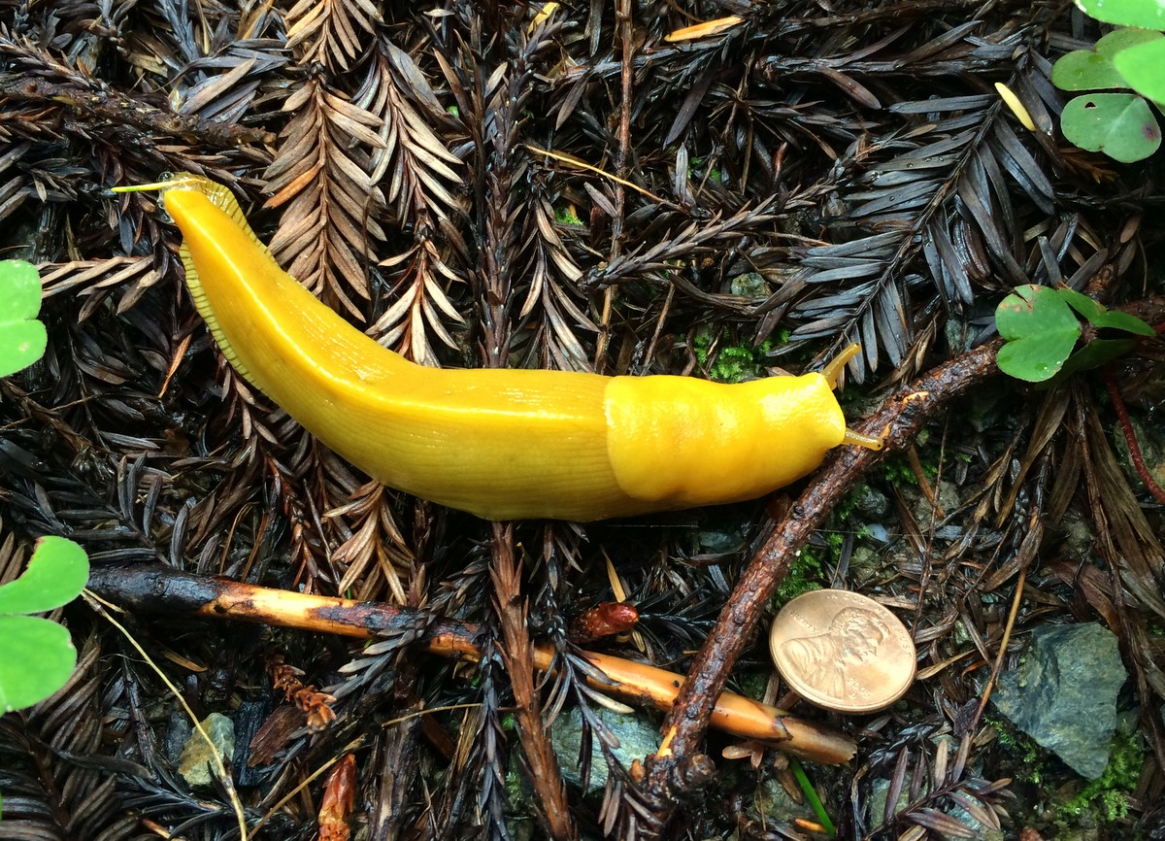
Use distance over time to calculate speed
To measure an animal’s speed, measure the distance an animal moves over a period of time.
For example, time the distance a banana slug moves in one minute.
Lay a ruler beside the banana slug and start your timer. At one minute, measure its distance next to the ruler.
Write it as “10cm/minute” and say “ten centimeters per minute.”
While a stop watch is a good tool, for longer processes, such as a leaf changing color, you’ll need a calendar!

Slide 9
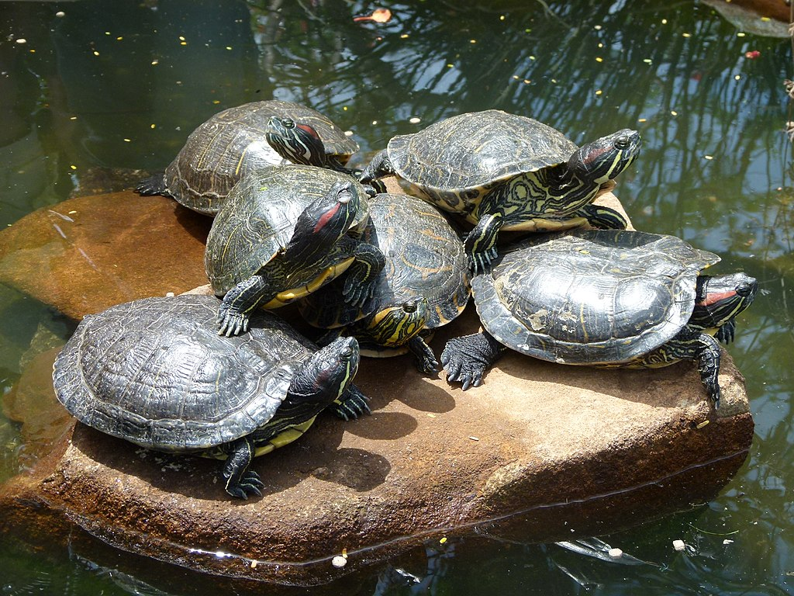
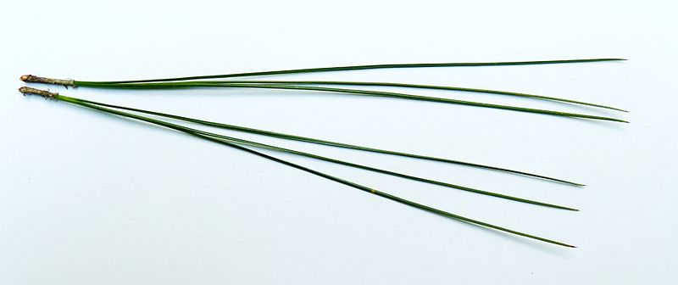
Counting
As soon as we start counting things, we discover patterns that we can use to better understand our surroundings.
We can count numbers of individual organisms, such as the number of turtles sunning on a rock,
Number of parts of an organism, such as the number of pine needles in each bundle
You can also count nonliving parts of a landscape, such as holes in the ground.
Include the context in your counts
The number of lady bugs: found on a bush,
or across a whole field, or seen over an entire day?

Slide 10
Use hash marks (aka tally marks), graphs, maps, charts to display counting data.

Slide 11
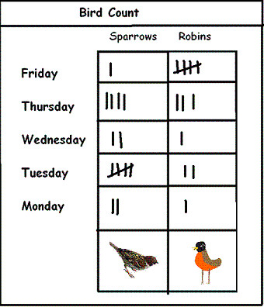
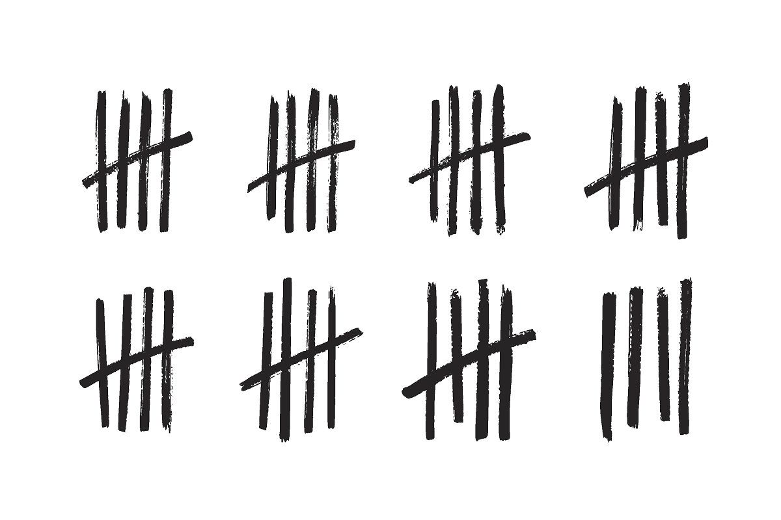
Practice 3: Counting
Find things to count nearby, recording your data in your journal, asking questions and using writing and pictures to show your observations.
Count as many different things as you can.
You can use tally marks (hash marks) as you
count.
Counting hash marks are drawn as four vertical lines
with a diagonal line to finish the set of 5 things.

Slide 12
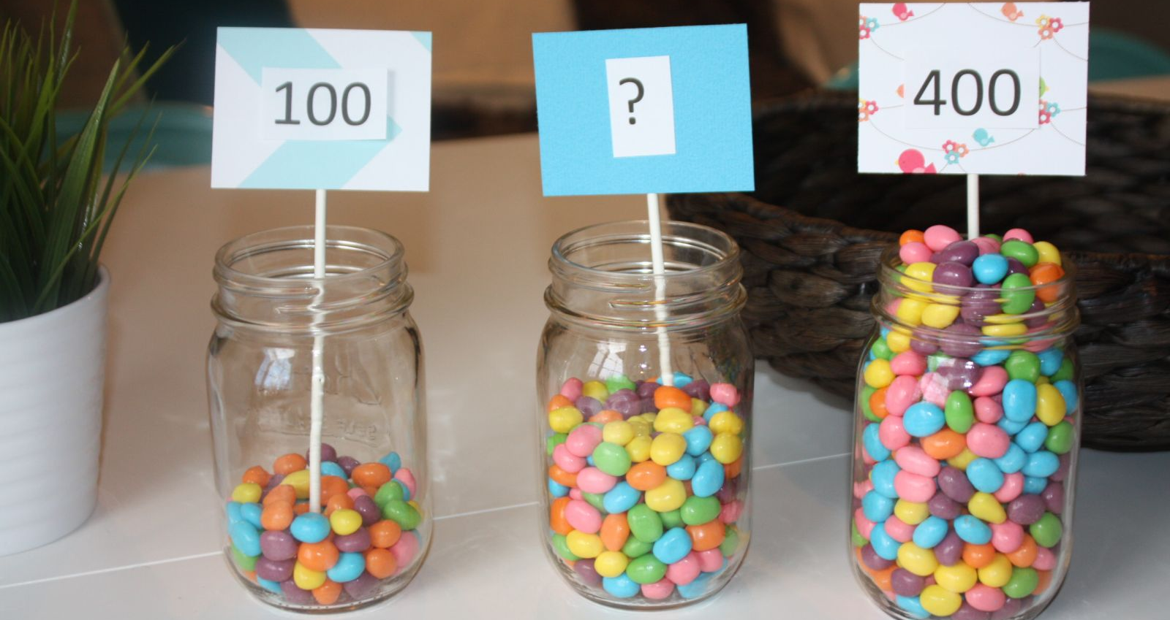
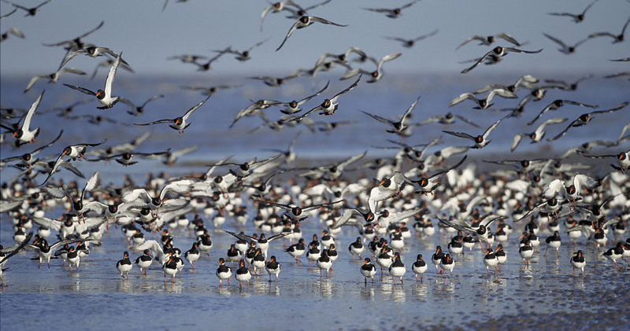
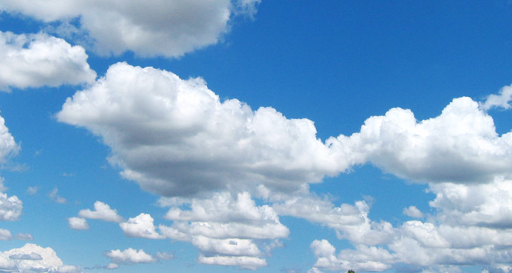
Estimation
You might want to use estimation to gauge large numbers, distances, percent cover, and other things that would be difficult to count or measure.
Number of leaves on a bush, number of birds in a flock, moving too fast to count each one, how much sky is clouded over.
Estimation isn’t just guessing. It’s using a specific approach to make an accurate guess.

Slide 13
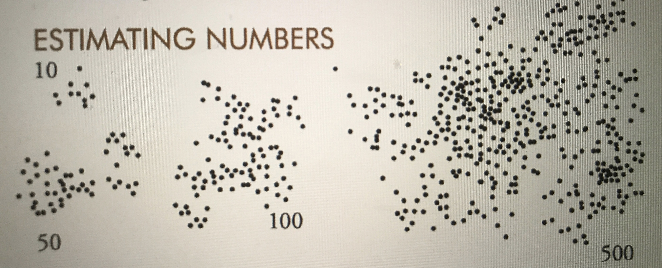
Estimation Strategies
One approach for estimating large numbers is to count just ten, see what that looks like, then count how many chunks of ten seem to be present
You can also use this chart that shows what 10, fifty, one hundred and five hundred look like to help you estimate.

Slide 14
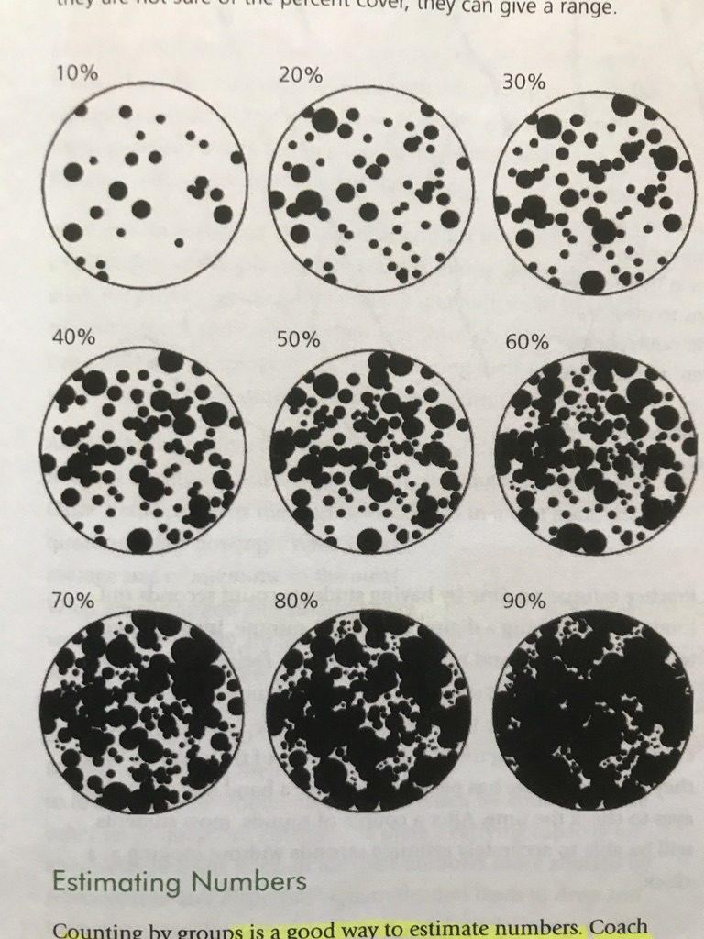
Estimating Percent Cover
To estimate something like the amount of sky covered by clouds or the amount of ground covered by grass, use this chart to make a quick guess.

Slide 15
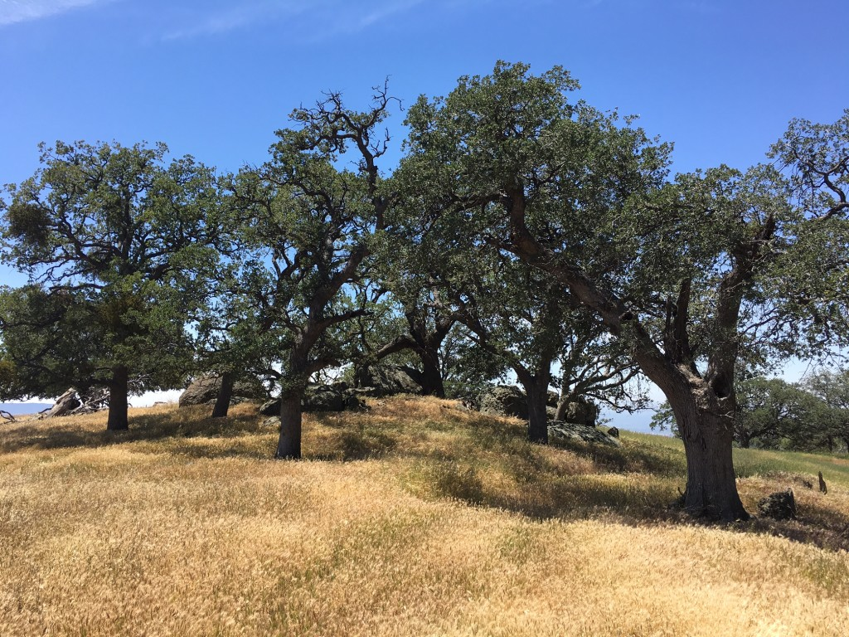
Practice 4: Count and Estimate
Go out and quantify nearby parts of nature, counting exactly if possible, estimating to determine large numbers, and recording estimates in your journal.
Pay attention to what situations are better to estimate than to count.
For large numbers, keep your estimates rounded off. If you count around a hundred ducks, then see two more, say, “about one hundred”, not “one hundred and two.”

Slide 16
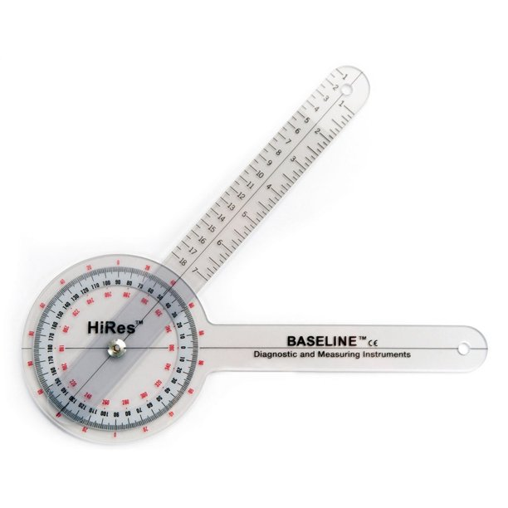
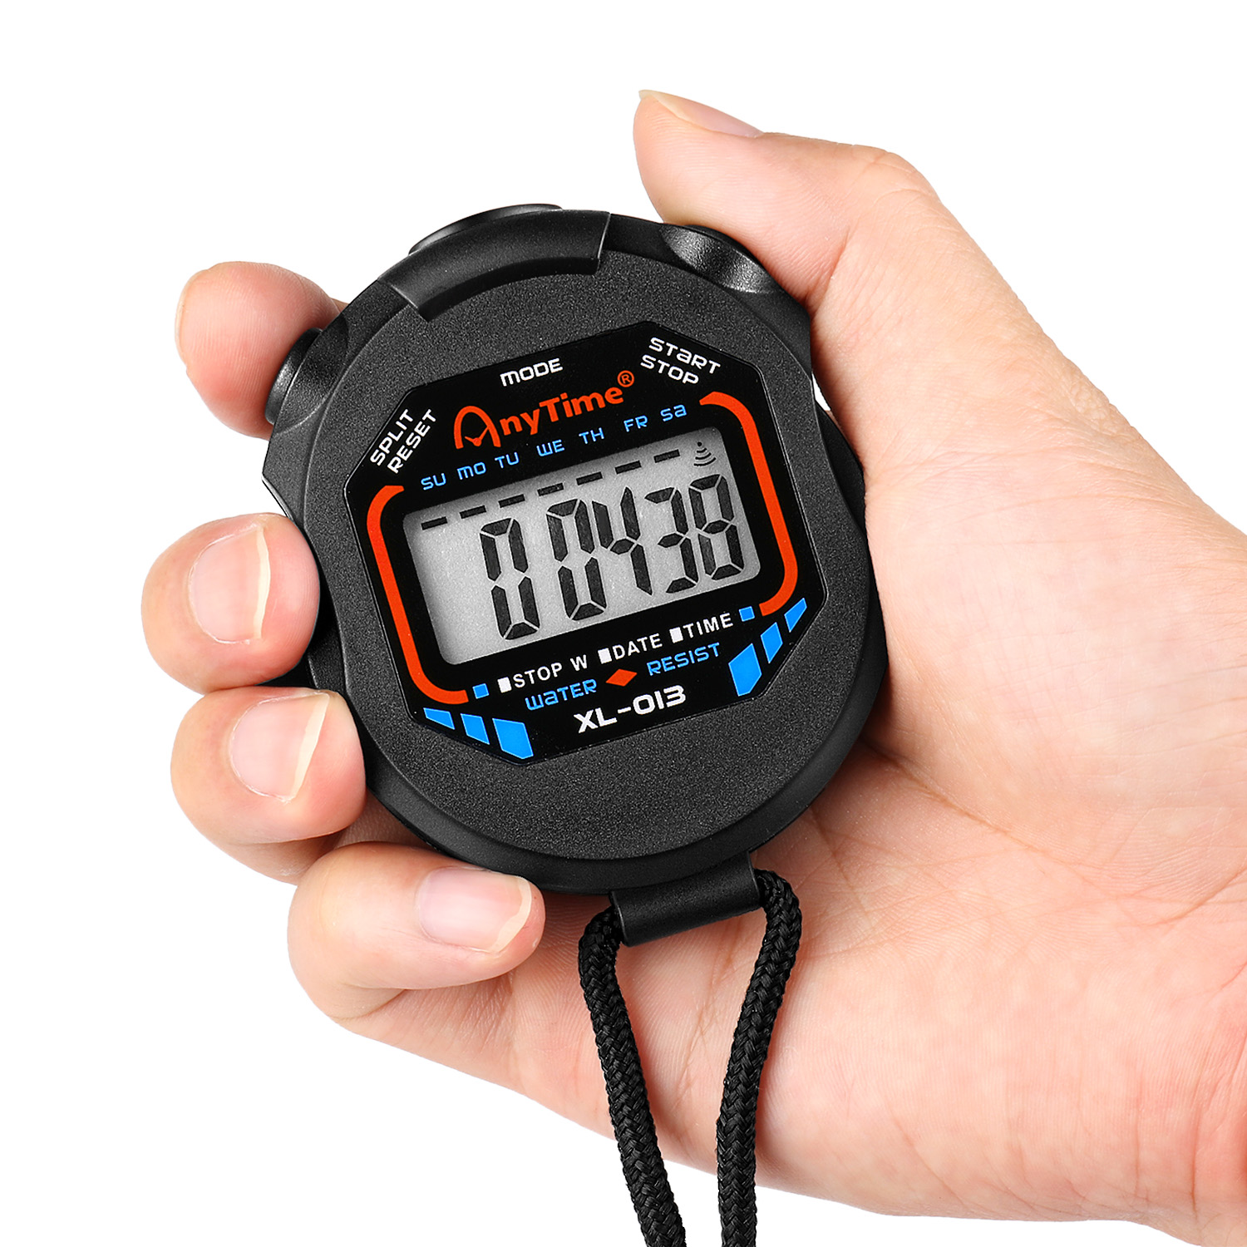
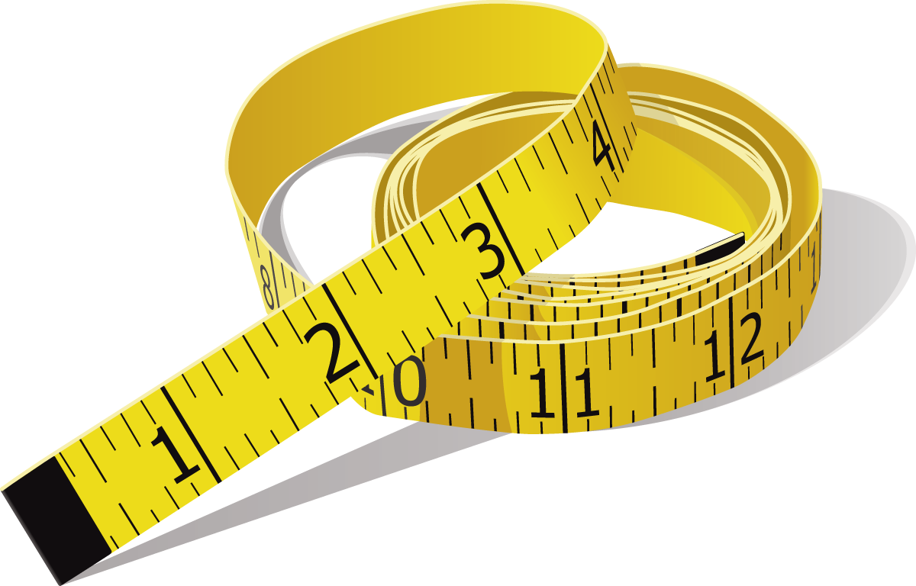
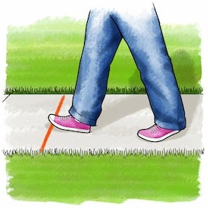
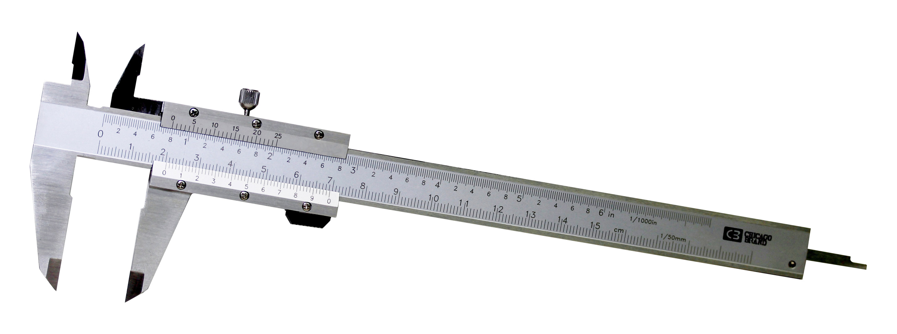
Put it all together
Explore the nearby area, using your new quantification skills to record data about anything that is interesting to you.
Record observations in drawing and writing, and look for ways to count, estimate, measure, or time what you are looking at.
This takes creativity. See if you can discover interesting or unexpected opportunities for quantification.
Create a visualization of your data by making a graph, histogram, stem-and-leaf plot or scatter plot.
Your goal is to see how many ways you can use numbers to describe your surroundings.
There is no penalty for making a mistake!

Slide 17
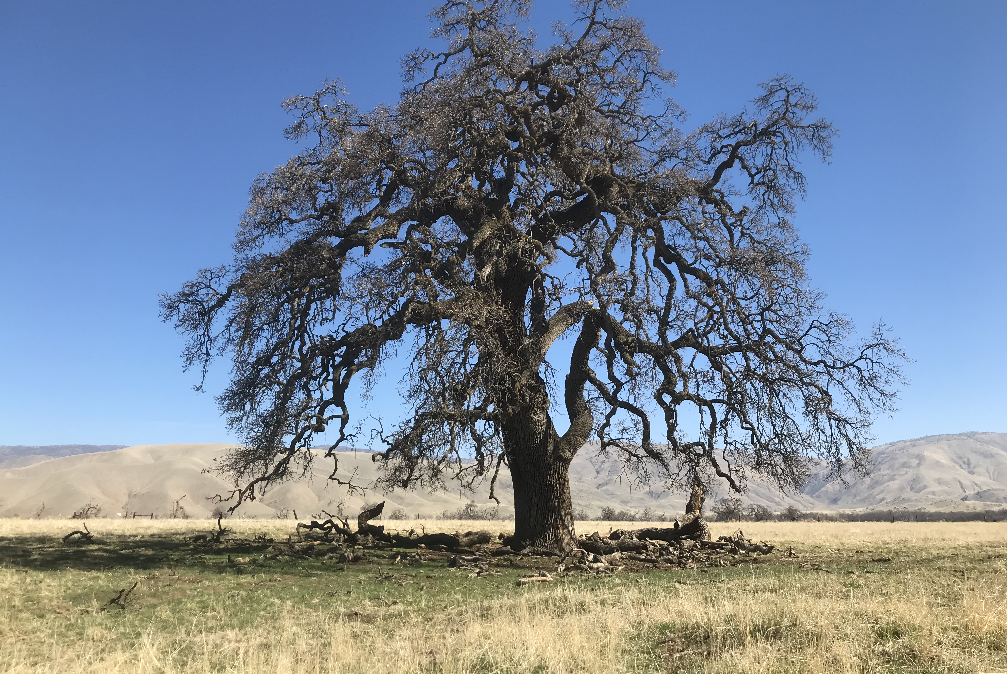
Thanks for Joining Me. See you Next Time!

