Slide 1
VIRTUAL GALLERY WALK
6th -8th grade class

Slide 2
HOW TO DO THIS
Here is a chance for you to share your hard work AND for you to see what your classmates have done.
Go to your next BLANK journal page. Write the title: JOURNAL IDEAS
As you look at others’ work, take notes on this page about what you saw that you’d like to add to your next journal entry.

Slide 3
WHEN IT’S YOUR TURN
When you see a slide with your journal pages, talk about what you were studying and explain what you did.
Tell what you like about your journal page and what you might change or add next time to make it better.
Ask for feedback from EVERYONE, if you’d like.

Slide 4
Focus on the Strengths
EVERYONE: Think about the strengths of the pages you’re seeing and ask permission to share your thoughts.
Start your comment by saying:
“I like the way you…”
Don’t use the words “good” or “bad.” We are not judging.

Slide 5
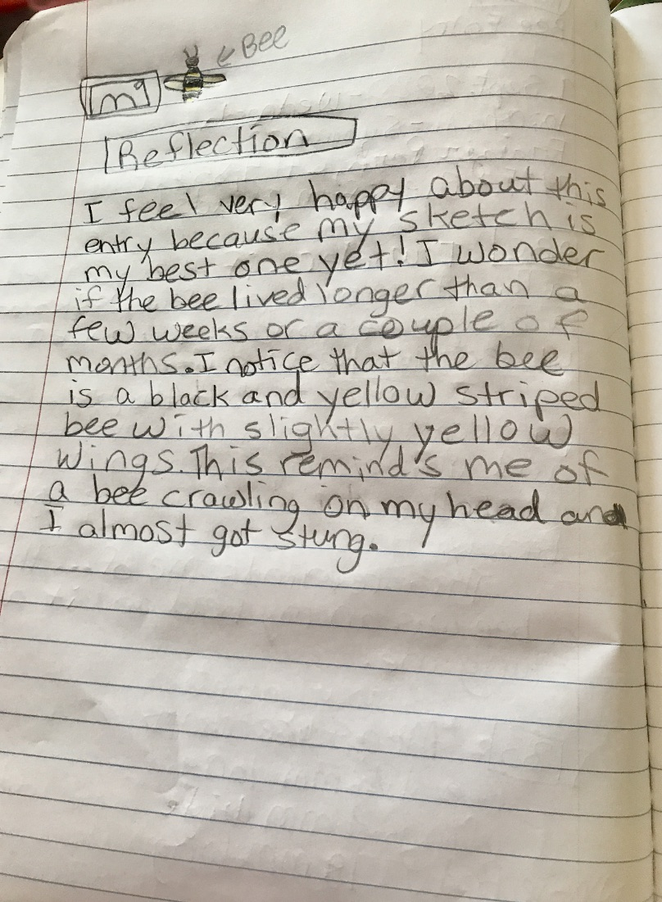

Slide 7
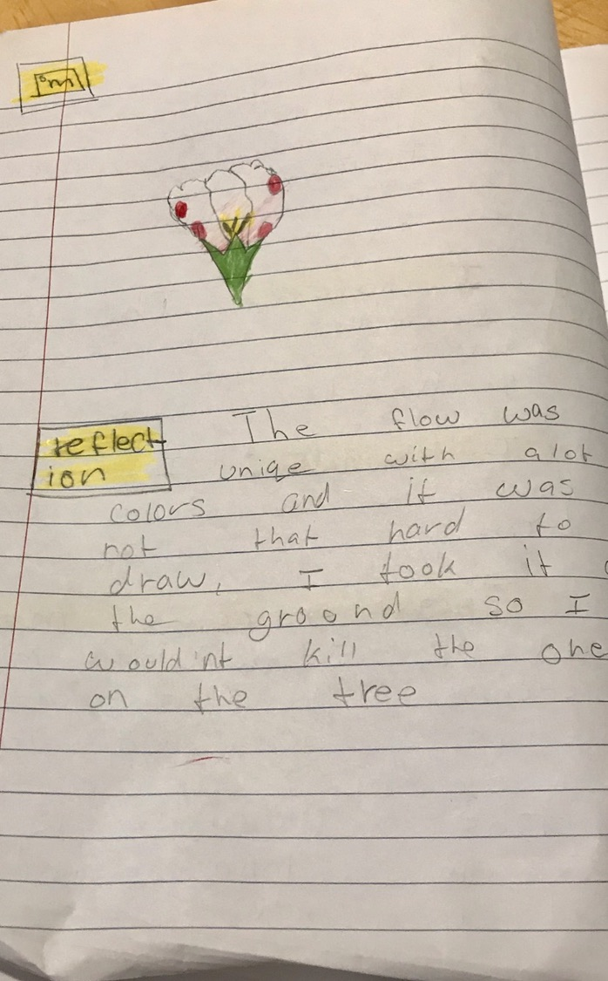

Slide 8
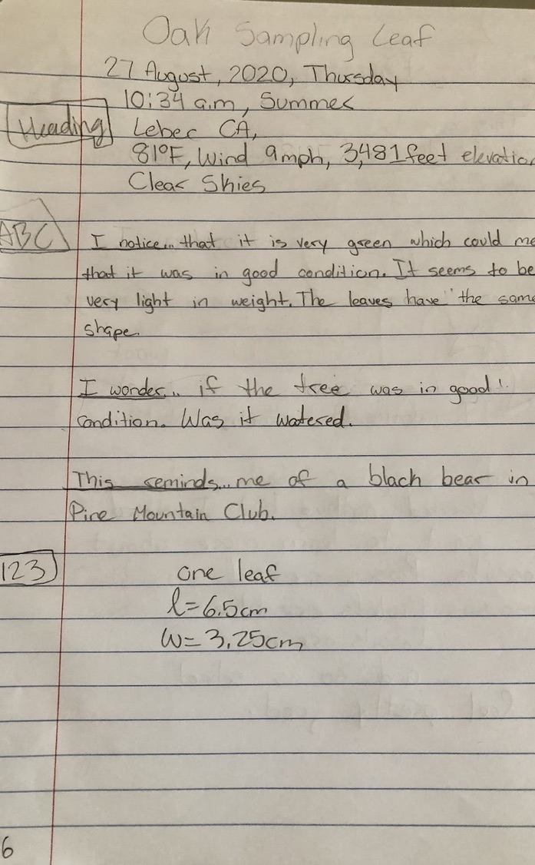

Slide 9
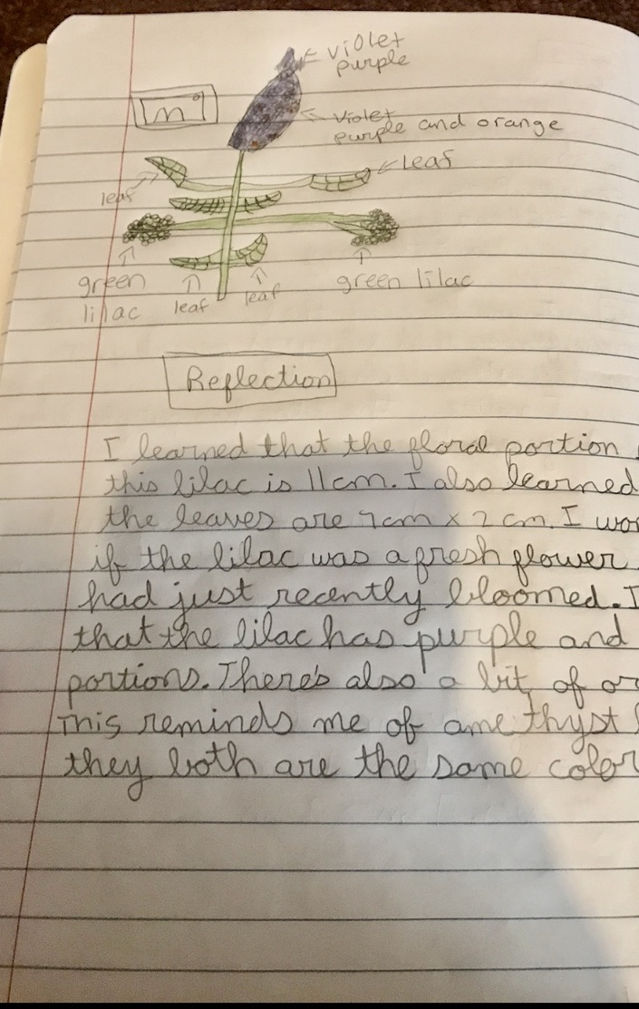

Slide 10
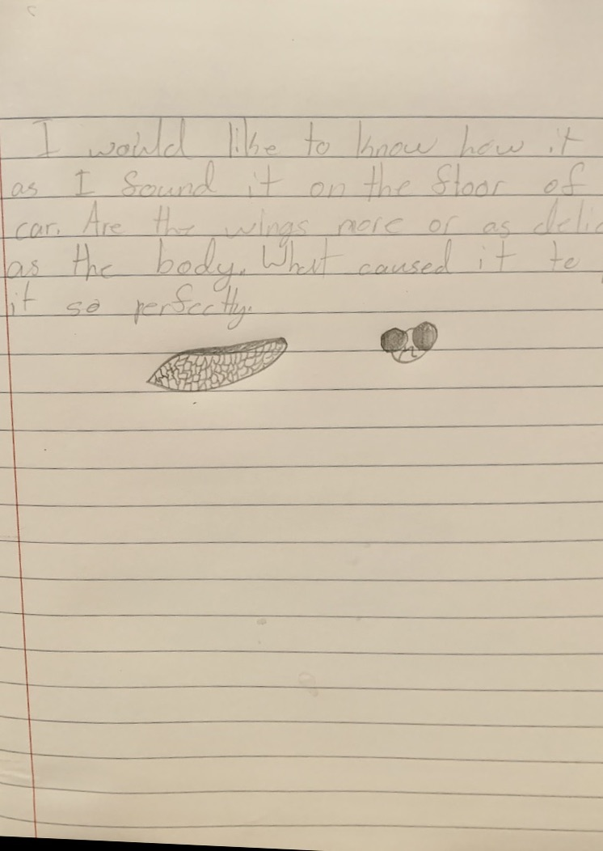

Slide 11
Thanks for Sharing. We Learn From Each Other

