Slide 1
BUILDING NEW SKILLS: BASIC DRAWING EXERCISES
Drawing Exercise 5

Slide 2
Practice will develop your drawing skills
Think of drawing exercises as warm-ups and drills.
Just as you get better at basketball with practice and repetition of basic skills, so too with drawing.
The more you practice making marks, the more you will naturally understand what your hand and pencil can do.

Slide 3
PRACTICE 5: CONTOUR DRAWING
Contour drawing is a way to train yourself to look at drawing shapes
The most important part of accurately drawing an object is to look at it carefully.
Too often we rely on our mental image or what we THINK our drawing subject SHOULD look like, instead of observation.
Contour drawing is the most powerful way to train yourself to look at the subject.

Slide 4
BLIND CONTOUR DRAWING
The point of blind contour drawing is not to draw, but to see. It’s a fun exercise that will train the connection between your eye and your pencil.
Select an interesting object to draw.
Stare at the object and slowly begin to draw its shape without looking at the paper. Let your eye crawl slowly along the contour (outline) of the object.
Let your pencil creep along your paper moving up or down, following the curves and angles that you see.
DO NOT LOOK AT YOUR PAPER!
5. With every change in angle, let your pencil respond with its own change of direction. Do not lift your pencil or look down to see where you are.
TAKE YOUR TIME!

Slide 5
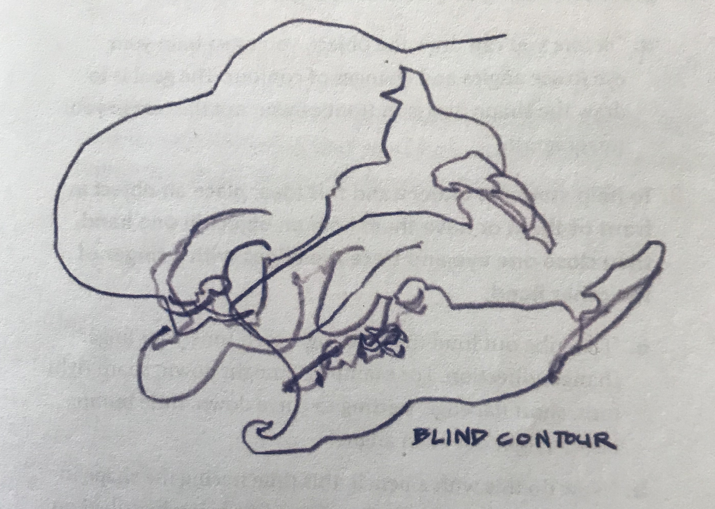
BLIND CONTOUR DRAWING (continued)
When you are done, take a look. The results might be comical and fascinating. Look for places where your lines reveal subtle changes or aspects of the real object.
You can continue practicing with other objects. This will train your hands to respond to what your eyes see.

Slide 6
MODIFIED CONTOUR DRAWING
A modified contour drawing also helps us hone our observations but results in a drawing that looks much more like the object.
The process is the same, only this time, you get to peek. Every now and then, you can glance down at your paper to allow yourself to relate the spacing and size of the lines to each other.
You can also pick up your pencil and move it to another spot. To keep the energy of the contour drawing, keep your eyes on the object as you draw.

Slide 7
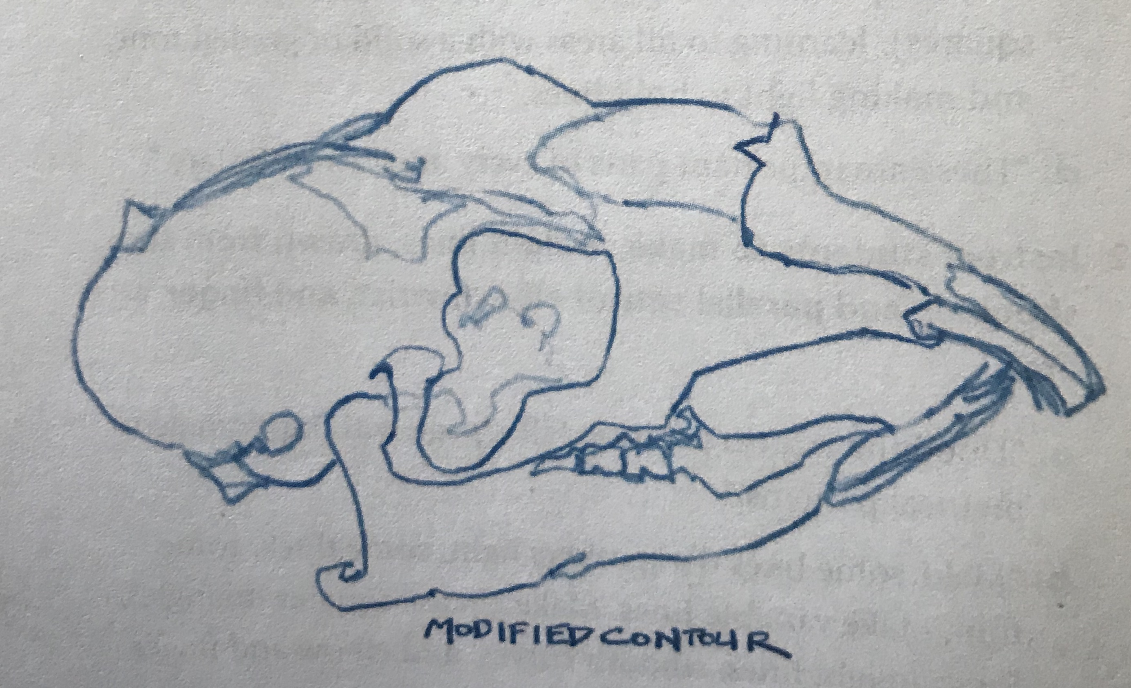

Slide 8
Bye for Now. Thanks for Joining Me.

