Slide 1
BUILDING NEW SKILLS: BASIC DRAWING EXERCISES
Practice #1

Slide 2
Practice will develop your drawing skills
Think of drawing exercises as warm-ups and drills.
Just as you get better at basketball with practice and repetition of basic skills, so too with drawing.
The more you practice making marks, the more you will naturally understand what your hand and pencil can do.

Slide 3
Lesson 1: Building Eye-Hand Coordination
Training your fingers to do what you see in your mind is one foundation of drawing.
The more pencil miles you put in, the more you train your fingers to respond to what you see.
We can practice drawing simple shapes (triangles, circles, squares), learning to fill areas with a solid or graded tone, and making light to bold lines.
These are important parts of every artist’s repertoire.

Slide 4
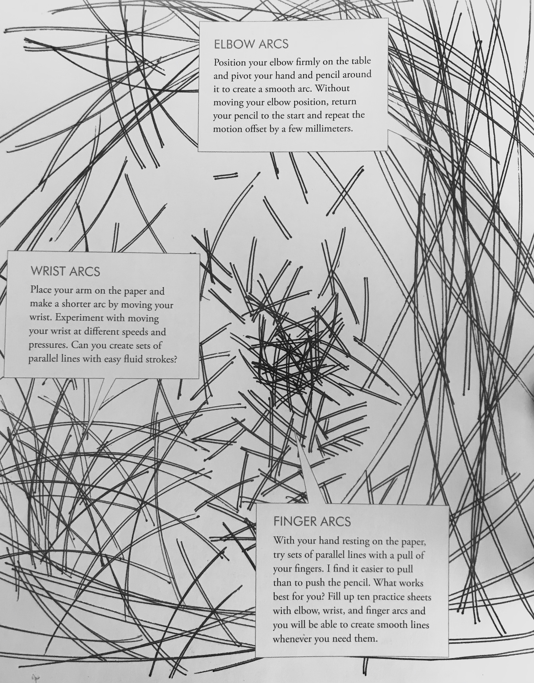
Elbow Arcs
Position your elbow firmly on the table and pivot your hand and pencil around it to create a smooth arc.
Without moving your elbow position, return your pencil to the start and repeat the motion offset by a few millimeters.

Slide 5
Wrist Arcs
Place your arm on the paper and make a shorter arc by moving your wrist.
Experiment with moving your wrist at different speeds and pressures.
Practice until you can create sets of parallel lines with easy fluid strokes.

Slide 6
Finger Arcs
With your hand resting on the paper, try sets of parallel lines with a pull of your fingers.
It is easier to pull than to push the pencil.

Slide 7
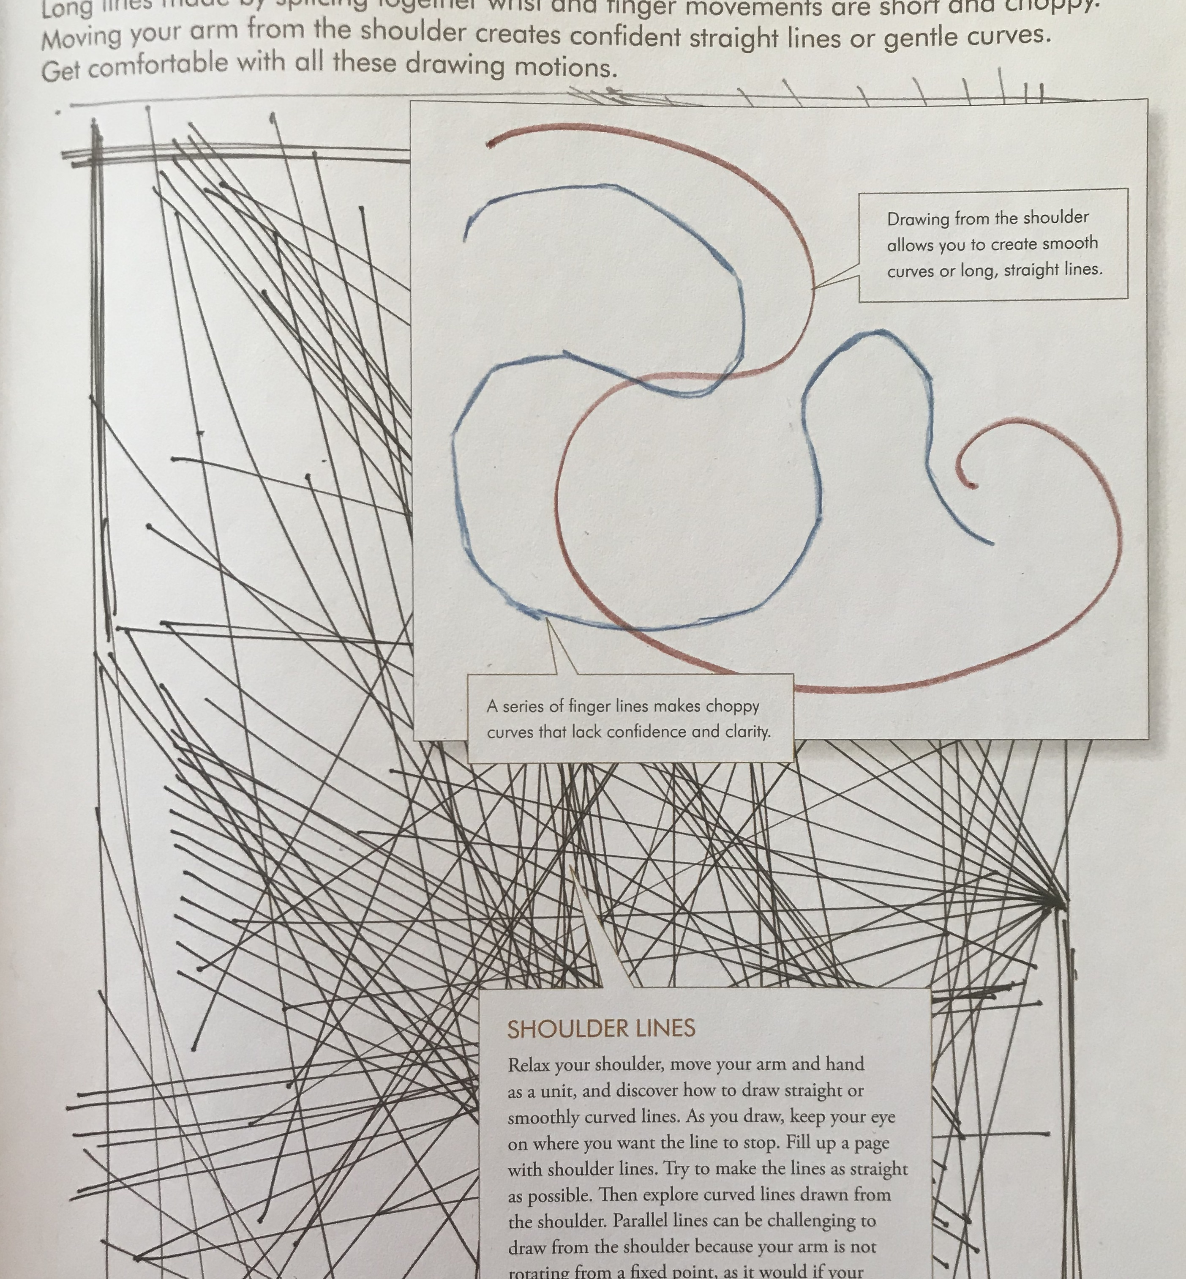
Shoulder Lines
Relax your shoulder, move your arm and hand as a unit and you will be able to draw straight or smoothly curved lines.
As you draw, keep your eye on where you want the line to stop.
Try to make the lines as straight as possible
Then create a variety of curved lines drawn from the shoulder.
Parallel lines can be challenging to draw from the shoulder because your arm is not rotating from a fixed point as it would if your elbow were locked on the paper.

Slide 8
Practice #1 Line Exercises
On two facing journal pages, practice making elbow arcs, wrist arcs, finger arcs and shoulder lines.

Slide 9
Bye for Now. Thanks for Joining Me.
Plathemis lydia Common Whitetail adult male

