Slide 1
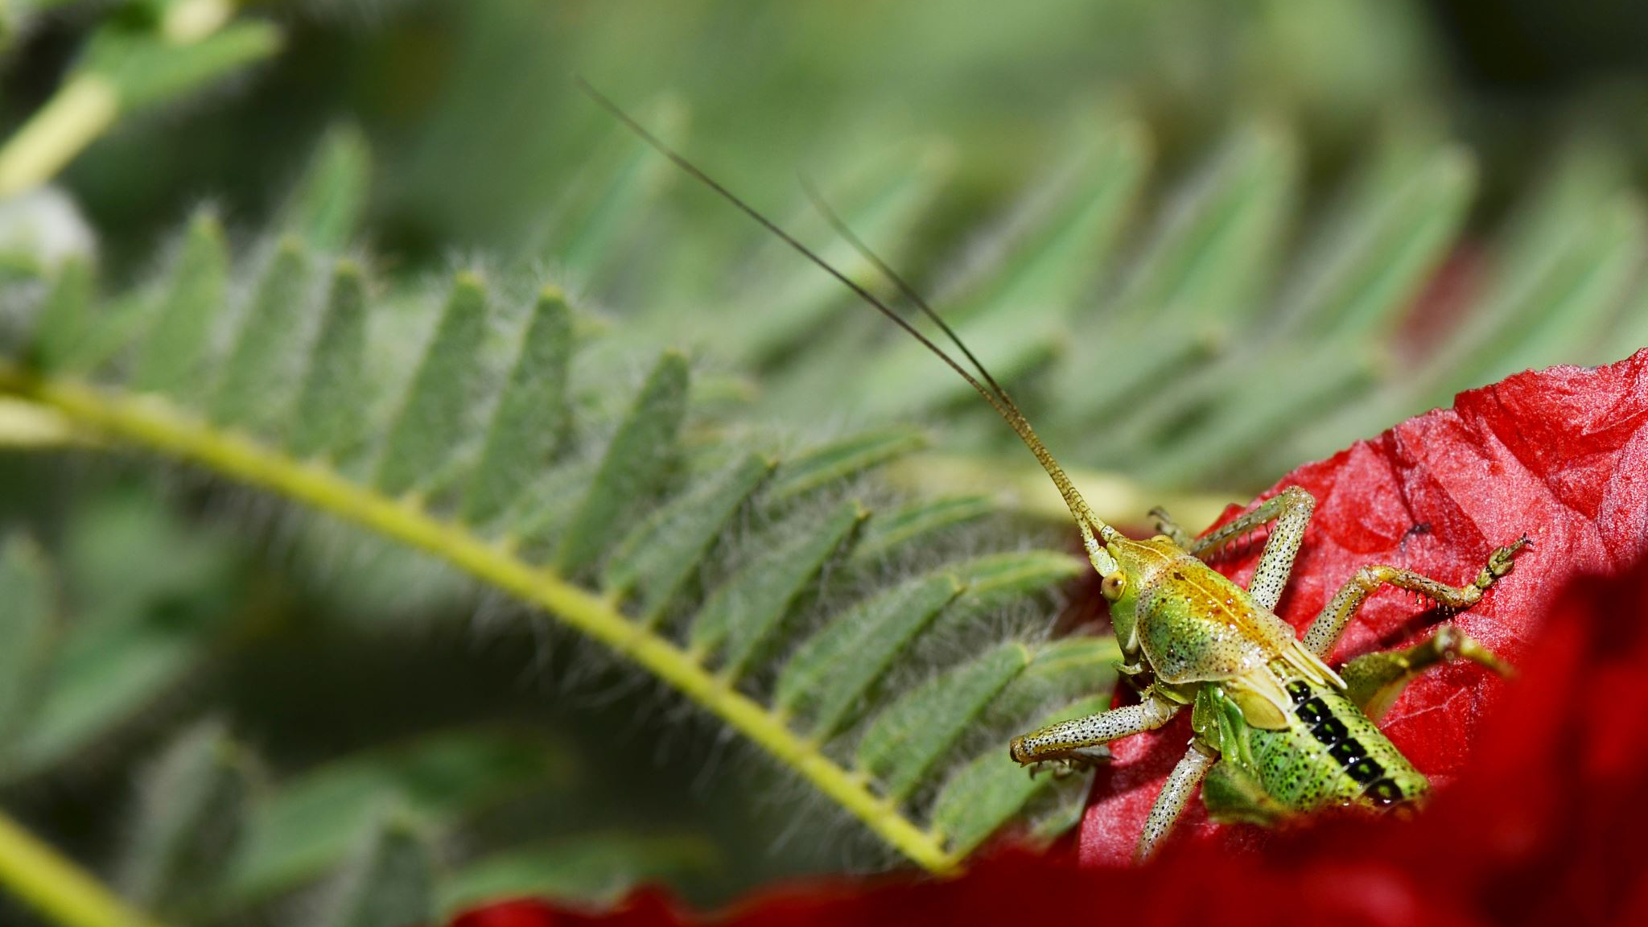
LESSON 9 SPECIES ACCOUNT
Choose one species that you can readily observe, and document as many details as you can about it through direct observation.

Slide 2
A FOCUSED SPECIES STUDY
Species accounts are a common approach to cataloging organisms and building a database of information.
In a species account, the observer attempts to learn as much as they can about the type of organism, using words, pictures and numbers to record details about structures, behaviors, and location in and interaction with the surrounding environment.
Any plant or animal that can be observed for a sustained period can be used for a species account.
If you think an animal might scamper away, use the Animal Encounters protocol instead (Lesson 8).

Slide 3
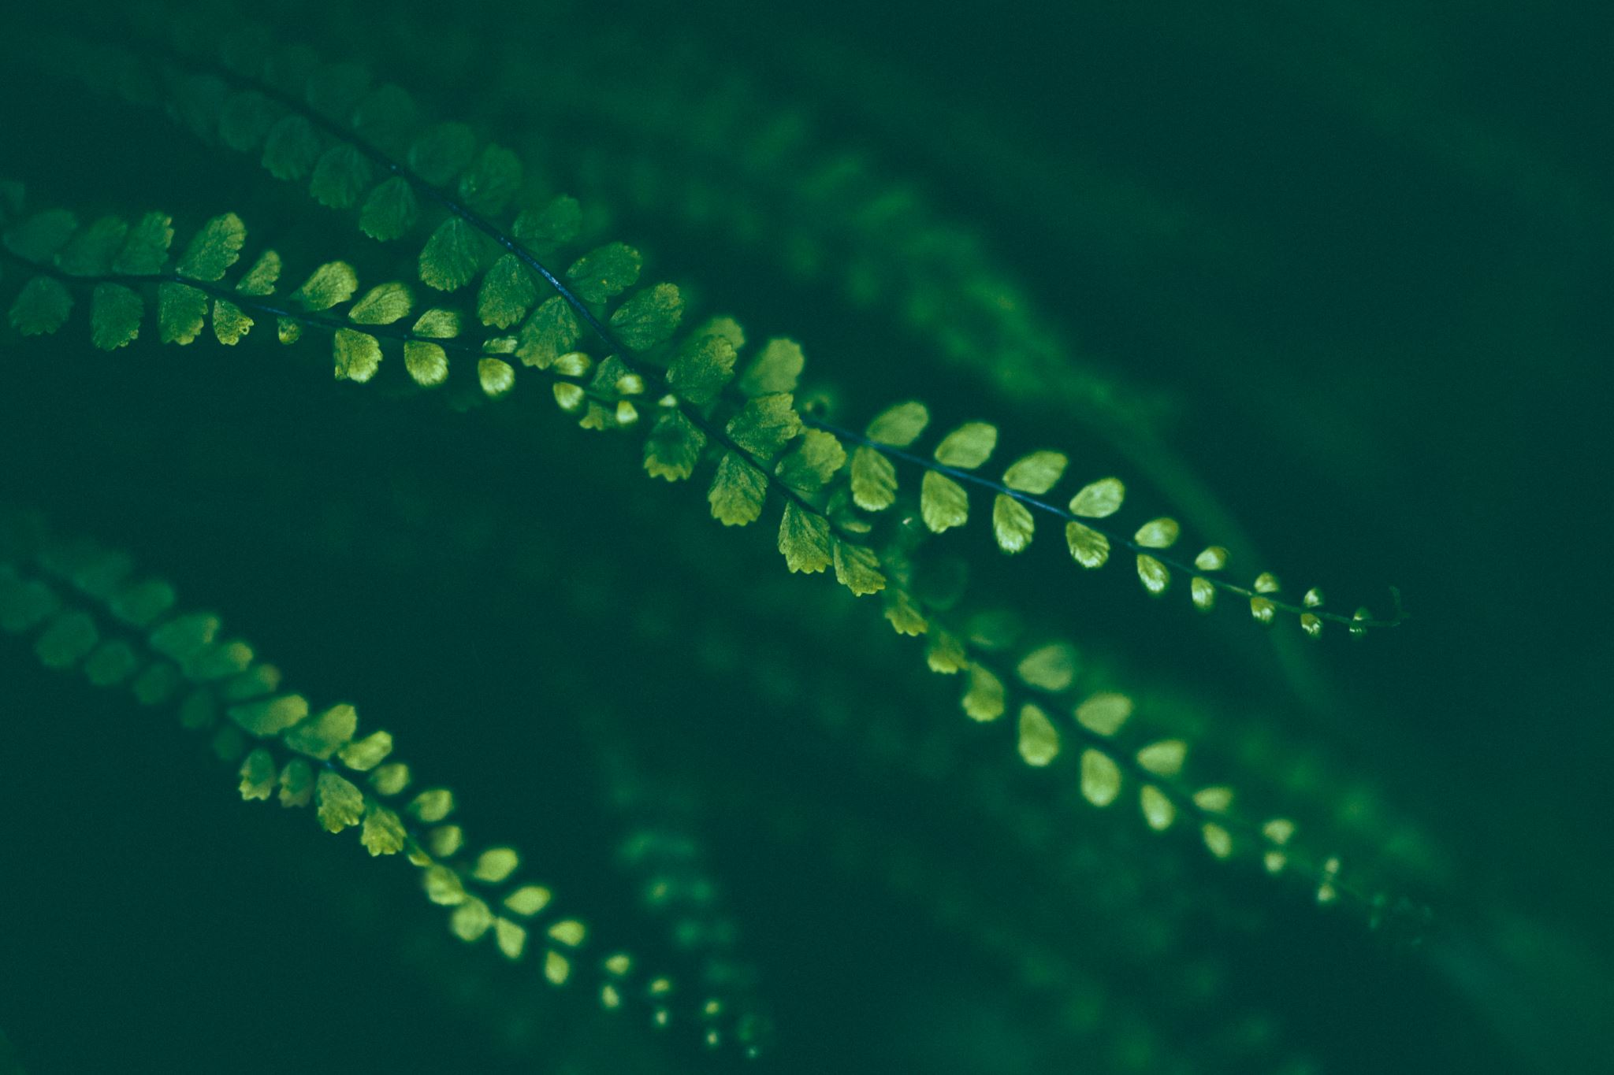
Choosing an Organism
Plants are very cooperative and will not walk away
Animals are fun because they exhibit behavior that can also be recorded
Choose animals that will not crawl or fly away halfway through the observation period.
Catching small insects in clear plastic cups is a way to deal with moving animals.
Captive animals are also easy to observe, but have behavioral and structural differences compared to wild animals.

Slide 4
Procedure
Record as many observations and questions about this species as you can, using words, pictures, and numbers.
Include information about how the organism looks, its behaviors and feeding habits, where it was found, etc.
Focus on specific observations, NOT explanations.
DO NOT ANTHROPOMORPHIZE (attribute human characteristics or behavior to animals). Think like a scientist, don’t make conclusions based on your feelings and emotions.

Slide 5
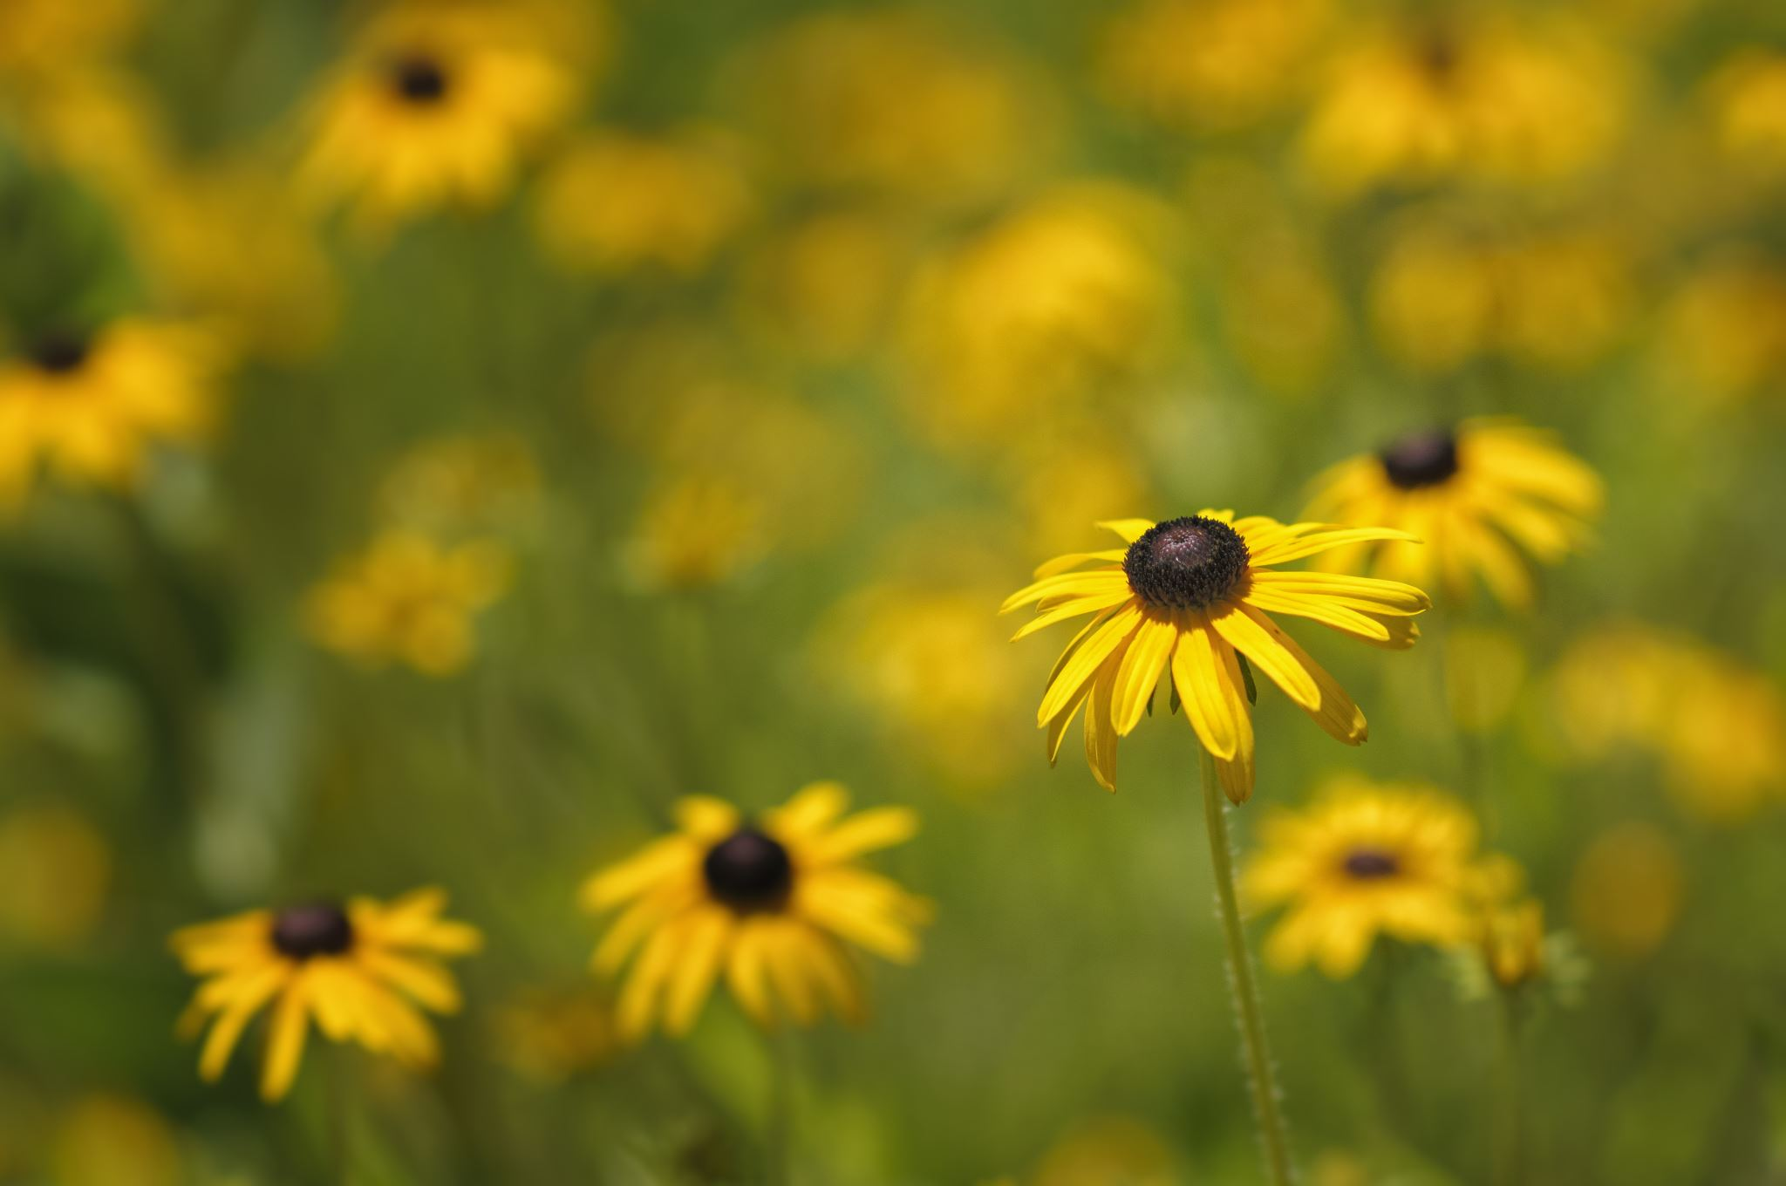
How to Record Direct Observations
Your goal is to describe the species you’re studying in as much detail as possible using words, pictures, and numbers. (ABC, 123, )
You need to record as many details in your observations as you can.
Be specific in your observations and language. Don’t just say “The leaf is green,” rather say “It is deep blue-green at the base, shading to yellow-green within two millimeters of the edges.”
It’s important to come up with an accurate description of the organism.
Focus on making observations (such as: There are yellow leaves at the ends of the branches.” Don’t make assumptions (The leaves at the ends of the branches are dying.)

Slide 6
Examples of DIRECT OBSERVATIONS
Notes about the subject’s location,
Notes about other nearby organisms,
Behavior of an animal,
Similarities or differences compared to nearby individuals of the same species,
Evidence of where else the organism has been,
Feeding behavior,
Nearby soil, weather conditions, associated species,
A small map showing the area of study.

Slide 7
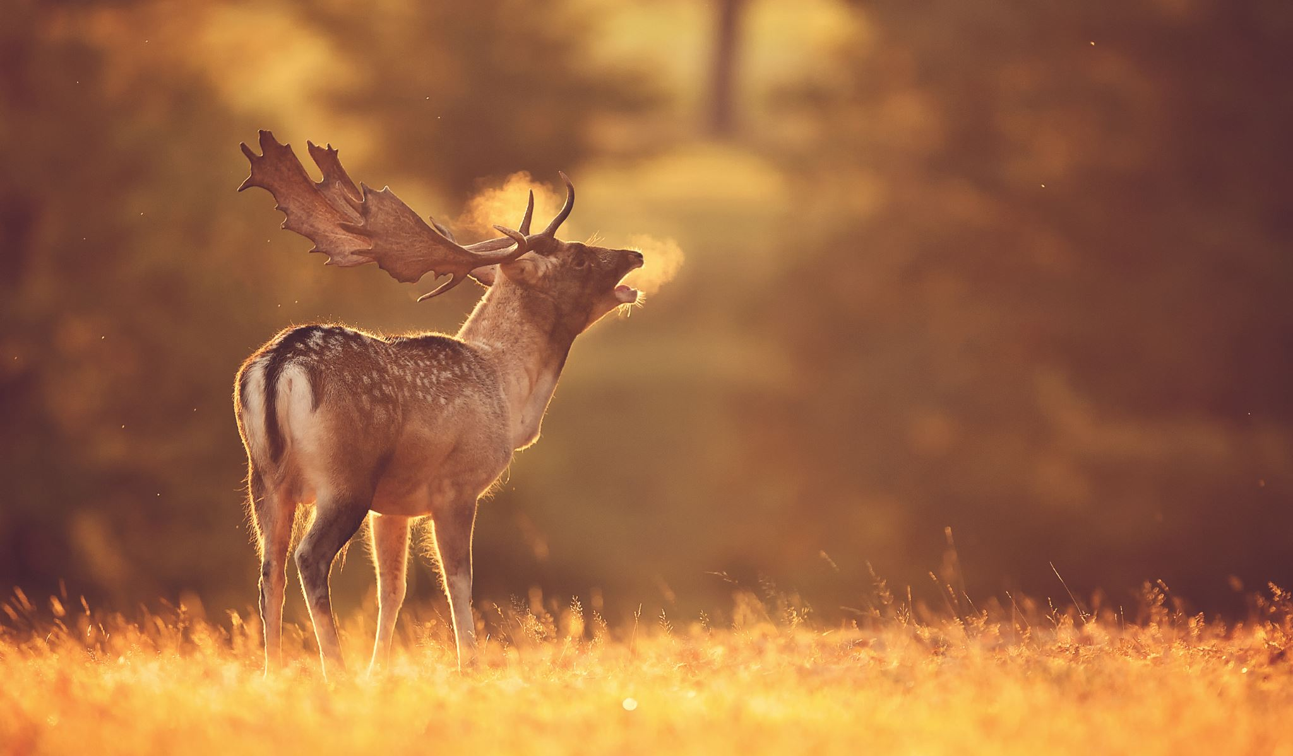
ASK LOTS OF QUESTIONS
Put a question mark somewhere on your journal page and make a list of questions that come to you as you work.
Include several hypotheses to your questions by completing the sentence frame:
COULD IT BE…

Slide 8
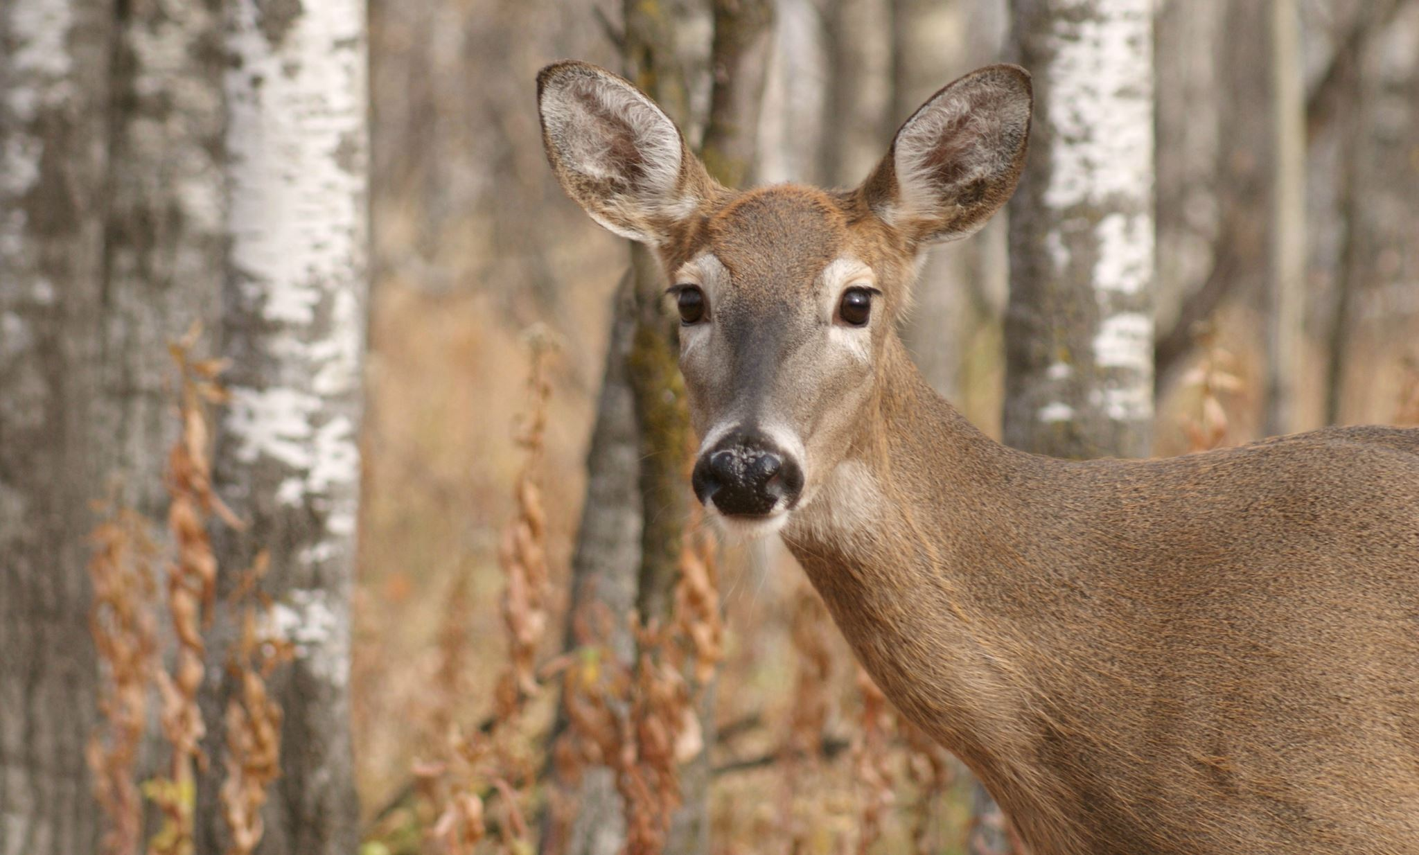
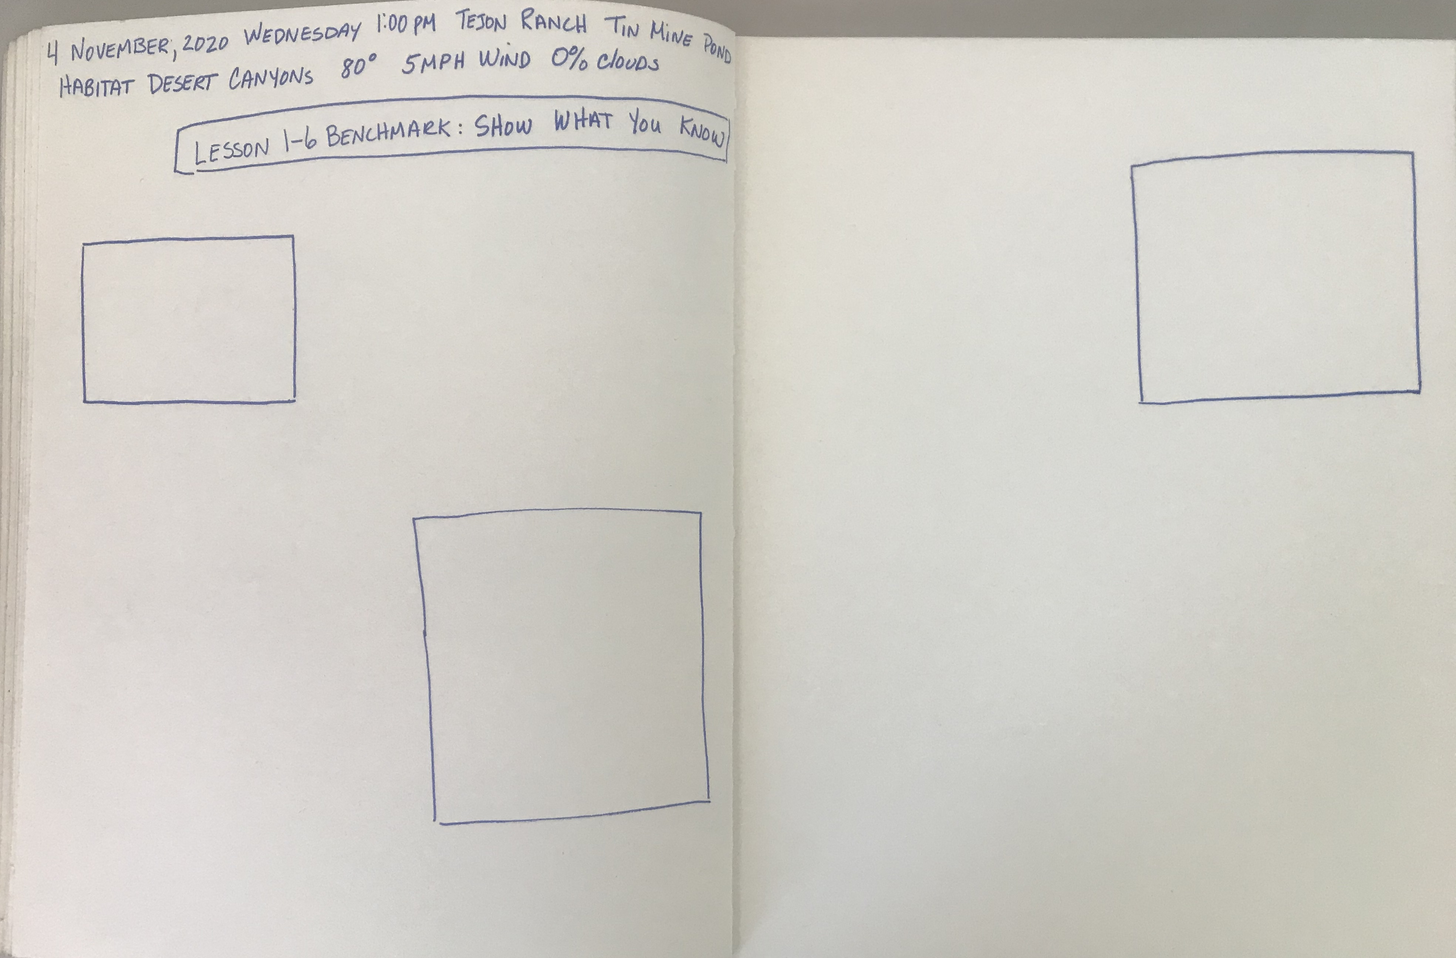
Plan your Journal Page
Metadata (date, day, time, season, location, habitat, weather – temperature, wind speed, cloud cover)
Title: SPECIES ACCOUNT (then name the subject you studied)
ABC – I notice, I wonder (could it be…), This reminds me of
123: metrics – numbers of population, measurements, dimensions, weight, elevation, etc.
Drawing, sketch, diagram (labeled)
Decide where you will put your drawings
and narrative on the page.

Slide 9
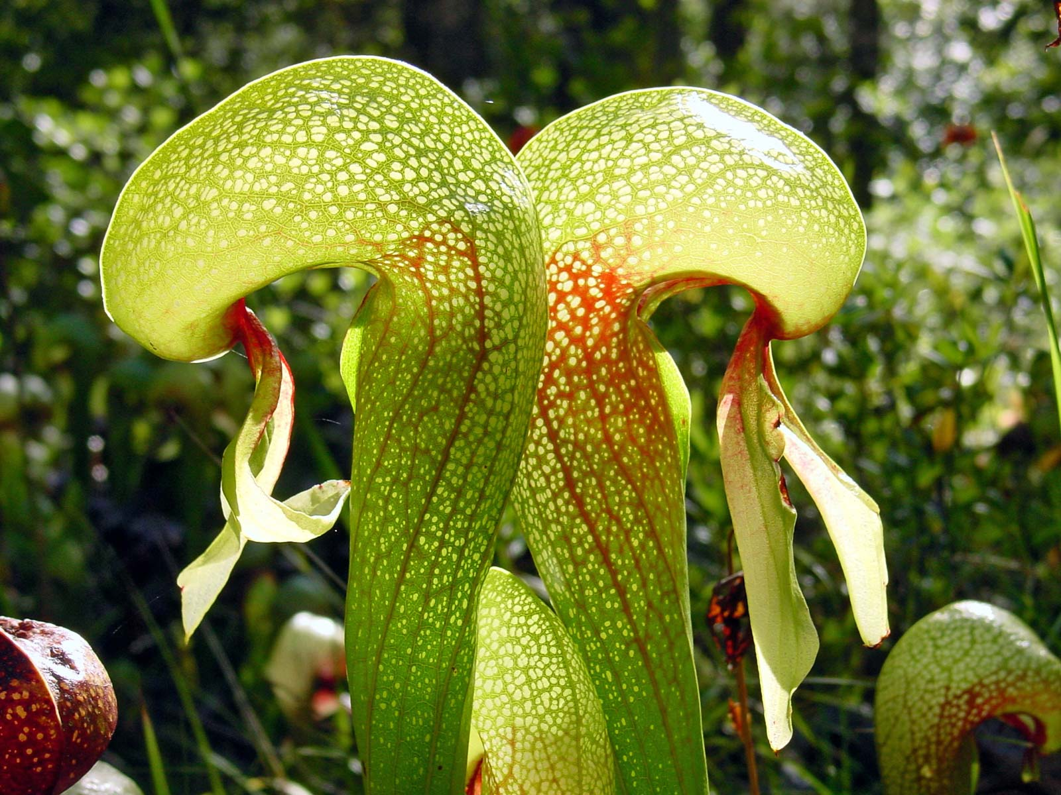
Student Journal Sample
Pitcher Plant

Slide 10
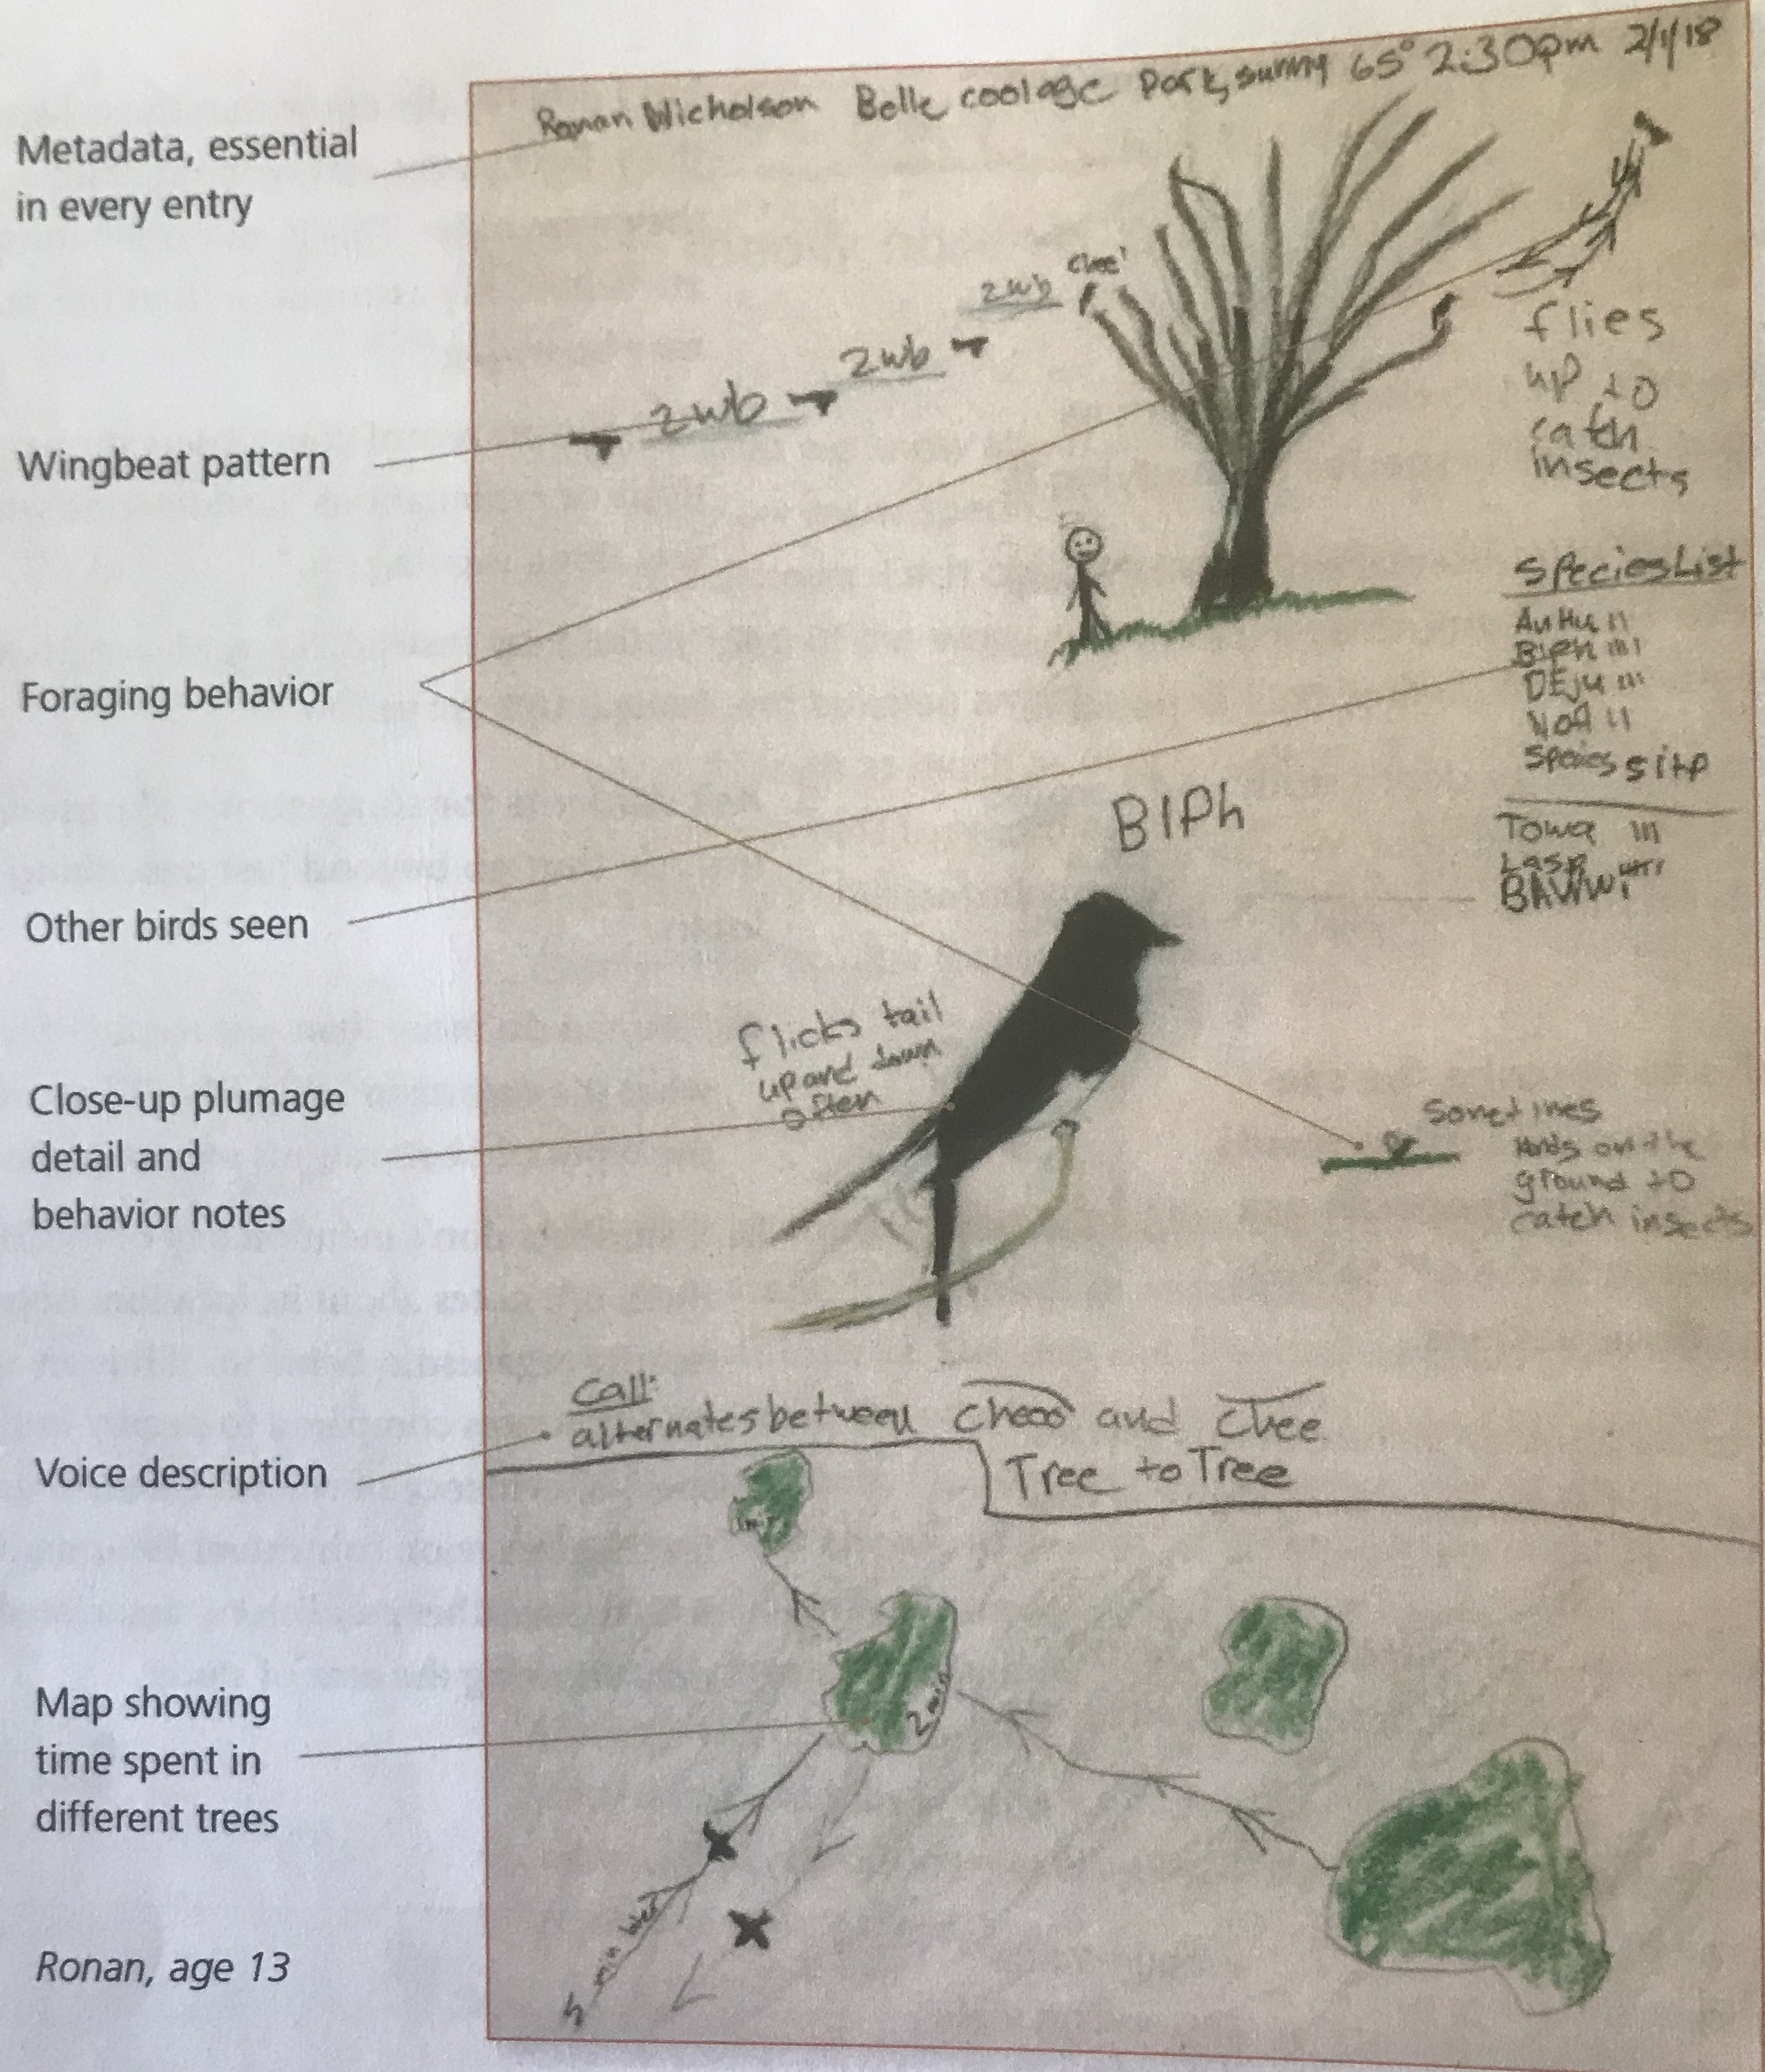
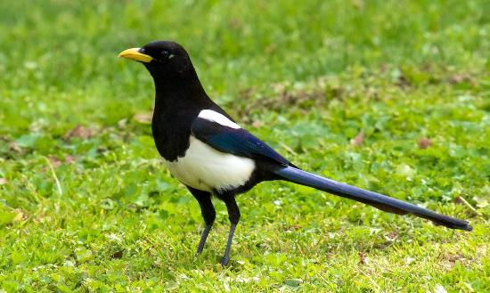
Student Journal Sample
Yellow Billed Magpie

Slide 11
FURTHER RESEARCH
Supplement your personal observations with research
Have other scientists seen the same patterns or behaviors that you observed?
Use field guides, research papers, or websites (web addresses ending in .edu or .org).
Cite your sources.

Slide 12
REFLECTION
Answer the questions in Question/Answer form (write as many words from the question into your answer).
Number the answers in the order you want to put them in a paragraph.
Begin your paragraph with a general topic sentence. (Example: In this journal exercise, I observed and studied the northern flicker.)
Write the answers to the questions in your selected order.
Finish your scientific paragraph with a concluding sentence. (Example: By using direct observation skills, I learned a lot about the northern flicker.)

Slide 13
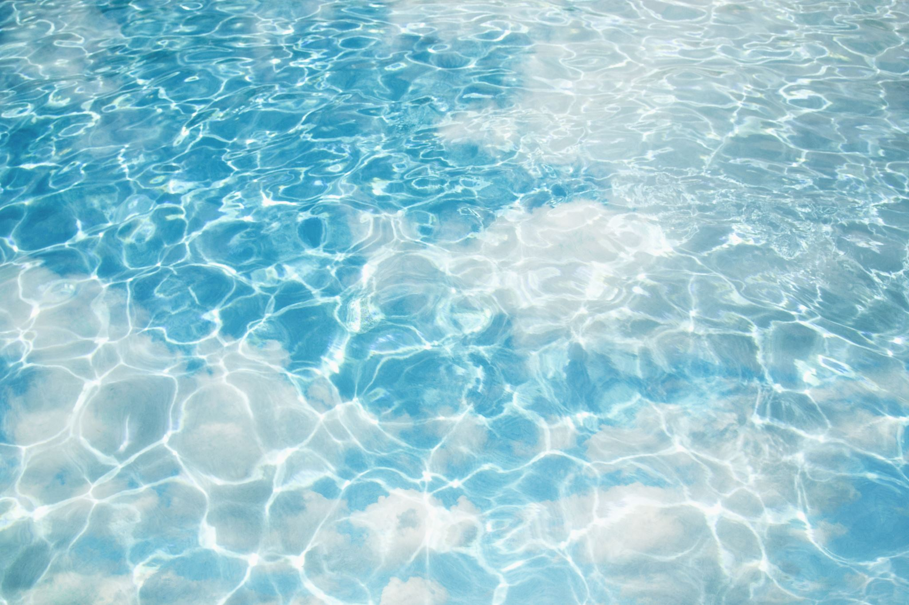
Reflection Questions
How did recording your observations in a journal help you learn?
What patterns did you observe? What are some possible explanations for one of the patterns you observed?
How might the interactions you observed be affected by the time of day, year, weather, or locations?
What are some of the structures you noticed while studying this species. What do you think are the functions of those structures?
How do the organism you studied and the other organisms in the area affect each other?

Slide 14
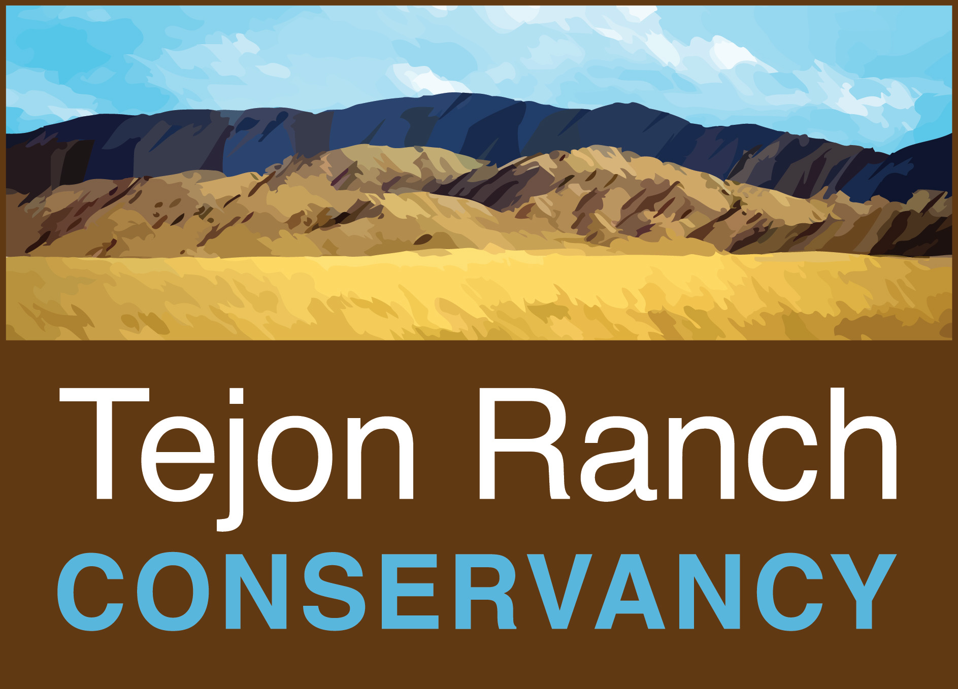
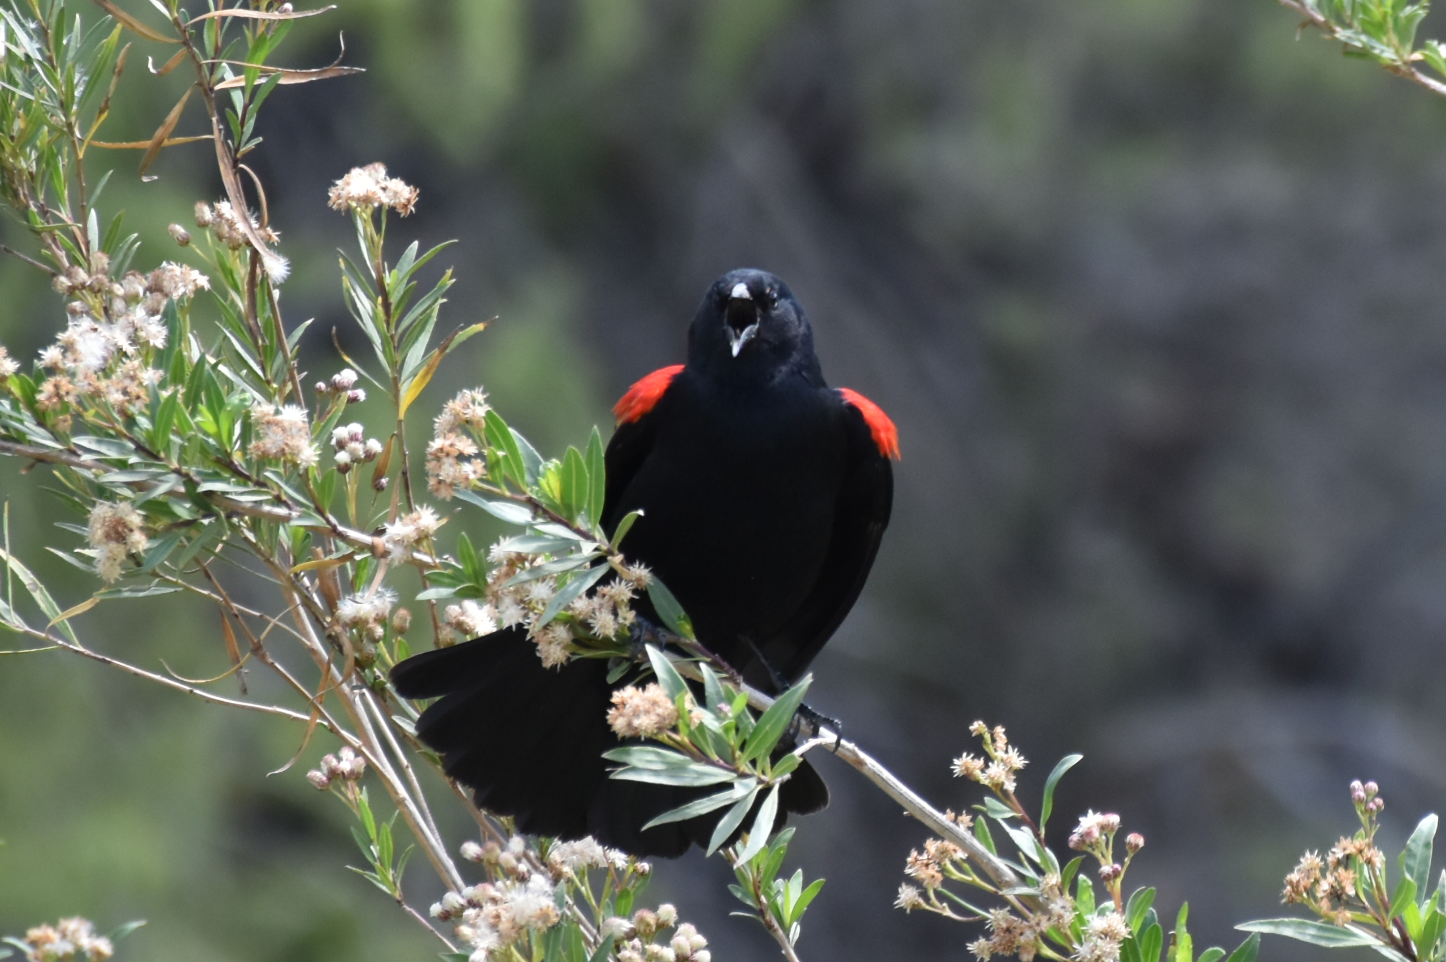
Bye for now. Thanks for joining me.

