Slide 1
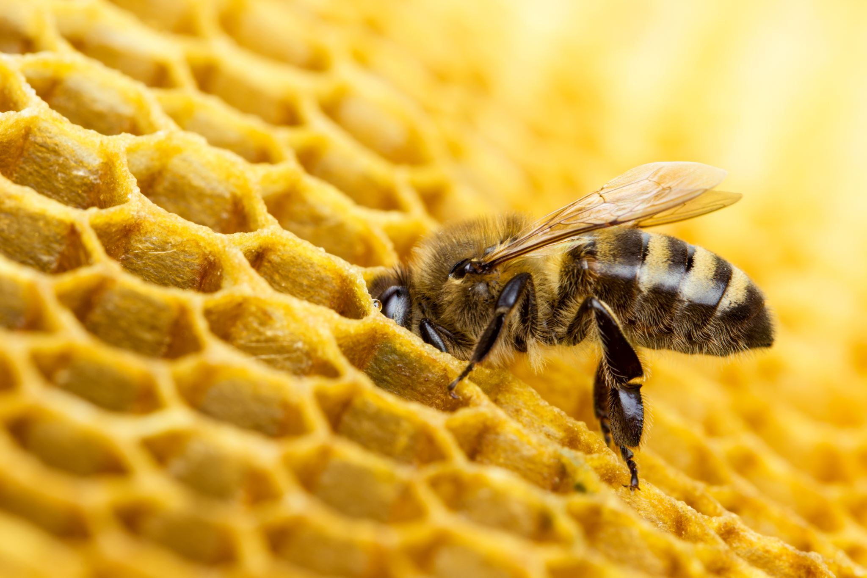
Lesson 6 Part 3
A COLLECTION OR FIELD GUIDE:
SYSTEMS AND SYSTEM MODELS

Slide 2
SYSTEMS
A system is a collection of parts which are interconnected because they continually affect each other over time in unpredictable ways.
A system can carry out functions its individual parts cannot.
To understand systems, the relationships between or among the parts must be examined.
Thinking of a natural feature as a system helps us think about the impacts and interactions that lead to changes we can observe.
Studying systems is about studying the interconnections and relationships between things.

Slide 3
SYSTEM MODELS
Models can be used to represent systems and their interactions—such as inputs, processes and outputs—and energy and matter flows within systems.
Models are limited in that they only represent certain aspects of the system under study.
Models can be used to predict the behavior of a system, but these predictions have limited precision and reliability.

Slide 4
How to Study Systems and System Models
Ask yourself these questions when you are doing an observation:
What are the parts of this system?
What are the boundaries?
How does the system work?
How do the parts of the system interact?
What would happen if a part was removed?
What would happen if a part were added?

Slide 5
Examples of Systems and System Models
A “Tiny World”
Things on a lawn
Under rocks or a log
On a rotting log
In puddles
Populations of organisms (a herd, a hive)
Parts of one organism (Parts of a plant)
Communities of different organisms (An oak woodland)
An ecosystem (A pond, a forest, a prairie)

Slide 6
Natural systems and their interconnections can be investigated by:
looking at the adaptations of the species living there; (e.g. the hawk can fly and has superb vision to locate the rabbit)
examining the flow of energy through the system(s); (e.g. apple tree gets energy from sun and some is stored in the apple which you and the ants eat, and which gives nourishment)
exploring the networks or webs of relationships; (e.g. the grass that took up the water did so through a network of roots)
understanding the cycling of water, air and other nutrients; (The apple core is broken down by bacteria which make the nutrients in it available for the grass to use.)

Slide 7
Your Turn
Make a field guide of your chosen subject that shows Systems and System Models.
Include three to five things in your field guide.
This could be the parts of a “tiny world” or
3-5 examples of similar systems such as plants showing their parts).
Arrange the page so that you show a drawing with words and numbers next to it.
Record observations with words, pictures, and numbers, paying attention to similarities and differences and evidence of Systems and System Models.

Slide 8
Remember to begin with your metadata
Date, Day, Time
Location, habitat
Weather
Temperature
Wind
% Cloud cover

Slide 9
Plan your page
Heading first
Then Title
Create enough space to show all 3 to 5 subjects.
Use the next page for your reflection questions/paragraph.
Remember to include ABC’s, 123’s and drawing/sketch/diagram for each subject.

Slide 10
Remember
For each “I wonder”, Write one or two hypotheses by completing the sentence frame:
“Could it be…”

Slide 11
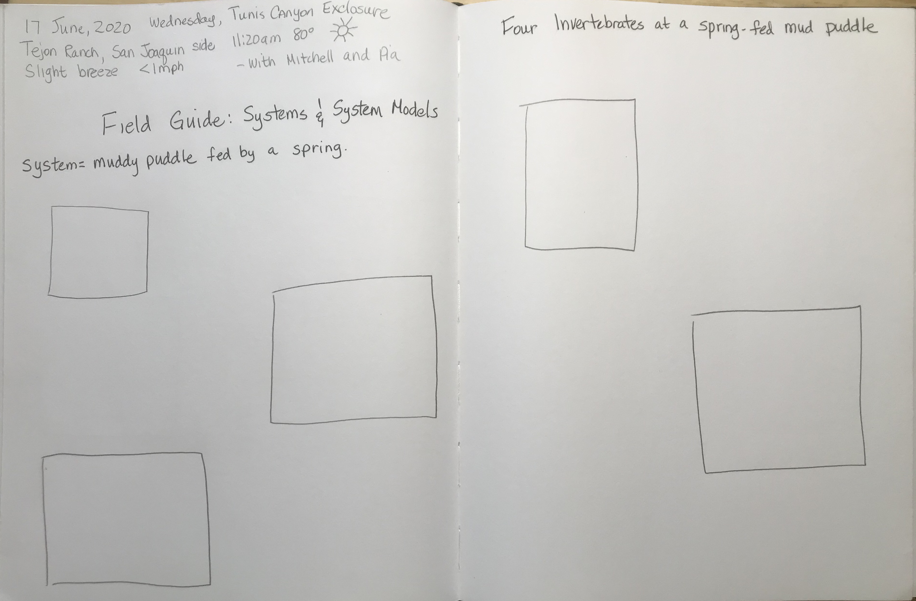
Plan your layout the way you want it.
Here’s mine:
Two pages
Metadata top-left
Title under metadata
Sub-title top right
5 boxes with space for writing
The top-left box is for a mini landscape
Landscapes give a sense of place

Slide 12
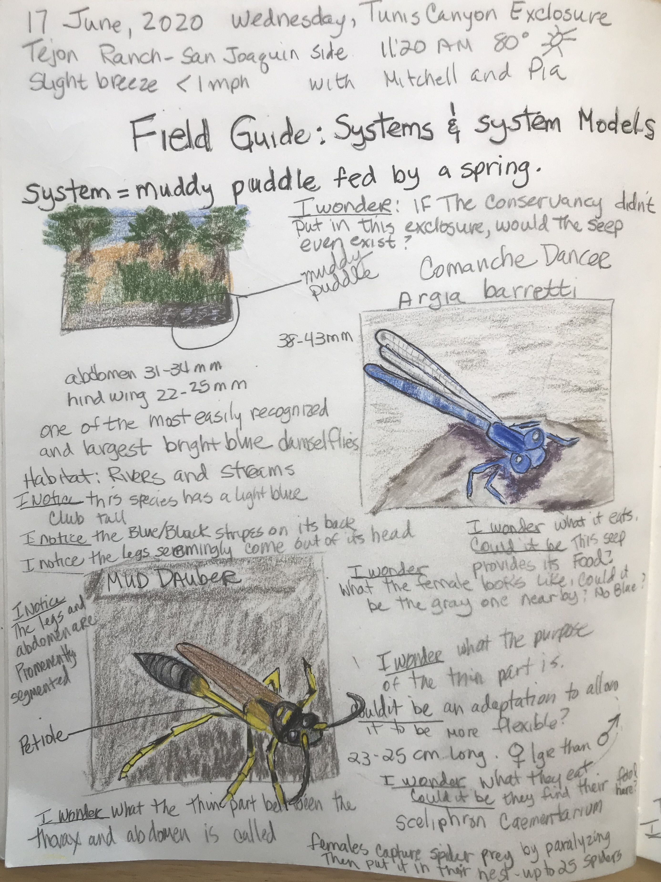
Notice:
*Metadata
*Title
*I identified the system I studied
*I draw a mini-landscape circling the area of study
*Because this is about systems AND system models, I wrote an important “I wonder” question that ponders what would happen if there was a change in the model.

Slide 13
*I continued on to the second page. *I included a sub-title that connects with the title on the previous page. *When I got home, I did some research to identify the animals I saw and to answer some of my questions. I added that information to my journal pages including my source of information.

Slide 14
Because I planned out out my pages before starting my study, the finished journal entry looks attractive and balanced.

Slide 15
Now do your own field guide. Focus on SYSTEMS AND SYSTEM MODELS
Take about 1 hour to work on all your studies, about 15-20 minutes each.
Come back and do your reflection questions on your next page.

Slide 16
REFLECTION
Question/Answer
Question/Answer form (Put as many words from the question into your answer.)
Answer
Answer all questions, then put them in an order that makes sense for a paragraph.
Topic Sentence
Begin with a topic sentence (“I created a field guide focusing on SYSTEMS AND SYSTEM MODELS.”)
Closing Sentence
End with a closing sentence (“It was fun to hypothesize about the SYSTEMS AND SYSTEM MODELS of my subjects.”)

Slide 17
REFLECTION QUESTIONS
What are the different things you found?
Did you see any interactions or evidence of interactions between different organisms, or between the organisms and the environment?
What are some other interactions you imagine might occur? (This is predicting using a system model.)
What are the nonliving factors that affect the organisms you saw?
How might the organisms or the interactions between them be impacted if some of these environmental conditions were to change? (This is also predicting using a system model.)

Slide 18
Looking Forward
Next time, we’ll create a field guide focused on Structure and Function.
Start looking around for interesting subjects.

Slide 19
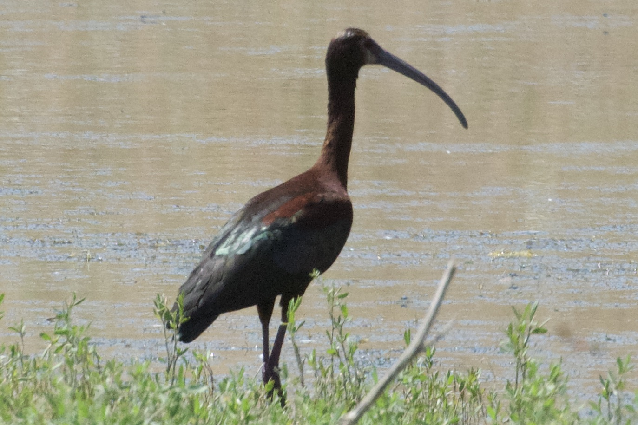
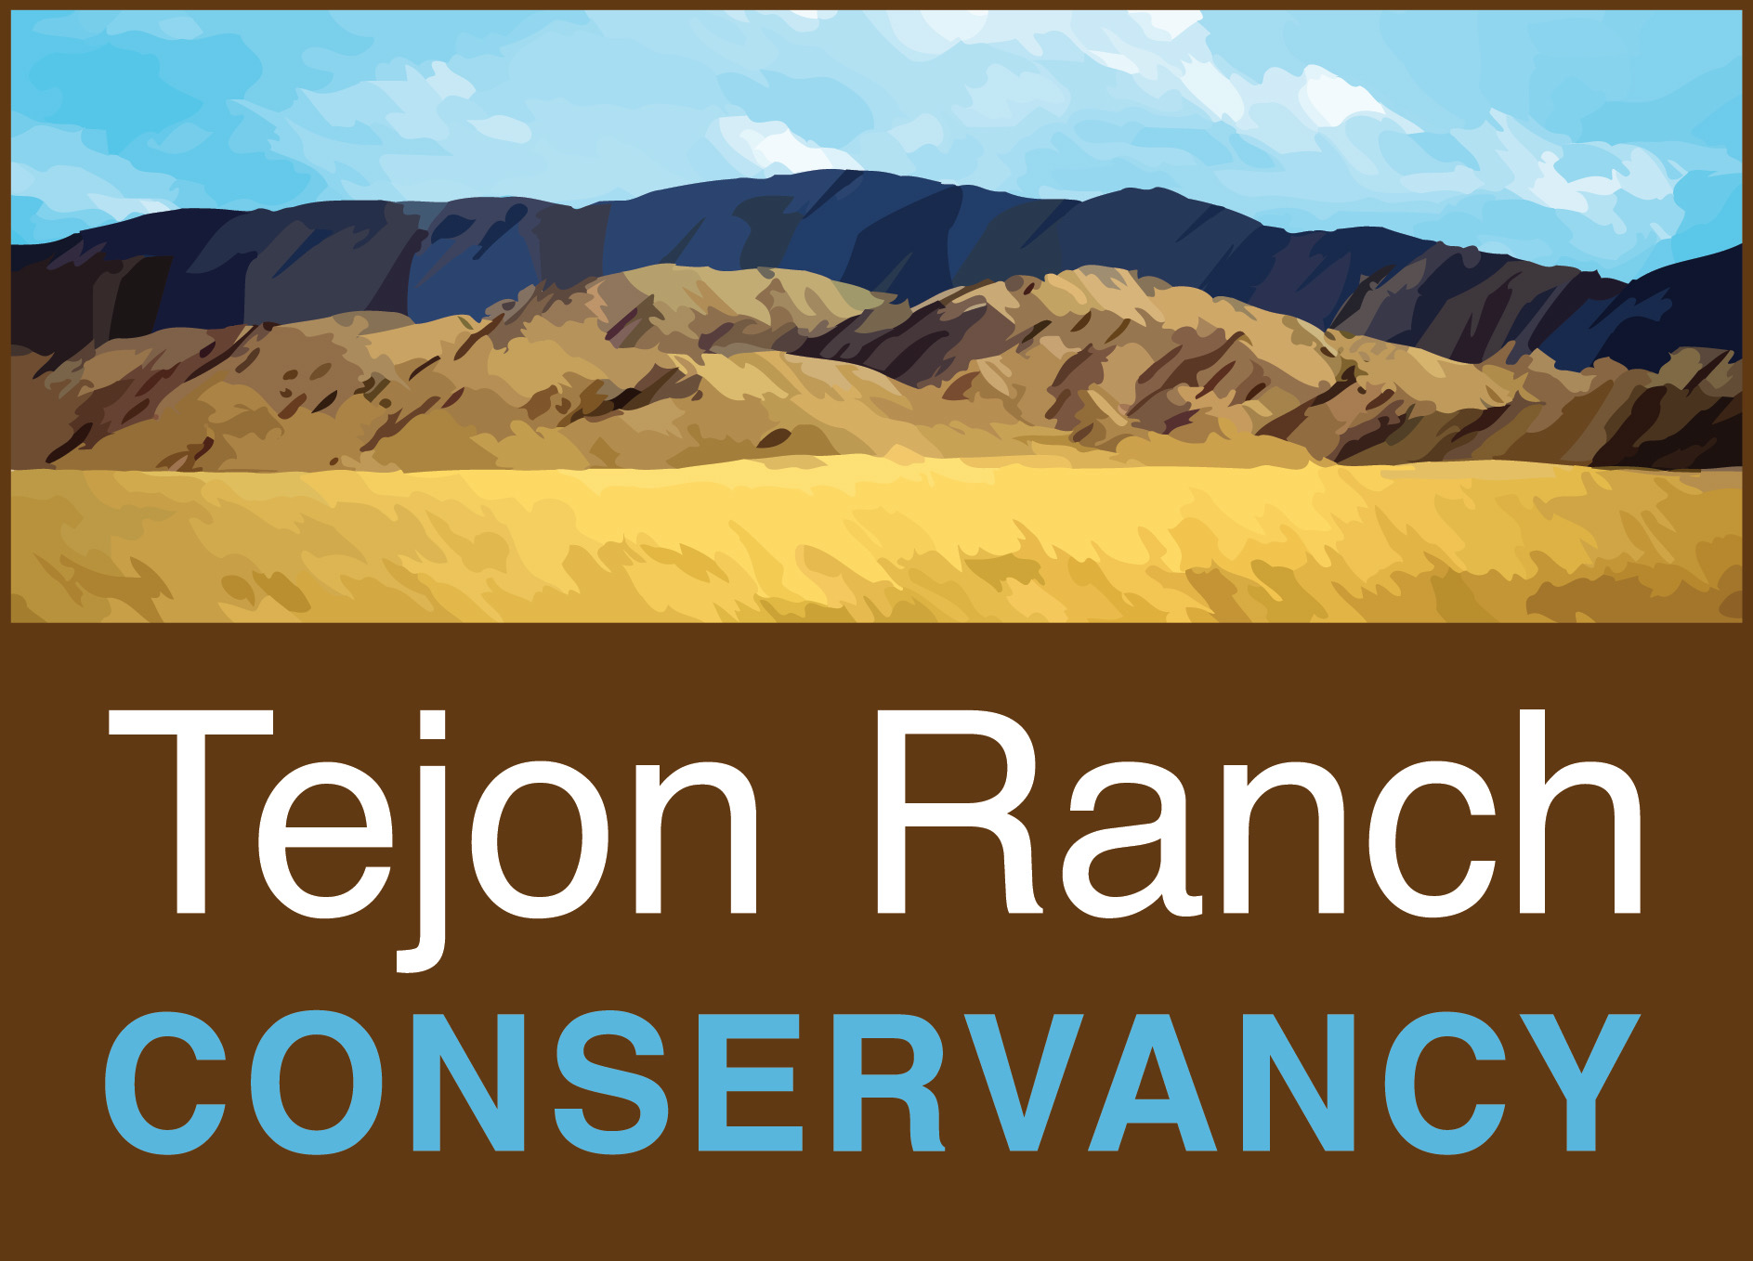
BYE FOR NOW. THANKS FOR JOINING ME.
White-faced Ibis

