Slide 1
LESSON 8
ANIMAL ENCOUNTERS

Slide 2
Ramping up Your observation skills
When you encounter wildlife, the opportunity for observation may be brief.
In this lesson, you will learn how to take advantage of the situation by using deliberate observation techniques and getting your observations to paper as fast as possible.
Having a plan for animal encounters allows you to be flexible and respond to the environment.

Slide 3
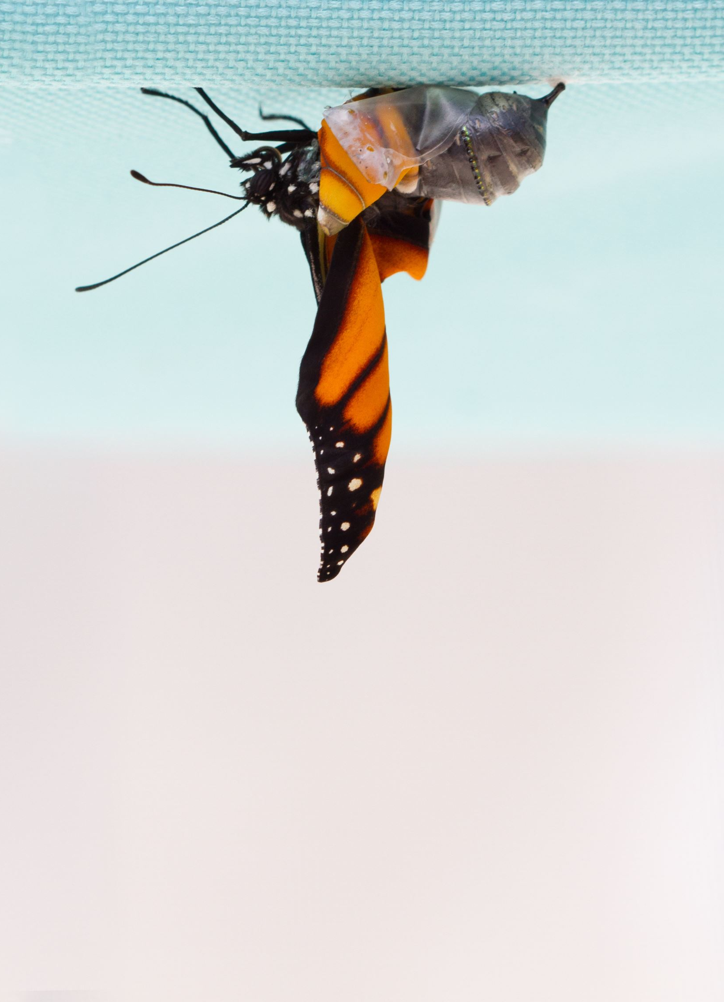
Be flexible in your approach
When you see an animal, assume the animal will not be around for too long. Start working with that in mind.
If you notice the animal is sticking around, you can change your approach and continue journaling.

Slide 4
Natural phenomena
You can use this procedure with any animal encounter you have. This approach works for mammals, birds, insects, reptiles, and amphibians.
The longer, closer, and less obstructed the view the better, but go with what you get.
Even a quick glimpse of a deer in passing is rich with information if you intentionally remember what you see.

Slide 5
Procedure summary
Say observations out loud as long as you can see the animal.
Use words, pictures and numbers to describe the appearance and behavior of the animal, using words to capture what is difficult to draw quickly.
The detail you put into your words will serve as a recipe for your drawings.
Because the animal will move, start several drawings and work on one whenever the animal assumes that pose.

Slide 6
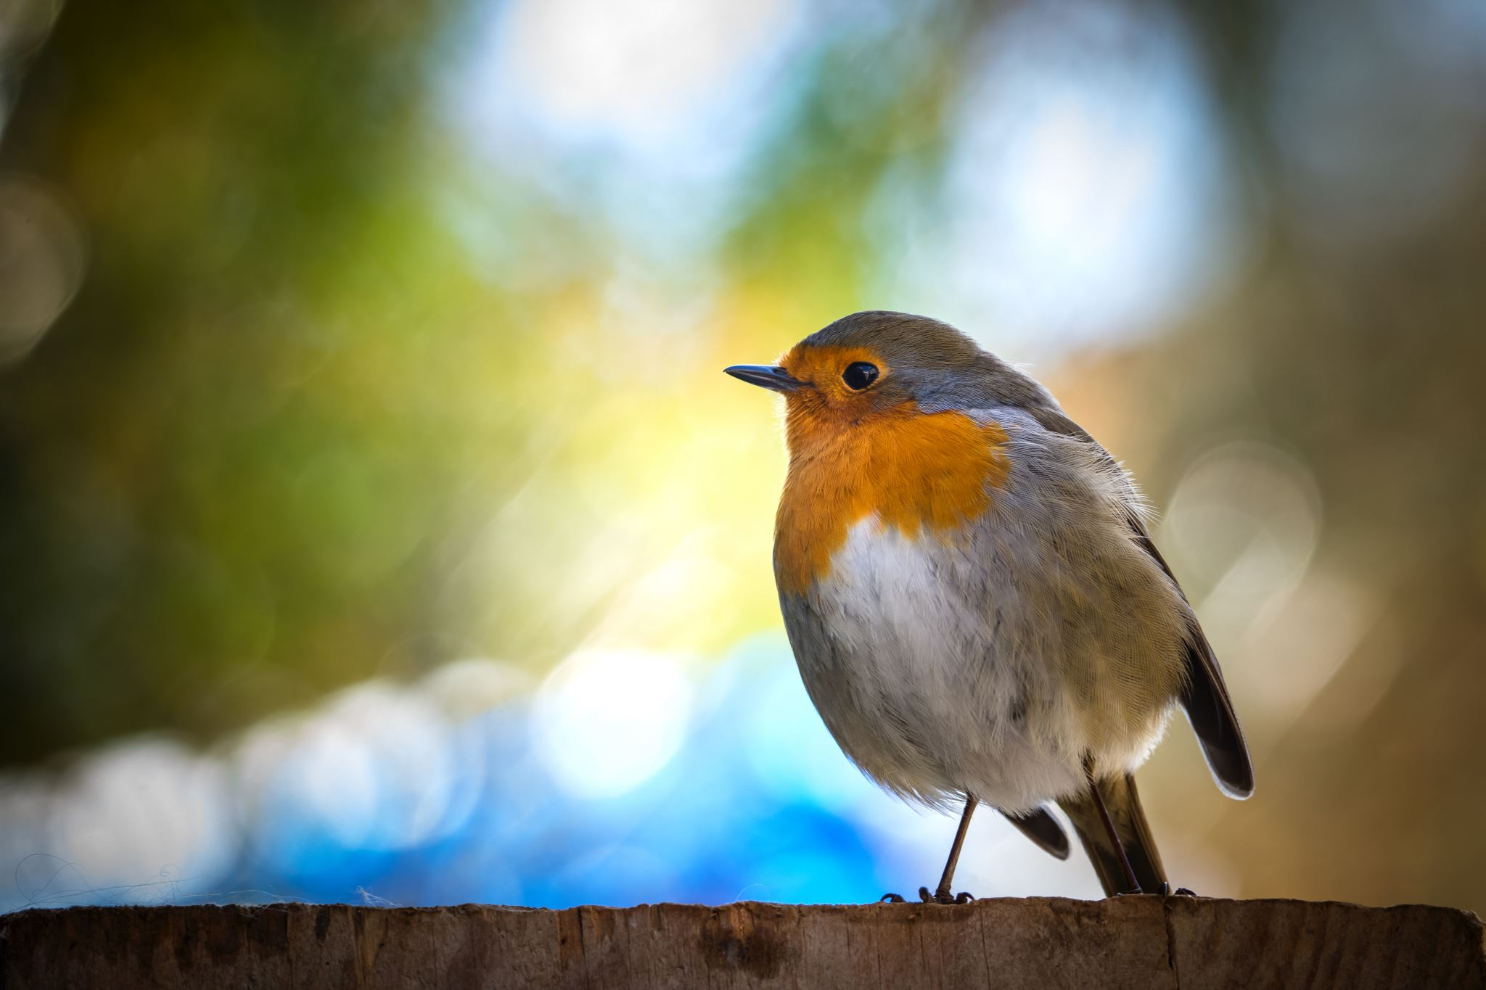
Step 1
Start verbalizing your observations in a soft conversational voice.
This helps you remember the details you see and to make sure you observe accurately.
Describe how the animal looks and what it is doing.
You MUST say this out loud, but quietly enough that you don’t scare away the animal.

Slide 7
Step 2
Continue to make your observations.
Start using words, pictures and numbers to describe the appearance and behavior of the animal and write them into your journal page.
Think carefully about which note-taking approach is best for the information you are trying to capture.

Slide 8
Step 3: Quick strategy for dealing with the animal’s movements
Start three drawings of different poses.
Shift the drawing you’re working on when the animal moves.
Make two drawings that show different views or poses. These could be side and back views, or two different positions the animal returns to often, like head up and head down.
The third view will be a close-up of some detail that is interesting to you.

Slide 9
How to draw three things at once
Bounce around from one drawing to another as the animal moves.
When you get a good look at the detailed pose you are interested in, work on that drawing.
When you get your side view, work on that drawing.
You do not need to finish all three drawings.
One will probably get further developed than the others, and that’s okay.

Slide 10
Modifying your strategy if the animal stays around
As time passes, you can begin to find the numbers hidden in your observations.
Count, measure, and time things.
For example,
you might time the number of seconds the animal spends doing different behaviors,
estimate the distance between the animal and the forest,
count the number of stripes on the animal.

Slide 11
Ask questions
Take a moment to focus on asking and recording questions.
Make a question mark icon and list as many questions as you can come up with below it.
Then go back to observing and add in questions as they come to you.

Slide 12
When the animal leaves
Complete field notes from memory, adding in details that haven’t been recorded yet.
This will be easy if you described your observations aloud.
In time we will forget the details we do not put down on paper. Think for a moment about details or behaviors you observed that are not recorded in your notes.
Take another five minutes to fill out the rest of your notes.
This could be written descriptions or more details in your drawings.
When you are finished with your journal page, look up information on your animal. Cite your source and write all about your animal. Become an expert!

Slide 13
Two drawing techniques
Contour Drawing: Try lightly drawing the outline of the animal you’re studying first. Then use your eraser to make adjustments. After you have all the proportions the way you want them, color your drawing.
Geometric shapes: If the animal is too difficult to draw as a contour, break down the parts of the animal into general geometric shapes next to one another. Draw the geometric shapes very lightly with your pencil. Then use your eraser and pencil to adjust the shapes to the actual shape of your animal. After you have all the proportions the way you want them, color your drawing.
ALWAYS begin with a light pencil sketch that you can erase easily. Finish with colors as your last step.

Slide 14
Here’s what I got done before the Coot disappeared into the Cattails: 1. Lots of descriptions written down after I said them aloud. 2. Small landscape picture 3. Three drawings in different positions 4. Close up study of head and tail. 5. List of questions with “?” icon.

Slide 15
I continued to work on the journal page 1. I corrected shapes. 2. I added details (like the reflection of the coot in the water). 3. I added more ABC’s and 123’s. 4. I colored my drawings last.

Slide 16
My research: 1. I cite my source at the top of the page. 2. I identify my animal. 3. I include the title of this lesson. 4. Lots of ABC's and 123’s. 5. Some of my questions have been answered by my research.

Slide 18
REFLECTION
Question/Answer
Question/Answer form (Put as many words from the question into your answer.)
Answer
Answer all questions, then put them in an order that makes sense for a paragraph.
Topic Sentence
Begin with a topic sentence (“I studied an American Coot in a pond.”)
Closing Sentence
End with a closing sentence (“It was challenging to capture my observations as quickly as possible.”)

Slide 19
Reflection questions
1. What were some interesting questions you produced? What are some hypotheses for your questions?
Patterns: What patterns did you observe? What else have you seen with a similar pattern?
Cause and Effect: How might the behaviors you observed be affected by the time of day, year, weather, or location? What kinds of things might cause this animal’s behavior to change?
Structure and Function: Study your notes and drawings of your subject. Do any body parts seem specialized to do specific things or functions? Describe them.

Slide 20
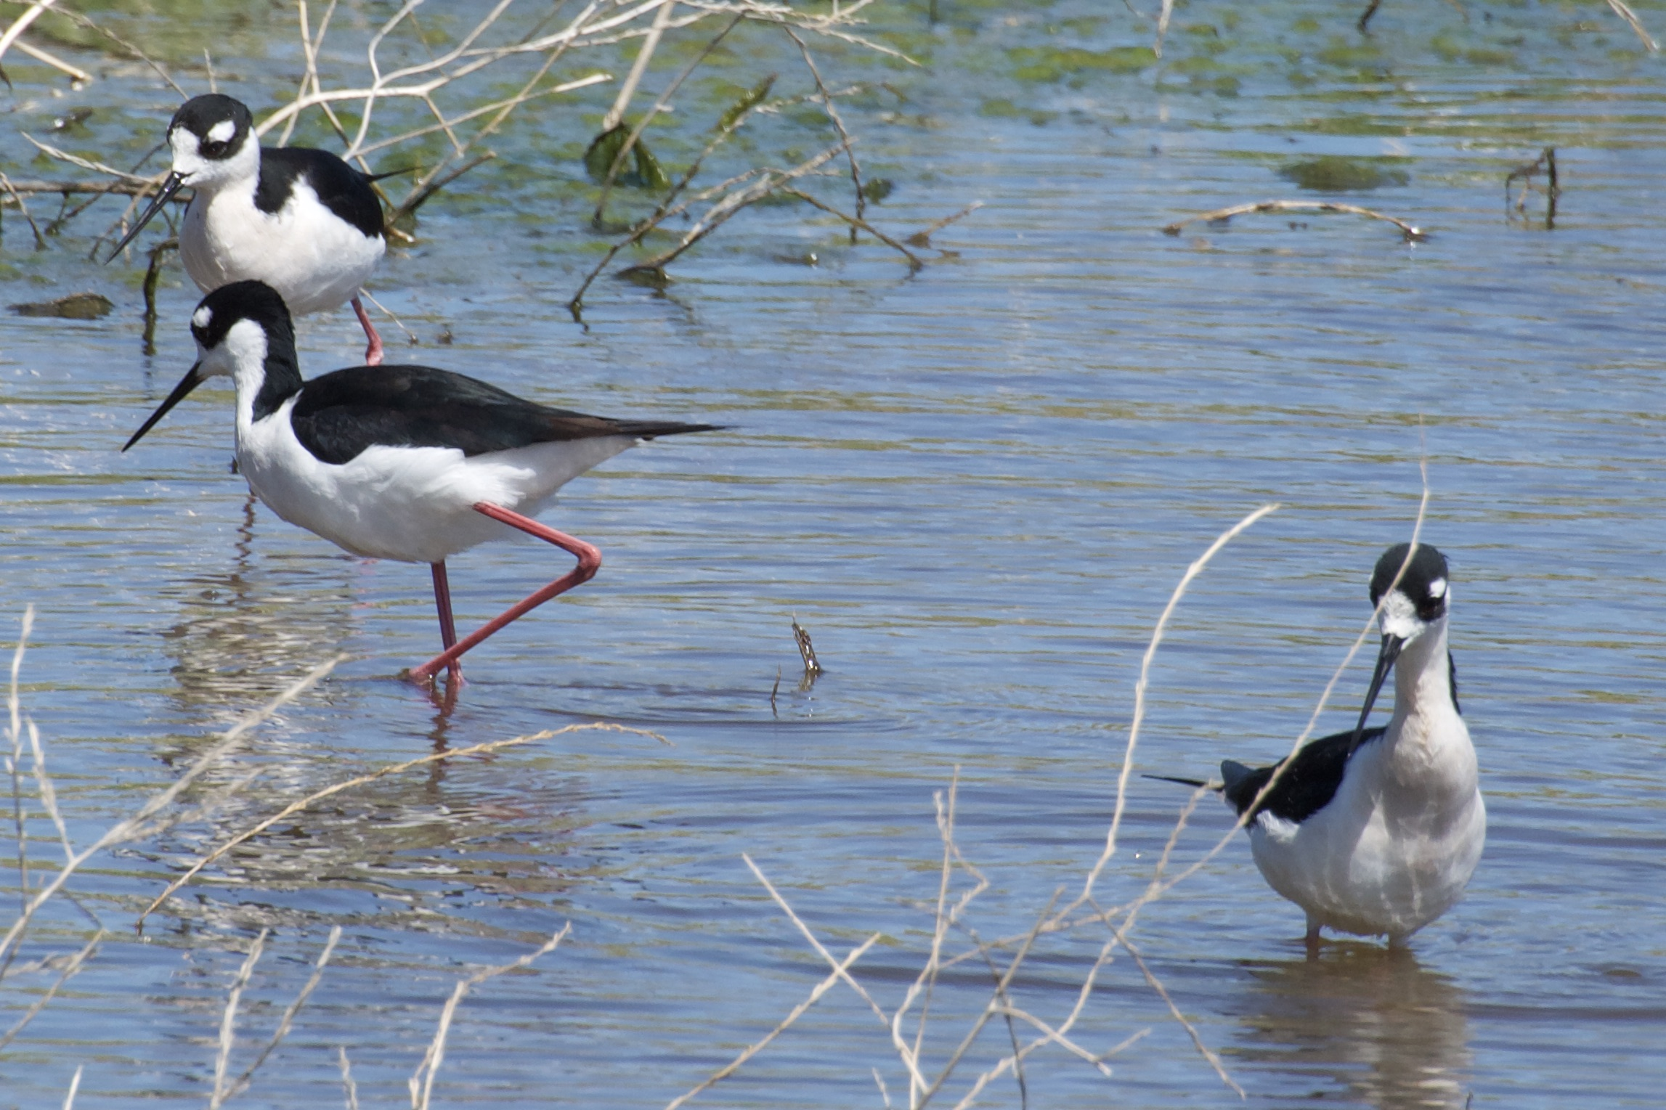
Bye for now Thanks for joining me
Black Necked Stilt

