Slide 1
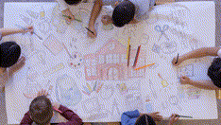
BUILDING NEW SKILLS:
BASIC DRAWING EXERCISES
Drawing Exercise #2

Slide 2
Practice will develop your drawing skills
Think of drawing exercises as warm-ups and drills.
Just as you get better at basketball with practice and repetition of basic skills, so too with drawing.
The more you practice making marks, the more you will naturally understand what your hand and pencil can do.

Slide 3
Practice #2 Drawing Geometrical Patterns
Step 1
Doodling is great practice. Fill a page with random geometrical patterns.
Make some lines dark, others light, some thick, some thin. Make variable lines. Make circles, squares, triangles, long straight lines, smooth curves and elbow and finger arcs.
*Practice drawing these shapes focusing on moving only your shoulder, only your elbow, only your wrist, only your finger, as you did in Practice #1.
When you have drawn all your lines and shapes, go back and label them as finger, wrist, elbow, and shoulder drawings. Make sure you have LOTS of each.

Slide 4
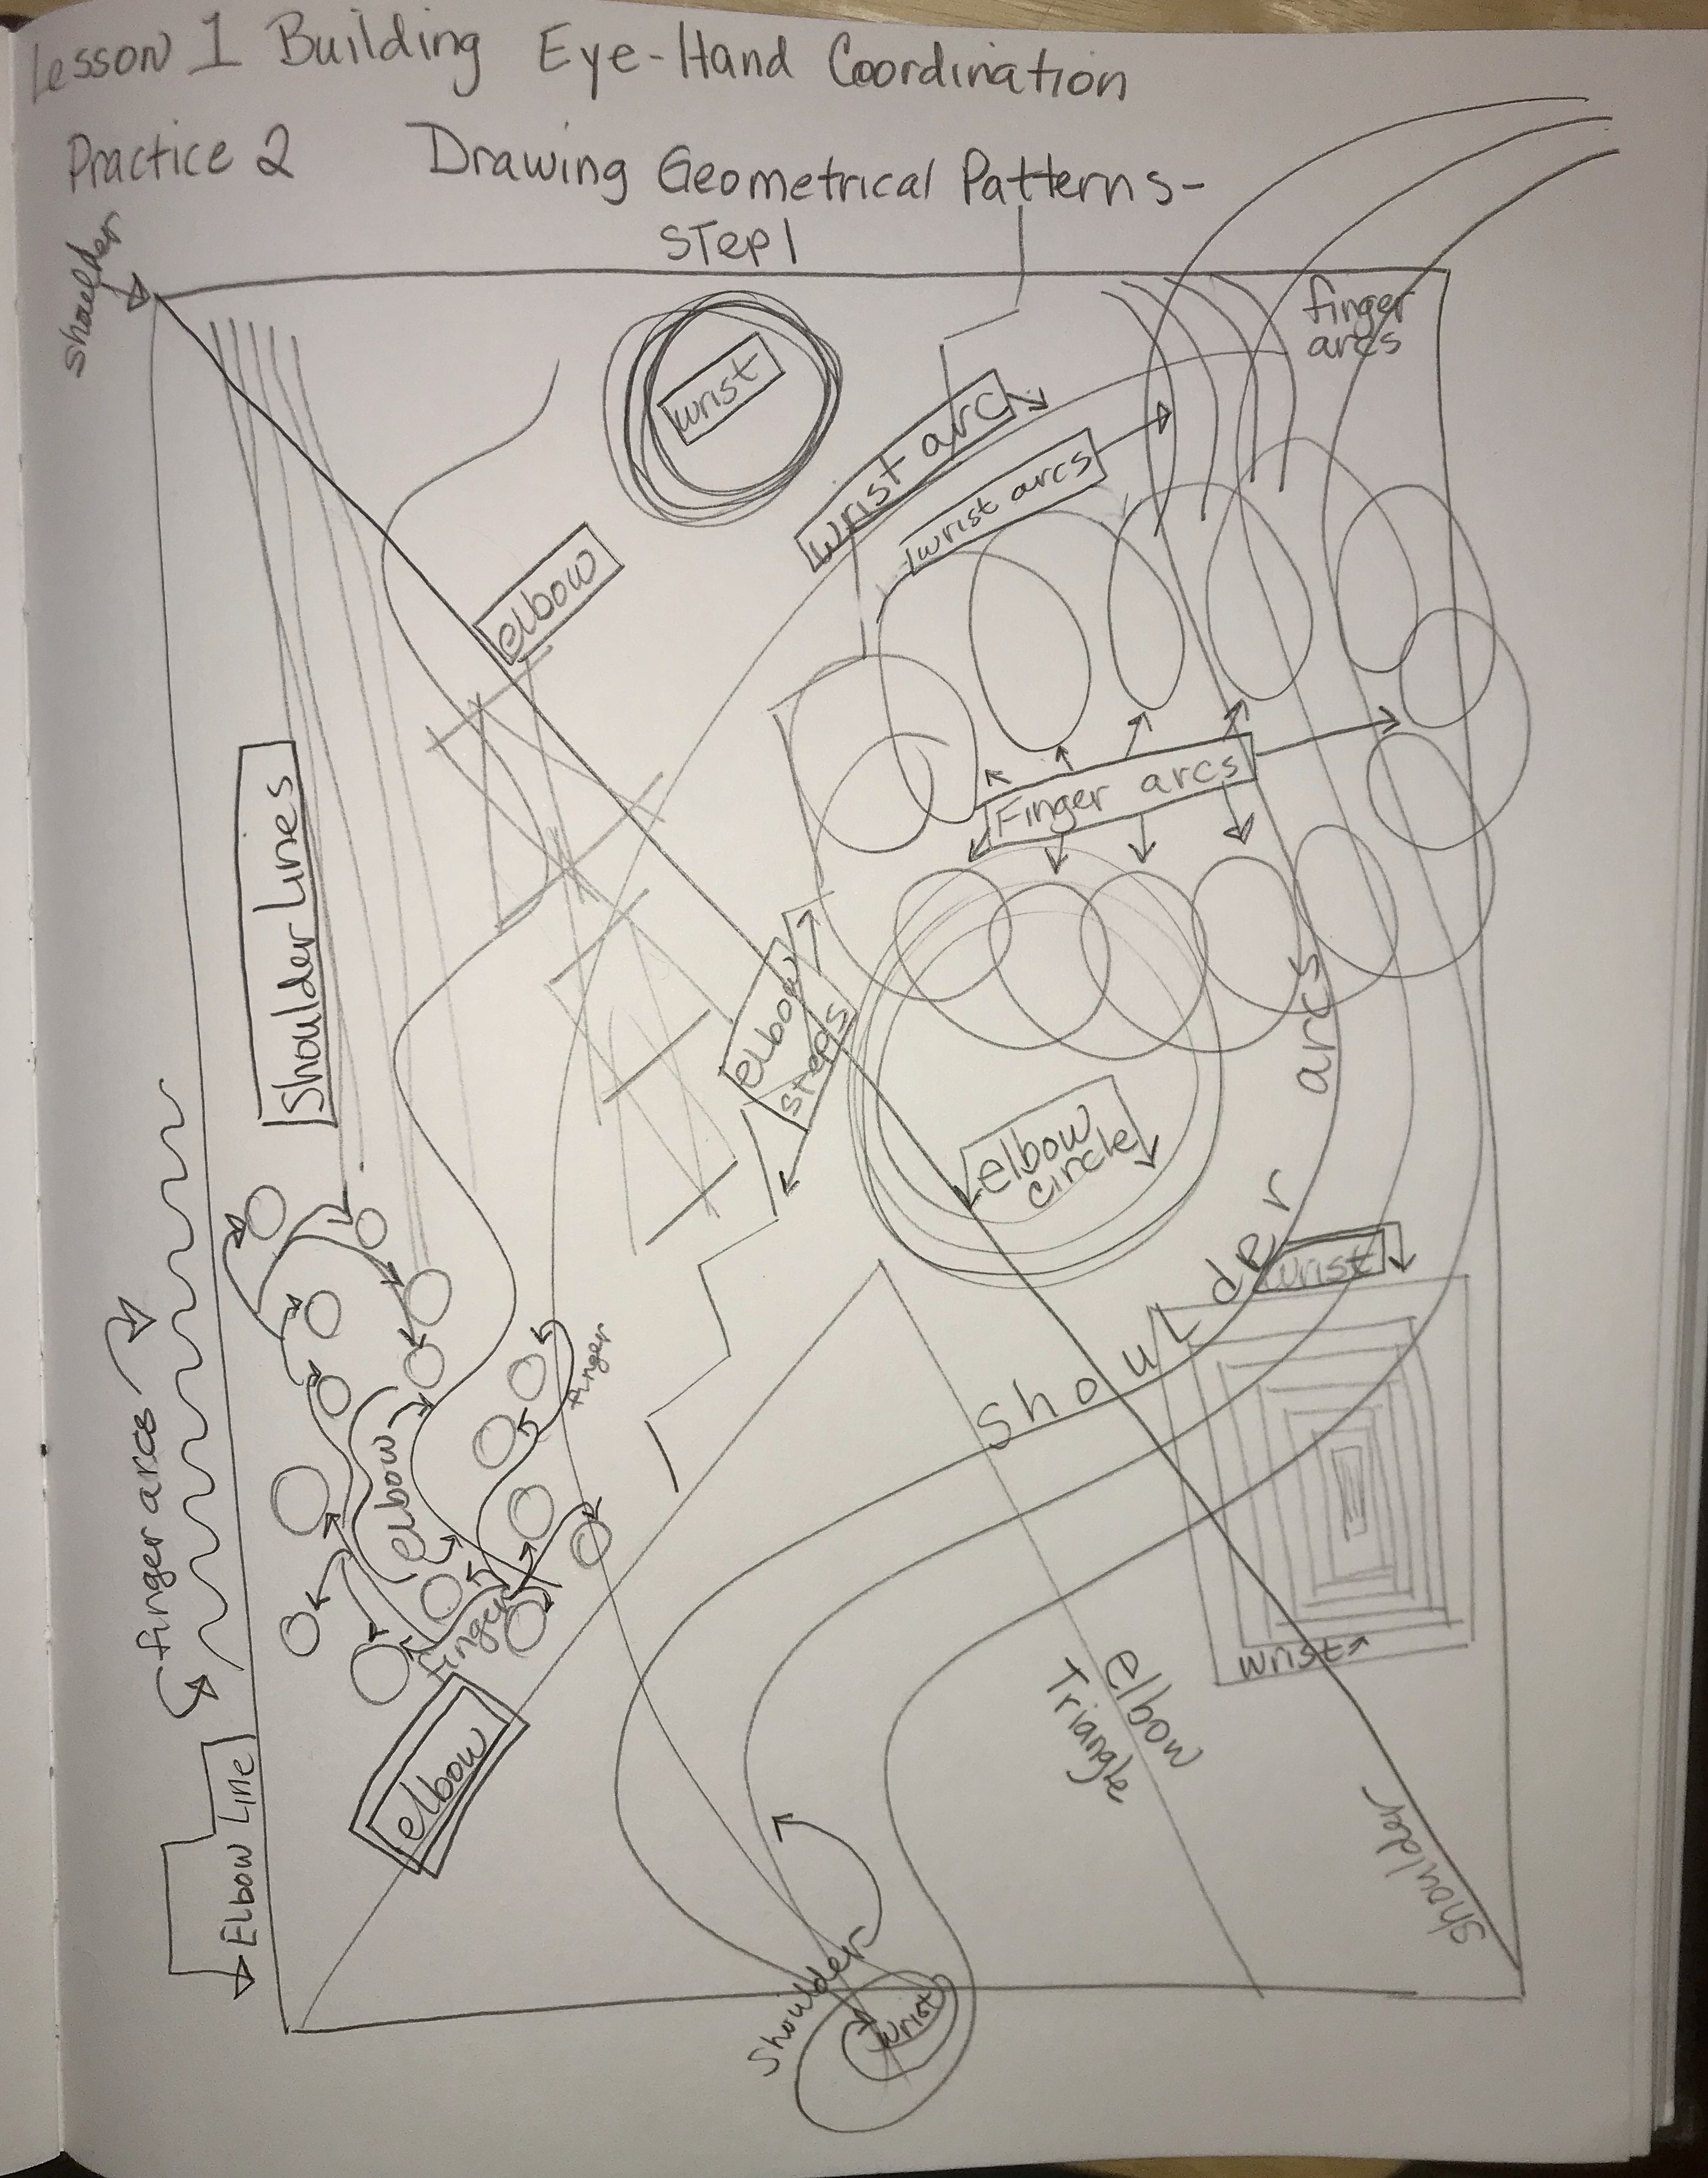
Practice 2, Drawing Geometrical Patterns
Step 1
Draw geometrical shapes
Light and dark lines
Thick and thin lines
Circles, squares, triangles
Long straight lines, smooth curves
Elbow and finger arcs
Label finger, wrist, elbow, and shoulder lines.
Make sure you have LOTS of each kind.

Slide 5
Practice #2 Drawing Geometrical Patterns
Step 2
Fill in spaces with tone, grading and texture. Fill in some of the spaces with even, continuous tone, or a smooth graded tone going from rich dark to as light a value as you can make.
  Fill boxes with hatched lines and cross hatching.
  Invent textures: A hairy surface, a bumpy surface, a pitted surface, a pebbled surface, dry cracks.
  Use only one color but vary the texture and pressure to create color and tone.
With this training, you will be able to draw straight lines, smooth curves, and sets of parallel lines, which are great for plant stems.

Slide 6
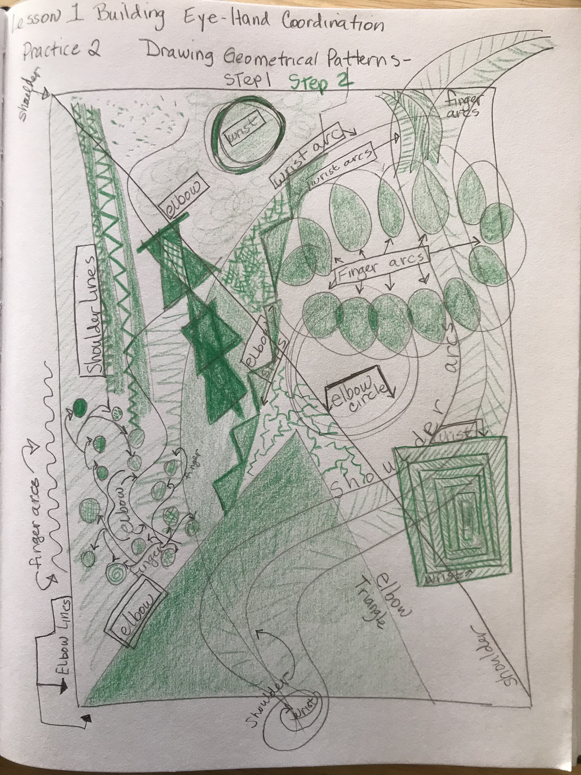
Practice #2, Step 1
Practice #2, Step 2

Slide 7
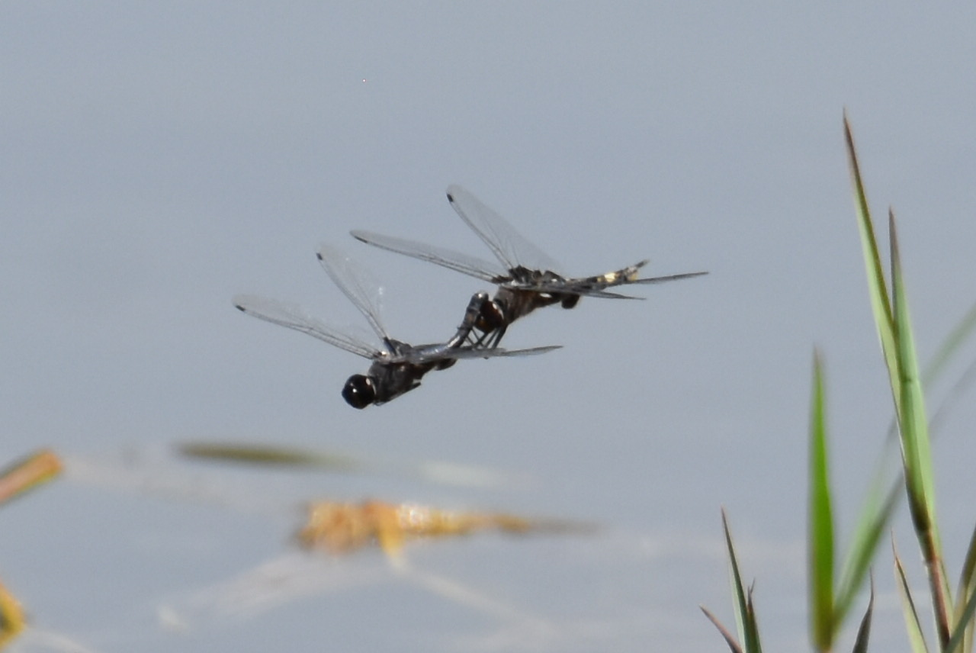

Bye for Now. Thanks for Joining Me.

