Slide 1
INQUIRY, INVESTIGATION, AND SCIENTIFIC THINKING
INTENTIONAL CURIOSITY AND TOOLS TO PURSUE QUESTIONS
BUILDING SKILLS IN ASKING VARIED QUESTIONS AND APPROACHES FOR DANCING WITH THOSE QUESTIONS

Slide 2
YOU CAN TRAIN YOURSELF TO BE MORE CURIOUS AND TO FIND MYSTERIES EVERYWHERE YOU LOOK
Why should you develop your sense of curiosity?
Curiosity focuses attention
Curiosity drives discovery, investigation
Curiosity increases intelligence
Curiosity improves memory and thinking
Curiosity promotes a flow state in which you perform your best work

Slide 3
Building a Curiosity Tool Kit
“That’s odd…”
Mysteries often present themselves this way. Often, we ignore that feeling.
STOP DOING THAT!
Instead, lean into it and IMMEDIATELY say or write the question before it’s lost forever.
Slow down and look. Mysteries are EVERYWHERE.
Attempt to unravel these mysteries. It’s surprising, interesting, and FUN.

Slide 4
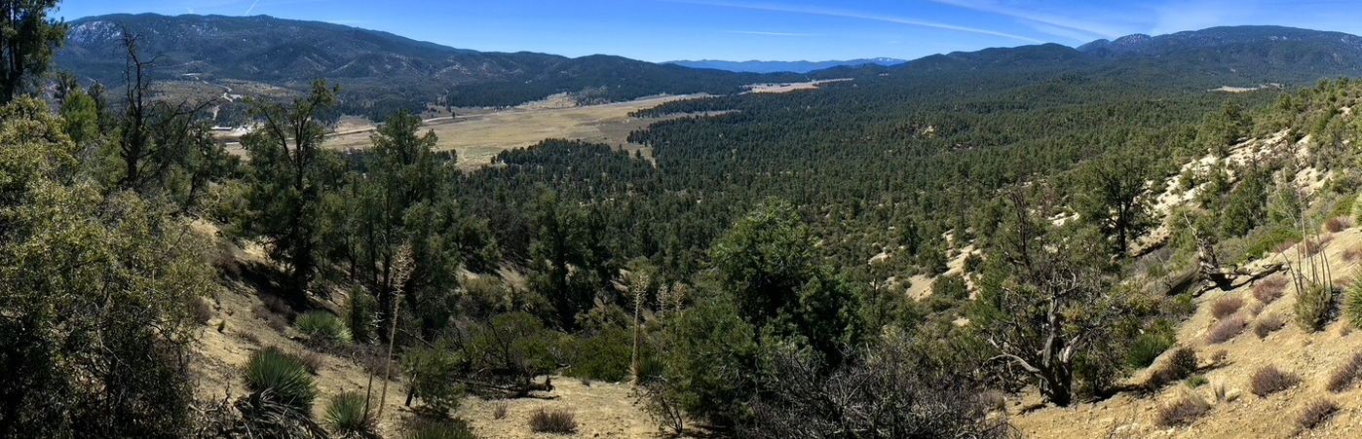
What is OPEN INQUIRY? What is its purpose?
Shifting back and forth between observation, questions and explanations.
The goal is NOT finding the right answer!!!!!!!
Often we will never find an answer to our mysteries, but we still learn plenty in the process.
We are allowed to explore, notice, wonder, propose explanations, make mistakes, and change our mind. THAT is the purpose of Open Inquiry.

Slide 5
Best Practices
Include metadata (date, time, location, weather, etc.)
Make Observations (I notice…, I wonder…, This reminds me of…)
INTENTIONALLY ask varied questions, including questions from observations and curiosity scaffolds ( Like: who, what, where, when, why, how)
Pursue questions that can be answered through observation in the moment.
Make explanations, including “Why Webs,” which present multiple plausible explanations to answer a “Why” question.

Slide 6
Best Practices (continued)
Distinguish between observation and explanation. Use icons or symbols for each type of information. ? ! # *
ALWAYS support claims or generalizations with EVIDENCE.
You can always change your mind if evidence suggests it and identify changes and shifts in your thinking.
Cite sources when information comes from a place other than your observation or thinking.
When collecting data, consider bias, describe or diagram methods and, when possible, test your claims using large and random samples.

Slide 7
Your curiosity tool kit: 5 tools to help you develop your curiosity
The following slides explain how you can use a variety of approaches to develop your curiosity.
Each approach can be used with the others.
Pick and choose which approaches you like and add new ones as you get better and better at asking questions.

Slide 8
Your curiosity tool kit: #1. Curiosity Scaffolds or Question Generators
What are Curiosity Scaffolds?
Prompts that help you generate rich and varied questions from your observations.
These open-ended observation-based questions are readily investigated through further direct observation.
I Notice… (Observations)
I Wonder…(Questions)
Who, What, Where, When, Why, How
It Reminds Me Of…(Connections)
Could It Be…(Explore and Explain)

Slide 9
Your curiosity tool kit: #2. How to focus your attention on inquiry while you journal
2. Before you even begin to journal, prime your curiosity by writing down the words PATTERNS and CHANGE on your page. This will remind you to look for these while you observe.
3. NGSS Crosscutting concepts: These are the BIG IDEAS that reflect how scientists think.
Patterns Structure and Function
Cause & Effect Systems and System Models
Scale, Proportion, and Quantity Energy and Matter
Stability and Change
4. 5W’s + H: Who, What, Where, When, Why and How. This is a good baseline (beginning) for starting to question.

Slide 10
Your curiosity tool kit: #3. The 7 Crosscutting Concepts
Patterns
Ask: What patterns do you notice? How can you describe the pattern? Are there exceptions to the pattern? What might be causing the pattern? What does the pattern remind you of?
Cause and Effect
Ask: What happened here? Why is it like this? What might be causing the effect you observe? What are other possible explanations? What might happen if…? Is this causation or correlation? How do you know?
Scale, Proportion, and Quantity
Ask: At what scale have you explored this phenomenon? Would you think about it differently if you zoomed in or out? Can you make a model that helps you understand nature at this scale? How can you measure change at different scales? What can you quantify at this scale and how can you measure it accurately?

Slide 11
The Crosscutting Concepts (Continued)
Structure and Function
Ask: What is it like? How might this structure work to help the organism survive in its environment? How does it work? How is this structure like others you have seen? How is it different? How might those differences impact the function of the structure?
Systems and System Models
Ask: What are the boundaries of this system? How does the system work? What are the parts of the system? How do the parts interact? How is this system affected by other things? What would happen if X were removed? What would happen if Y were added? Is there feedback? What was it before? What will it be next? How can you model this system?

Slide 12
The Crosscutting Concepts (Continued)
Energy and Matter
Ask: Where does the matter in this system come from? How does it change within the system? Where does it go? How do matter and energy interact with this system? Where does the energy in this system come from? What does the energy do in this system?
Stability and Change
Ask: What causes change in this system> What is stable in this system? What isn’t? What changes quickly in this system? What would happen if X were different?

Slide 13
Your curiosity tool kit: #4 Who, What, Where, When, How, and Why
Who: Identification and classification
Ask: Who is it? Who was it? Who will it be? Who made these tracks? Who could have made these holes in this leaf? What bird is that?
What: Questions about phenomenon. Focuses on cause and effect
Ask: What is happening? What happened? What will happen next? What does it do? What will the caterpillars do when the leaves fall from the trees(prediction)? What causes the darkened sky above the rainbow?
Where: Space, location, and biogeography
Ask: Where is it? Where was it? Where will it be? Where is the bird’s nest? Where is the current fastest? Where do frogs go at night?

Slide 14
Who, What, Where, When, How, and Why (Continued)
When: Timing—How long?
Ask: When did it happen? When will it happen? What is the timeline? When did this tree start to grow?
How: Mechanism—how does it work? Focuses on form and function
Ask: How do cracks in mud form? How do beavers survive under a frozen pond? How did that tree grow from such a tiny crack in the rock?
Why: Meaning, cause and effect, structure and function
Ask: Why did this happen? Why is it this way? Why do small birds fly in a tight flock and not a V? Why are the leaves darker green on one side and pale on the other? Why is the plant hairy?

Slide 15
Your curiosity tool kit: #5 The 8 International Baccalaureate Key Concepts
These concepts are similar to Crosscutting Concepts but with a slightly different focus.
Form: The understanding that everything has a form with recognizable features that can be observed, identified, described and categorized.
Ask: What is it like?
Function: The understanding that everything has a purpose, a role, or a way of behaving that can be investigated.
Ask: How does it work?

Slide 16
International Baccalaureate Key Concepts (Continued)
Causation: The understanding that things do not just happen, that there are causal relationships at work, and that actions have consequences.
Ask: Why is it like this?
Change: The understanding that change is the process of movement from one state to another; it is universal and inevitable.
Ask: How is it changing/stable? What was it like before? What will it become? What is the rate of change?

Slide 17
International Baccalaureate Key Concepts (Continued)
Perspective: The understanding that knowledge is moderated by perspectives; different perspectives lead us to put our attention in different places and make different observations. Perspectives affect our interpretations, understanding and findings.
Ask: What are the points of view? What is another perspective on this?
Reflection: The understanding that there are different ways of knowing and that it is important to reflect on our conclusions, to consider our methods of reasoning and the quality and reliability of the evidence.
Ask: How do I know? How strong is the evidence? How reliable is the source of my information?

Slide 18
International Baccalaureate Key Concepts (Continued)
Connection: The understanding that we live in a world of interacting systems in which the actions of any individual element affect others.
Ask: How is it connected to other things? How is it a part of a system or systems?
Responsibility: The understanding that people make choices based on their understandings and the actions they take as a result do make a difference.
Ask: What is my responsibility? What is my impact in this situation?

Slide 19
How do you answer your questions?
We can do a lot more with questions than just look up the answers. Learning to engage with nature mysteries can lead to huge learning opportunities.
Science is a system of creating and evaluating testable explanations of natural phenomena.
It is limited to the study of what can be DIRECTLY OBSERVED or inferred from observation.
Scientific explanations must be testable, or able to be supported or contradicted by concrete evidence.
A scientist should be able to ask, “How would I know if I were wrong?”

Slide 20
How do you answer your questions?
Scientific Mindset: Ask questions, find mysteries, look for clues, make explanations, try to prove yourself wrong, and change your mind in the presence of evidence.
If there is no way to test whether an explanation is wrong, it is NOT open to science. It must be able to be observed and measured.
Our tendency to rush for answers is tempting when we can find them with a click of a button.
BUT we can train ourselves to sit with mysteries and use methods to approach deeper understanding. It takes patience but ultimately it enhances our understanding of the world and our connection to it.

Slide 21
Here are some approaches to exploring nature mysteries.
LET’S GO SEE: Sometimes we can observe an answer to one of our questions right away. If it’s possible to answer a question through observation, but it will require additional equipment or time, we “wait and see,” gathering the data to answer the question later.
COULD IT BE, MAYBE: If we can’t directly observe an answer to one of our questions, we can come up with possible explanations for it. We can create “Why webs” proposing several possible explanations to the nature mystery or “Why” question. We can weigh one explanation against another using evidence to INFER which ones are plausible and which one is more likely to be right.

Slide 22
Here are some approaches to exploring nature mysteries (continued)
LOOK IT UP: If we can’t answer a question through our own observations, we can look up the subject or see whether additional information will provide evidence to deepen our understanding. BUT play with your mysteries first, instead of turning straight to an outside resource. Be certain you ask yourself what the credibility is of the sources you're using. Just because it’s written or on the internet doesn’t make it true!!!!!
LET IT BE: Science is a system of creating testable explanations of natural phenomena. If it can’t be directly observed or inferred from observations, your question is outside the realm of science. Therefore, if a question cannot be answered, you should let it be.

Slide 23
Here are some approaches to exploring nature mysteries.
A TOOL FOR EACH MYSTERY: For any mystery, we can ask questions, make observations, construct explanations and look things up.
We don’t need to do anything in a specific order!
We might ask a question, then come up with a possible explanation, then make an observation that contradicts our explanation, which leads us to another question.
We might consult a source to find some key piece of evidence, then go back out to observe more.

Slide 24
Curiosity Chains and Why Webs
The most interesting questions are rarely the first ones asked. Being deliberately curious and following a train of thought on the page can lead to learning, wonder, and insight.
Look for what is out in nature waiting for you.
Once you find a mystery, start asking basic questions that lead to more and more complex questions.
If you can’t think up interesting questions right from the start, use the basic questions (who, what, where, when, why, how) to start up your curiosity.

Slide 25
Curiosity Chains and Why Webs
A set of observations and questions begins with an “unexpected observation.” This stimulates questions which lead to more observations, which lead to more questions…
If you find yourself saying, “That’s interesting…” you’ve found an unexpected observation.
Use drawings, words, and numbers. Use arrows to track the flow of observations and ideas.

Slide 26
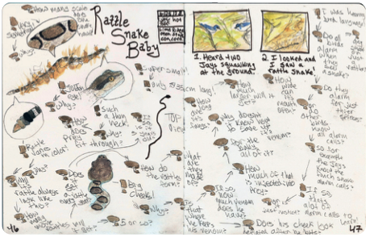
Show Observations and Thinking
A set of comic panels describes the interactions between jays and a snake.
Inset drawings capture specific details.
Words and arrows track the flow of observations and ideas. Including different ways of showing observations and thinking leads to a dynamic journal entry.

Slide 27
Icons like exclamation points and question marks, highlight key discoveries and make the page easier to scan.
What is the question behind the question?

Slide 28
Making a “Why Web”

Slide 29
FINALLY! The Activities
Now that you have your Curiosity Tool Kit ready, let’s practice.
You will be looking for four different mysteries that you can study.
Have fun with this!

Slide 30
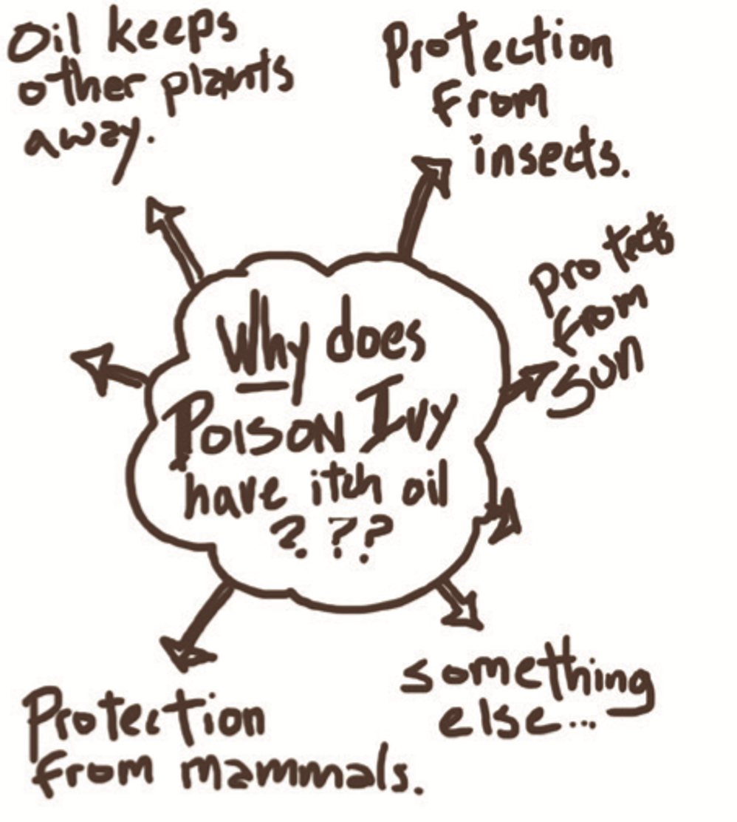
Activity #1 Make three WHY WEBS
Find three “unexpected observations”
Remember:
If you find yourself saying, “That’s interesting…” you’ve found an unexpected observation.
Create a “Why Web” for each of the three unexpected observations.
Start your journal page with your metadata.
Write a “Why” question for each of your observations, then write several (4-5) possible explanations.
Include one sketch or diagram with each of your webs.

Slide 31
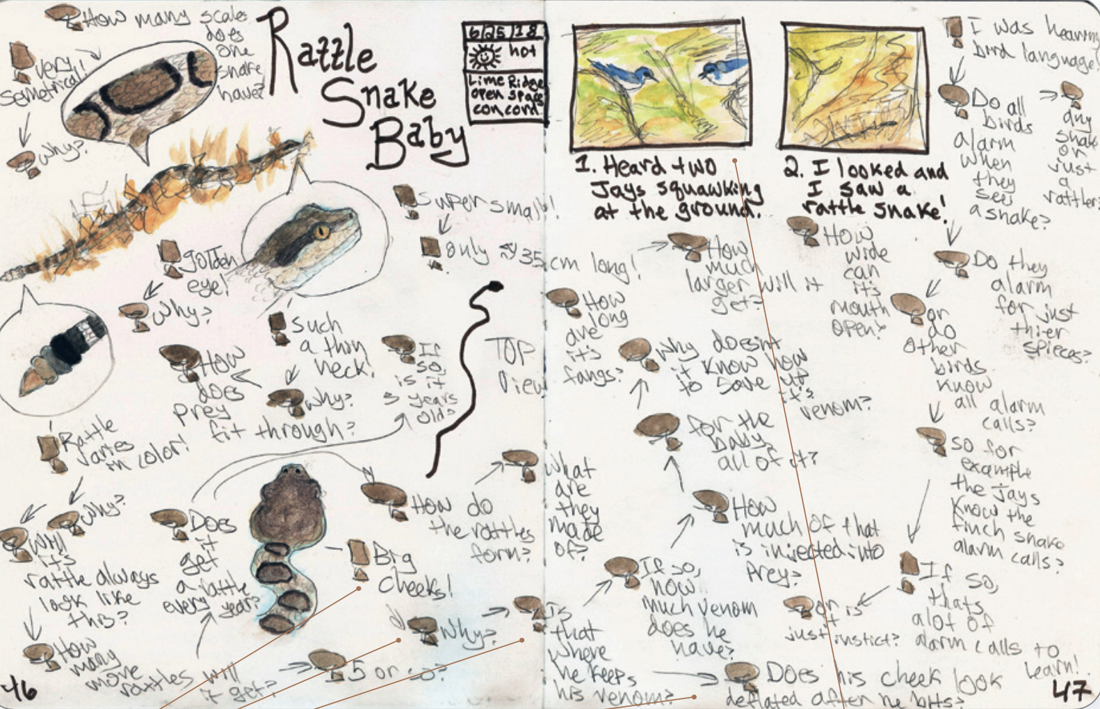
Activity #2 Create One CURIOSITY CHAIN
Find one more “unexpected observation.”
Create a Curiosity Chain for that observation
Remember to include icons like explanation points! and question marks?.
Highlight key discoveries,
Write your first questions, then let that question lead you to the next question.
Use the language of uncertainty, by saying “Maybe” or “Perhaps” or “Could it be”
Use ABC’s, 123’s and drawings, sketches or diagrams.

Slide 32
Reflection
In a short summary, starting with a topic sentence and ending with a closing sentence, explain what you learned while working to increase your curiosity by asking questions.
Consider these questions to help you write:
What was it like to observe, explore nature mysteries, and come up with explanations?
What helped you learn during this activity?
What skills do you feel like you got better at doing?

Slide 33
BYE FOR NOW. THANKS FOR JOINING ME
VALLEY OAK

