Slide 1
BUILDING NEW SKILLS: BASIC DRAWING EXERCISES
Drawing Exercise 4

Slide 2
Practice will develop your drawing skills
Think of drawing exercises as warm-ups and drills.
Just as you get better at basketball with practice and repetition of basic skills, so too with drawing.
The more you practice making marks, the more you will naturally understand what your hand and pencil can do.

Slide 3
Practice 4: Learning to Draw Lightly
Learning to draw lightly is a skill we can develop with a little practice.
The energy behind this kind of drawing will be used again and again in observational drawing.
Using one journal page, get ready to warm up!

Slide 4
Practice 4 Learning to Draw Lightly
Use the following sequence as a warm-up to drawing.
Start by loosening up. Relax your shoulders, arm and hand. And draw a circle on your paper.
Drop your shoulders, unclench your jaw, loosen up on your pencil grip and move your pencil grip back a little.
When you draw, move your whole arm, not just the fingers. Draw another circle, then another.

Slide 5
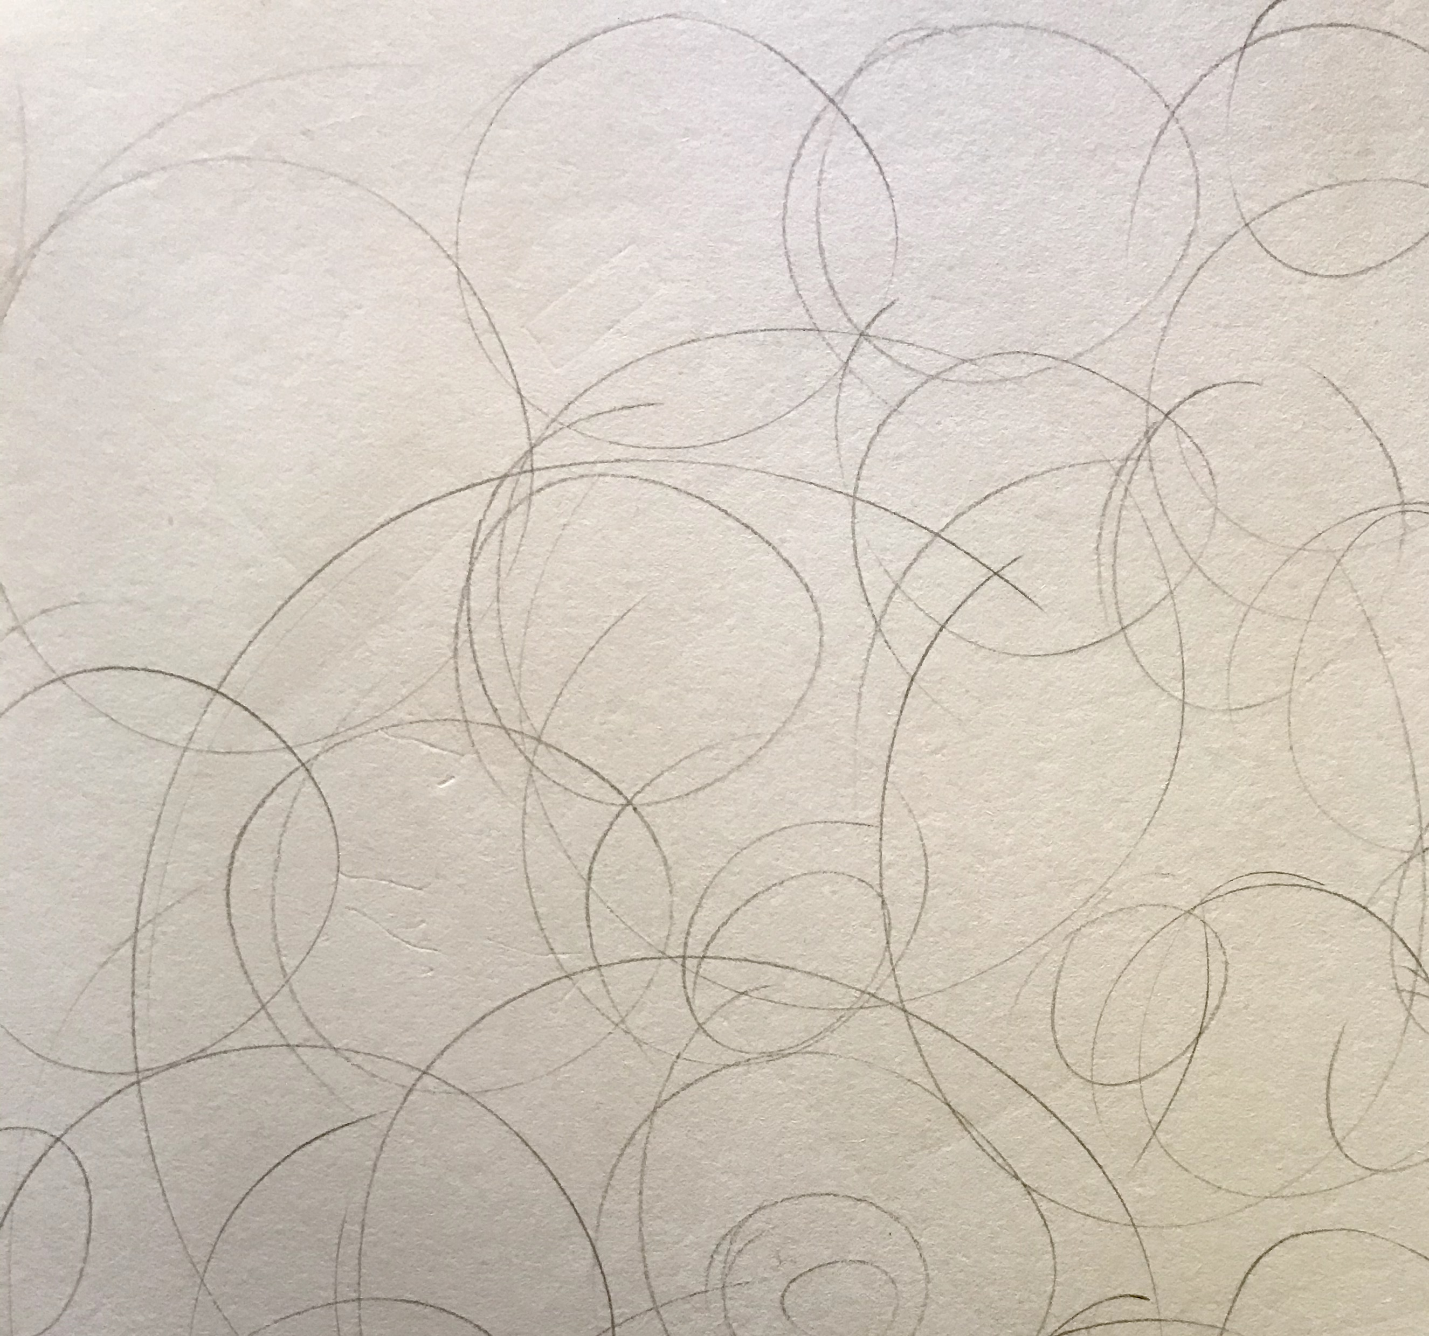
Practice 4: Learning to Draw Lightly
Now lighten up!
Draw a circle as lightly as you can.
Now see if you can draw one that is even lighter.
Fill the whole page with the lightest circles your pencil can make.
Now speed it up. Keep the lines loose and light, but this time the goal is to also make them fast.
Make a series of overlapping circles, scribbles, and flowing lines.

Slide 6
Bye for Now. Thanks for Joining Me.

