Slide 1
VALUE THE PARTS OF A SHADOW
Shadows give your subject form and dimension. Learn to see and draw the core shadow, reflected light, center light, highlight, and cast shadow.

Slide 2
Value
Value describes the light-to-dark range seen on objects around us and in our drawings.
Observing and recording values improves both drawing and observation skills.
Seeing values is not as easy as it sounds. One way to help your eyes see value is to squint. This blurs your vision and removes the distractions of detail and color.
Limit the steps in your value scale to three or four steps.
In drawing shadows, there are 5 steps.

Slide 3
5 Steps to Drawing Shadows
The dark core shadow on the side of the object opposite the light source,
Reflected light that is the mid-tone between the core shadow and the shadowed edge of the object,
The center light, also a mid-value, lightening as you move toward the light source,
Crisp, bright highlight in the center (shiny objects have brighter highlights than dull ones),
Cast shadows created by the object itself. This is the darkest value.

Slide 4
Parts of a Shadow
Try this 5-step exercise.
After you complete the exercise, you will begin to change the way you see the subject you are drawing.
Shadows gives your subject a 3-dimensional form.
Special tip: When drawing your subject, put the shadows in BEFORE you color it.

Slide 5
Use this guide to help you complete this exercise.

Slide 6
Draw your own shapes template or use this quick sketch. Fill in the shadows using the 5 steps.

Slide 7
Step 1
Draw these four different geometrical shapes. (Start with the basic shape at end, then extend the lines.)
Or print out the quick sketch found on the previous slide.
Draw the dark core shadow on the side of the object that is farthest from the light source. This will be dark.
Step 1
Draw the dark core shadow on the side of the object that is farthest from the light source.

Slide 8
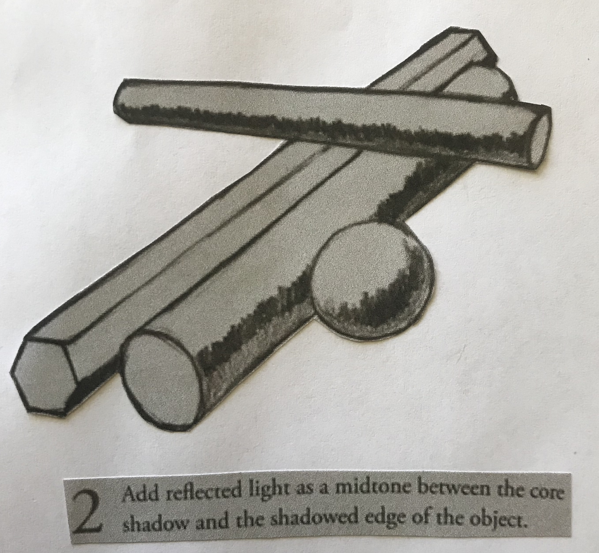
Step 2
Under the dark core shadow, add in the reflected light.
This is light reflected from the surface on which the objects are sitting.
This is a mid-tone, lighter than the dark core shadow and the shadowed edge of the objects, which is very dark.
Step 2
Add reflected light as a mid-tone between the core shadow and the shadowed edge of the object.

Slide 9
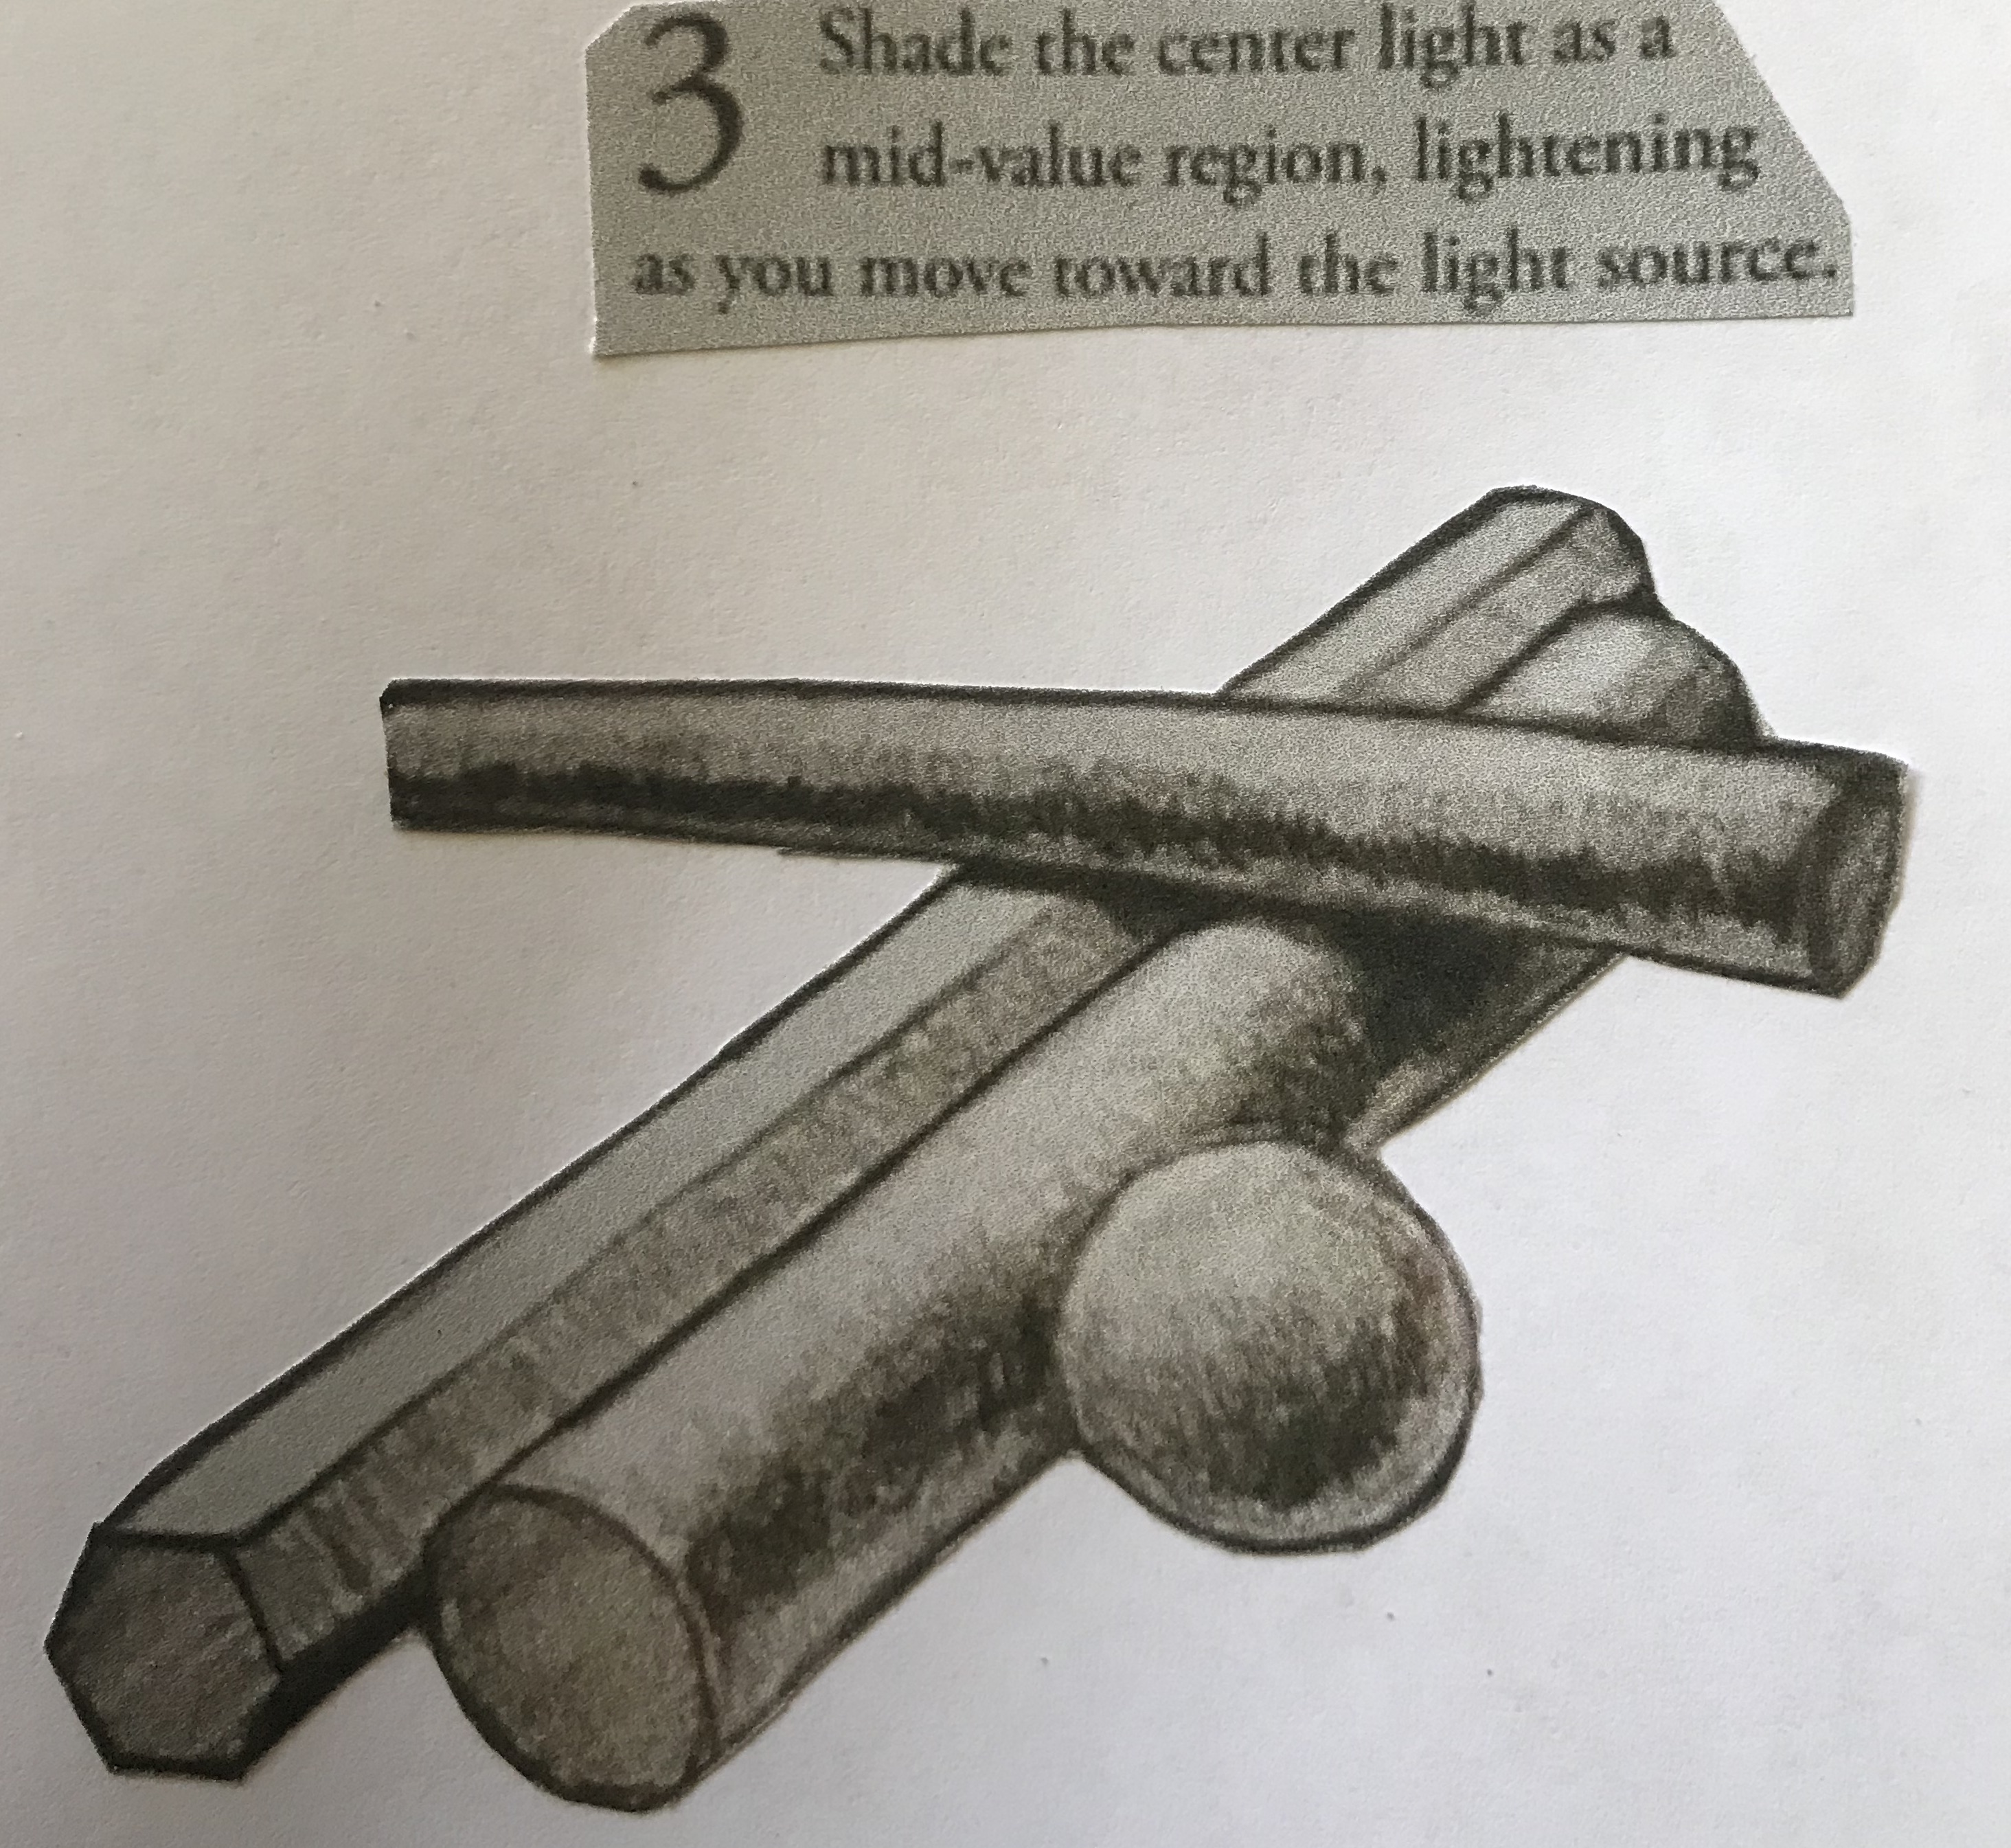
Step 3
Shade the enter light as a mid-value region, lightening as you move toward the light source.
Step 3
Shade more mid-value tone next to the dark core shadow to represent the center light.
Lighten this tone as you move toward the light source.

Slide 10
Step 4
This is the fun part. Use your eraser for this step.
Erase a crisp highlight into the center-light value you drew in step 3.
Shiny objects have brighter highlights than dull ones.
The highlight moves as the observer moves. It is close to the middle of the center light if the light is behind you. It moves toward the core shadow if you are looking into the light.

Slide 11
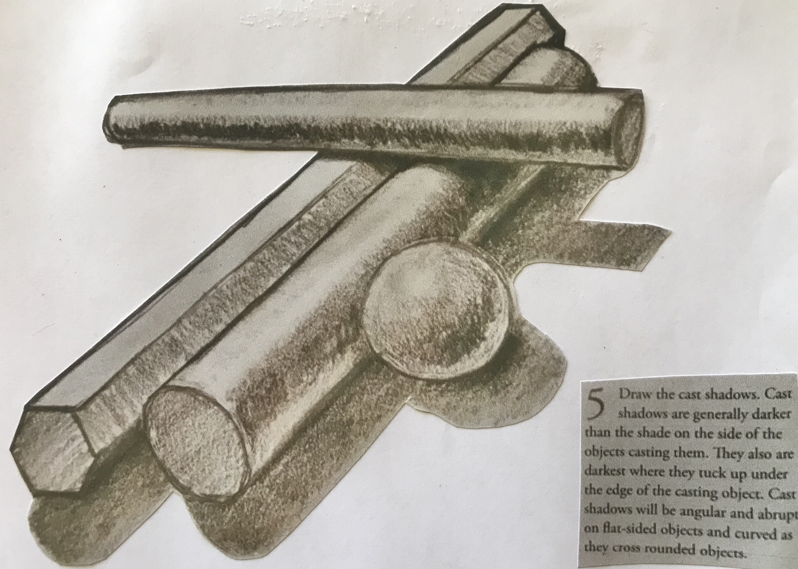
Step 5
The final step is to draw the shadows cast by the objects.
These shadows are darker than the dark core shadow (step one) drawn on the objects.
They are darkest where they tuck up UNDER the edge of the casting object.
Cast shadows will be angular and abrupt on flat-sided objects and curved as they cross rounded objects.
Step 5
Draw the cast shadows. Cast shadows are generally darker than the shade on the side of the objects casting them.

Slide 12
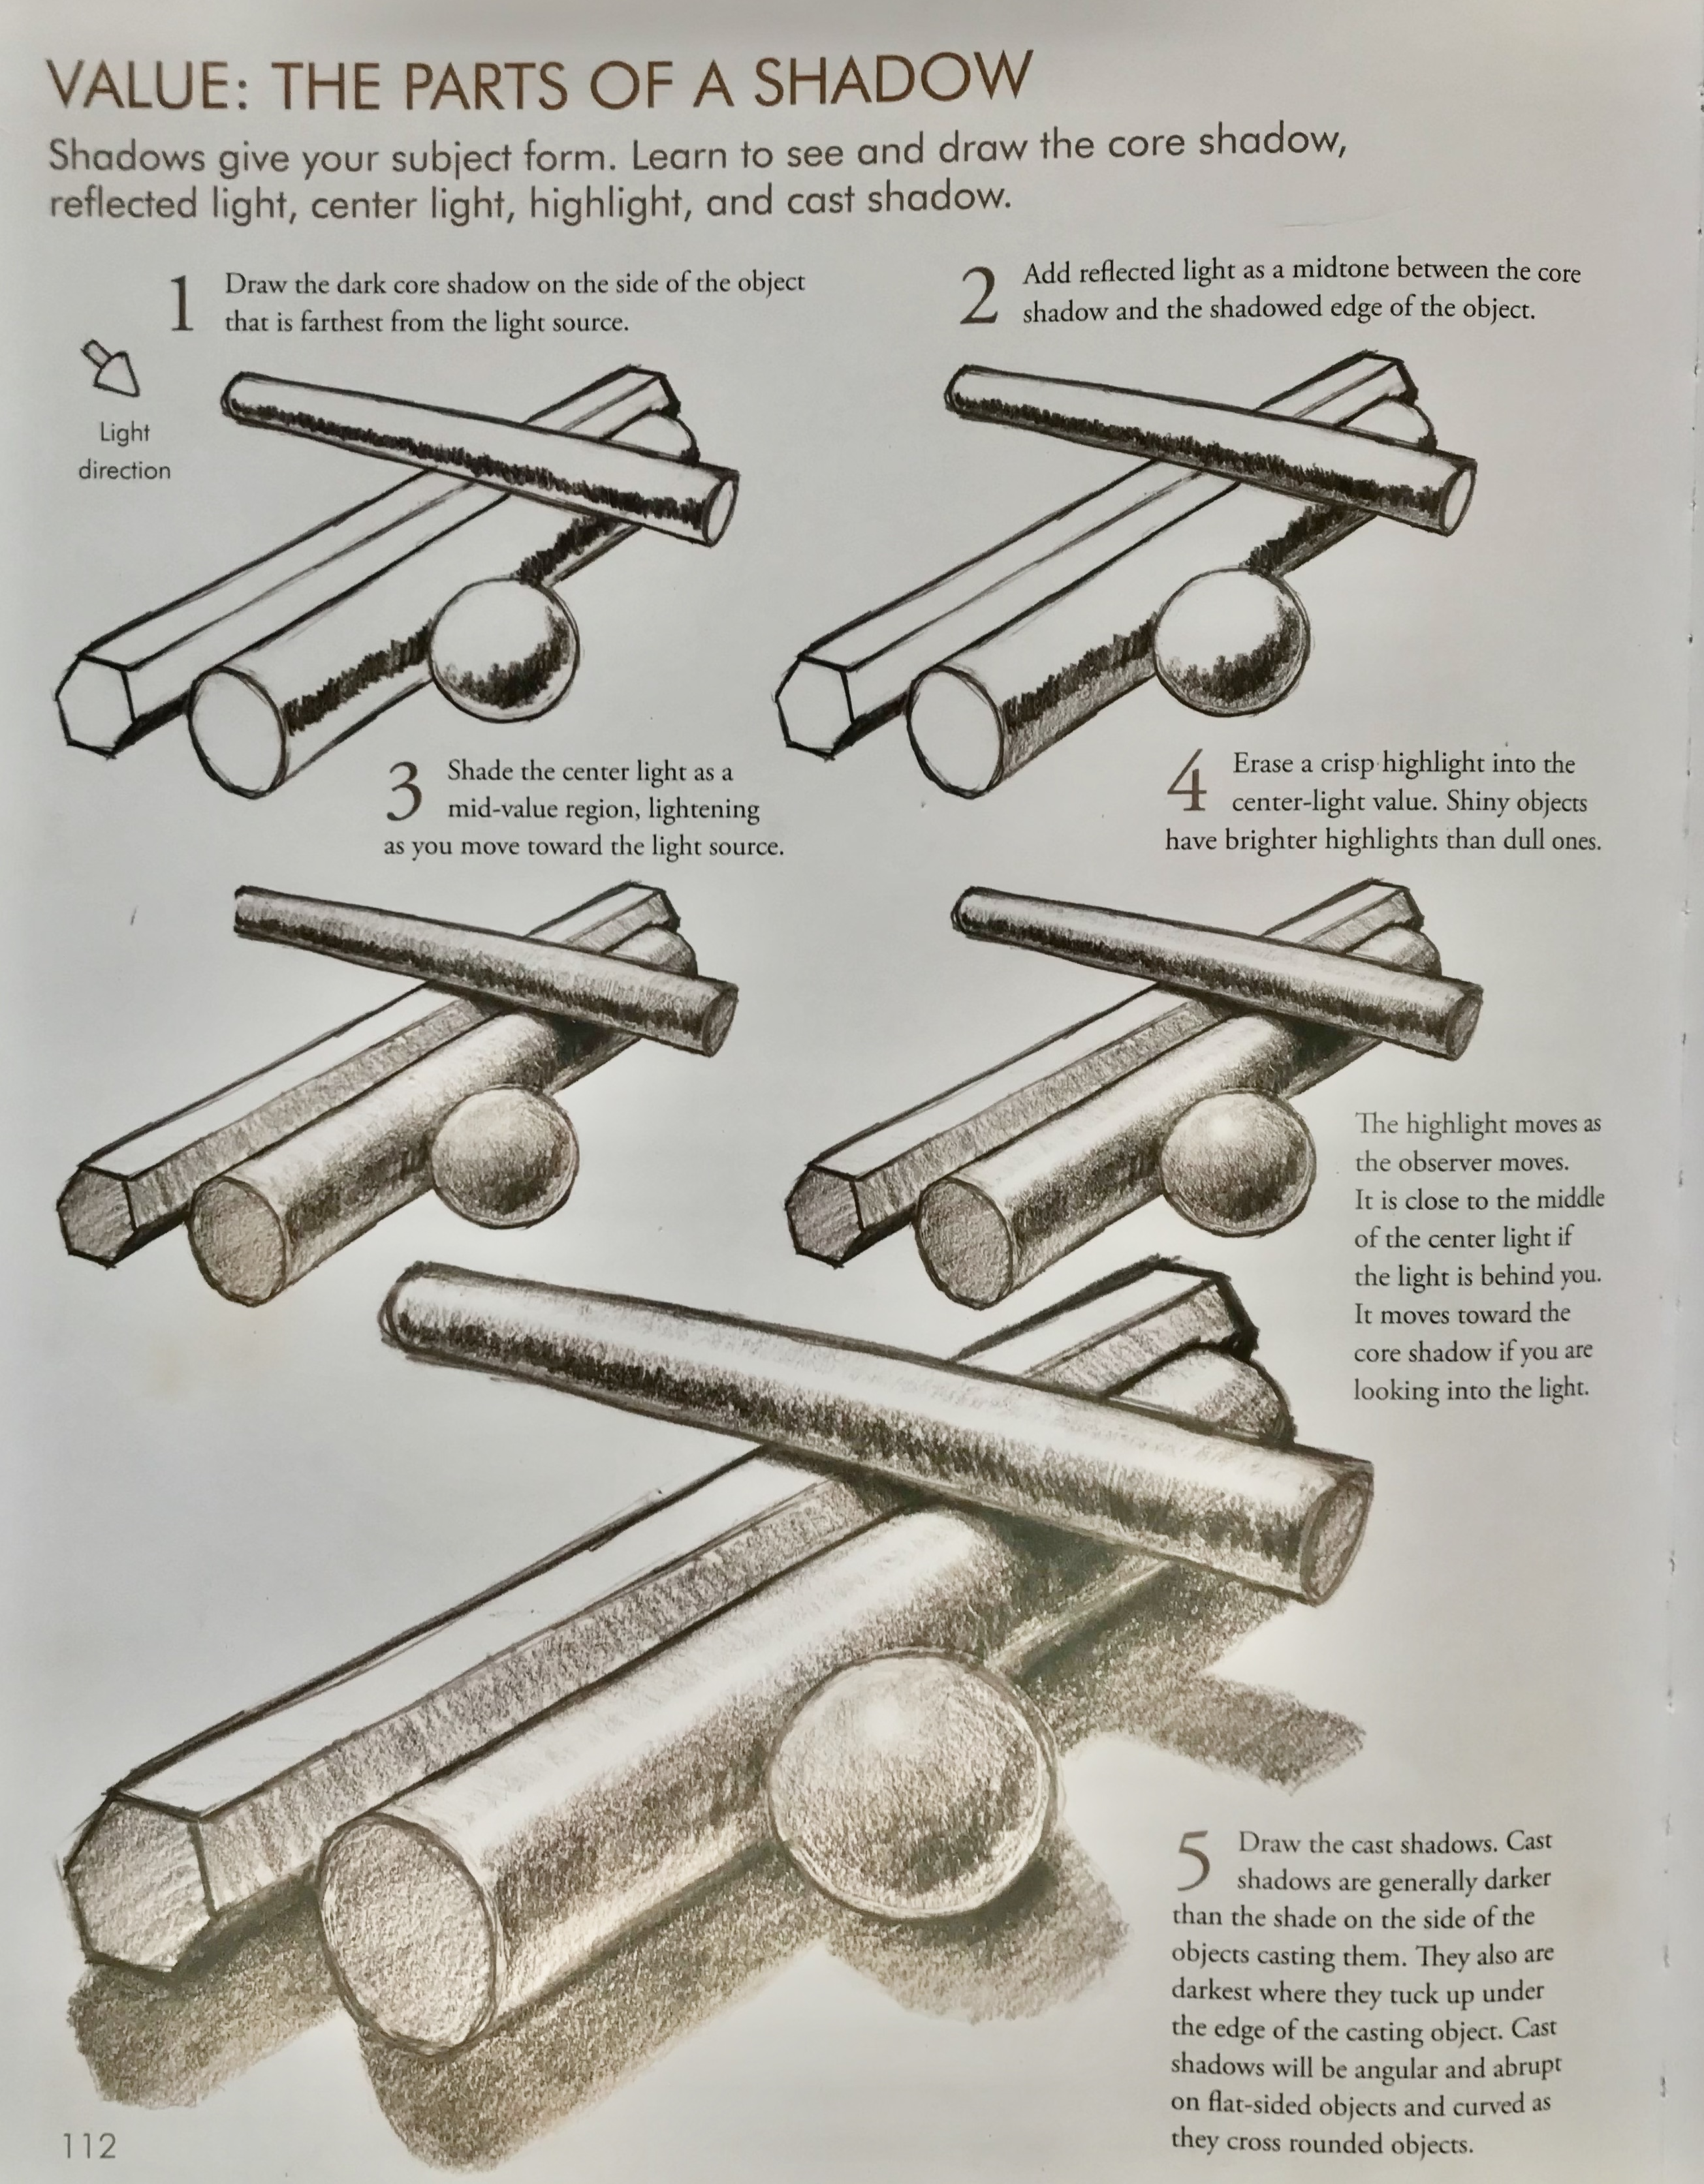
You can use this 5-step illustration while you practice creating shadows.
Next, practice with other objects you find around the house or outdoors

Slide 13
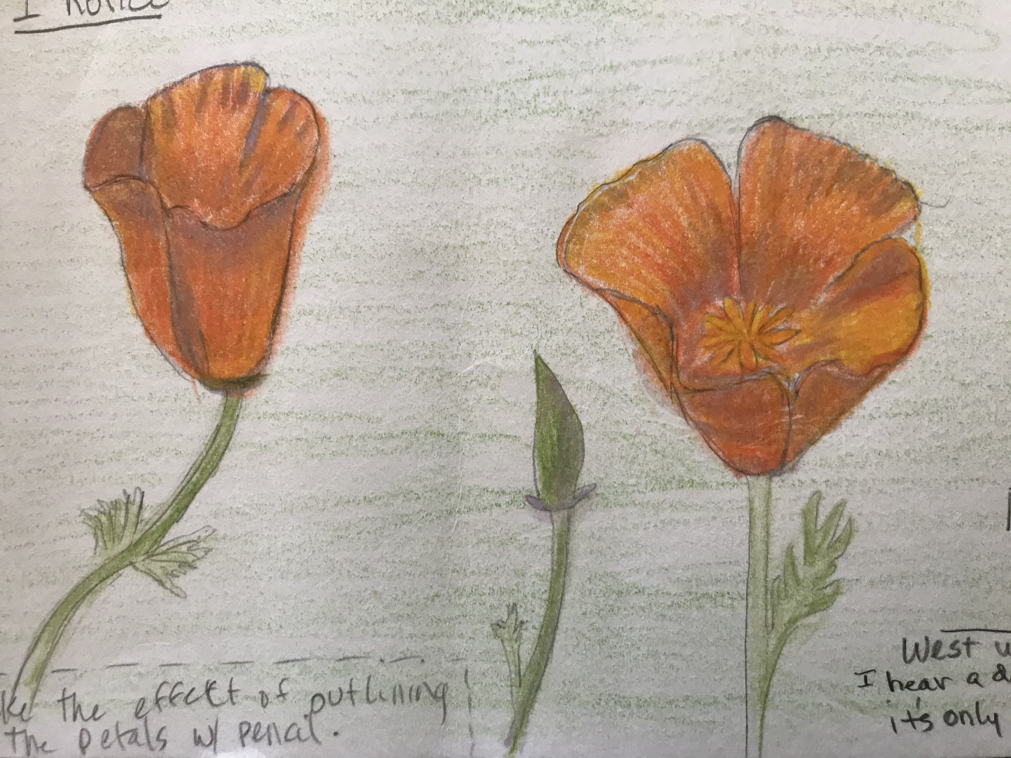
Apply shadow BEFORE applying the color of the object.
Start with the contour of the object and draw in the details. Then draw the shadows.
In this case, light purple was used for shadow.
Then apply the color over the shadow.

Slide 14
Bye for now. Thanks for joining me.

