Slide 1
Lesson 4 Compare and Contrast
In this lesson, you will study two kinds of things that are very similar, such as two shells, two feathers, two leaves from similar plants (like two different kinds of oaks), two kinds of similar fruit (like a lemon and orange), two kinds of beetles. You get to choose your subject!

Slide 2
What do we mean by Compare and Contrast?
This is very important:
If you are asked to compare two things, you need to tell
HOW THEY ARE THE SAME.
If you are asked to contrast two things, you need to tell
HOW THEY ARE DIFFERENT.

Slide 3
This is so important we need to repeat it.
Compare: Show how they are the same.
Contrast: Show how they are different.

Slide 4
What tool helps you compare and contrast?
VENN DIAGRAM

Slide 5
MODEL LESSON
I’m going to show you how to do this journal entry. Then you will select your own subject, journal it, and send your finished journal entry to your teacher.
As in Lesson 3, you will answer some questions and turn them into a paragraph for your reflection.

Slide 6
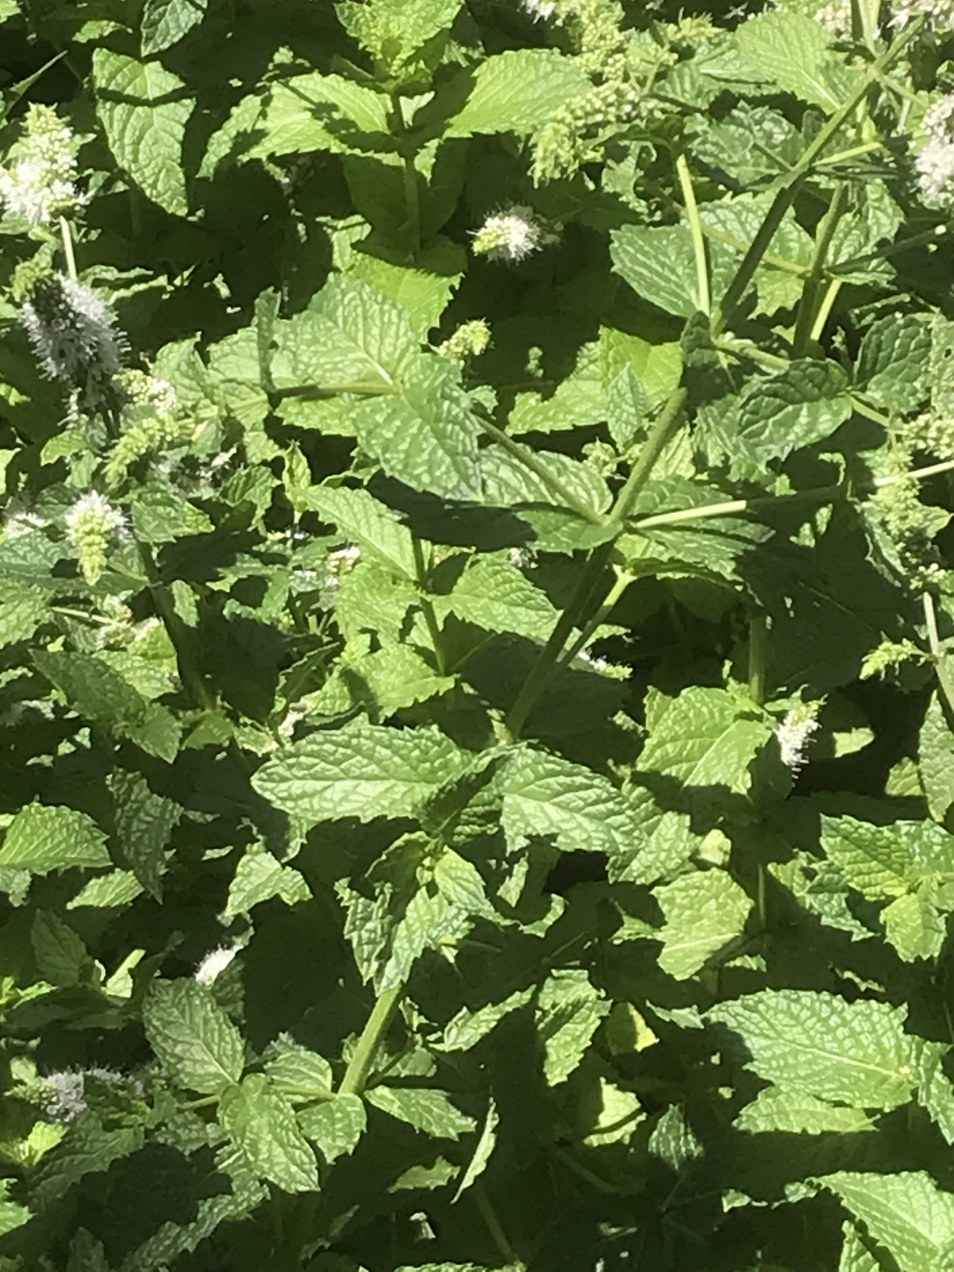
Example journal My Mint Study
I have two different species of mint growing in the same place in my garden. I’m going to compare and contrast
the two mints.

Slide 7
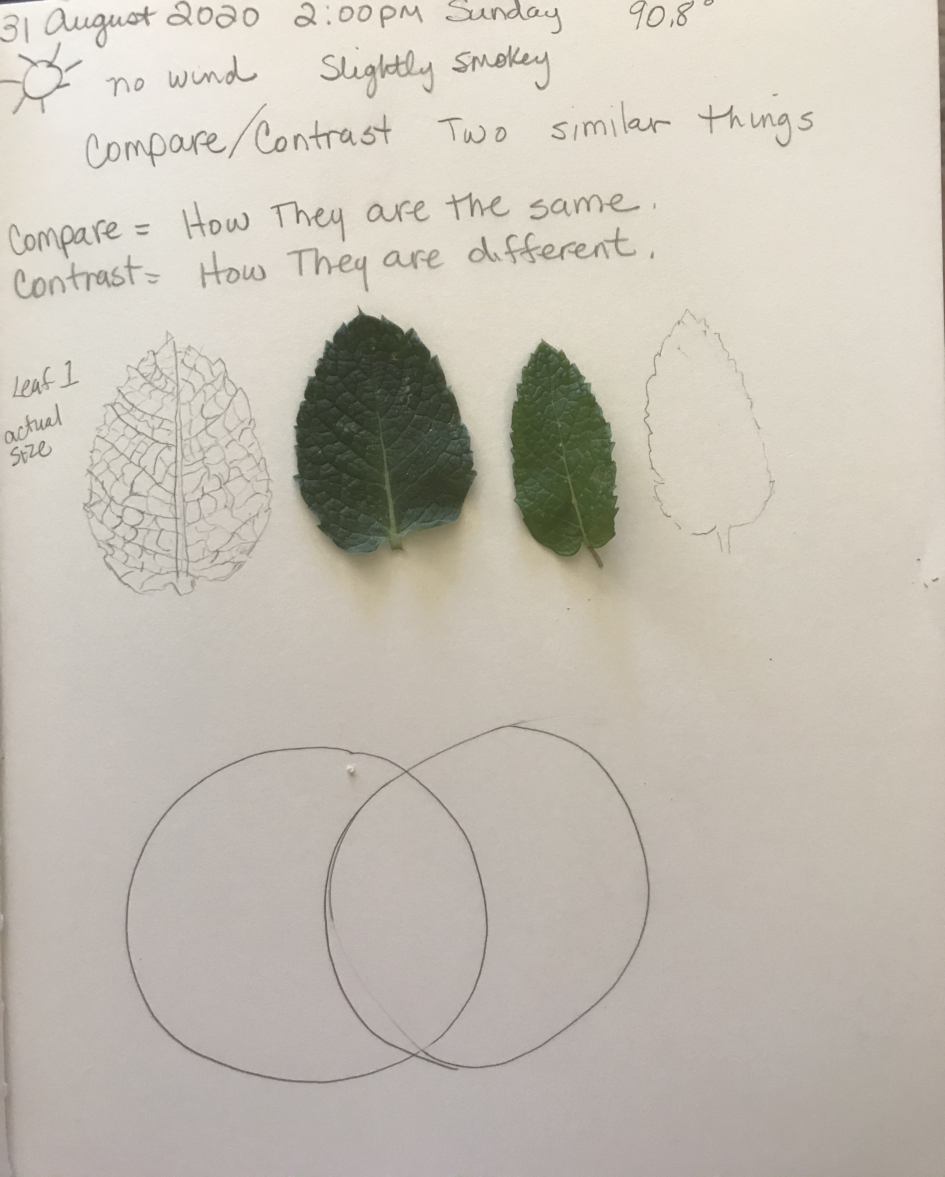
Head your journal with your Metadata
Drawing strategy: If your subject is small enough and is flat, trace it.
Place you Venn Diagram on your page.

Slide 8
I NOTICE, I WONDER, THIS REMINDS ME OF…
SELF TALK (I NOTICE, I WONDER, THIS REMINDS ME OF…)
WRITE YOUR OBSERVATIONS AND DESCRIPTIONS, FILL IN YOUR VENN DIAGRAM AS YOU GO.
DRAW YOUR TWO SUBJECTS, DO YOUR METRICS (123) AND CONTINUE ADDING TO YOUR VENN DIAGRAM AND “I NOTICE, I WONDER, THIS REMINDS ME OF…”

Slide 9
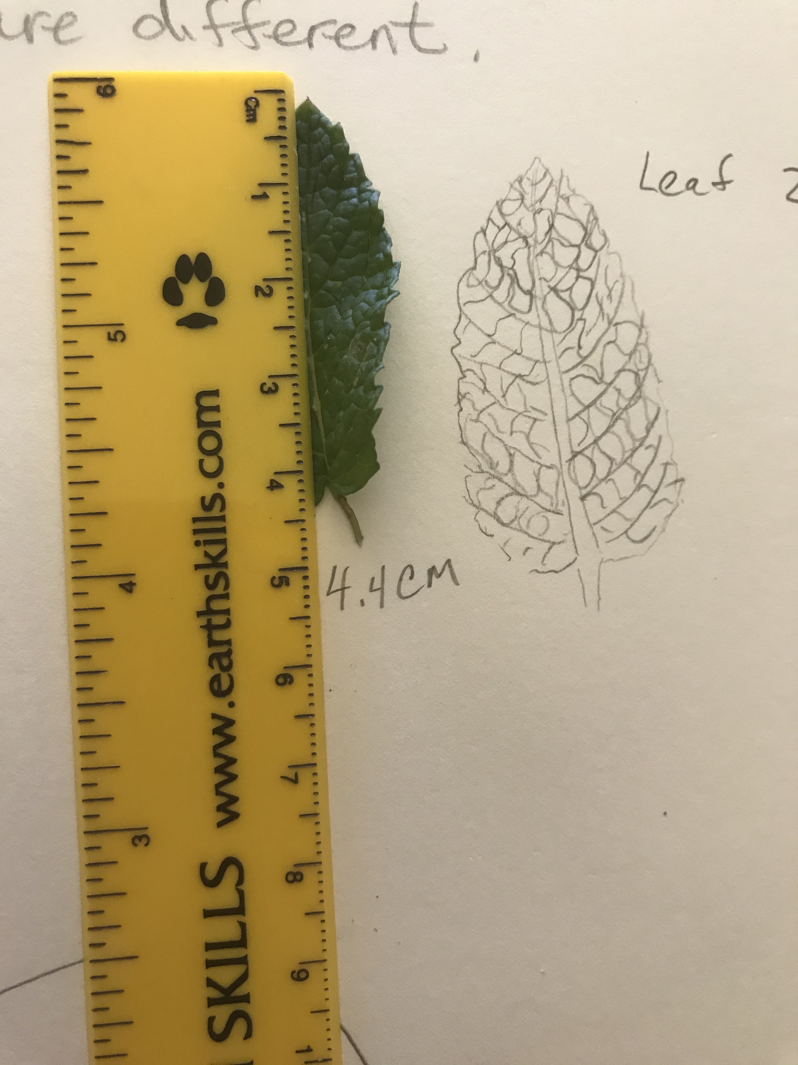
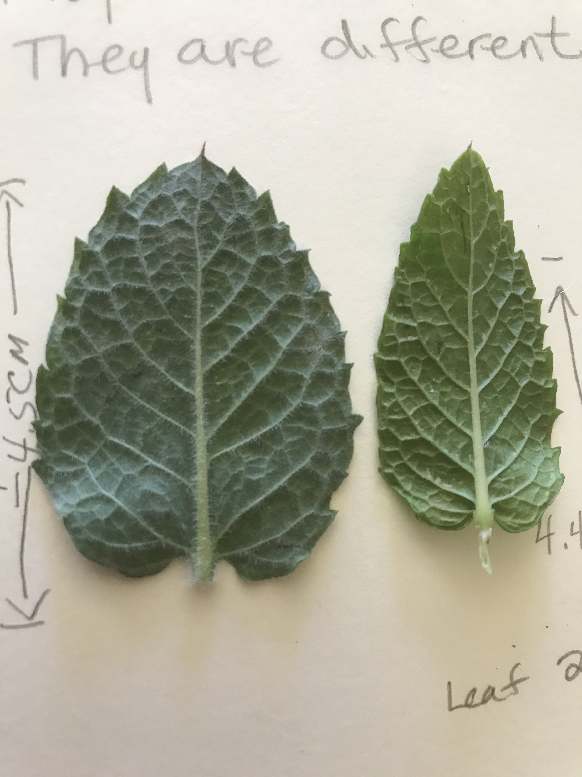
USE YOUR TOOLS
123: USE A RULER OR TAPE MEASURE TO MEASURE YOUR SUBJECT

Slide 10
USE YOUR HAND LENS OR MAGNIFYING GLASS TO STUDY YOUR SUBJECTS CLOSE UP. BRING THE LENS UP TO YOUR EYE (LIKE GLASSES) THEN BRING YOUR SUBJECT UP TO THE LENS UNTIL IT’S FOCUSED.

Slide 11
I notice small hairs all along the veins of the underside of the leaf

Slide 12
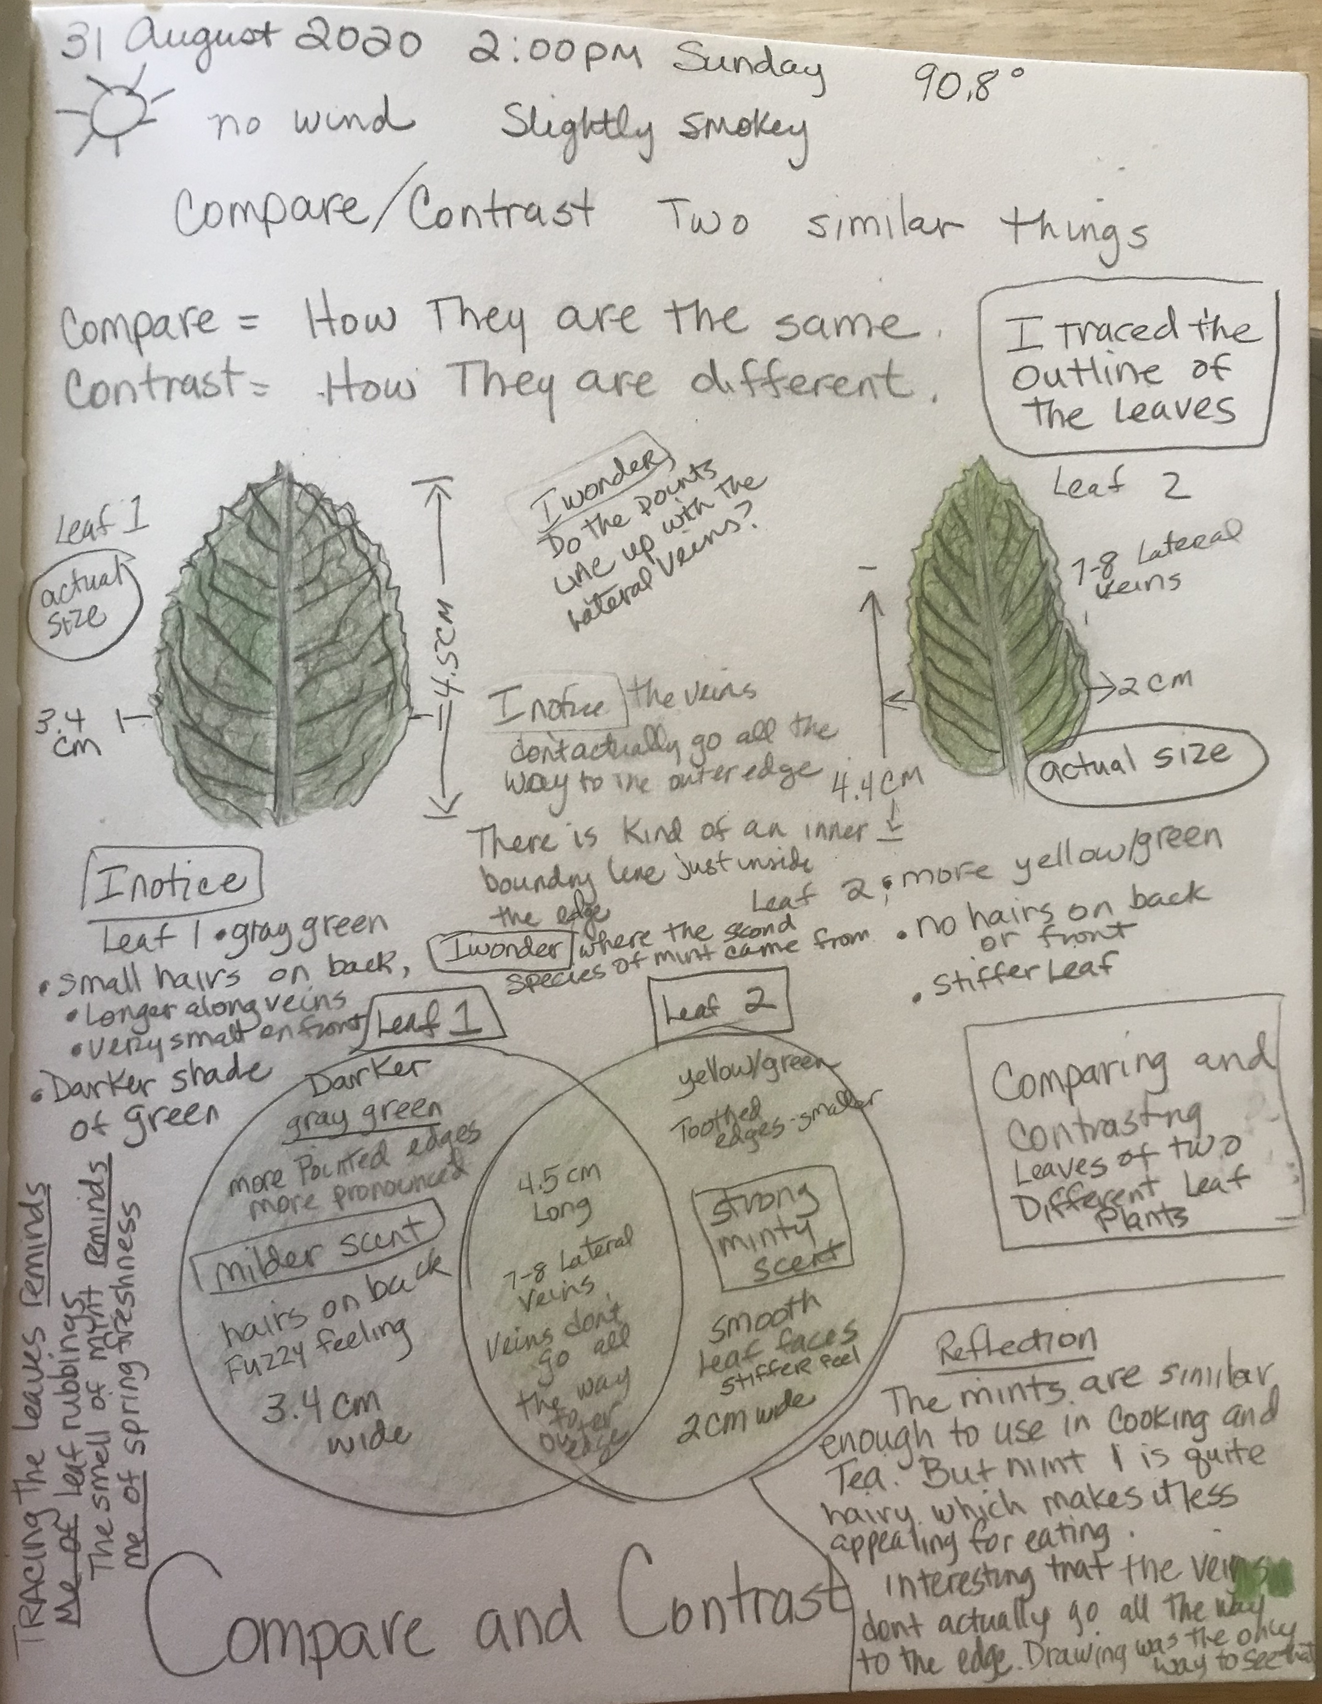
Add color to your drawings
Check your page over to make sure you have everything:
ABC
123
And
I put my title at the bottom. Where do you want to put yours?
Don’t forget to add Lesson 4 to your Table of Contents.

Slide 13
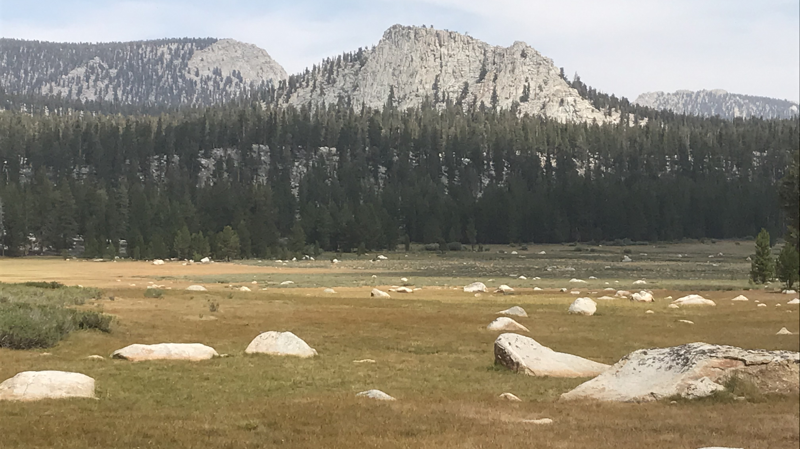
YOU’RE READY TO DO YOUR OWN COMPARE/CONTRAST STUDY
Pause this Video
GO FIND YOUR TWO SUBJECTS. REMEMEBER, THEY NEED TO BE VERY SIMILAR
AN ORANGE AND A LEMON, A PEACH AND AN NECTARINE
TWO LEAVES
TWO SIX-LEGGED INSECTS
TWO SEED PODS FROM DIFFERENT TREES
TWO FEATHERS , TWO SHELLS, TWO ROCKS

Slide 14
Welcome Back. Let’s do our Reflection
Do your reflection on the page following your compare/contrast study.

Slide 15
REFLECTION
REMEMBER HOW TO DO IT?
Answer the following questions in
QUESTION/ANSWER FORM.
Number your answers in the order in which you want to write them into your paragraph.
Begin with a topic sentence and finish with an ending sentence to tie all the answers together.

Slide 16
REFLECTION QUESTION #1 AND #2
NGSS CROSS-CUTTING CONCEPTS: PATTERNS
What are some patterns you noticed?
What features were similar?
What features were different?
2. Why might those features be similar or different?

Slide 17
QUESTION/ANSWER FORM
USE AS MANY WORDS FROM THE QUESTION IN YOUR ANSWER.
EXAMPLE: WHAT STATE DO YOU LIVE IN?
Q/A FORM: THE STATE I LIVE IN IS CALIFORNIA.

Slide 18
A little help to get started: Here’s how to turn the first question into Q/A Form:
1. What are some patterns you noticed? What features were similar? What features were different?
Q/A Form:
Some of the patterns I noticed were_____, and _____. The features that were similar were____, and ___. The features that were different were ______, and _____.

Slide 19
REFLECTION QUESTION #3 AND #4
NGSS CROSS-CUTTING CONCEPT: CAUSE AND EFFECT
3. Look back at your journal page and focus on the differences between the two subjects. What are some possible causes for the differences you observed?
4. What might have caused any of the patterns you observed?

Slide 20
REFLECTION QUESTION #5 AND #6
NGSS CROSS-CUTTING CONCEPT: STRUCTURE AND FUNCTION
5. What were some of the differences you observed? How were the structures (leaves, bark, branches, etc.,) different from one another?
6. How might these structures function differently?

Slide 21
Move your answers into a paragraph
Number your answers in the order that makes sense.
Start with a topic sentence.
Finish with a ending sentence.
DON’T FORGET TO PROOFREAD YOUR PARAGRAPH.

Slide 22
BYE FOR NOW. THANKS FOR JOINING ME.

