Slide 1
LESSON 1-6 BENCHMARK Show what you know!
Free Choice
Choose Your NGSS Cross-Cutting Concepts and Journaling Strategies for Your Next Journal Entry

Slide 2
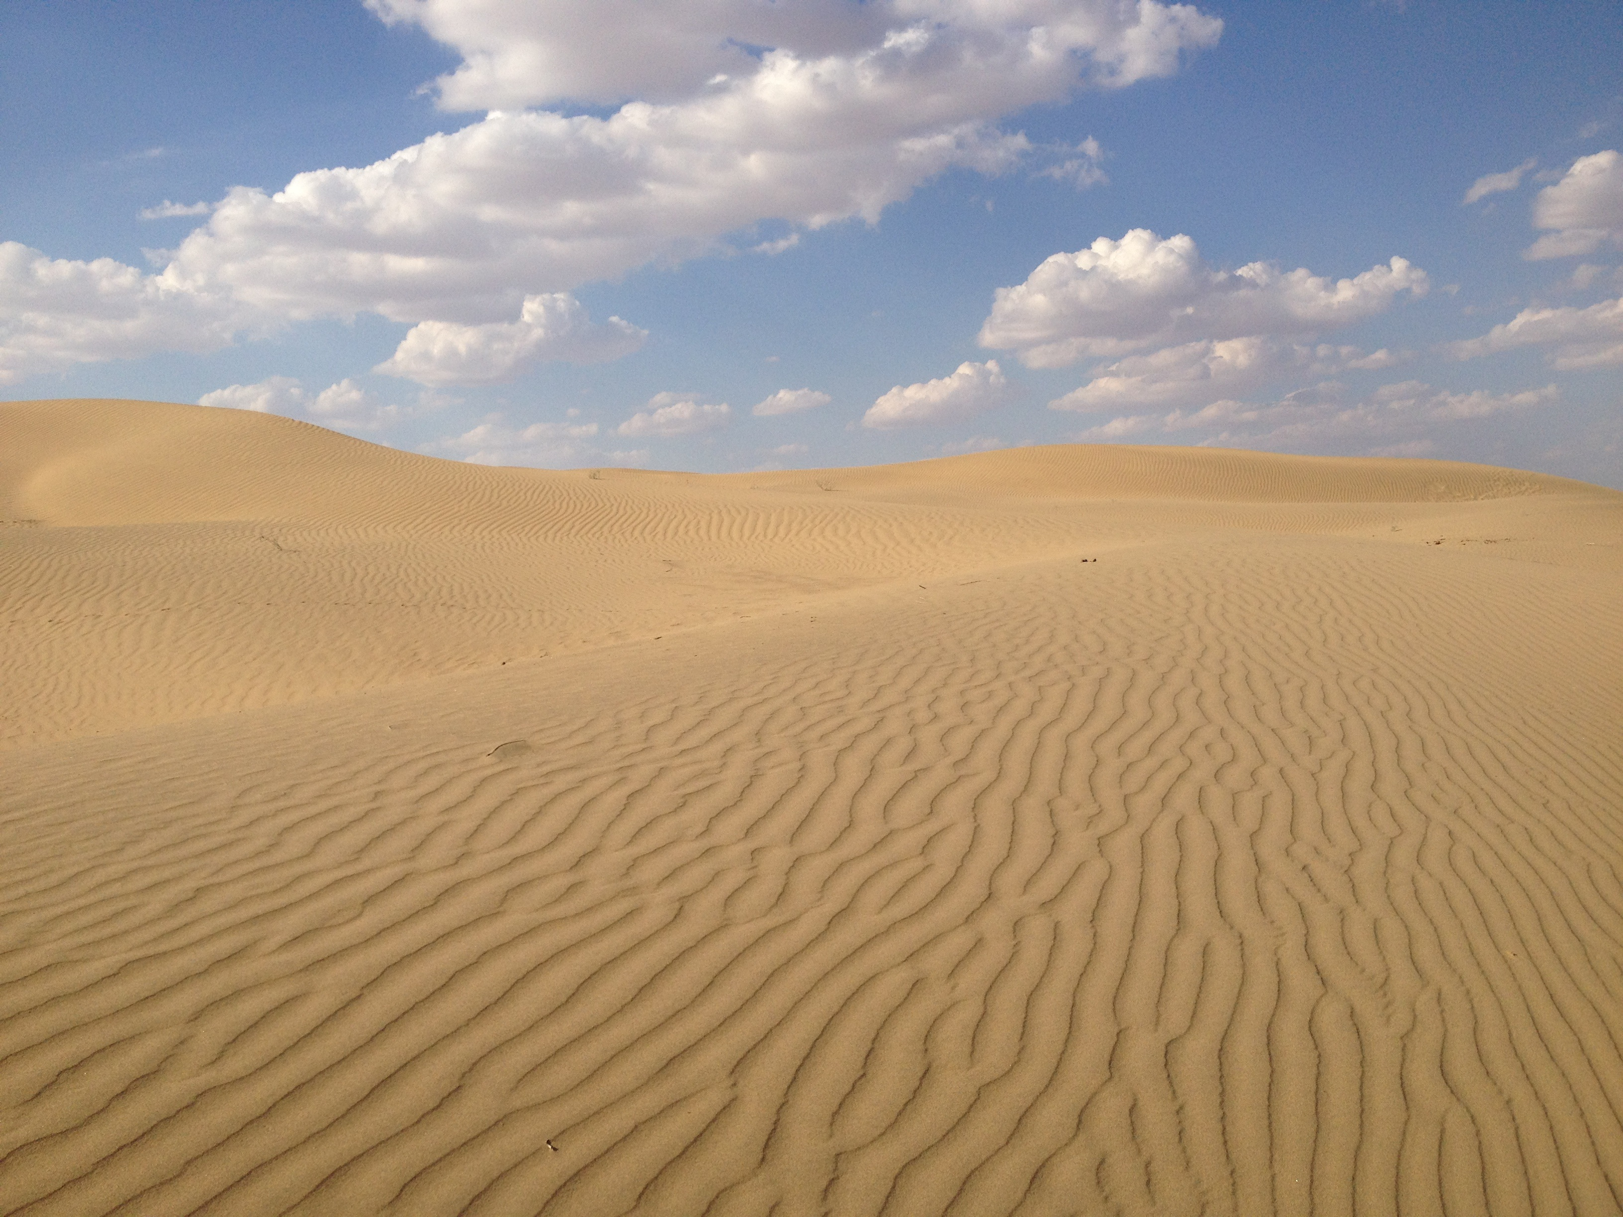
MAKING IT YOUR OWN
Nature journaling is a VERY personal experience.
When you create a journal page, you’re doing several things:
Observing Nature Deeply
Tickling Your Curiosity
Expressing Your Very UNIQUE Style
LEARNING

Slide 3
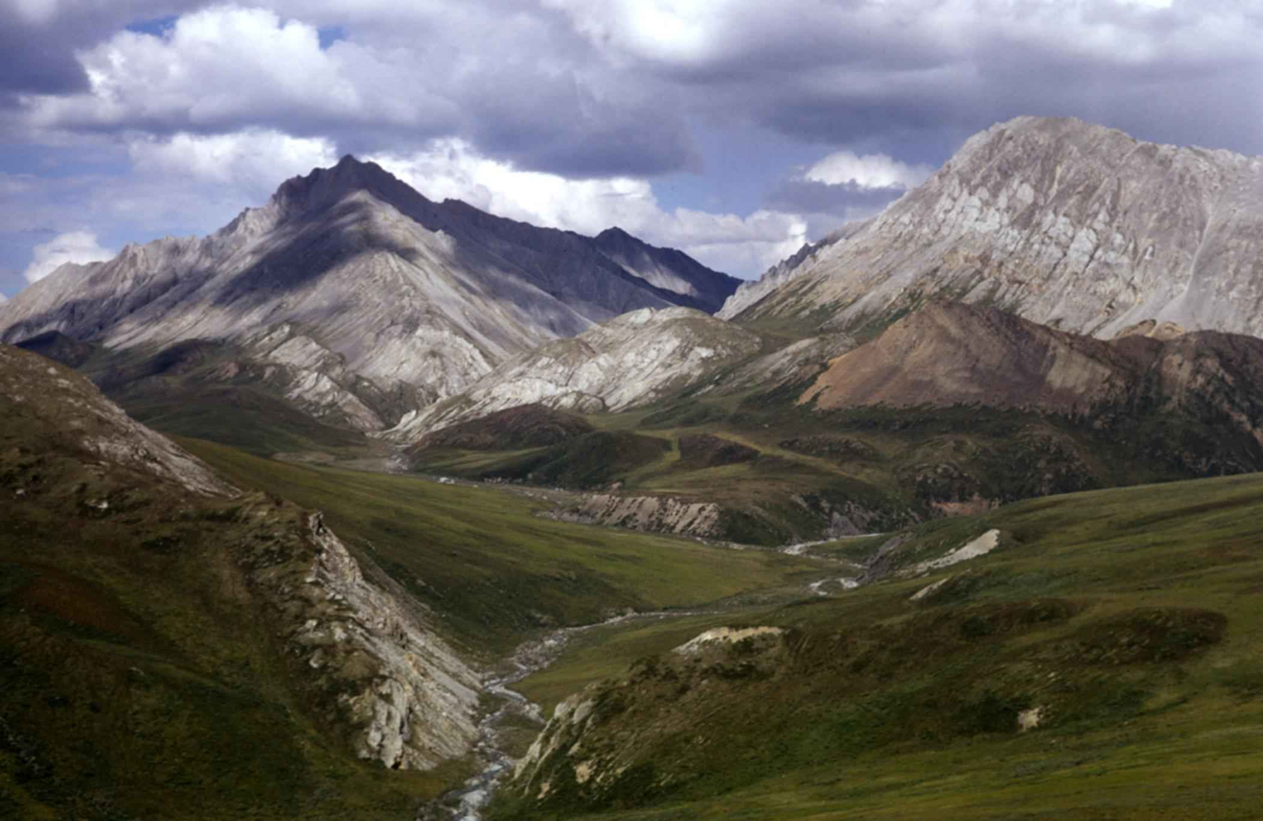
WHAT YOU’LL DO
Keeping in mind all we’ve learned so far, you’ll create your own journal entry of anything (or things) you’d like to study.
Incorporate as many of the strategies and NGSS Cross-Cutting Concepts as you can in this journal entry.
Express your own unique style and personality.
Write your own reflection.

Slide 4
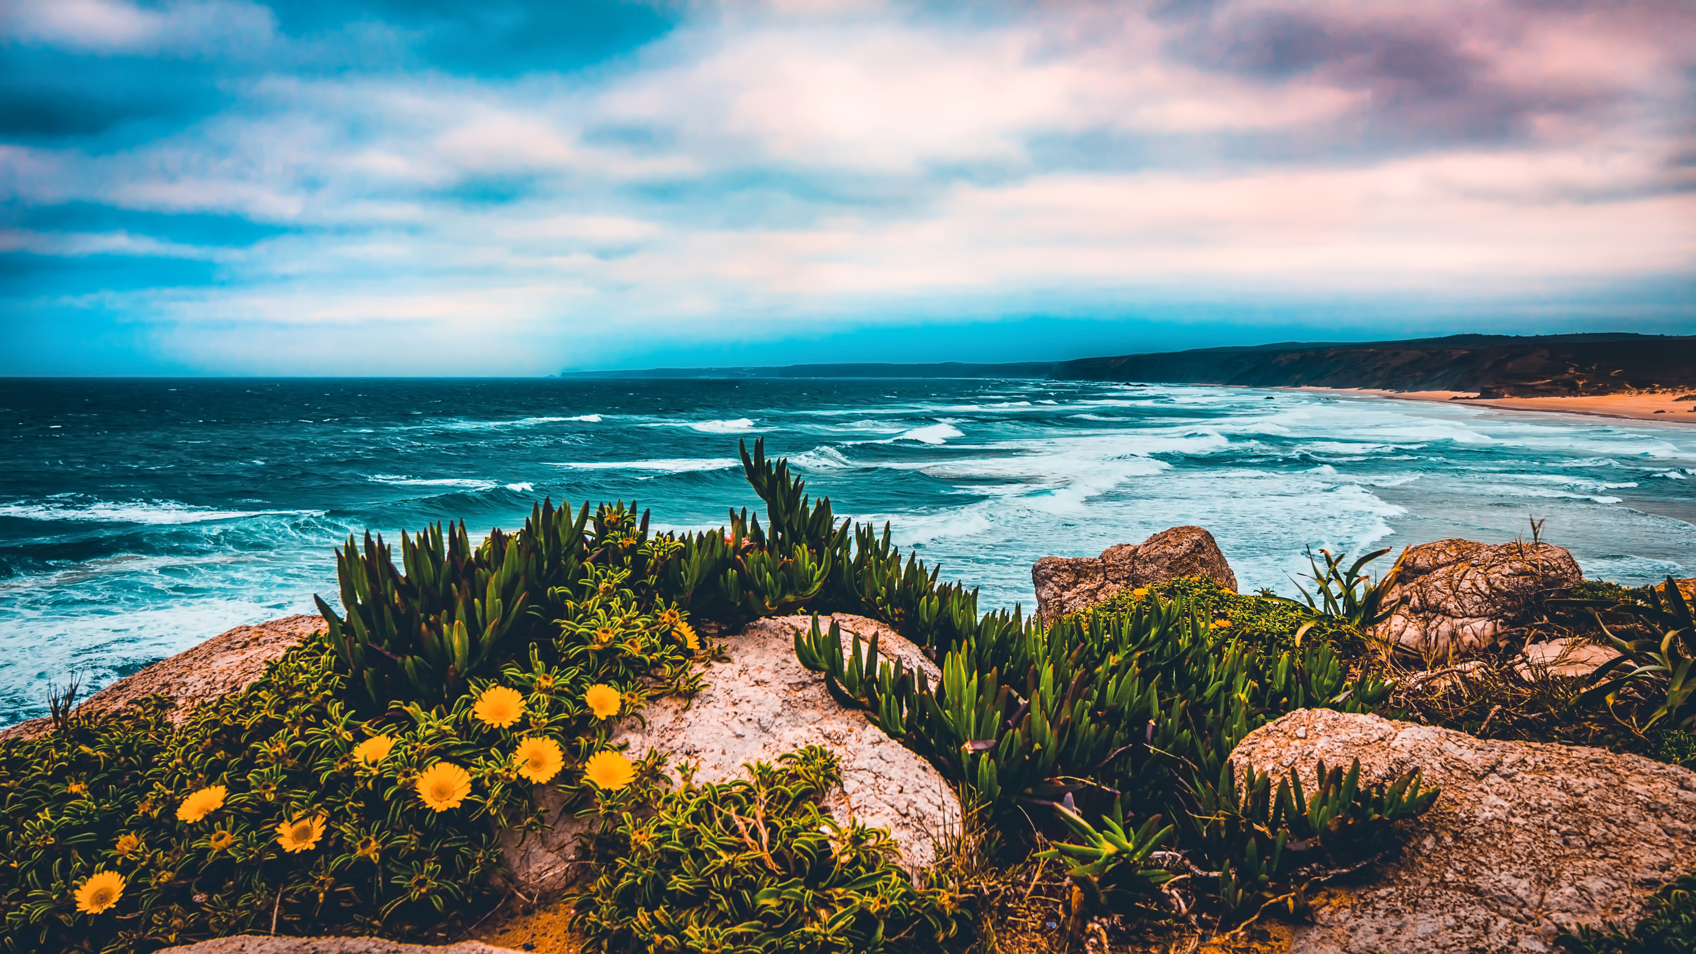
LET’S REVIEW The Basics
METADATA: Day, Date, Time, Location, Weather
ABC
I Notice,..
I Wonder…
(Could It Be…),
This reminds me of…
123: The Metrics:
height, distance, speed, weight, length, area, elevation, etc.
Drawing, Sketch, Diagram (labeled)

Slide 5
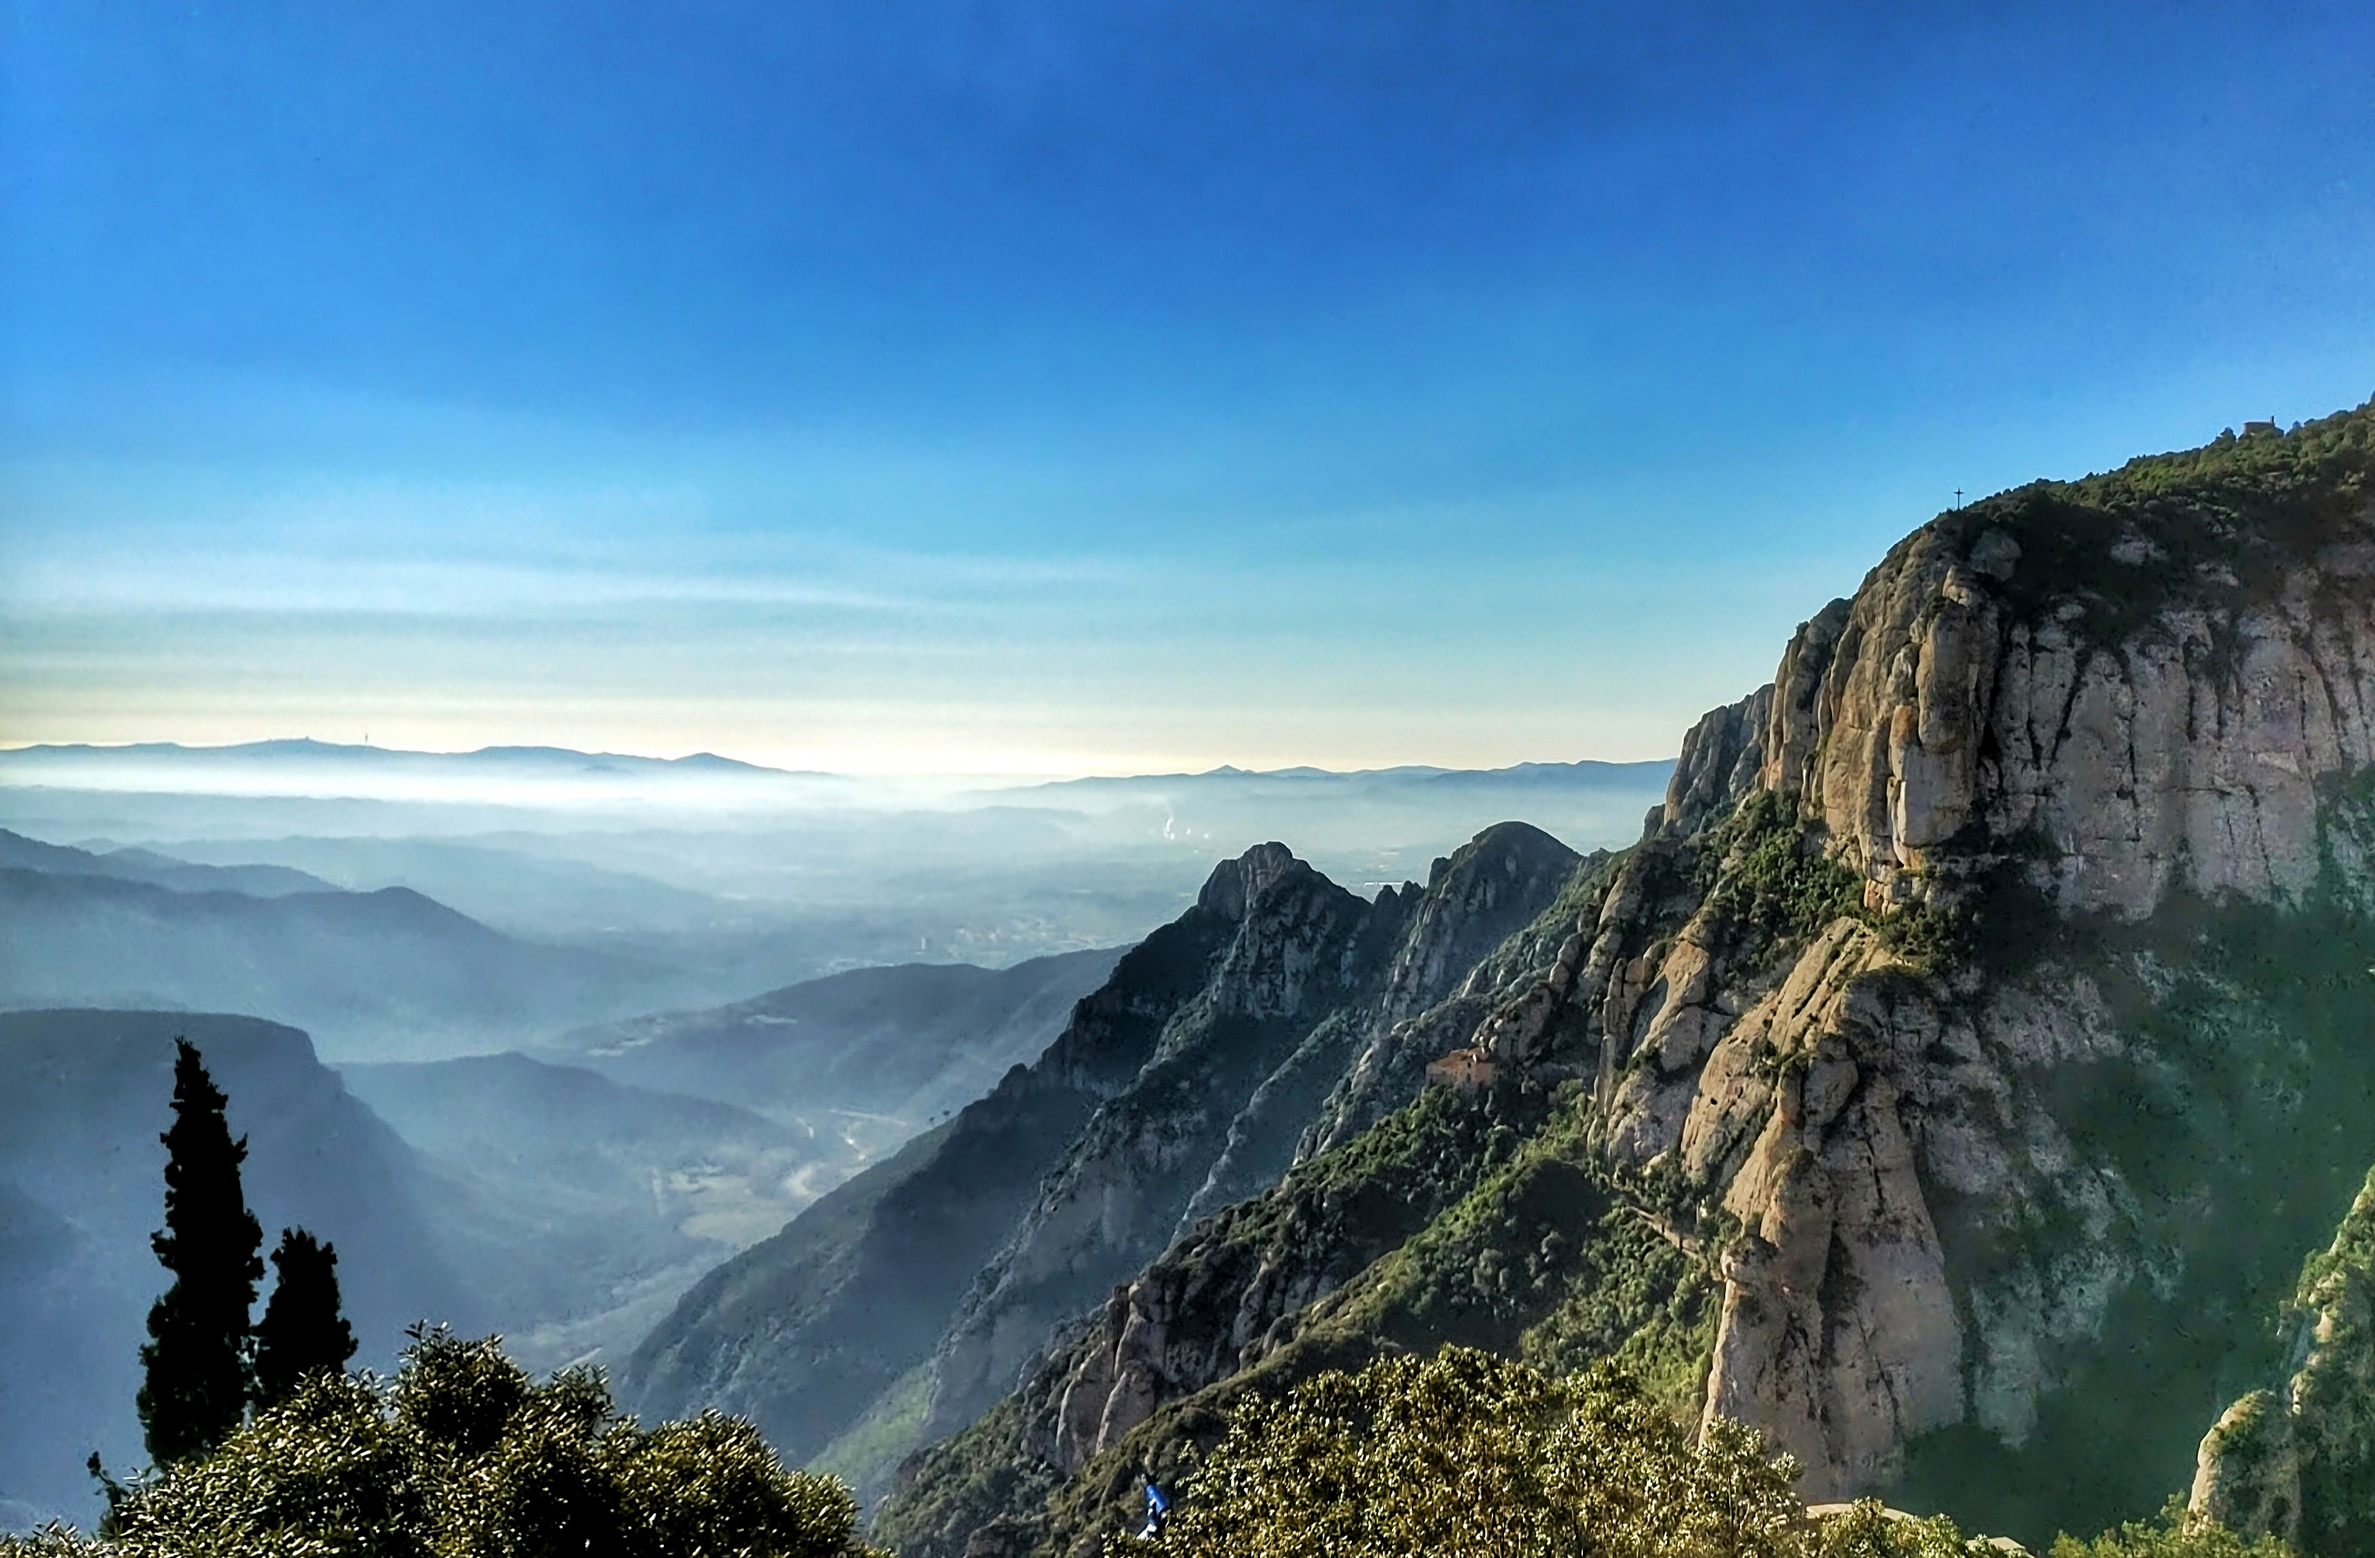
JOURNALING STRATEGIES
COMPARE AND CONTRAST
Showing how two things are the same and different
Venn Diagram
ZOOM IN/ZOOM OUT
1. Life Size View
2. Close-up, Magnified View
3. Distance View

Slide 6
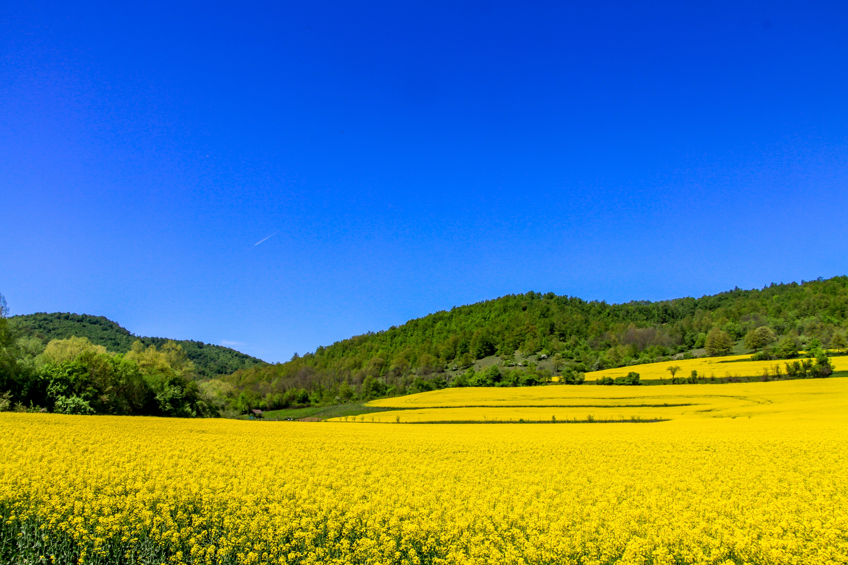
NGSS CROSS-CUTTING CONCEPTS
PATTERNS
Nature is full of patterns and scientists often use patterns to group or categorize species, or as clues to underlying processes or forces at work.
A pattern exists when a set of numbers, colors, shapes, or sounds are repeated.
Patterns can be found everywhere: in animals, plants, and even the solar system!
Some specific patterns are called fractals or spirals. Fractals are patterns that repeat at different scales.

Slide 7
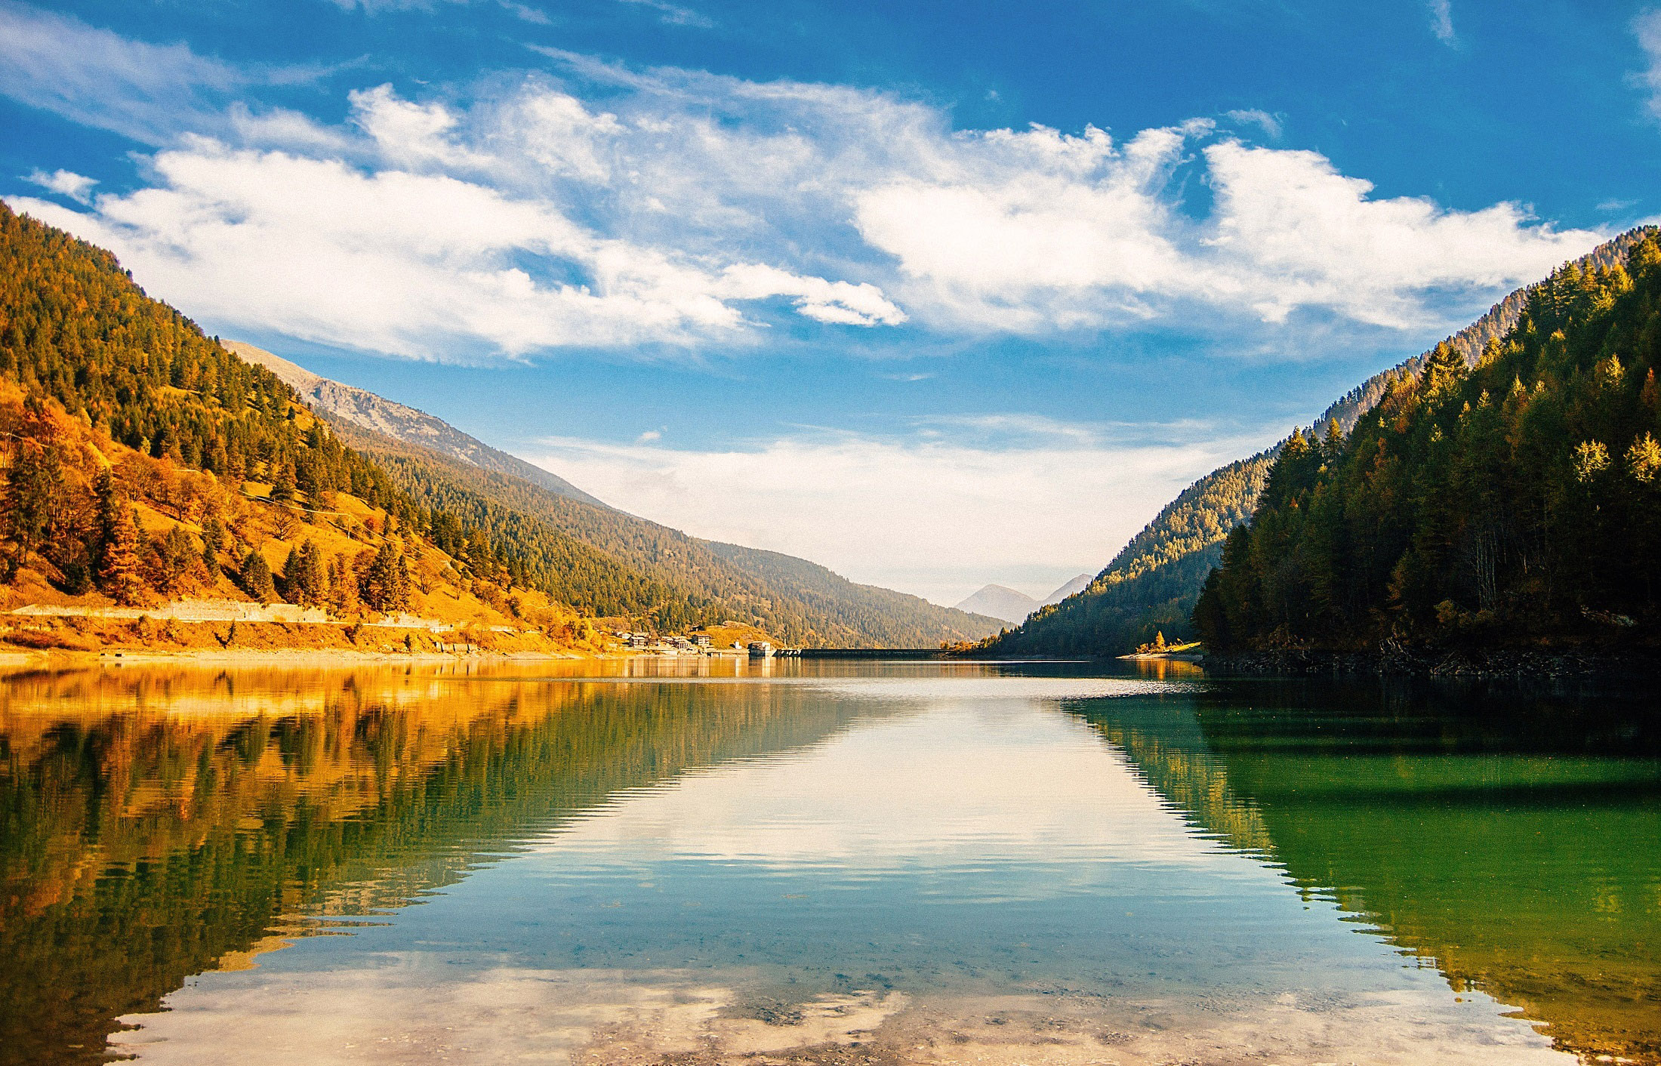
NGSS CROSS-CUTTING CONCEPTS CAUSE AND EFFECT
Events have causes. We can think of nature as a world full of mysteries, or “effects,” and try to explain what might have caused what we see. Cause and effect relationships may be used to predict events.
In scientific practice, deducing the cause of an effect is often difficult, so multiple hypotheses may coexist. (Think about the different hypotheses about the extinction of dinosaurs – a meteor, climate change, starvation and more.)
Cause and Effect can be answered with COULD IT BE… hypotheses.

Slide 8
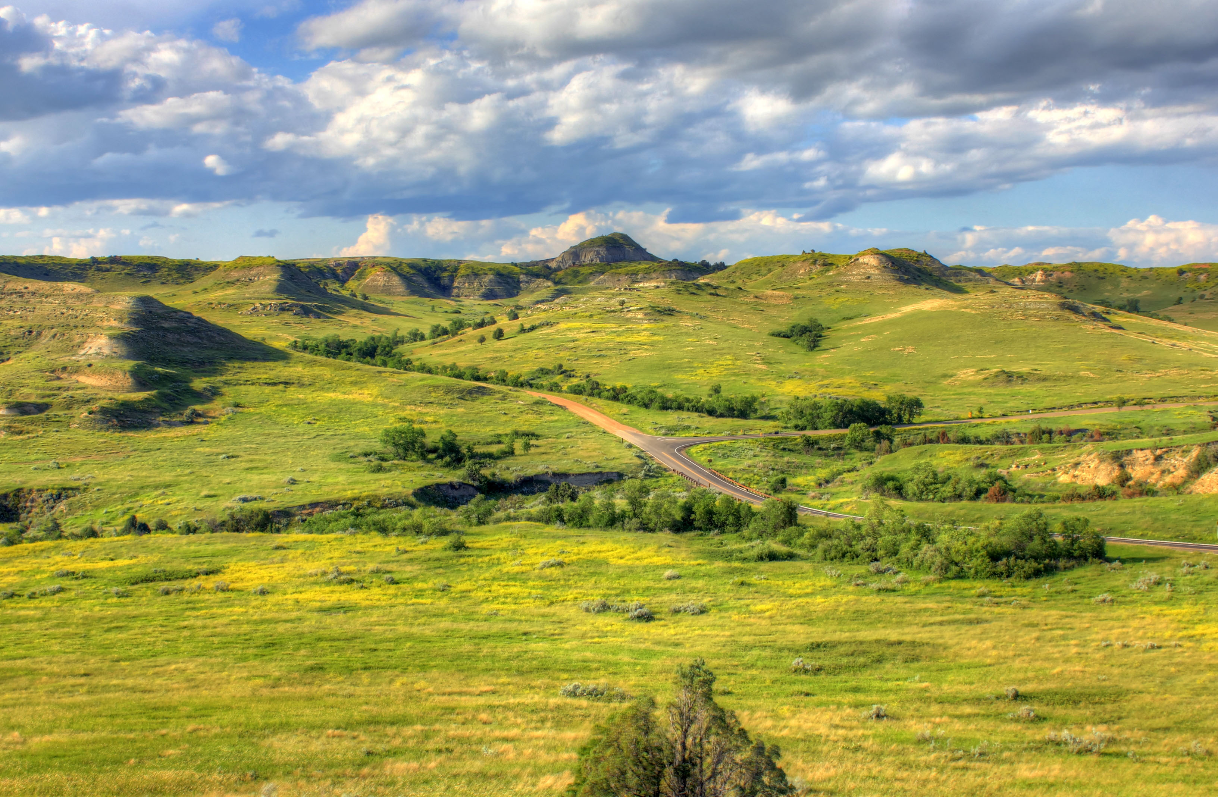
NGSS CROSS-CUTTING CONCEPTS SYSTEMS AND SYSTEM MODELS
A system is a collection of parts which are interconnected and they continually affect each other over time.
A system can carry out functions its individual parts cannot.
To understand systems, the relationships between or among the parts must be examined.
Studying systems is about studying the interconnections and relationships between things.
Models can be used to represent systems and their interactions—such as inputs, processes and outputs—and energy and matter flows within systems.

Slide 9
NGSS CROSS-CUTTING CONCEPTS STRUCTURE AND FUNCTION
A structure is anything made up of parts. Plants and animals have many structures that help them survive.
An object’s shape and structure relate directly to how it functions. We can observe structures and attempt to explain how they work.
Natural structures can be analyzed to determine how they function.
The functions and properties of organisms can be inferred (could it be…) from their overall structure, and the way their components are shaped.
This Photo by Unknown Author is licensed under CC BY-SA

Slide 10
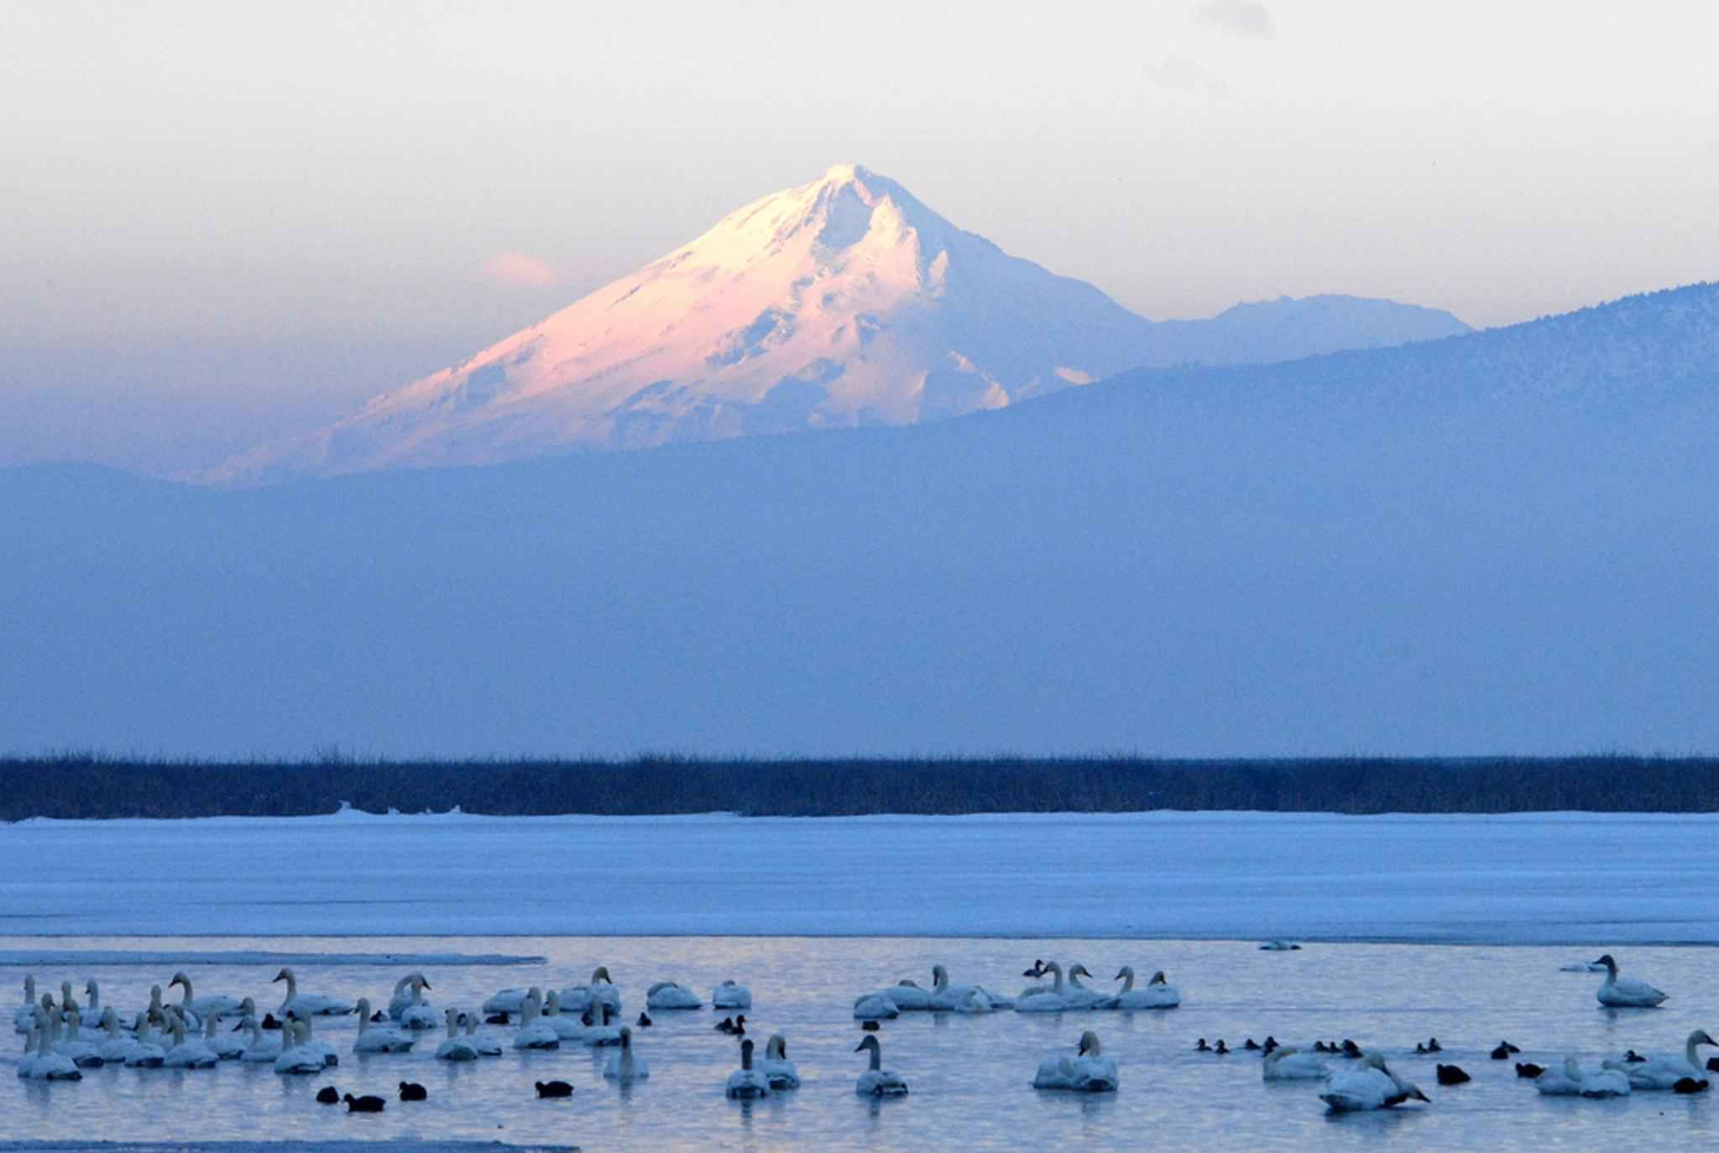
YOUR TURN
Create a journal entry on anything you’re interested in studying. Use TWO pages to complete this journal entry.
Include ALL the basics
Metadata
ABC, 123,
Include at least one strategy
zoom in/zoom out,
compare/contrast,
And at least one NGSS Cross-Cutting Concept
Patterns,
Cause & Effect,
Systems & System Models,
Structure & Function

Slide 11
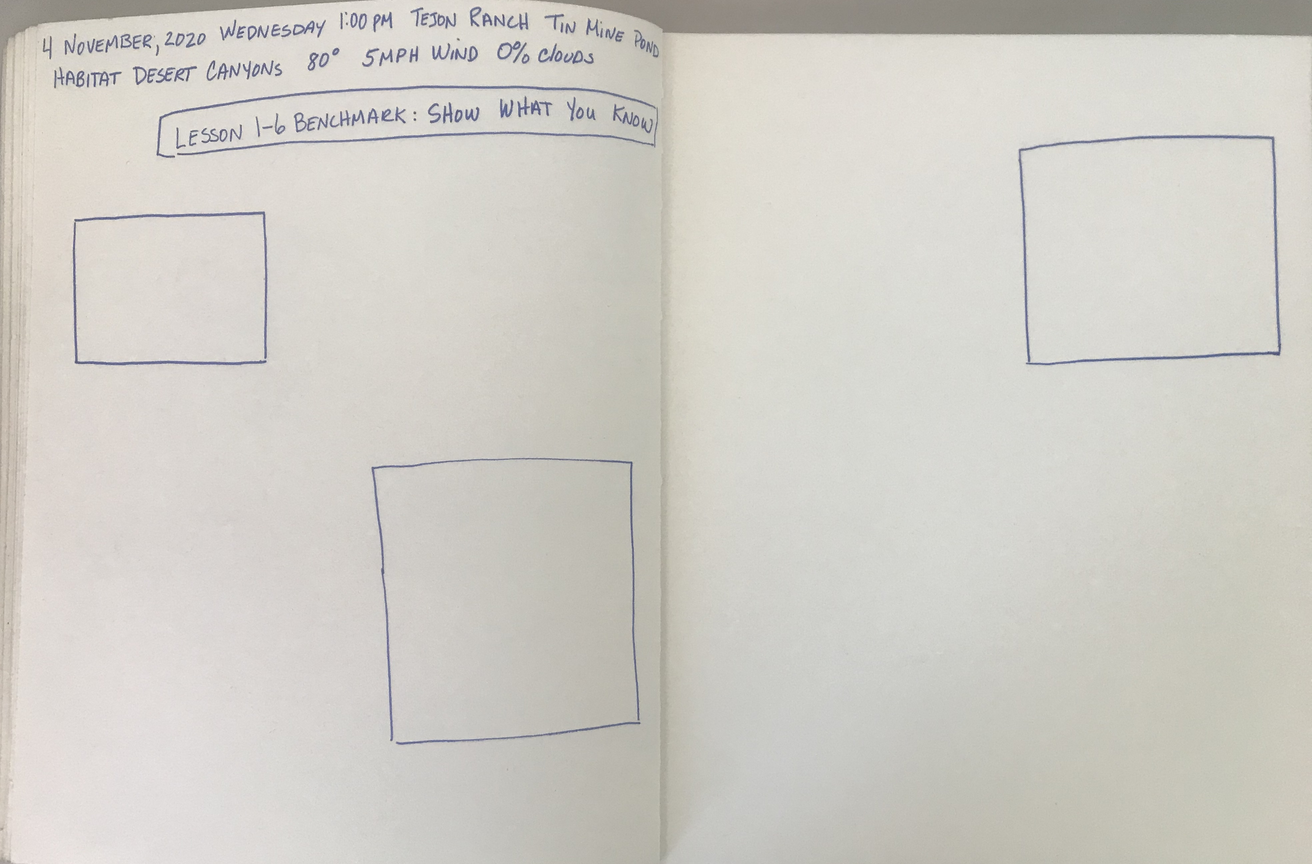
PLAN AHEAD
Once you have selected the subject or subjects you’ll be journaling, take the time to plan the layout of your journal pages before you begin.

Slide 12
Additional Research
Once you have finished your journal entry in the field, return to your computer and do a little additional research about your subject.
Remember to evaluate your sources. Anyone can post to the internet, but that doesn’t make the information correct.
When researching scientific information, the best sites are educational institutions or non-profit environmental organizations.
Web addresses that end in .edu or .org will offer the best information.
Always cite the source of your information in your journal.

Slide 13
REFLECTION
After you complete your journal page, write a reflection.
Options:
Scientific Paragraph (as you have been doing).
Diary Entry (thoughts and feelings while you were journaling).
Poem
Letter to yourself in the future.
Letter to a younger student, teaching them what you learned.

Slide 14
CHECKLIST WHEN YOU FINISH, USE THIS CHECKLIST TO ENSURE YOU DIDN’T FORGET ANYTHING
METADATA
DATE, DAY, TIME
LOCATION - PLACE AND HABITAT
WEATHER – TEMPERATURE, WIND, CLOUD COVER
TITLE: Lesson 1-6 Benchmark: Show What You Know
Page Layout
The Basics
ABC
123
Picture, drawing, or labeled diagram
Strategies
Compare/Contrast
Zoom in/Zoom Out
NGSS Cross Cutting Concepts
Patterns
Cause & Effect
Systems and System Models
Structure and Function
Reflection
Scientific Paragraph
Diary Entry
Poem
Letter to self
Letter to younger student

Slide 15
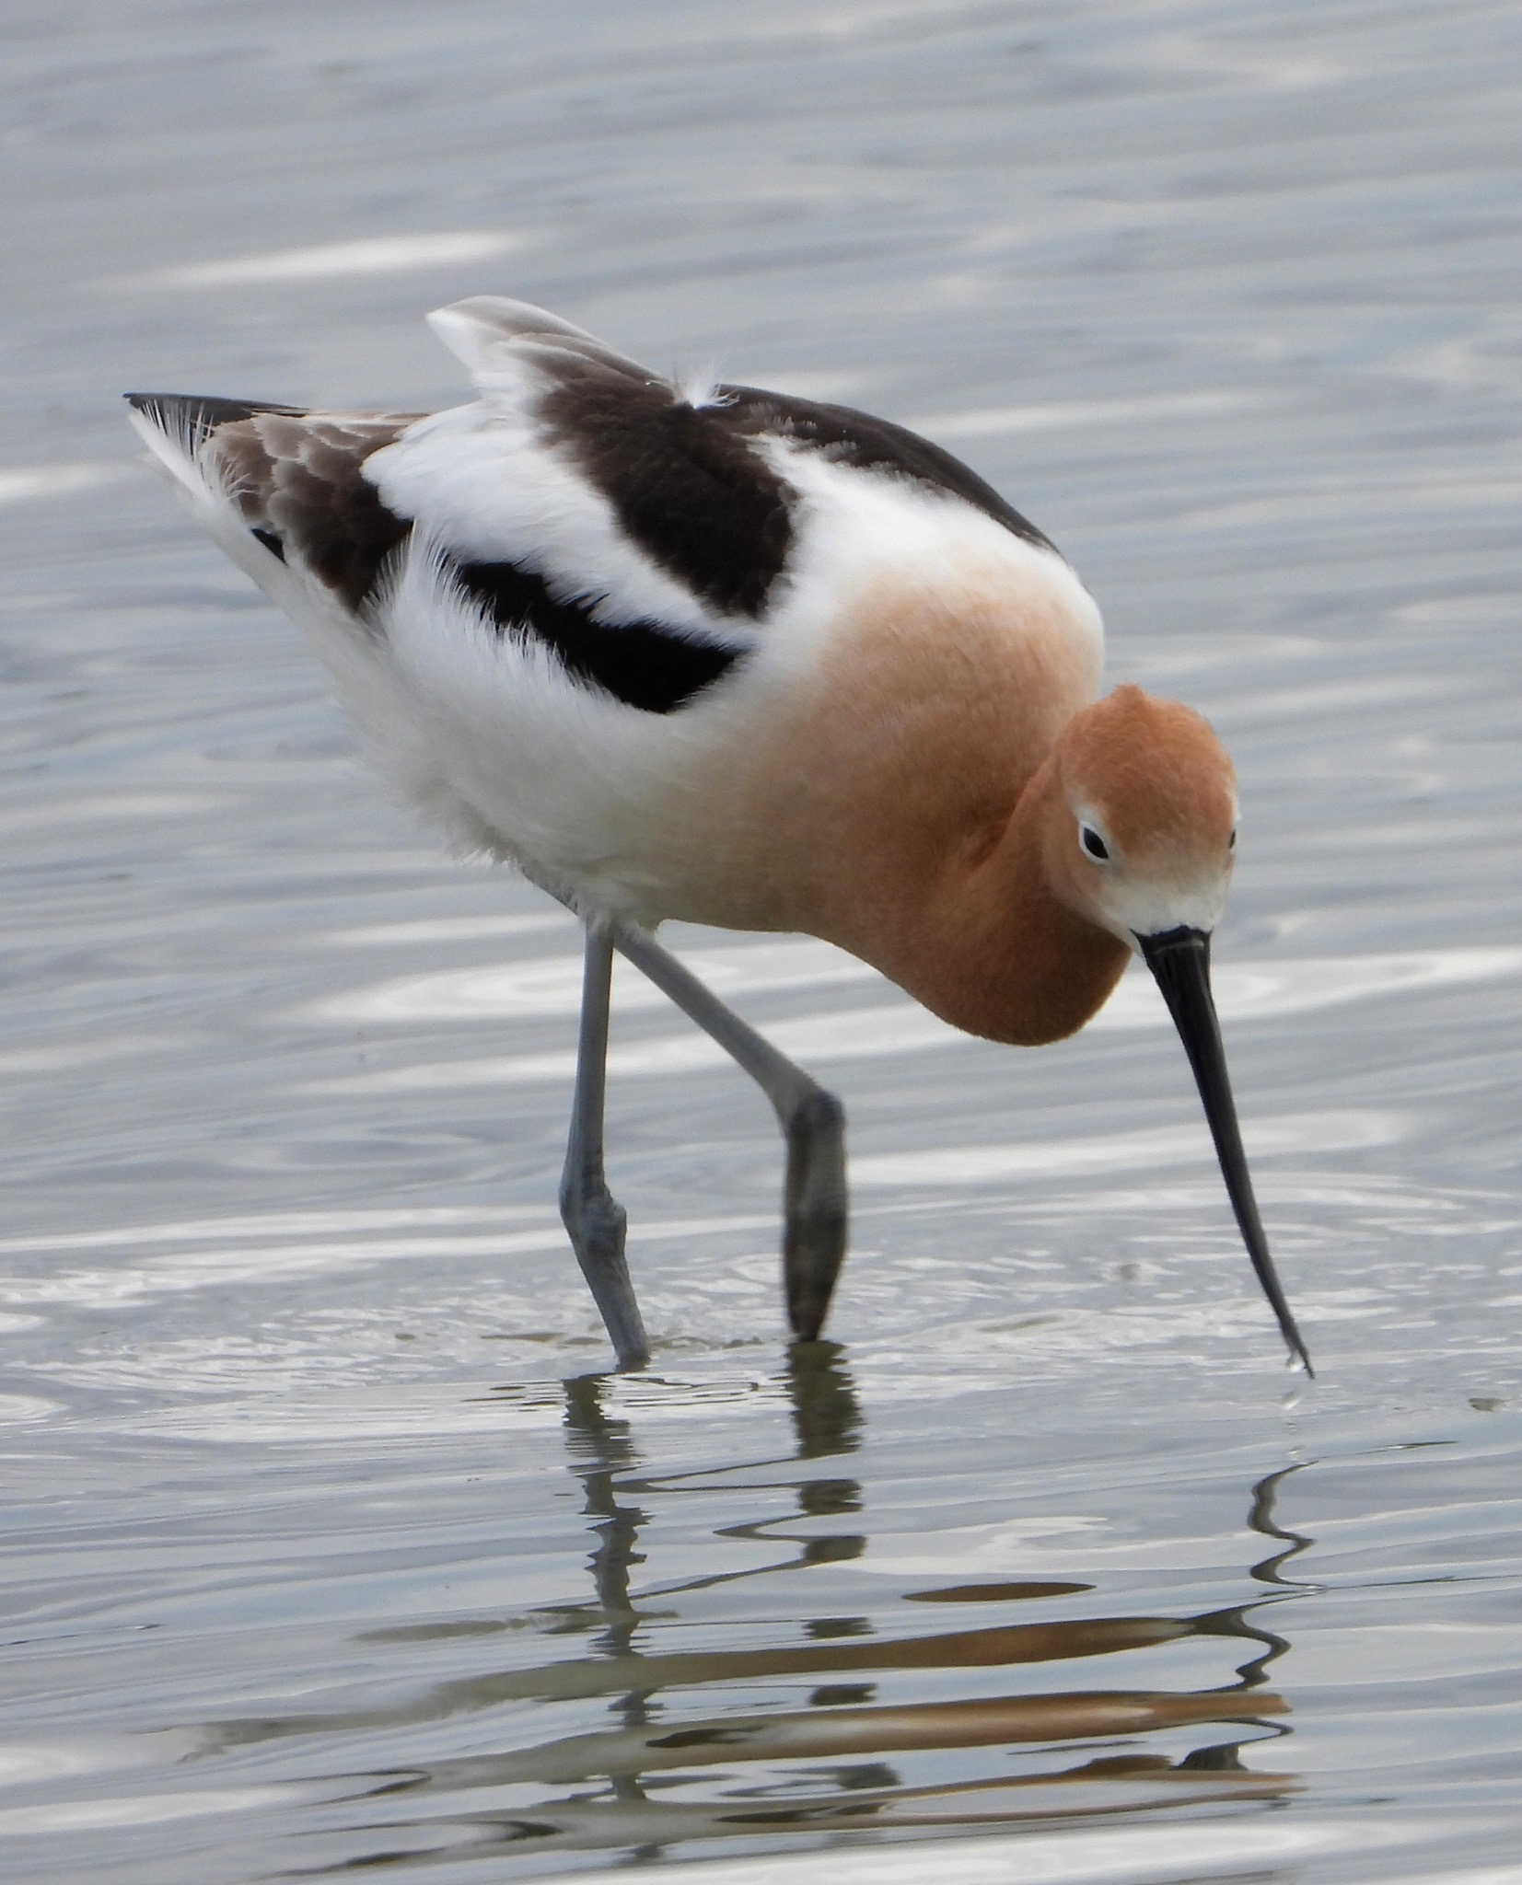
BYE FOR NOW THANKS FOR JOINING ME.
American Avocet
Mono Lake, California

